Slide 1
SUMMER TRAINING 7TH SEMESTER
Underwater Segmentation
Ujjwal Chopra - CO21363

Slide 2
Topics We’ll Cover
Introduction
Dataset
U-Net
FCN
DeepLab-V3
Results

Slide 3
Introduction
Image segmentation is an important step in many computer vision and image processing algorithms. It is often adopted in tasks such as object detection, classification, and tracking. The segmentation of underwater images is a challenging problem as the water and particles present in the water scatter and absorb the light rays. These effects make the application of traditional segmentation methods cumbersome.
It tries to explore underwater objects by applying semantic image segmentation.
Underwater image segmentation concentrates on separating the source input into individual and non-overlapping portions, which is a fundamental and critical step for image analysis and understanding. In recent years, plenty of underwater image segmentation models have been investigated.
Therefore , in this project we shall be exploring the use of underwater image segmentation and see the results after applying different algorithms such FCN , U-Net and DeepLabV3 on the SUIM dataset.

Slide 4
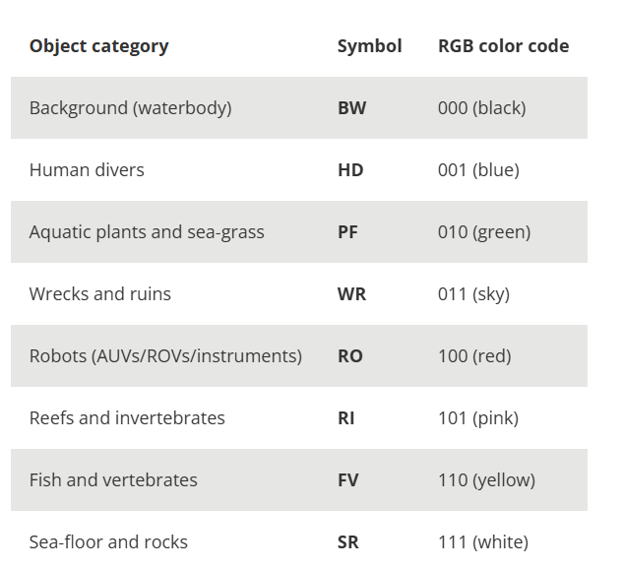
Dataset – SUIM Dataset
The performance of the model is validated by using the dataset SUIM (semantic segmentation of underwater imagery) proposed by Islam et al. (2020) [1] for semantic segmentation of underwater images and the data set.
The SUIM dataset contains 1525 natural underwater images with their real semantic labels and a test set of 110 images collected during ocean exploration and human–robot cooperation experiments.
Figure 1. Pixel Annotations

Slide 5
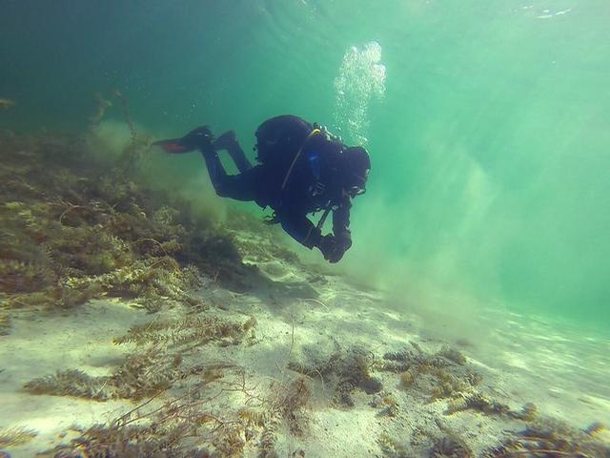
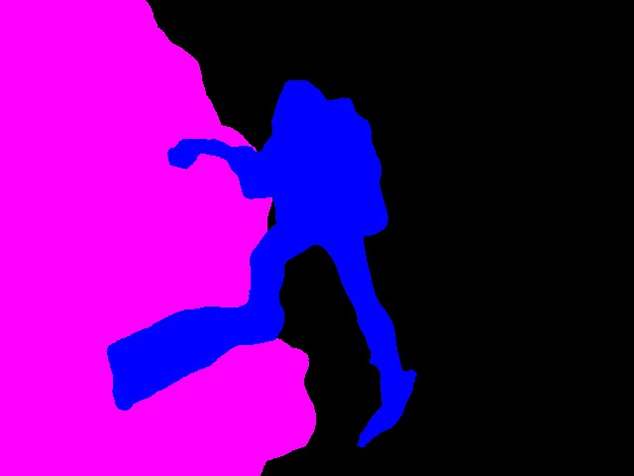
Figure 2. Images Dataset
Figure 3. Mask Labels

Slide 6
FULLY CONNECTED NETWORK[2]
It is the first neural networks to be used for image segmentation.
They construct the frames using the deconvolutional layers to restore the size of the productions result .
Employs acceptance of any input image
Disadvantages –
Downsampling to upsampling process successfully eliminates interference from the complicated process.
Struggle to segment multiple outputs such as ships , fish , etc..

Slide 7
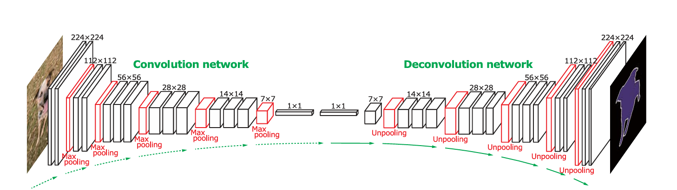
Figure 4. FCN Architecture

Slide 8
U-NET
U-Net is a typical network architecture for image segmentation based on a full convolutional network.[3]
The most significant feature of U-Net is its symmetric encoder–decoder structure and the skip connection channels between these symmetric convolutional layers on both sides.
These skip connection channels enable the entire network to memorize feature maps at different scales and be more accurate in image segmentation tasks.
It uses the bottleneck layer to increase the no. of filters for decoder input.

Slide 9
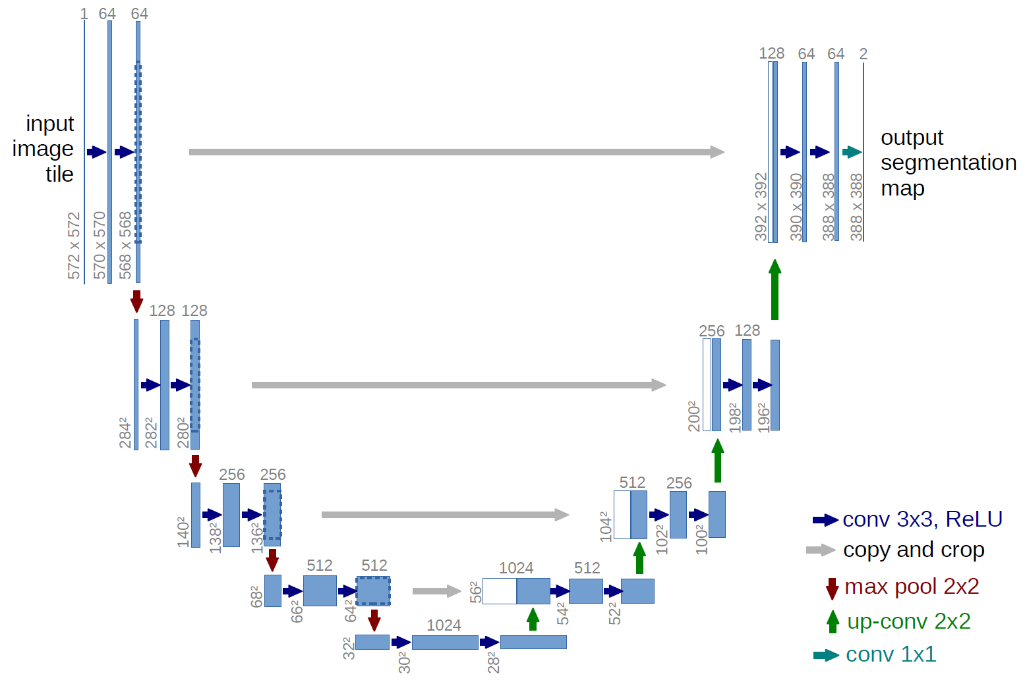
Figure 5. Unet Architecture

Slide 10
DeepLab V3+
As the most deep learning segmentation architectures, DeepLabv3+ is an encoder-decoder network; moreover, it is fully convolutional and, currently, one of the top ranked architectures in the PASCAL VOC segmentation challenge.[4]
The main idea behind the architecture is to preserve spatial information by reducing the number of strided pooling operations. Furthermore, atrous convolutions compensate the reduction in the receptive field.
Another adopted technique is the detection of objects at multiple scales by parallel atrous convolutions at different sampling rates.
We choose the DeepLab architecture because it is the state-of-the-art in semantic segmentation.

Slide 11
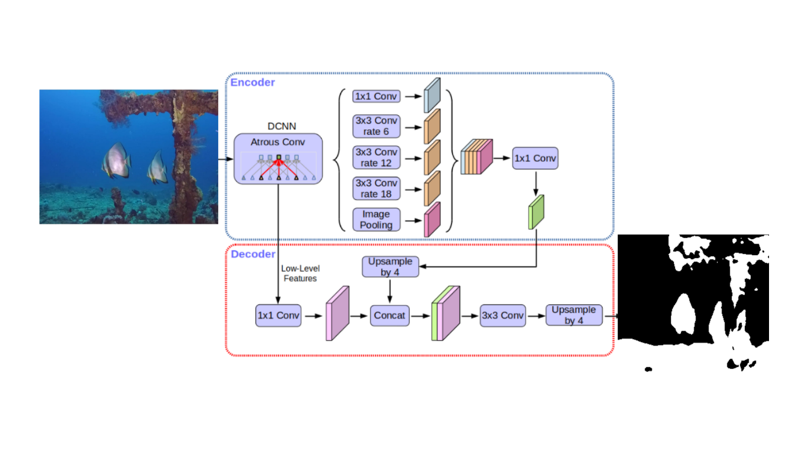
Figure 6. DeeplabV3 Architecture

Slide 12
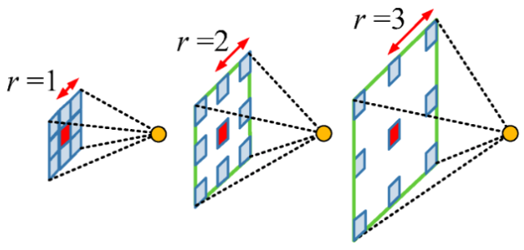
Dilation rate in Atrous Convolution
For rate = 1 (standard convolution) = 3*3 kernel covers 3*3 area
For rate = 2 , 3*3 kernel covers a 5*5 area .
For rate =3 , 3*3 kernel covers a 7*7 area
Effective_resultant_kernel_size = (kernel_size -1)*rate +1
Figure 7. Dilation Rate

Slide 13
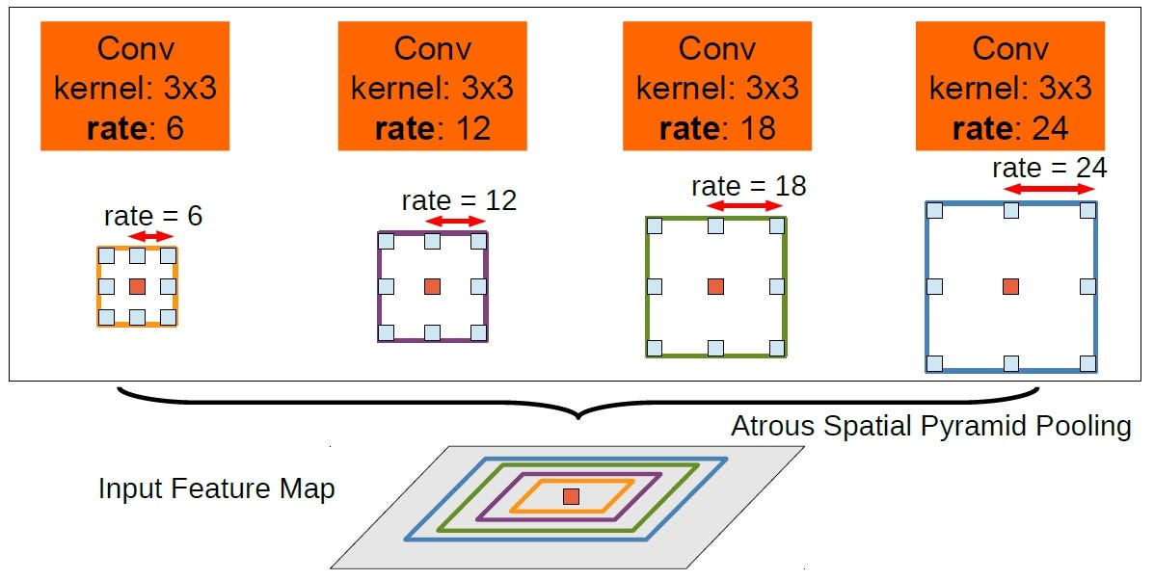
Figure 8. Concatenation of Atrous Convolution

Slide 14
RESULTS -
MODEL | TESTING ACCURACY | TESTING LOSS | EPOCHS
FCN | 80% | 0.55 | 75
UNET | 78% | 0.6 | 100
DeepLab-V3 | 90.2% | 0.45 | 150
Note -
Trained on NVIDIA RTX 4060 GPU where time taken to train the model varies from 90 seconds to 180 seconds for 1 epoch depending on algorithms used .

Slide 15
FUTURE WORKS POSSIBLE -
There is a possibility for segmentation for multiple pixel as there is availability of pixel annotation.
We can try to improve over the algorithm DeeplabV3+ so that results can be improved.
We can validate the future proposed algorithm on two datasets available publicly .

Slide 16
PROJECT LINK AS FOLLOWS – www.github.com/Ujjwal6710/Underwater-bodies-semantic-Segmentation [5]

Slide 17
References -
Islam, M. J., Edge, C., Xiao, Y., Luo, P., Mehtaz, M., Morse, C., … Sattar, J. (2020). Semantic Segmentation of Underwater Imagery: Dataset and Benchmark. 2020 IEEE/RSJ International Conference on Intelligent Robots and Systems (IROS), 1769–1776. doi:10.1109/IROS45743.2020.934[1]
Long, J.; Shelhamer, E.; Darrell, T. Fully Convolutional Networks for Semantic Segmentation. IEEE Trans. Pattern Anal. Mach. Intell. 2014, 39, 640–651[2]
Ronneberger, O.; Fischer, P.; Brox, T. U-net: Convolutional Networks for Biomedical Image Segmentation. In Proceedings of the International Conference on Medical image computing and computer-assisted intervention, Munich, German, 18 May 2015; pp. 234–241.[3]
Chen, LC., Zhu, Y., Papandreou, G., Schroff, F., Adam, H. (2018). Encoder-Decoder with Atrous Separable Convolution for Semantic Image Segmentation. In: Ferrari, V., Hebert, M., Sminchisescu, C., Weiss, Y. (eds) Computer Vision – ECCV 2018. ECCV 2018. Lecture Notes in Computer Science(), vol 11211. Springer, Cham. https://doi.org/10.1007/978-3-030-01234-2_49 [4]
Ujjwal6710/Underwater-bodies-semantic-Segmentation: Semantic segmentation for underwater bodies using models like Fcn , U-net , etc. with gpu computation[5].

Slide 18
THANK YOU!

