Slide 1

ADAMTS-13 Activity Assay for Research Use Only in US & Canada
Tips for Training & Validation

Slide 2

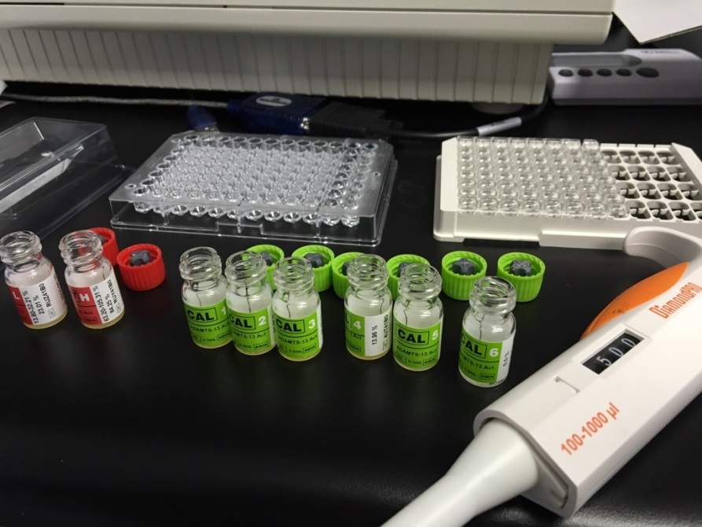
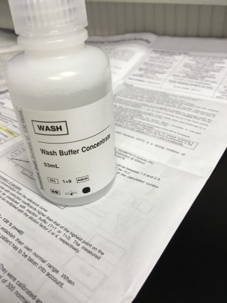
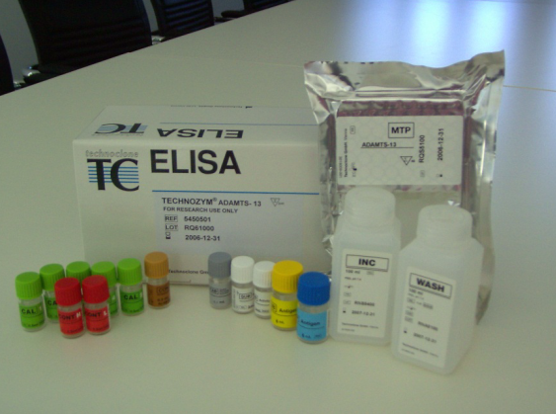
Assay & Reagent Prep
Allow all reagents to reach Room Temperature
Dilute wash buffer by mixing 1 part
wash buffer with 9 parts diH₂O
Reconstitute vWF substrate solution with 6mL diH₂O.
15 min after reconstitution mix for 10 sec using vortex mixer
Reconstitute calibrators and controls with 500µL diH₂O
15 min after reconstitution mix for 10 sec using vortex mixer

Slide 3
Reagent Info & Storage
Material/Reagent | State | Storage | Expiration
ELISA test strips | after opening | 2-8°C in storage bag with desiccant | expiration date on bag
GST-vWF73 Substrate | after reconstitution | -20°C | 6 weeks
Calibrators, Controls | after reconstitution | -20°C | 6 months
Reaction Buffer | after opening | 2-8°C | 6 months
Conjugate | after opening | 2-8°C | 4 months
TMB Color Reagent | after opening | 2-8°C | expiration date on bottle
Wash Buffer Concentrate (10x) | after opening | 2-8°C | 6 months
Wash Buffer | after reconstitution | 2-8°C | 3 weeks
Stop Solution | after opening | 2-8°C | expiration date on bottle
Expiration date on labels refers to storage of unopened vial at 2-8°C.
Tech tip: Aliquot reconstituted calibrators, controls & substrate in no less than 250µL.
Storage in Eppendorf vials is acceptable. Thaw at room temperature for best results.

Slide 4
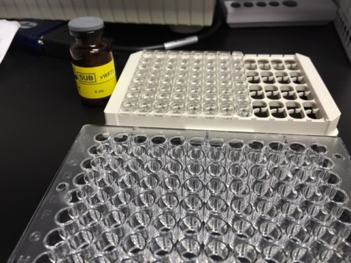
Sample Dilution & Preparation
Dilute samples and reconstituted calibrators & controls 31-fold:
Using the sample dilution microplate, pipette 5µL of sample, reconstituted
calibrator or control. Then add 150µL of reaction buffer and mix well.
Note: Samples, cals & controls should be tested in duplicate so this dilution
will need to be done 2x for each sample.
For higher precision, use dilution tubes and add 20µL of sample, reconstituted
calibrator or control to the tube. Then add 600µL of reaction buffer and mix well.
Note: Samples, cals & controls should be tested in duplicate so pipette duplicate
wells from this 1 dilution preparation.
Reverse pipetting is recommended.
Incubation times begin after pipetting the last sample. Pipetting time for each test
strip should not exceed 60 seconds (cals/controls/samples/conjugate).
Samples > highest cal should be re-tested by pre-diluting 1:2 or 1:4 with reaction
buffer. The measured concentration is then multiplied by the dilution factor.

Slide 5
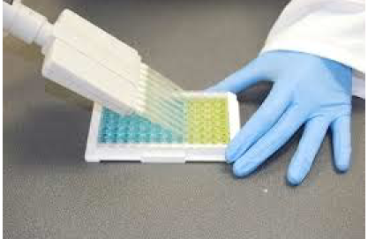
Assay Tips
Reagents from kits with different lot numbers should not be used together.
exclusions: wash buffer concentrate, stop solution, sample dilution
microplate & plate sealers
Avoid using thawed calibrators, controls or substrate with fresh calibrators, controls or substrate.
i.e. If using thawed calibrators, all calibrators should be thawed.
Precision & Performance depend on:
ELISA reader: verify appropriate maintenance
Appropriate incubation temperature (20-25°C)
Appropriate incubation times – should not vary by more than +/-5%
GST-vWF73 substrate incubation: 57-63 min
Sample incubation: 28.5-31.5 min
Conjugate reaction: 57-63 min
TMB Color Reagent reaction: 28.5-31.5 min
Pipetting time during substrate reactions and at stopping should not exceed 10 sec per test strip.
Tech Tip: Incubating at the highest allowable temp (25°C) & for longest allowable time (63 or 31.5 min) will increase assay OD values.
Use of a multichannel pipette is encouraged. Remember to change tips when pipetting from row to row.

Slide 6
Limitations & Interferences
EDTA is a strong inhibitor of ADAMTS-13 function. Do not use samples with EDTA.
Hemolysis: No interference is observed with samples containing up to 200mg/dL
hemoglobin, which corresponds with a moderate haemolysis /dL.
Lipemia: No interference is observed with samples containing up to 300 mg/dL Intralipid,
which corresponds with a moderate to severe concentration.
Icterus: No interference was observed with samples containing up to 15mg/dL bilirubin
(conjugated as well as unconjugated), which corresponds with a moderate to severe
concentration.
Rheumatoid factor: No interference was observed up to 30U/mL RF, with corresponds
with a 2-fold concentration of normal.
Anti CD20 antibodies: No interference was observed up to a level of 200µg/mL,
which corresponds to the upper level of serum concentrations found after
Rituximab administration.

Slide 7
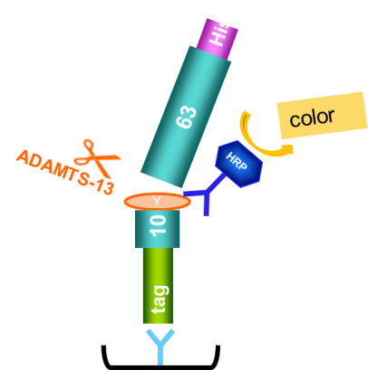
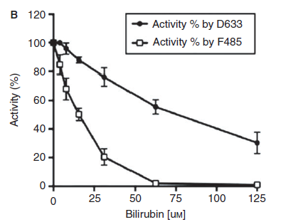
Interferences – ADAMTS13 Assays
Fluorogenic Assays
TECHNOZYM® ADAMTS-13 Activity ELISA
Unconjugated bilirubin interferes with fluorogenic assays:
Plate is washed
No interference of unconjugated bilirubin during measurement independent of ADAMTS-13 concentration range
7

Slide 8
Interferences – TECHNOZYM® ADAMTS-13 Activity ELISA
No interference of hemolysis, lipemia, conjugated bilirubin and rheumatoid factor during measurement.

Slide 9
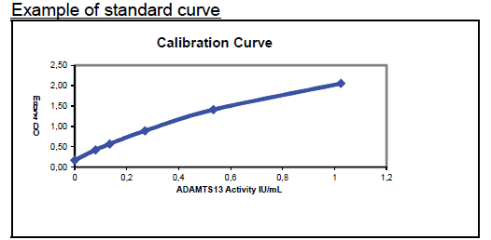
Analysis of Results
Reader settings should be established with the aid of your instrument’s technical
support &/or internal IT department.
Evaluation software (Excel spreadsheet with calculations) is available from Technoclone to
convert raw OD values to IU/mL , though most readers can do this as well.
Set up a reference curve:
X-axis = ADAMTS-13 activity (IU/mL)
Y-axis = extinction at 450nm
Graph a linear-linear plot with a best fit curve.
Validity of the test is assessed using the calculated control values.

Slide 10
Lot-to-Lot Qualification Suggestions
Lot to lot qualification procedures should always be established in conjunction with
each institution’s QA policies & procedures.
Perform 20 assay runs of each control to establish your laboratory control range.
Test using a previously qualified lot; and
Use control range on the Certificate of Analysis from the new lot of control to accept/
reject the “test” control.
Take the mean of these 20 values to establish the mean for your laboratory.
Use Westgard rules & a Levey-Jennings chart to accept/reject runs based on control values
with the new lot.
Test previously assayed samples using the new lot. Verify sample interpretation is the
same between lots.

Slide 11
Method to Prepare Low-Activity Samples
Heat-treat normal human plasma at 56°C for 30 minutes (inactivated plasma)
This inactivates endogenous ADAMTS13 protease activity.
Heat-treated plasma can then be diluted in different concentrations (1:1, 1:2, 1:4, 1:8, 1:16) with normal plasma (pooled 5-10 individuals).
Run the normal plasma straight to calculate expected values of diluted heat-inactivated samples & then run those as low-activity samples.

Slide 12
Training Video
www.diapharma.com/a13

