Slide 1


The Future Of Medicine
How ChatGPT can revolutionize health care

Slide 2
What is ChatGPT?
Artificial intelligence tool which uses natural language processing technology.
It is designed to understand language and generate responses in a conversational manner.

Slide 3
Use Cases
02
01
Diagnosis and Treatment
EHRS
04
03
Patient Education
Medical Education
Natural Language Processing for Electronic Health Records

Slide 4

Language Processing
Digital versions of patient’s medical history
Unstructured data into structured one

Slide 5

Diagnosis and Treatment
Diagnostic reports or recommendations
Identify patterns and connections

Slide 6
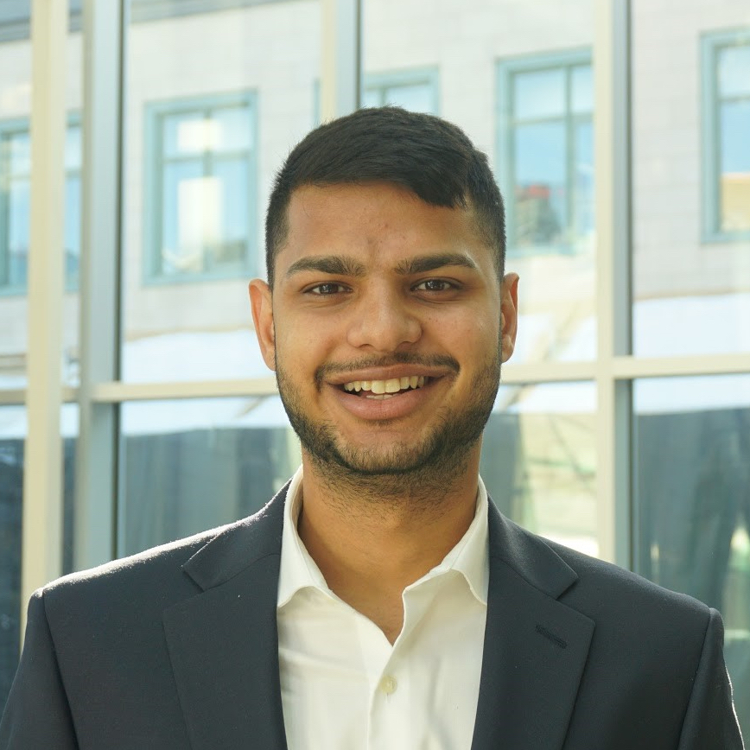

Response of ChatGPT
In the Emergency Department, physicians need to rule out which diagnoses when a patient presents with chest pain
In the Emergency Department, physicians need to rule out which diagnoses when a patient presents with chest pain?
Acute coronary syndrome
Pulmonary embolism
Aortic dissection
Pericarditis
Pneumonia
Anxiety disorder
Myocarditis
Pulmonary hypertension
Musculoskeletal pain

Slide 7

Medical Education
Personalized Learning Experience
Personal tutor for students

Slide 8
ChatGPT at USMLE
The future
Model
All three USMLE exam analysis, GPT passed all the three exams
No special training
Demonstrated high level of insight
Performance
50+%
Explanations can be helpful for students

Slide 9

Patient Education
Discharge summaries
Education materials
Treatment plans

Slide 10
Response of ChatGPT
Can you write a treatment plan for my patient who was diagnosed with type 2 diabetes in my family medicine office.
Treatment plan:
Education: Educate patient on type 2 diabetes, including risks factors, sign and symptoms, potential complications, and the importance of self management.
Blood sugar monitoring: Provide patient with a glucometer to monitor their blood sugar levels at home.
Referral to a dietitian: Provide patient with a referral to dietitian to help them develop a personalized meal plan that is tailored to their individual needs and health goals.

Slide 11
Final Quesiton
75%
25%
NO
Yes
More research is needed
Could still be used for improving patient care and outcomes

Slide 12
Thanks YOu!
Do you have any question?

