Slide 1
MingleNest Dating App
Ujjwal Poudel, Shrish Bhusal, Apurva Desai, Ikbal Muhammed Ekinci

Slide 2
Table of contents
01
02
03
04
05
06
Introduction
Problem & solution
Functional Component
Class Diagram
Context Flow Diagram
Diagrams state and sequence

Slide 3
Introduction
Our company
We are the member of Mingle Nest dating app representing group 4. This is the group project for Software Systems Design class.
Our idea
Minglenest addresses the challenges of contemporary dating by prioritizing genuine and meaningful relationships. Our app employs intelligent matching algorithms, comprehensive personality assessments, and real-time activity updates to enhance the user experience.

Slide 4
Problem and Solution
Problem
Solution
Capabilities
Growing isolation due to virtual interactions and device dominance.
Difficulty in forming meaningful connections, especially for introverted individuals.
Heightened challenges for the new generation in bridging the digital-physical gap
Urgent demand for a solution facilitating genuine connections in the digital age
Addresses diverse needs, from singles seeking family life to teenagers seeking gaming partners.
Our app caters to a broad spectrum of individuals, providing a versatile platform.
Advanced algorithms facilitate connections based on user interests and preferences.
Enables users to connect with those who genuinely pique their interest and more.
Communication and Chatting.
Search filters.
Real time notification.
Safety feature.
Payment for premium

Slide 5
Functional Components
User Profile System
Communication System
Create and Login account, reset password, logout of the system, edit profile and buy premium
Message, calling audio and video, Notification, profile likes and dislikes, Profile matchmaking, searching and reporting.
Setting Subsystem
Privacy, Themes, Language, Help and customer support.

Slide 6
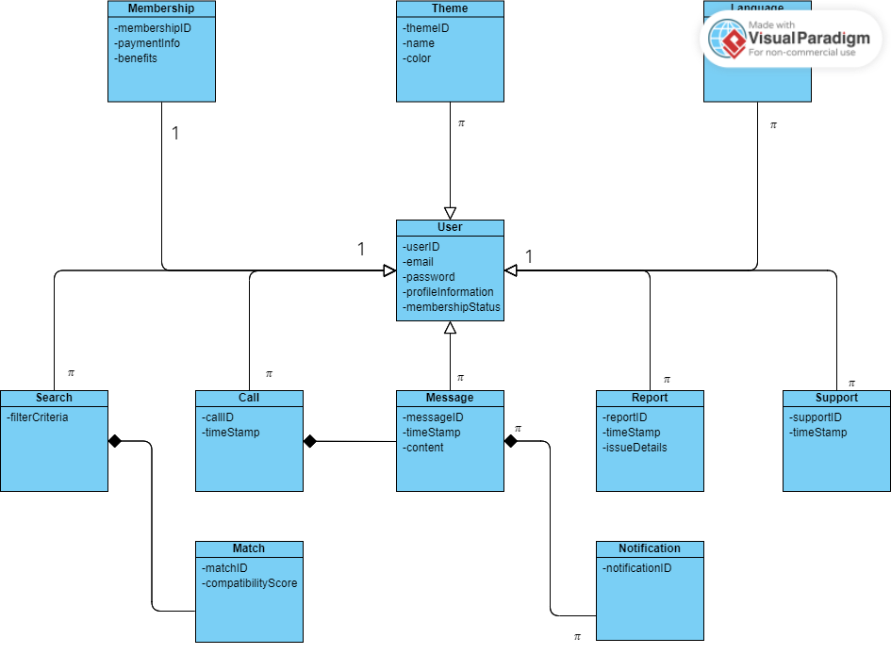
Class Diagram
Users
Message
Notification
Profile Information
Match
Search/Filter
Report
Premium Memberships
Theme
Language
Customer Support
Payment

Slide 7
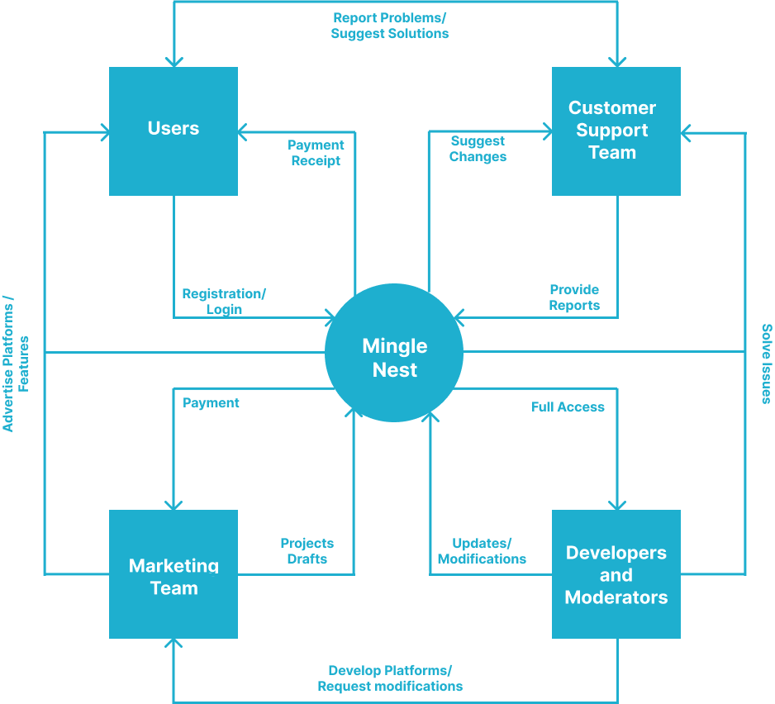
Context Flow Diagram
1
3
2
4
Users
Customer Support Team
Marketing Team
Developers and Moderators

Slide 8
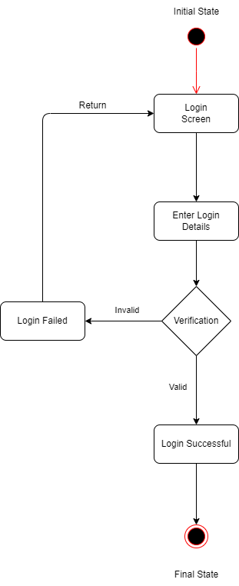
State Diagrams - Login
Login
Enter Details
User Login to the app by opening app
User will enter their login details
Verification
Login Failed
The system will verify
If verification fails, access is denied
Login Success
Final State
If verification is success, it will login
It will go into the app interface

Slide 9
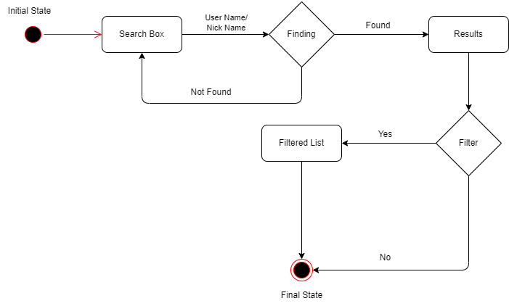
State Diagrams - Search

Slide 10
Search State Diagram
1
2
3
4
Initial State
Search box,
Search for the nickname
Finding process
Search box, if not found
5
6
7
8
If found, Shows the result
If clicked on filter
If no, directly shows all the users
If applied filter, it shows the filtered list

Slide 11
CRC Diagrams
Here are the list of all the CRC diagrams.
User Profile Subsystem
Communication Subsystem
Settings Subsystem

Slide 12
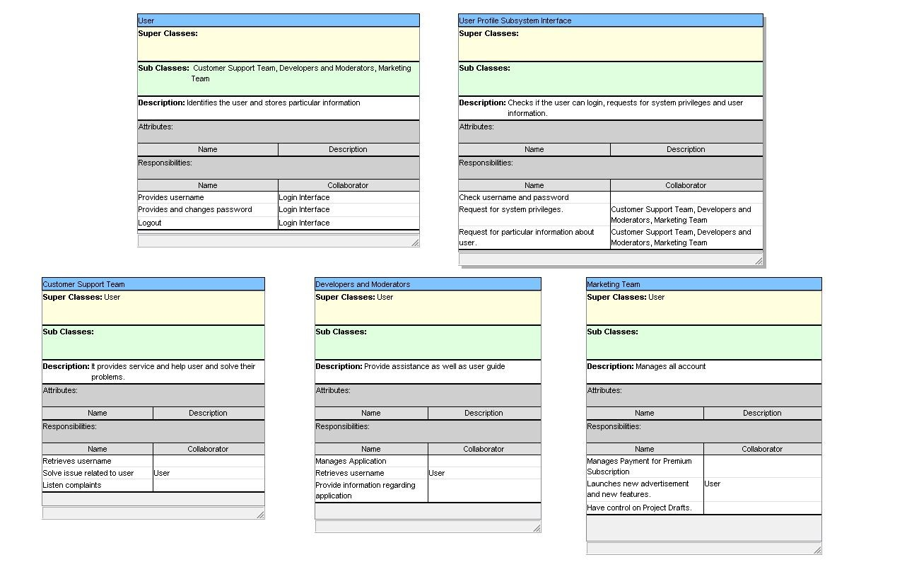

Slide 13
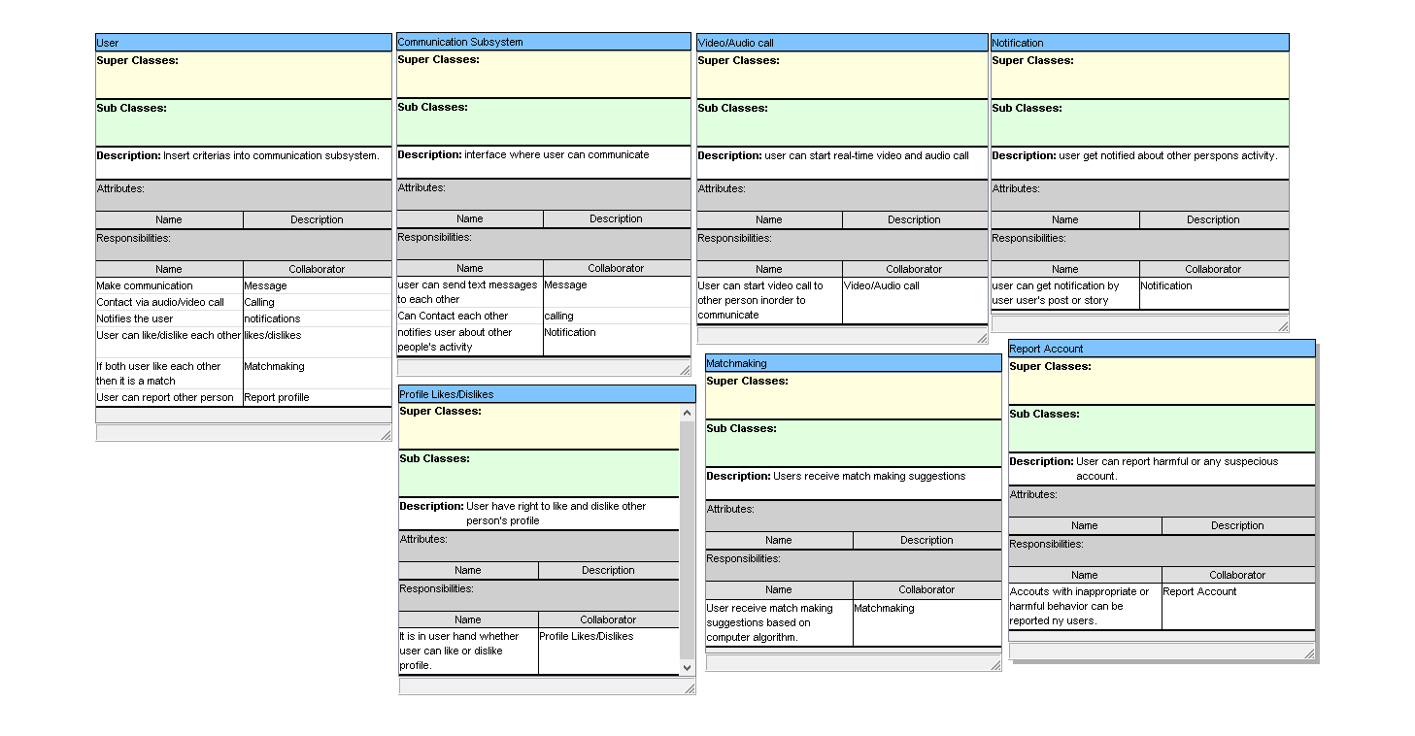

Slide 14
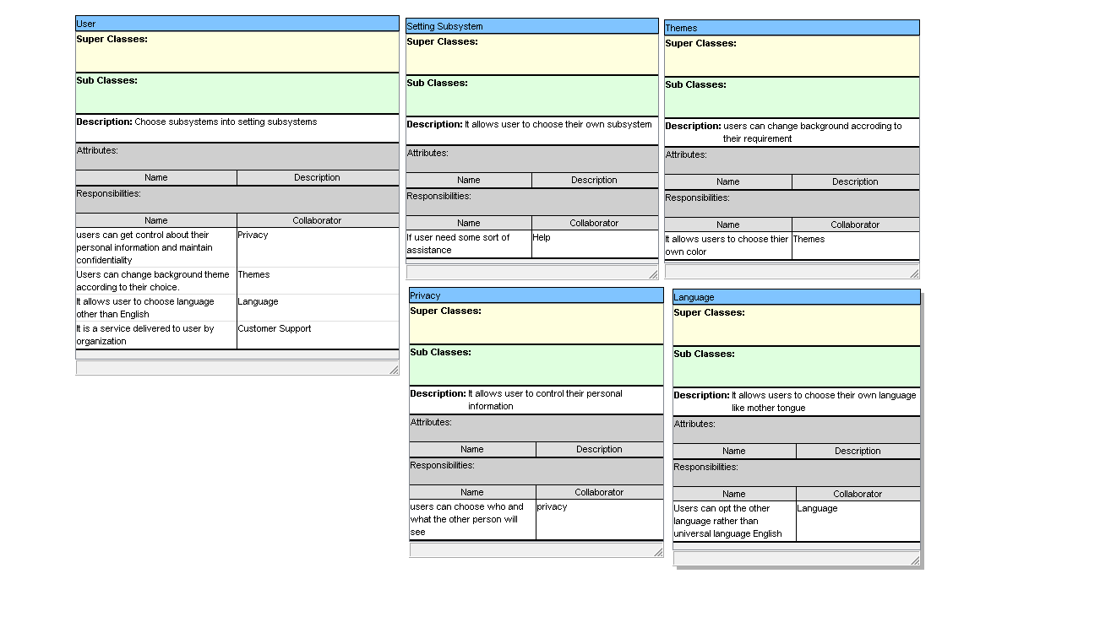

Slide 15
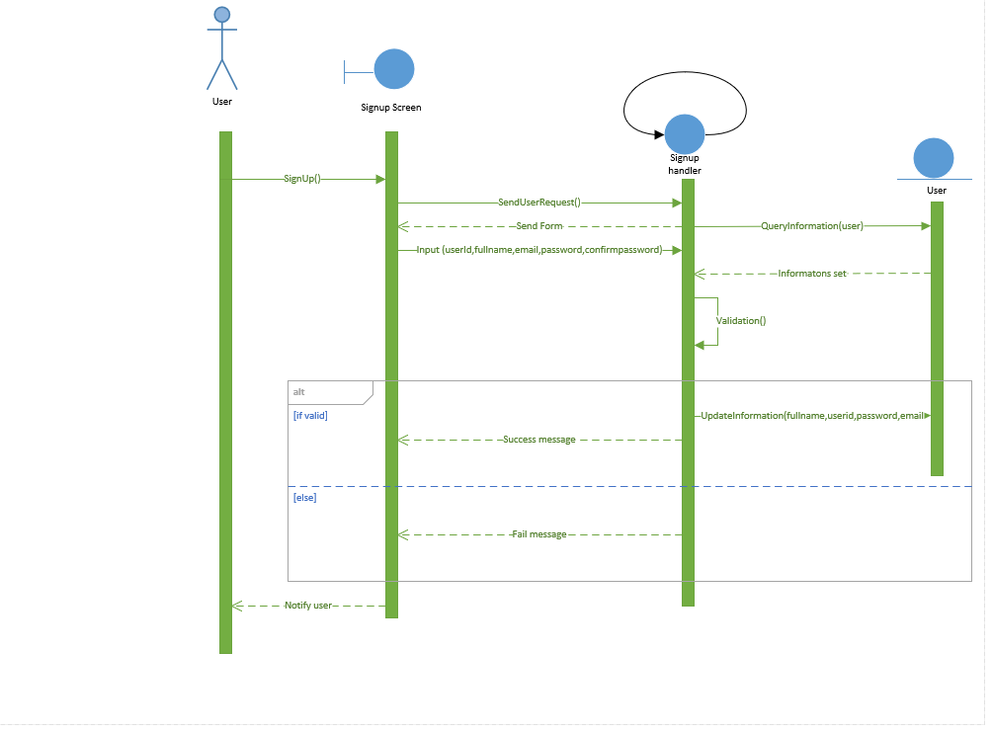
Sequence Diagrams User Registration

Slide 16
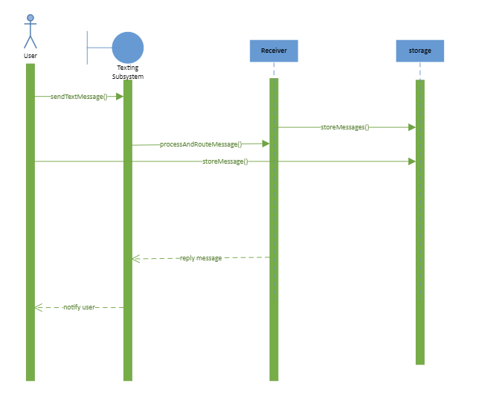
Sequence Diagrams User Messaging

Slide 17
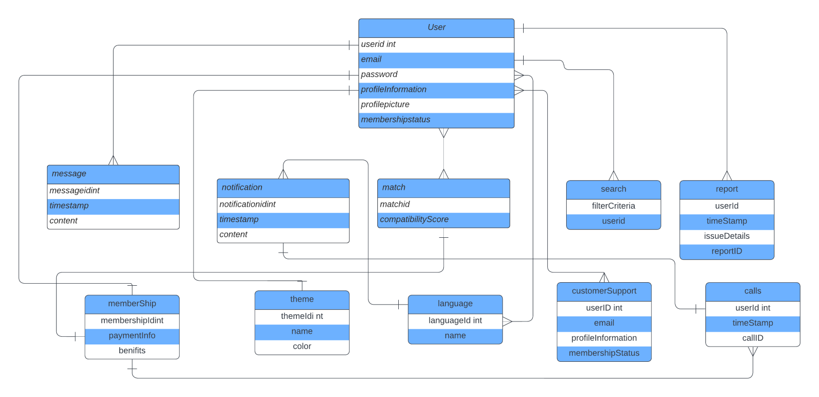
Database Schema

Slide 18
Thanks!
Do you have any questions?

