Slide 1

Creating a Calculator: HTML, CSS, and JavaScript
In this presentation, we'll explore the process of building a simple yet functional calculator using the core web technologies of HTML, CSS, and JavaScript. We'll cover the essential steps to create an intuitive and visually appealing calculator application.

Slide 2
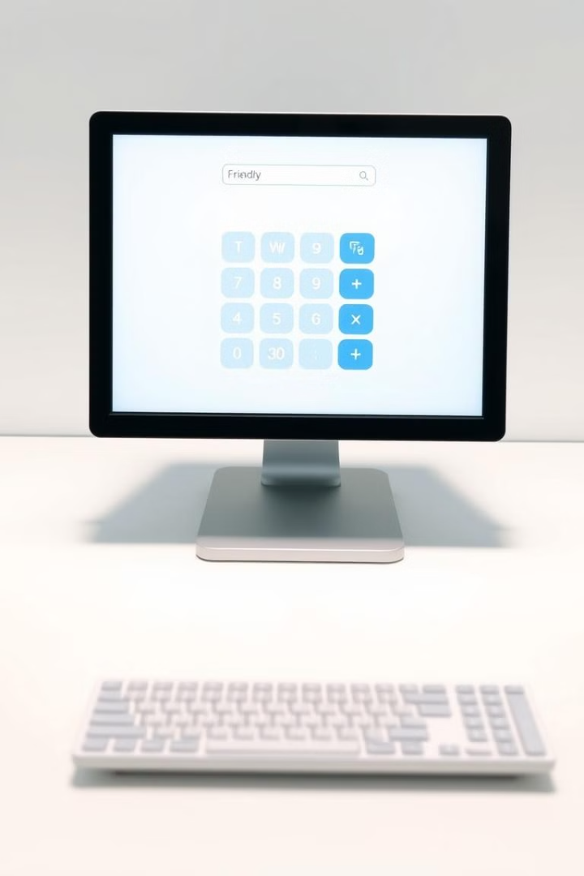
Introduction to the Calculator Project
1
Fundamental Functionality
2
User-Friendly Design
The calculator will perform basic arithmetic operations such as addition, subtraction, multiplication, and division.
The layout and styling will be designed to provide a clean and intuitive user experience.
3
Dynamic Interaction
The calculator will respond to user input in real-time, providing immediate feedback and results.

Slide 3
Setting Up the HTML Structure
Semantic Markup
Layout Elements
Accessibility Features
We'll use HTML tags like div, button, and input to create a well-structured and accessible calculator interface.
The calculator will be constructed using a grid-based layout, ensuring a clean and organized appearance.
The calculator will include features like keyboard support and screen reader compatibility, making it usable for all users.

Slide 4




Styling the Calculator with CSS
Typography
Carefully chosen fonts will enhance the overall aesthetic and legibility of the calculator.
Color Scheme
A visually appealing color scheme will be implemented, ensuring a cohesive and aesthetically pleasing design.
Responsiveness
The calculator will be designed to adapt to various screen sizes and devices, ensuring a consistent user experience.

Slide 5

Implementing the Calculator Logic with JavaScript
1
Event Handling
JavaScript will be used to capture user input from the calculator buttons and display the results.
2
Arithmetic Operations
The calculator will perform the necessary mathematical calculations based on the user's input.
3
Error Handling
The calculator will include logic to handle edge cases, such as division by zero or invalid input.

Slide 6

Practical Applications of a Calculator in Daily Life
Personal Finance
Cooking and Baking
Calculators can help with budgeting, tracking expenses, and managing personal finances.
Calculators can be used to scale recipes, convert measurements, and calculate ingredient ratios.
Home Improvement
Education and Learning
Calculators can assist with tasks like calculating the area of a room or the amount of materials needed for a project.
Calculators are essential tools for students in various subjects, from math to science and engineering.

Slide 7




Conclusion and Takeaways
Mastering Web Fundamentals
Building a calculator app helps solidify your understanding of HTML, CSS, and JavaScript.
Creativity and Problem-Solving
The process of creating a calculator encourages creative thinking and problem-solving skills.
Practical Applications
The calculator can be a useful tool in various aspects of daily life, from personal finance to education.
In conclusion, this project has provided a hands-on experience in building a functional and visually appealing calculator using HTML, CSS, and JavaScript. The skills and knowledge gained can be applied to a wide range of web development projects and real-world applications.

