Slide 1
HACKATHON
ALGOSTRATERGY - DEVELOPMENT

Slide 2
A LITTLE CHANGE IN STRATERGY
Initially, we were using a Fibonacci and supertrend with rsi.
But now we are using 2 supertrend with different settings with atr and rsi for much better performance.
we changed this because it was giving us a much better performance
We will be using a timeframe of 15 min so there is not much volatility.

Slide 3
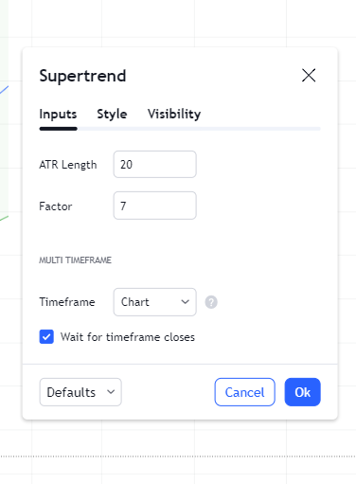
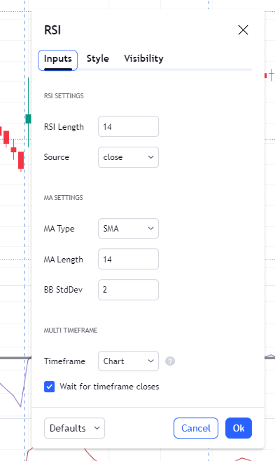
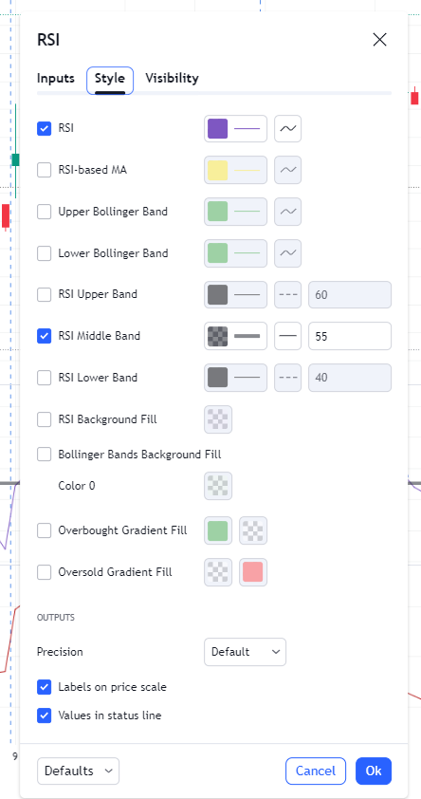
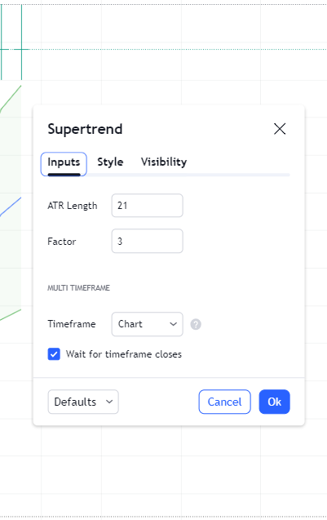
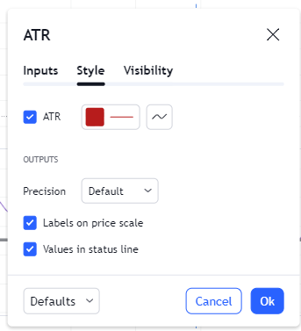
The setting of the indicators
Supertrend 1
Supertrend 2
ATR
RSI

Slide 4
WHY THESE SETTINGS????
Instead of using a naked supertrend, we are using 2 supertrends to prevent more fall signals in the market for a short-term market trend change.
Supertrend 1- to prevent false trend reversals/trap trading as the atr factor is 7, which takes into account a large range.
Supertrend 2- to grab the moment quickly as atr factor is 3.
RSI – above 55 it is considered as bullish and below 55 it is considered as bearish.
ATR-help us to get the stop-loss and the target as it tells us and the average value till the price moves.

Slide 5
IMPLEMENTATION OF THE STRATEGY.
FOR BUY TRADE—
We will first check whether the super trend is the same color, indicating the buy signal.
Then we will check whether rsi is above 55 or not. If it is check the atr value upon candle closing. If the atr value is under our stop-loss limit, we would enter into trade with the stop loss off atr(if atr less than 30 we would set our stop to 30 points other wise our sl will be atr) and target 2*atr, keeping the reward ratio 1:2. Once the target is achieved we would trail our stop-loss to our entry, and then check the atr value of current candle and same we would mark the target2 above that much points form target 1 and this continues until us trailing sl hits or the trading time end, we would not do BTST trade in this. We would accept our stop loss only if the candle closes above our stop loss line.

Slide 6
FOR THE SELL SIGNAL--
We would check the super trend signal and both should be the same upon candle closing and rsi below lev 55 and then we will check atr value.
If everything goes fine, we will enter in the trade with target, stoploss, and other things as mentioned earlier.

Slide 7
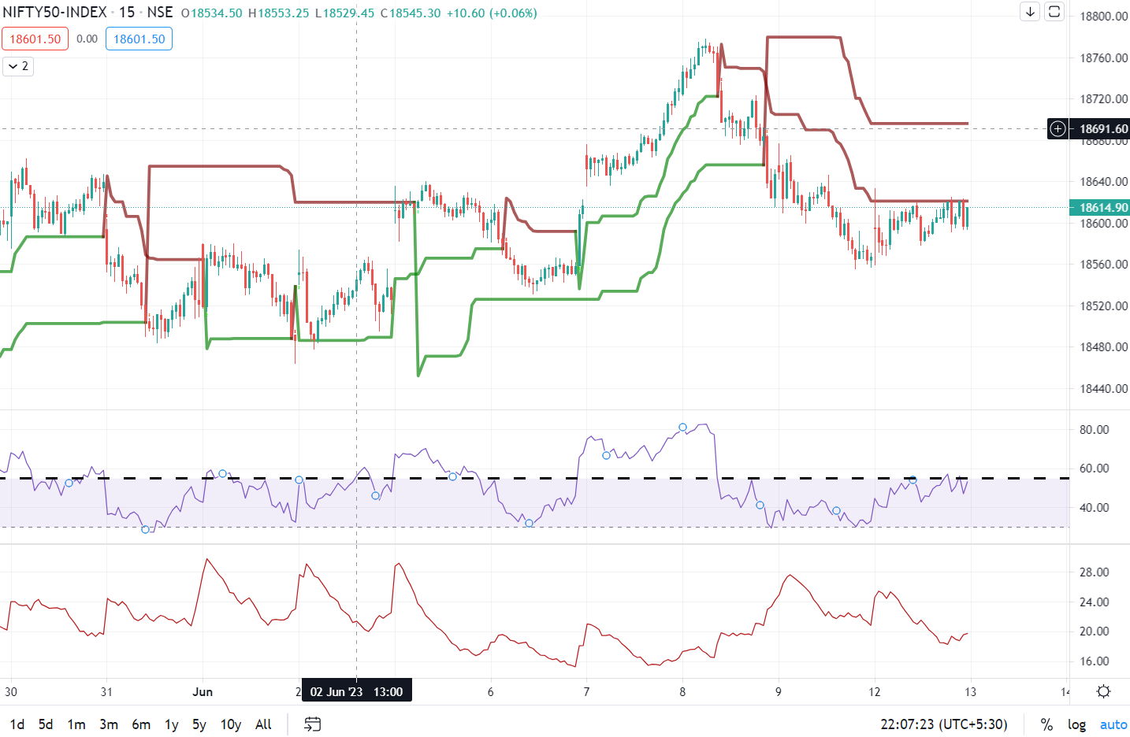
How does the screen look like….

Slide 8
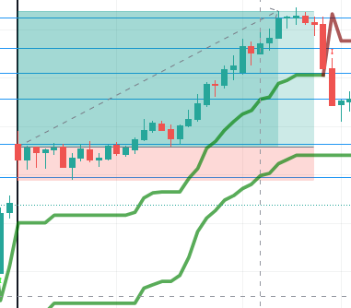
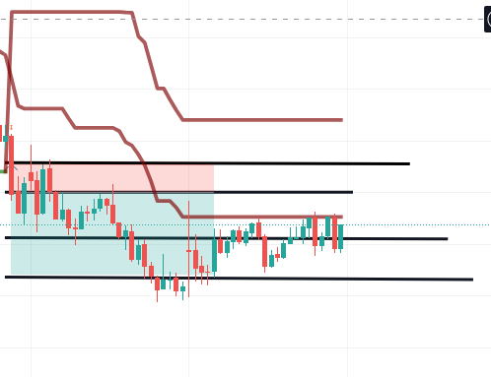
How it looks like.
LONG POSITION
SHORT POSITION

Slide 9
OUR CODE
We tried to test the code through Algo but couldn’t because our code didn’t work.
And then our team took the help of a chatgpt, which wasn’t successful. Here is what we tried.
strategy("SuperTrend with RSI Strategy", overlay=true)
// Define input variables
length1 = input(20, title="SuperTrend Length 1")
length2 = input(21, title="SuperTrend Length 2")
factor1 = input(7, title="SuperTrend ATR Factor 1")
factor2 = input(3, title="SuperTrend ATR Factor 2")
rsiThreshold = input(55, title="RSI Threshold")
// Calculate SuperTrend values
[upper1, lower1] = ta.supertrend(close, length1, factor1)
[upper2, lower2] = ta.supertrend(close, length2, factor2)
// Calculate RSI value
rsiValue = ta.rsi(close, 14)
// Generate buy and sell signals
buySignal = rsiValue > rsiThreshold and close > upper1 and close > upper2
sellSignal = rsiValue < rsiThreshold and close < lower1 and close < lower2
// Execute trades based on signals
strategy.entry("Buy", strategy.long, when=buySignal)
strategy.close("Buy", when=sellSignal)
// Plot SuperTrend values
plot(upper1, color=color.green, title="SuperTrend Upper 1")
plot(lower1, color=color.red, title="SuperTrend Lower 1")
plot(upper2, color=color.blue, title="SuperTrend Upper 2")
plot(lower2, color=color.orange, title="SuperTrend Lower 2")
// Plot RSI value
hline(rsiThreshold, "RSI Threshold", color=color.gray)
plot(rsiValue, title="RSI", color=color.black, linewidth=2)

Slide 10
// Calculate RSI value
rsiValue = ta.rsi(close, 14)
// Generate buy and sell signals
buySignal = rsiValue > rsiThreshold and close > upper1 and close > upper2
sellSignal = rsiValue < rsiThreshold and close < lower1 and close < lower2
// Execute trades based on signals
strategy.entry("Buy", strategy.long, when=buySignal)
strategy.close("Buy", when=sellSignal)

Slide 11
// Plot SuperTrend values
plot(upper1, color=color.green, title="SuperTrend Upper 1")
plot(lower1, color=color.red, title="SuperTrend Lower 1")
plot(upper2, color=color.blue, title="SuperTrend Upper 2")
plot(lower2, color=color.orange, title="SuperTrend Lower 2")
// Plot RSI value
hline(rsiThreshold, "RSI Threshold", color=color.gray)
plot(rsiValue, title="RSI", color=color.black, linewidth=2)

Slide 12
MANUAL BACKTESTING
WHEN WE BACKTESTED ON NIFTY AND BANK NIFTY –
FOR NIFTY, OUT OF 20 TRADES TAKEN 15 OF THEM WAS IN OUR FAVOUR
FOR BANK NIFTY OUT OF 25 TRADES TAKEN 19 WERE IN OUR FAVOUR
SO FOR MANUAL ACCURACY, WE CAN SAY IT IS:75% +-5% ON INDICES
BUT WHEN WE TRIED ON STOCKS THERE WAS A DRASTIC CHANGE IN OUR ACCURACY IT WHEN UP TO 90 % CONSIDERING STOCKS LIKE HDFC, BAJAJ, ADANI, AND CIPLA.
BAJAJ FIN AND TCS STOCKS RETURN RATE WAS AROUND 95%.

Slide 13
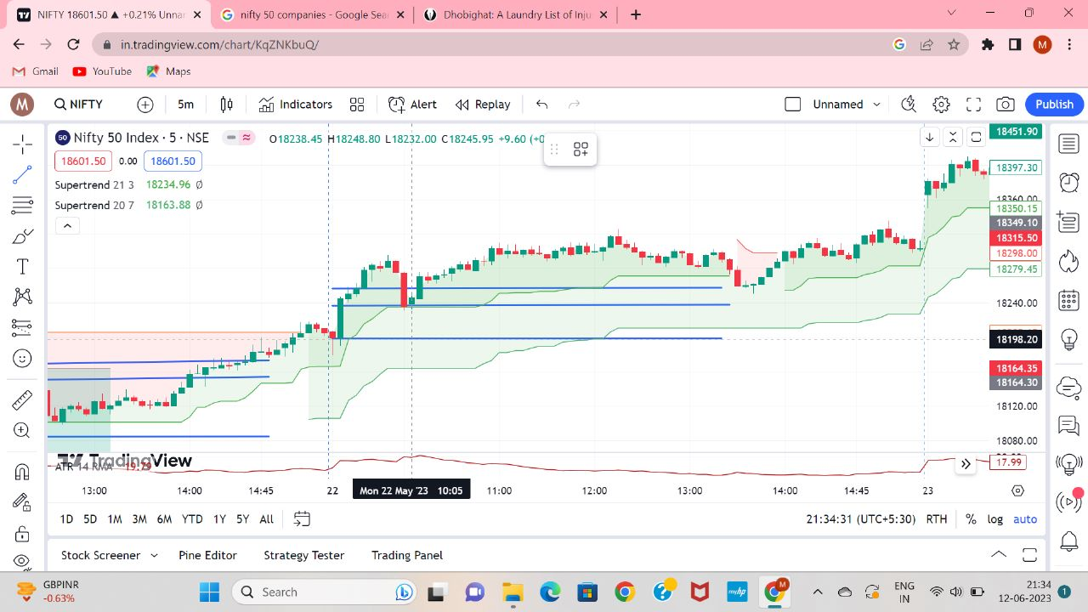
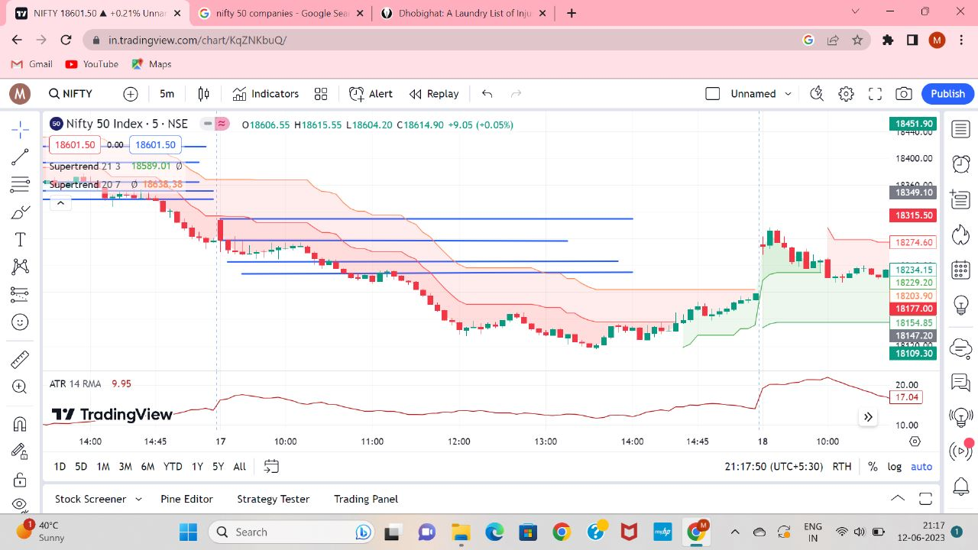
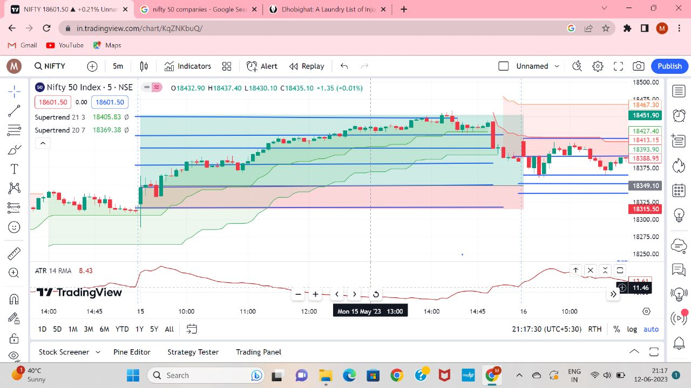
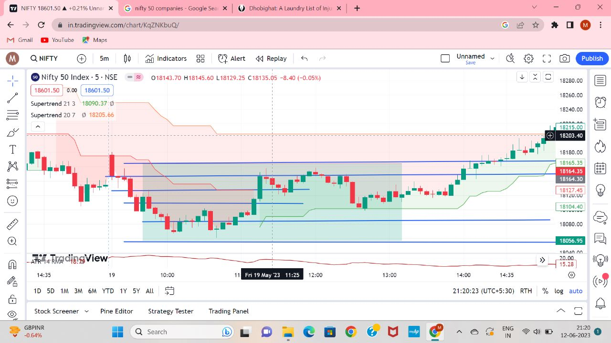
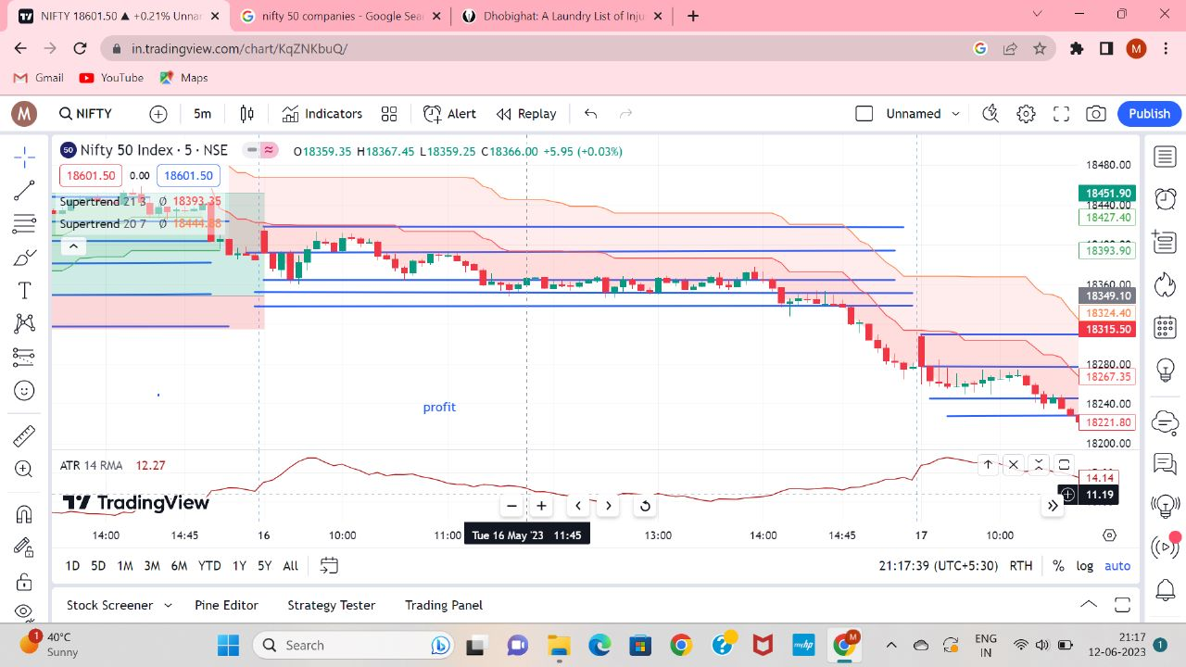
Some snippets of our manual back testing

