Slide 1

Presentation By: UJJWAL CHATURVEDI
Batch: DA/DS 21
Subject: Tableau
Topic: HR DATABASE
Faculity: Aryan Vijayvargiya Sir
Presented to: DR. ASHISH SIR

Slide 2
Objective:
Our database is an HR data for some random company. It has been extracted taken from a random site. It consists of many columns such as
The main objective of our analysis is to find the attrition rate and count by various aspects.
The analysis is done based on both the attrition as well as the active employees.
We can see which sector have the most active employees, attrition counts and their age so that we can make required recruitments and necessary steps can be taken.

Slide 3
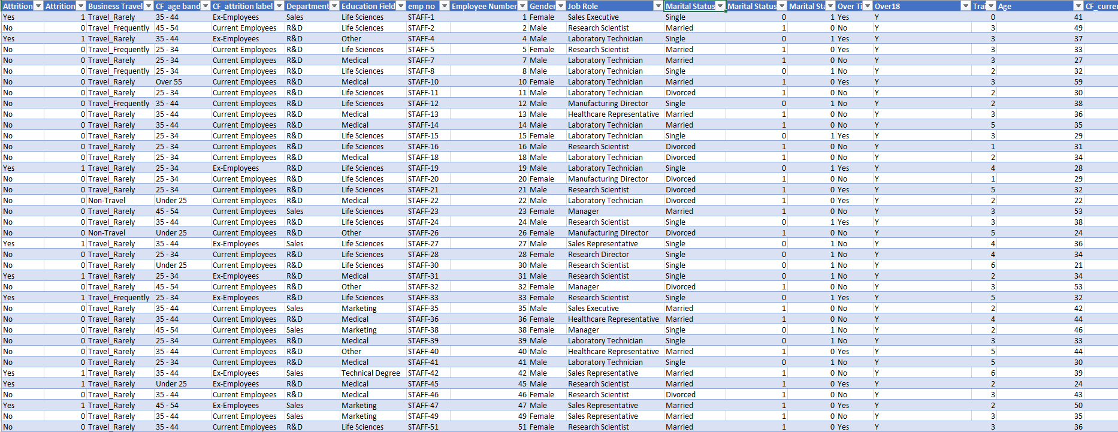
This is how our excel database looks like:

Slide 4
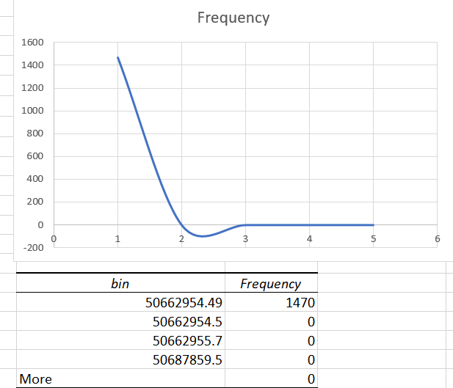
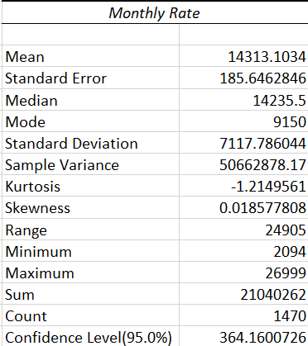

We also performed descriptive stats on monthly rate and created this graph.
There are total of 43 fields i.e., columns
It consists of 1470 rows. i.e., total entries
The descriptive stats of monthly rate is shown here:

Slide 5
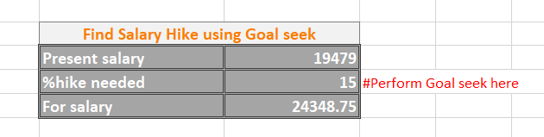
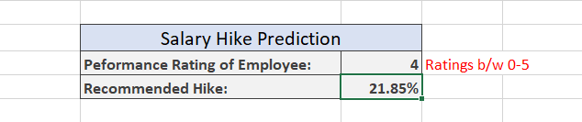
You can also fine the salary hike needed to increase salary of an employee to particular amount using Goal seek.
We can also get the recommended salary hike based on the performance rating of the employee using forecast based on previous data.

Slide 6
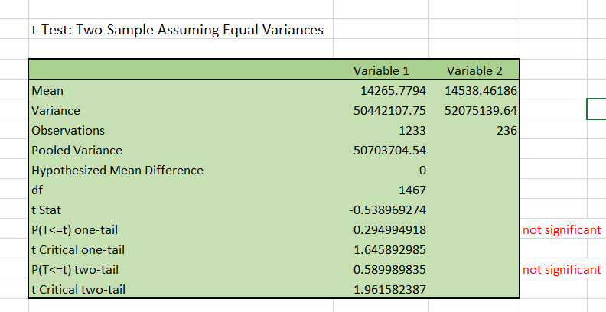
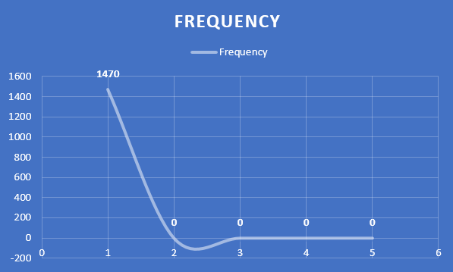
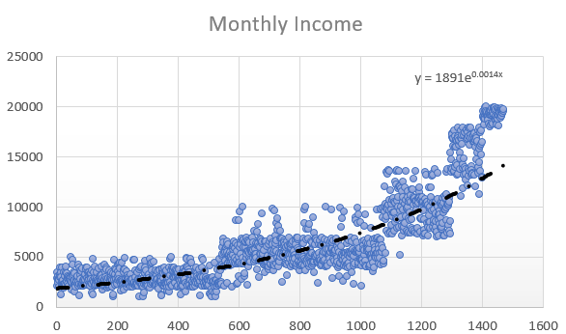
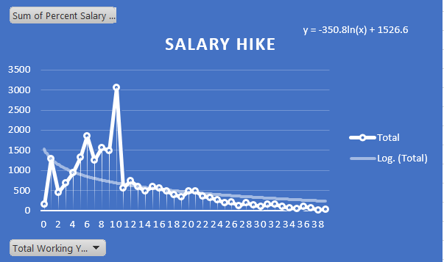
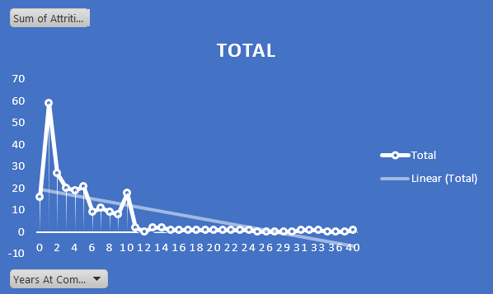
We can also see some graphs based on the data.
T-Test is a statistical test used to determine if there is a significant difference b/w the mean of two groups.
In order for the test being significant the value of these two P tails should be less than 0.05.

Slide 7
Heading on to tableau we will see:

Slide 8
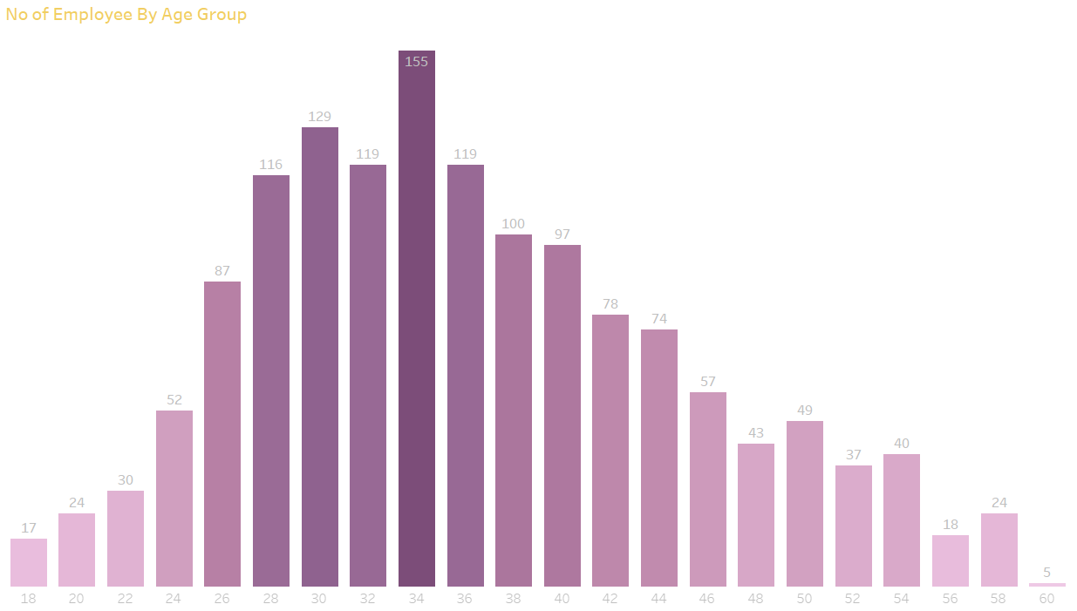
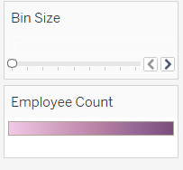
This graph helps us to analyze number of employees by age group in a company.
We can see that most of the employees are b/w 33-35.
This bin is provided so that we can adjust the age gap in graph.
We can also see that about 5 of the employee are about 60 and hence it is their retiring age.

Slide 9
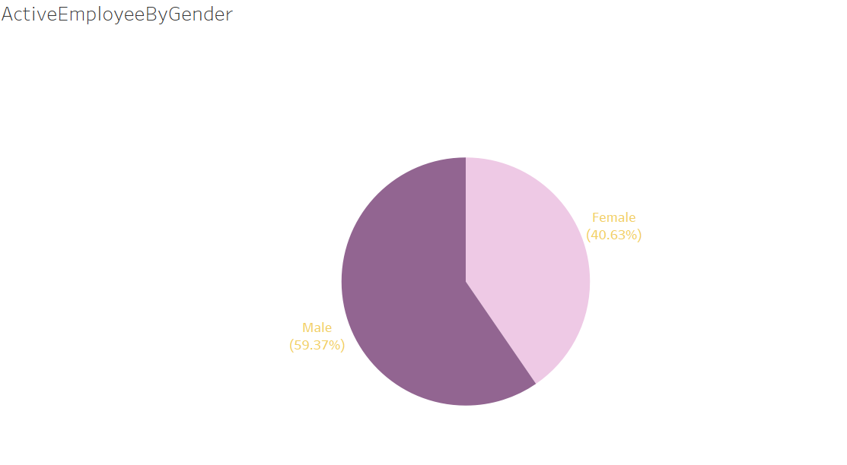
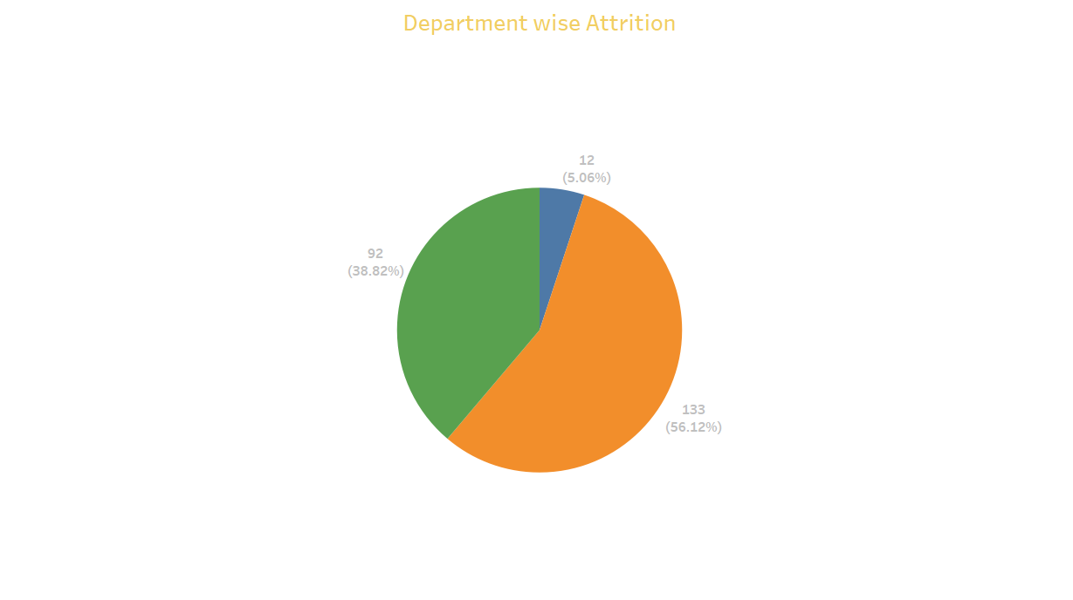
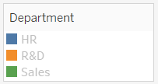
This chat about 59.37% of the active employees are male and 40.63% are female.
This chart shows us the composition of department wise attrition .
This legend tells us which color represents which department.
About 56.12% of attrition is from R&D department.

Slide 10
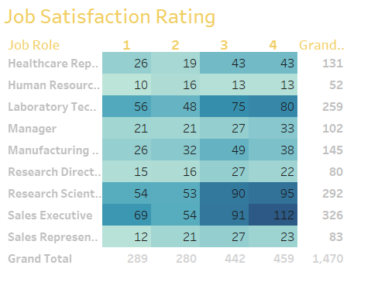
This table shows us the job satisfaction rating of every employee in different job roles.
Column wise we can se total number of employee in particular rating sector where as row wise we can see total employee in job role.

Slide 11
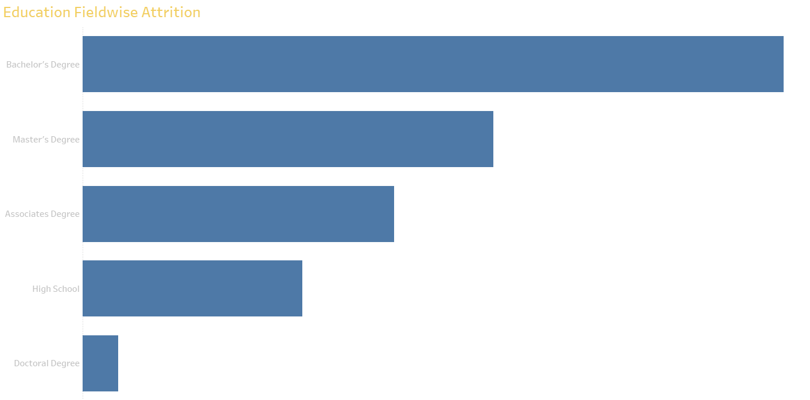
This chart shows that the employees from the B.Tech background leave the job most.
This chart help us to analyze the Education from which the employees leave the job most.

Slide 12
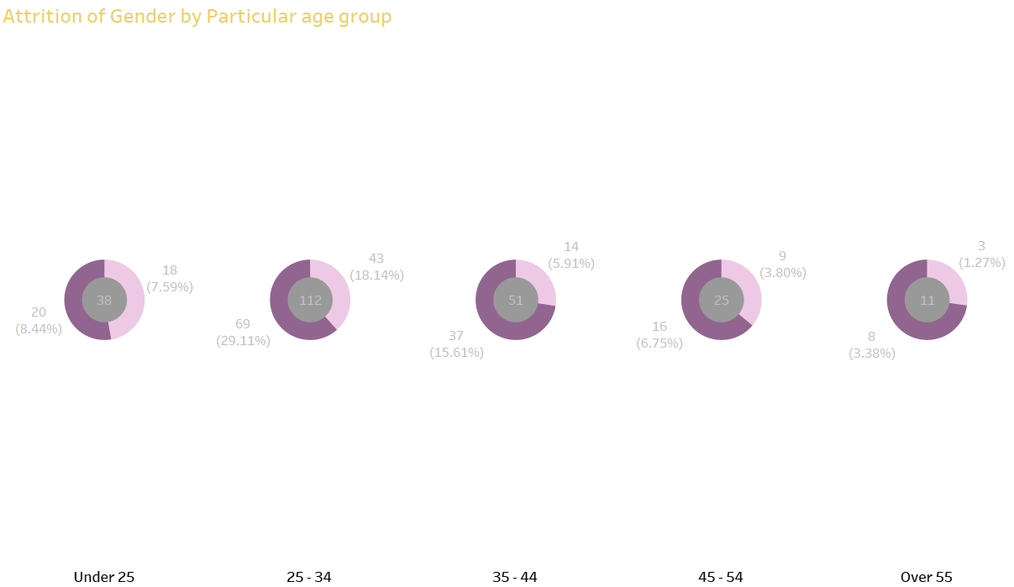

This donut chart represents the attrition of employees by gender in particular age group.

Slide 13
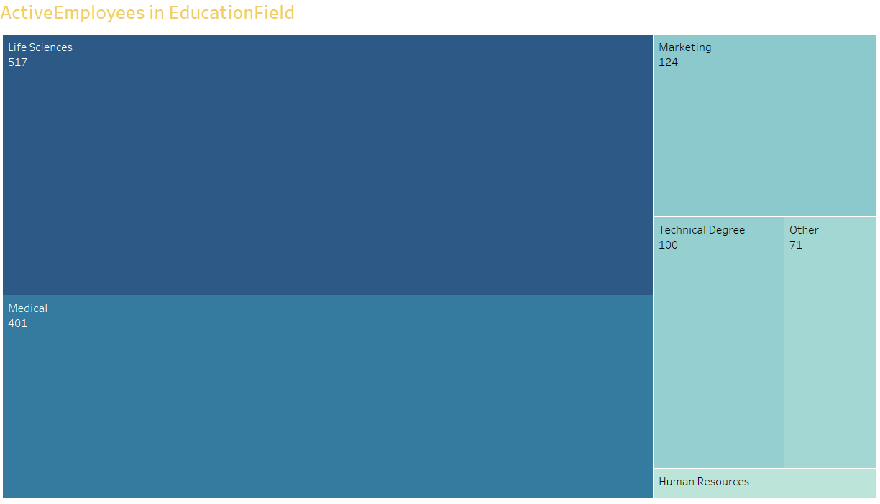
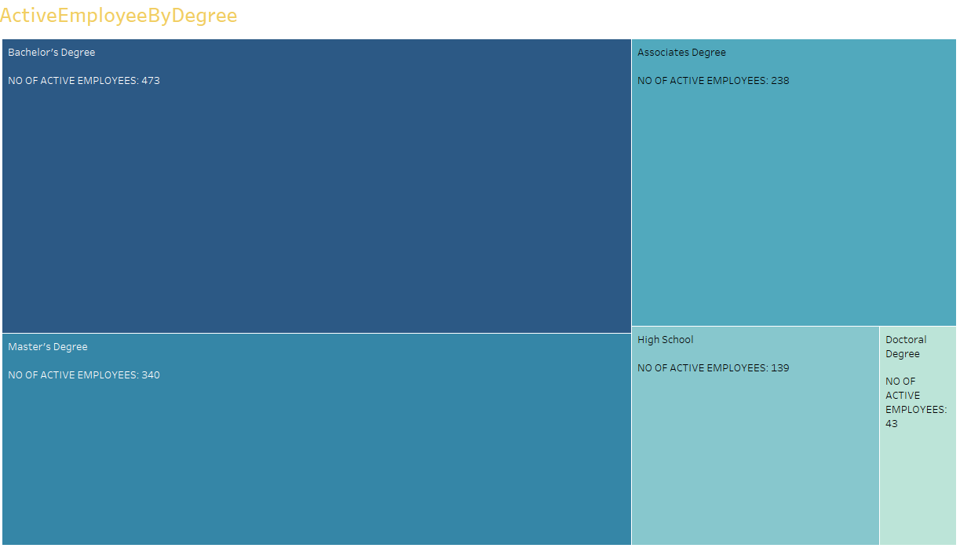
This tree map shows the composition of the active employees in Education Field
This tree map shows Active Employee composition by Degree.

Slide 14
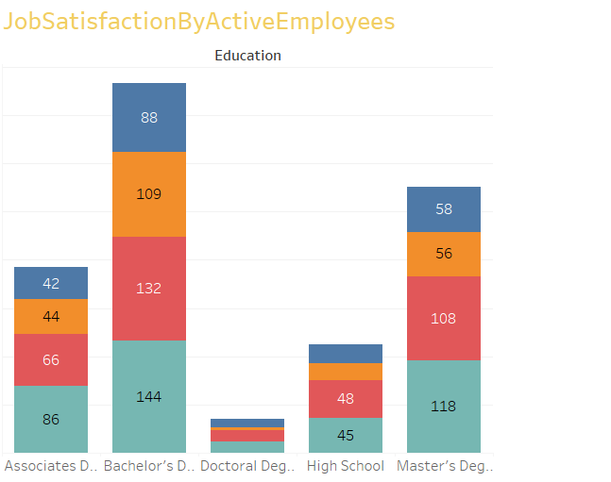
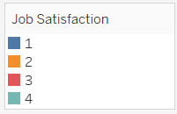
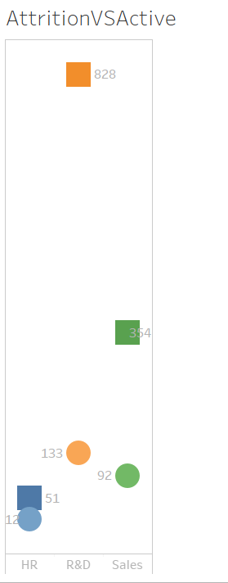
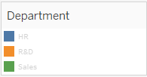
We can observe that maximum employees are from Bachelor’s degree. All the values represent the rating by no. of employees.

Slide 15
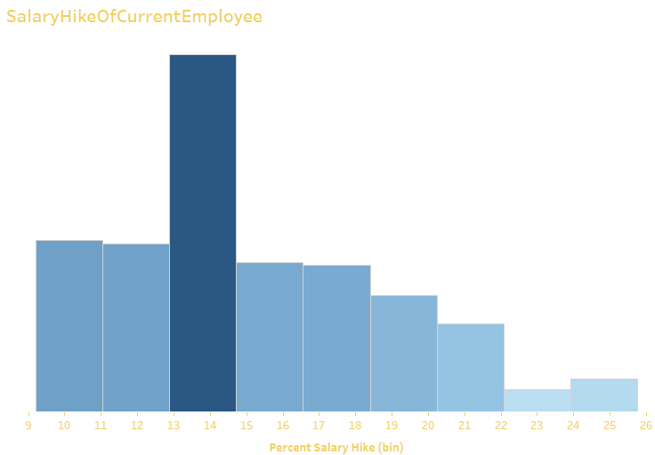
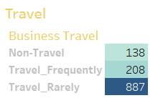
With this table we can see that there are 138 active employees do not travel.
This bar shows that the maximum salary hike% given to employees lies b/w 13-15%
208 who travel frequently.
887 who travel rarely. Since the colour of that block is dark we can clearly observe the majority.

Slide 16
Our Database consists of total 2 dashboards and 10 KPIs.
We have provided the snapshot of both the databases in the next slide.
To access the dashboard kindly continue with tableau book.

Slide 17
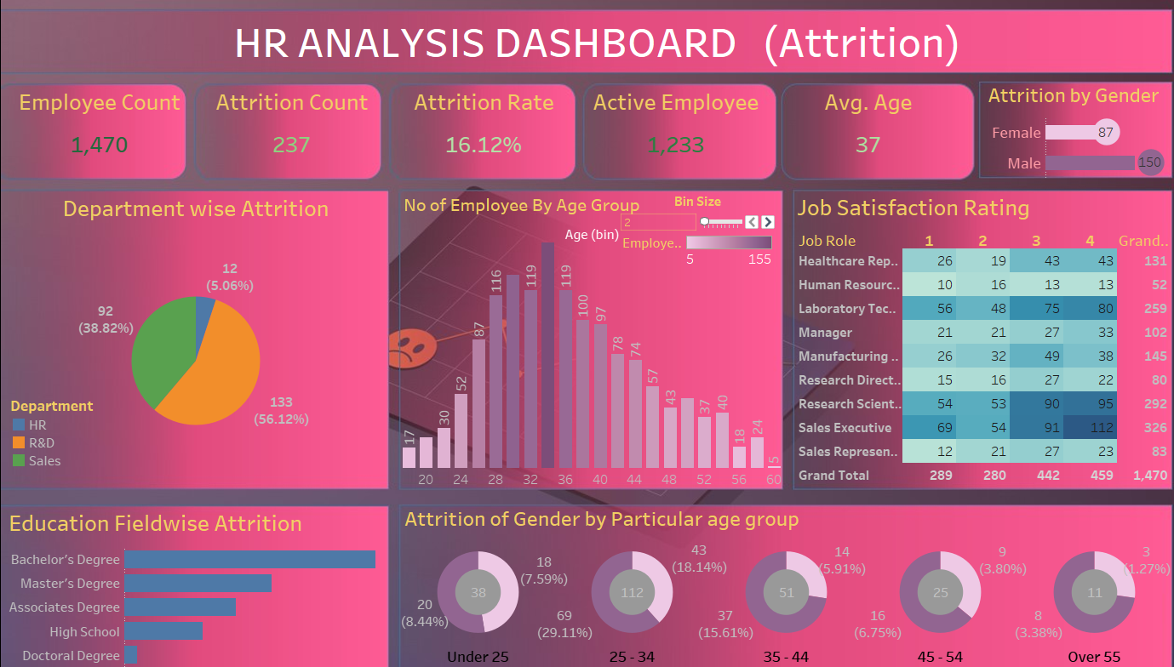

Slide 18
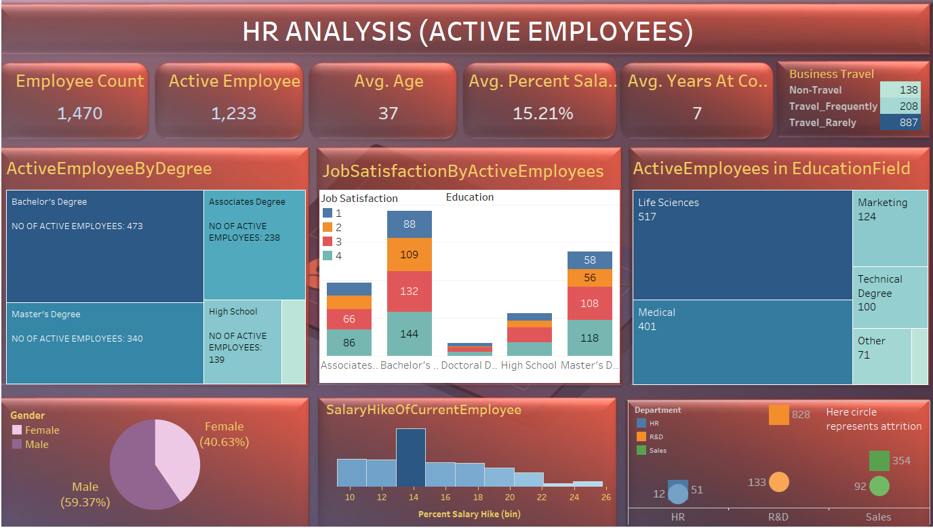

Slide 19
Thank You

