Slide 1
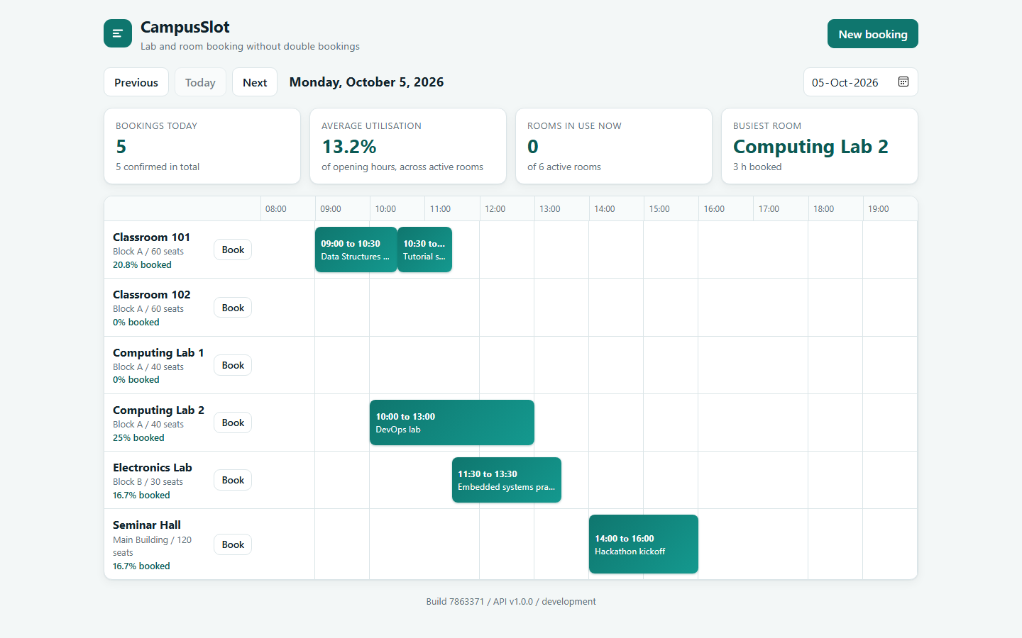
CampusSlot
Book a campus room or lab without ever double booking it
The problem
Rooms are often booked by message or spreadsheet, and two people end up with the same room at the same time.
The idea
A booking system that refuses an overlapping slot, and a delivery chain around it that is automatic, secure and observable.
Ujjwal Jain | 24bcs10173 | Section B
github.com/Ujjwaljain16/campusslot
CampusSlot | Ujjwal Jain | 1 / 17
Notes:
Hello. I am Ujjwal Jain, and this is my final DevOps project. CampusSlot is a small booking service for rooms and labs. The application is deliberately small, because the real subject of this project is everything around it: how the code is tested, packaged, scanned, shipped, deployed and watched, and what I do when something breaks. The one rule that the application guarantees is that two confirmed bookings can never overlap in the same room.

Slide 2
How the pieces fit together
From a developer's keyboard to a running, watched application
Developer
writes and pushes code
GitHub
keeps every version
GitHub Actions
tests, scans, builds
Image registry
images tagged with the commit
Kubernetes cluster
Argo CD
applies what Git says
Website
React + nginx
API
FastAPI
Database
PostgreSQL
Terraform
builds the cloud from code
AWS
network + EKS cluster
Prometheus, Loki and Grafana
metrics and logs on one dashboard
CampusSlot | Ujjwal Jain | 2 / 17
Notes:
This is the whole picture on one slide. On the top row, I push code to GitHub, and GitHub Actions tests it, scans it for problems, builds two container images and stores them in a registry. In the middle, Argo CD watches the desired state in Git and applies it to the Kubernetes cluster, where the website, the API and the database run. At the bottom left, Terraform builds the cloud network and cluster on AWS from code, and at the bottom right, Prometheus, Loki and Grafana show me what the running system is doing.

Slide 3
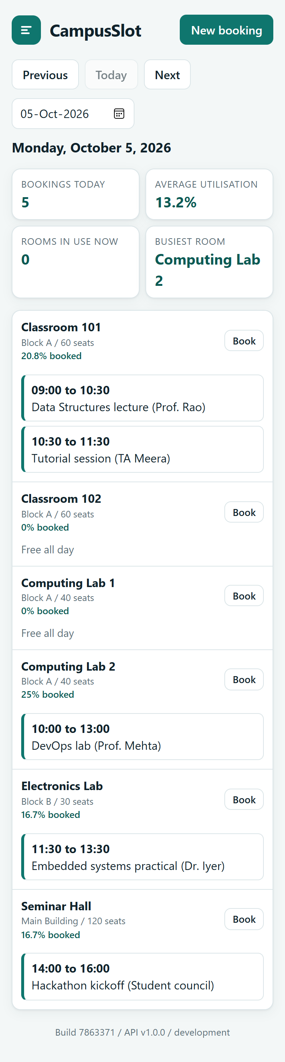
What the application does
Pick a room and a time. If the slot is taken, the system says no and says why.
Three layers protect the rule
1. Check the request makes sense
2. Look for an overlapping booking
3. The database refuses overlaps itself
A slot that ends when another begins is fine.
The day view for six rooms, with live numbers on top
Real data: bookings are stored in PostgreSQL and survive restarts.
On a phone
CampusSlot | Ujjwal Jain | 3 / 17
Notes:
This is the application. The page shows a day view for every room, with the bookings as coloured blocks, and a few numbers at the top such as utilisation. On a phone, the same page re-arranges itself into one column. The interesting part is the rule that protects the bookings. A request is first checked for sense, for example an end time before the start time. Then the service looks for an overlapping booking and answers with a conflict, naming the booking that is in the way. Finally, the PostgreSQL database itself has a constraint that makes an overlap impossible, even if two people press the button at exactly the same moment. A booking from 10 to 11 and another from 11 to 12 are allowed, because they only touch.

Slide 4
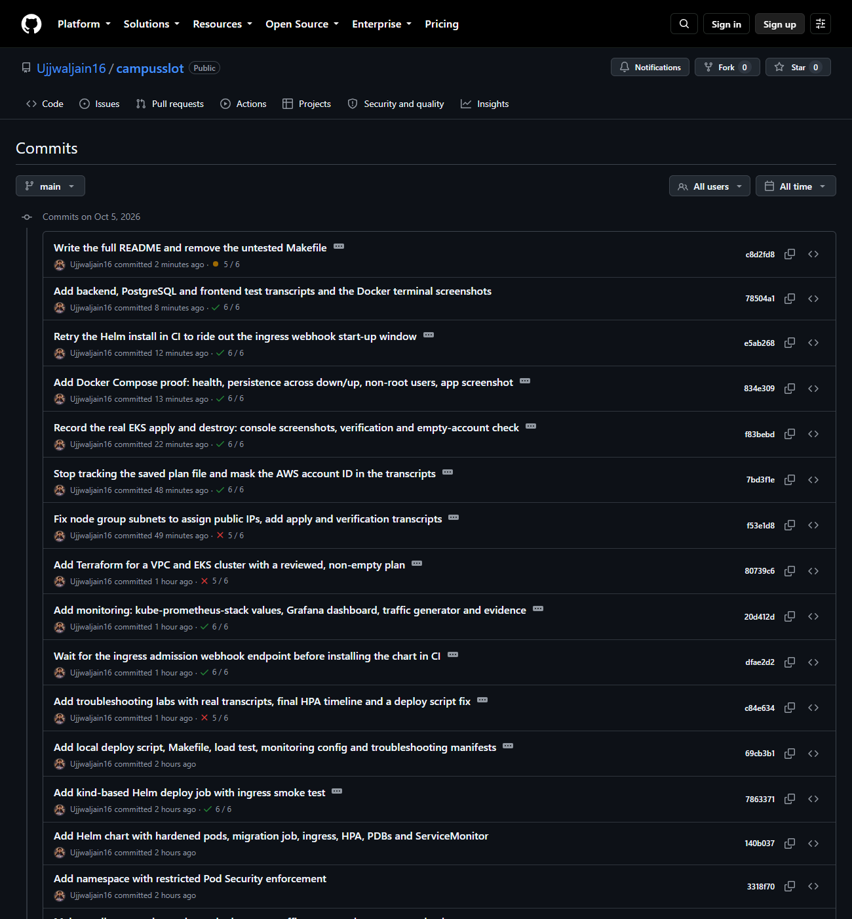
How the project is organised
More than 80 meaningful commits, each one a small step that can be explained
backend/ API, migrations, tests
frontend/ website and nginx
helm/ the Kubernetes package
terraform/ AWS network and cluster
gitops/ what Argo CD applies
security/ the security gates
monitoring/ dashboards and logs
troubleshooting/ four failures on purpose
docs/evidence/ real screenshots and logs
.github/workflows/ the pipeline
Public commit history on GitHub
CampusSlot | Ujjwal Jain | 4 / 17
Notes:
The code is in one public repository. Every commit message says what changed and why, for example adding the migration, adding the Trivy gate, or fixing a failing smoke test. I did not manufacture commits: the history includes my failures, such as the red pipeline runs, because those are part of the story. The folders are named after what they do, so a reviewer can find the backend, the frontend, the Helm chart, the Terraform, the GitOps files and the evidence quickly.

Slide 5
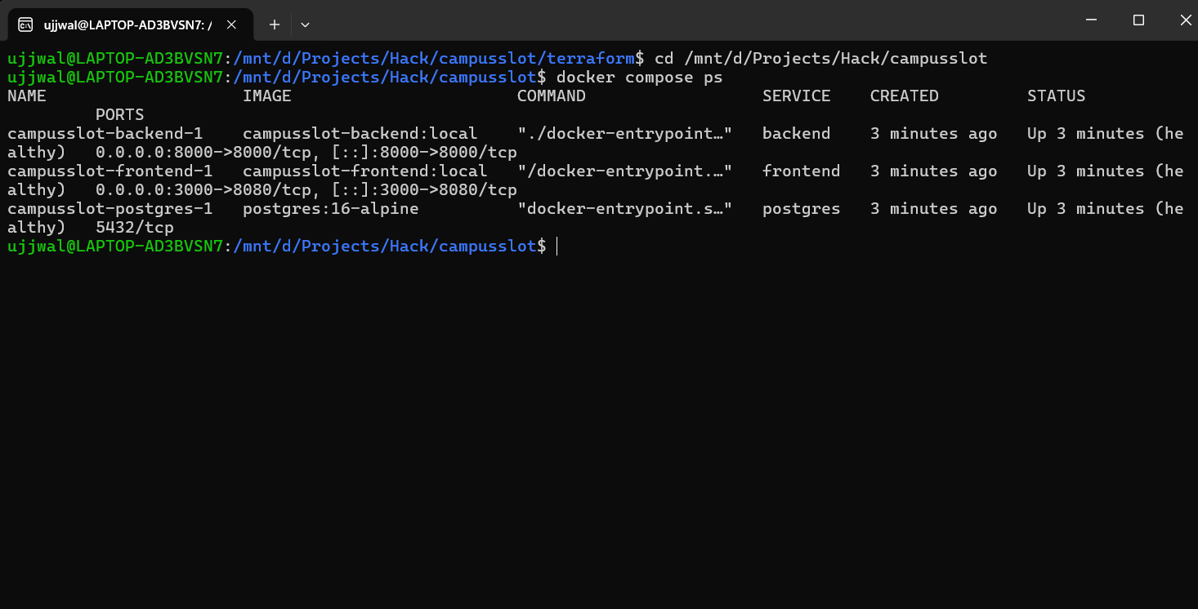
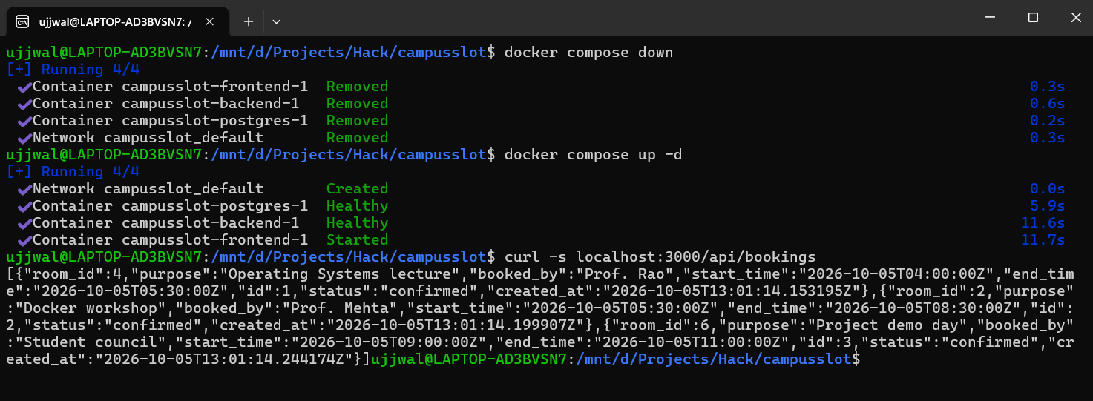
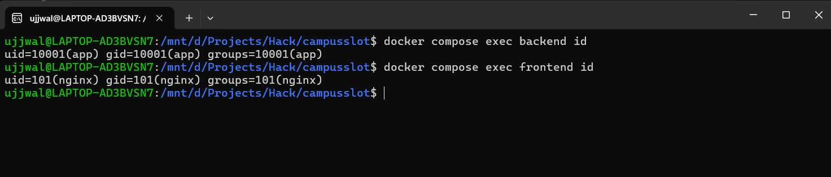
One command starts everything
docker compose up: website, API and database, with the data kept safe
Three services, all healthy
Bookings survive down and up
• Two small images, built in stages
• Health checks on every service
• The database keeps its data on a volume
Both containers run as a normal user, not as root
CampusSlot | Ujjwal Jain | 5 / 17
Notes:
With Docker Compose, one command starts the website, the API and the database. Both of my images run as a normal user and not as root, which limits the damage if something goes wrong. I proved that the data is safe by taking the whole stack down, starting it again, and finding the booking still there, because the database lives on a named volume.

Slide 6
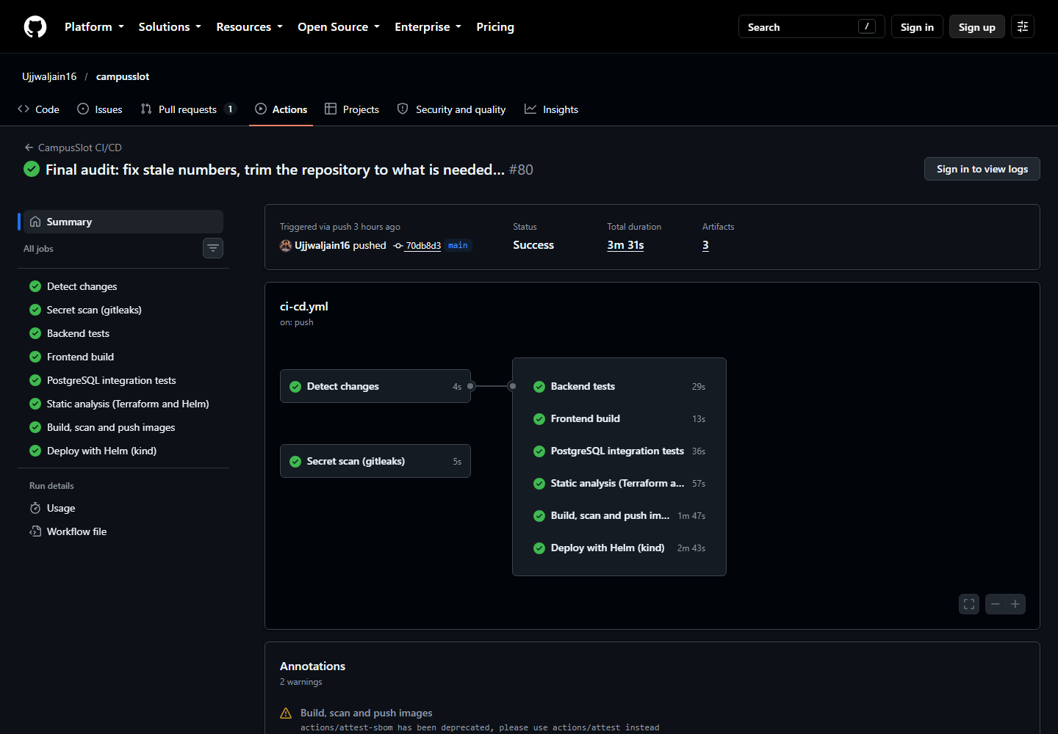
Every push is checked automatically
Nothing reaches the cluster unless every earlier check has passed
Run in the screenshot | Time
Backend tests | 19 s
Frontend build | 9 s
Database tests | 34 s
Secret scan | 7 s
Build, scan, push | 98 s
Deploy and smoke test | 98 s
• Runs on every push to main
• Images are tagged with the commit, never latest
• Today: jobs side by side, about 3 minutes
CampusSlot | Ujjwal Jain | 6 / 17
Notes:
This is the pipeline in GitHub Actions. When I push code, the tests run, the dependencies and the history are checked for known problems, and the frontend is built. Only if all of that passes are the two images built, scanned and pushed to the registry, tagged with the exact commit. Then the chart is installed into a temporary Kubernetes cluster and the real application is tested through the ingress. The run in the screenshot took about four minutes. Today the jobs run side by side, with a static analysis job for the infrastructure code and signed provenance for the images, and a full run takes about three minutes. The pipeline was red a few times while I built it, and each failure taught me something that is written up in the README.

Slide 7
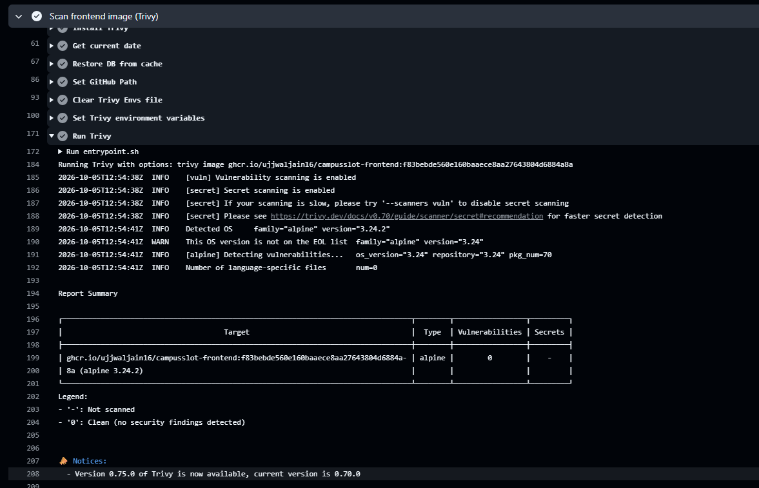
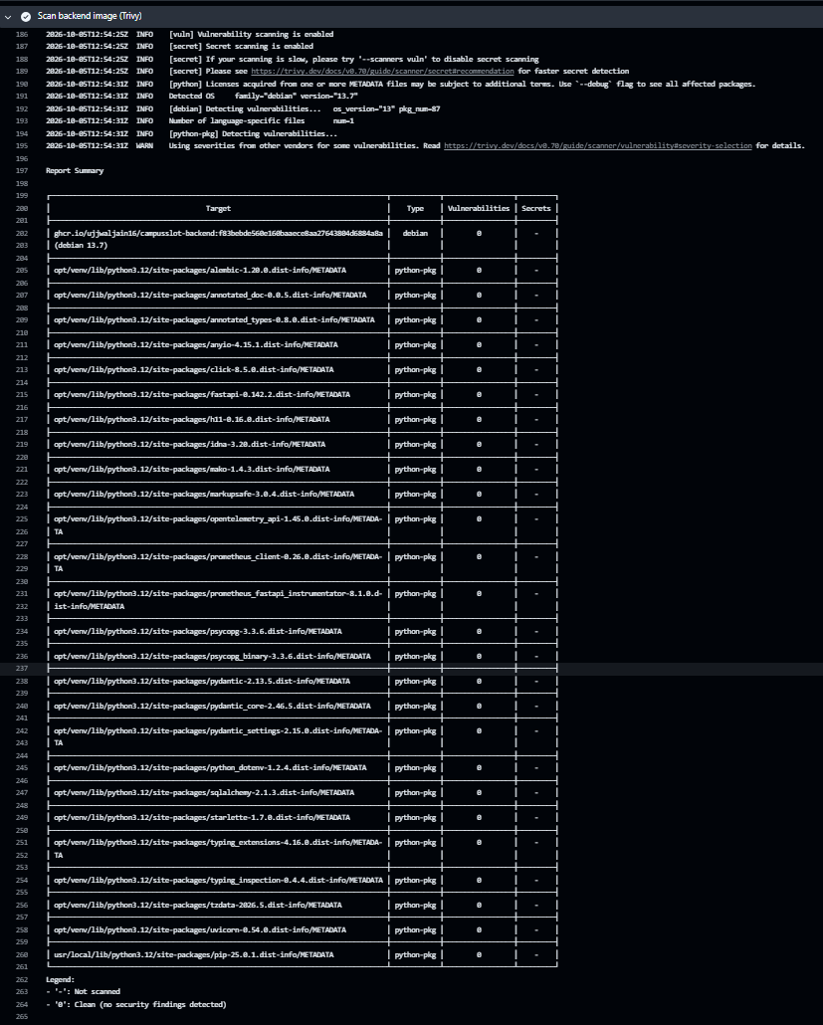
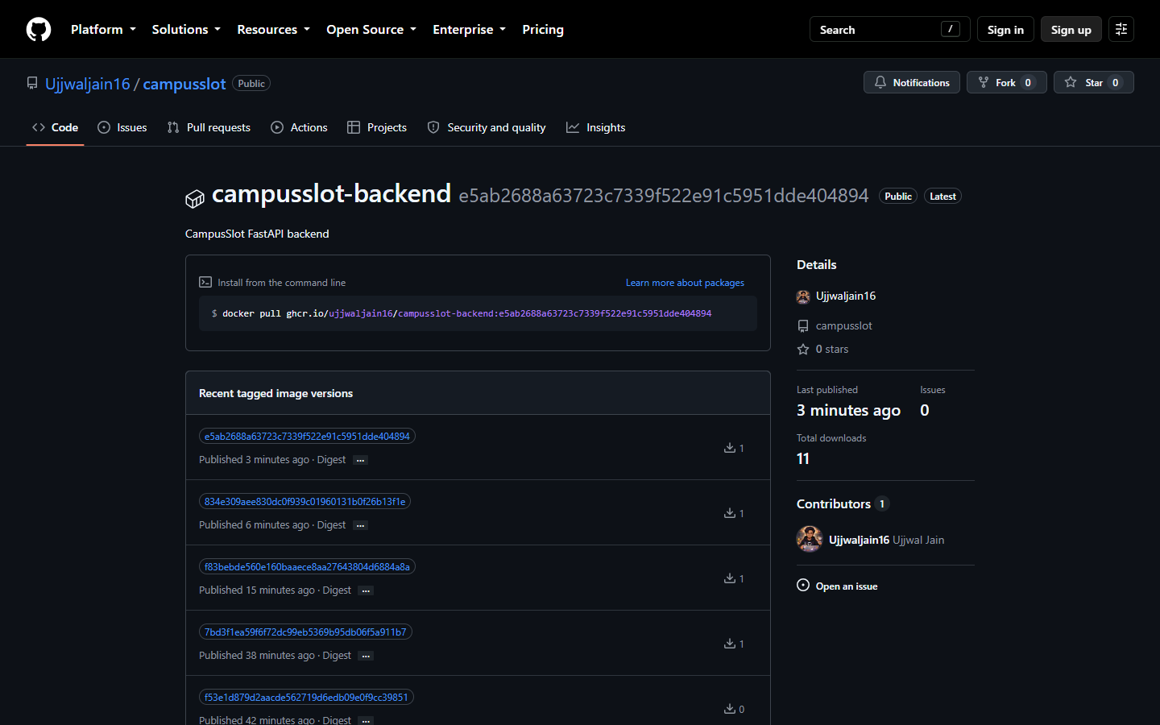
Security checks before anything ships
Both images scanned: zero serious findings
Six kinds of check
Code: Bandit
Libraries: pip-audit, npm audit
Secrets in history: Gitleaks
Images: Trivy, blocks the build
Terraform and Helm: Trivy
Origin: signed provenance
A clean scan is not proof of safety. It means nothing fixable was known that day.
Frontend image: 0 vulnerabilities
Backend image: 0 vulnerabilities
Published in GHCR, tagged with commits
CampusSlot | Ujjwal Jain | 7 / 17
Notes:
Trivy scans both images for known vulnerabilities, and the build fails if a serious one has a fix available. On every run, the result was zero, so I have no failing scan to show, and I did not invent one. A clean result means that, on that day, no known fixable problem was found. It does not prove the images are safe, because new vulnerabilities appear every day, and the gate exists to catch them on the day they do. Next to Trivy, there are checks for the code, for the Python and JavaScript libraries, and for secrets in the whole Git history. The images are published with the commit as their tag, so every running version can be traced to one commit.

Slide 8
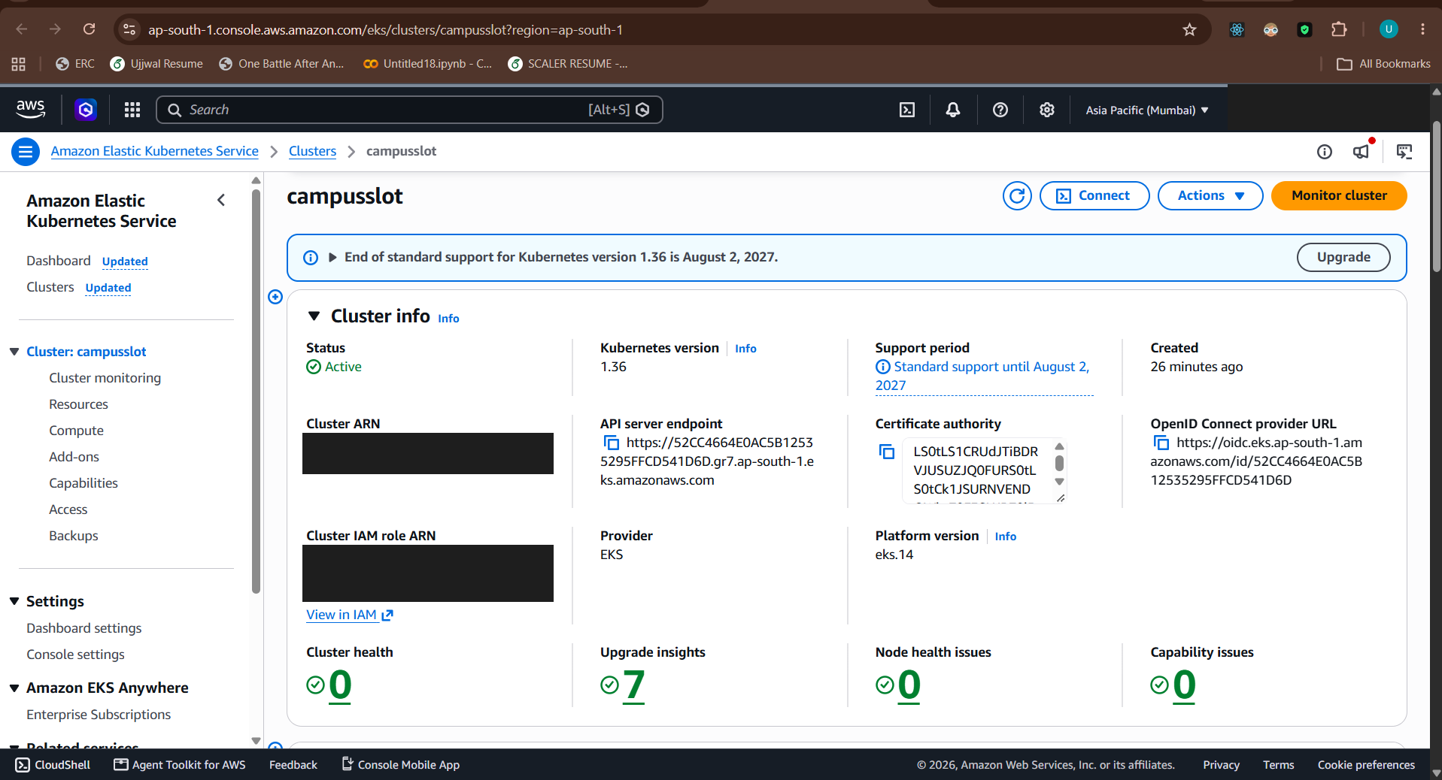
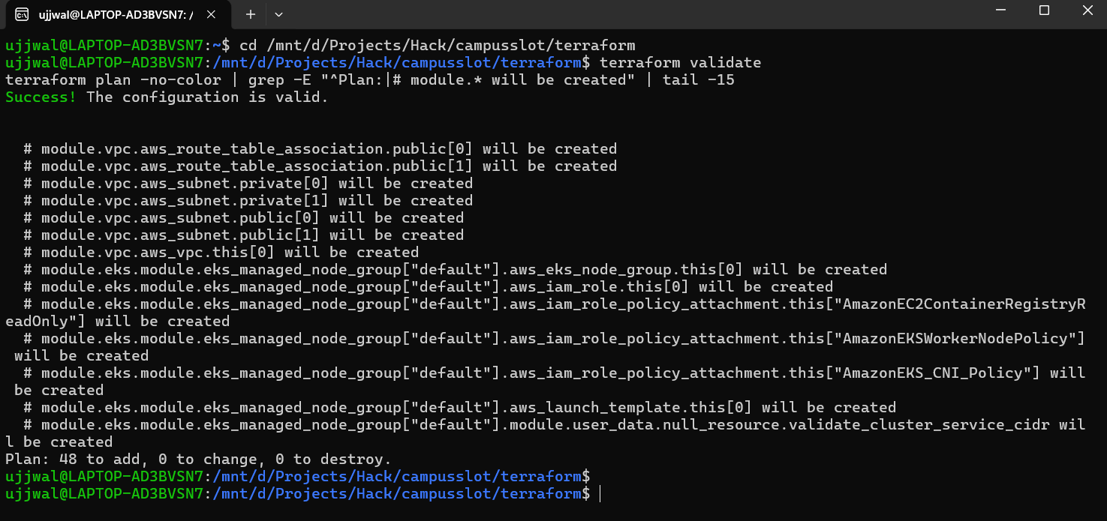
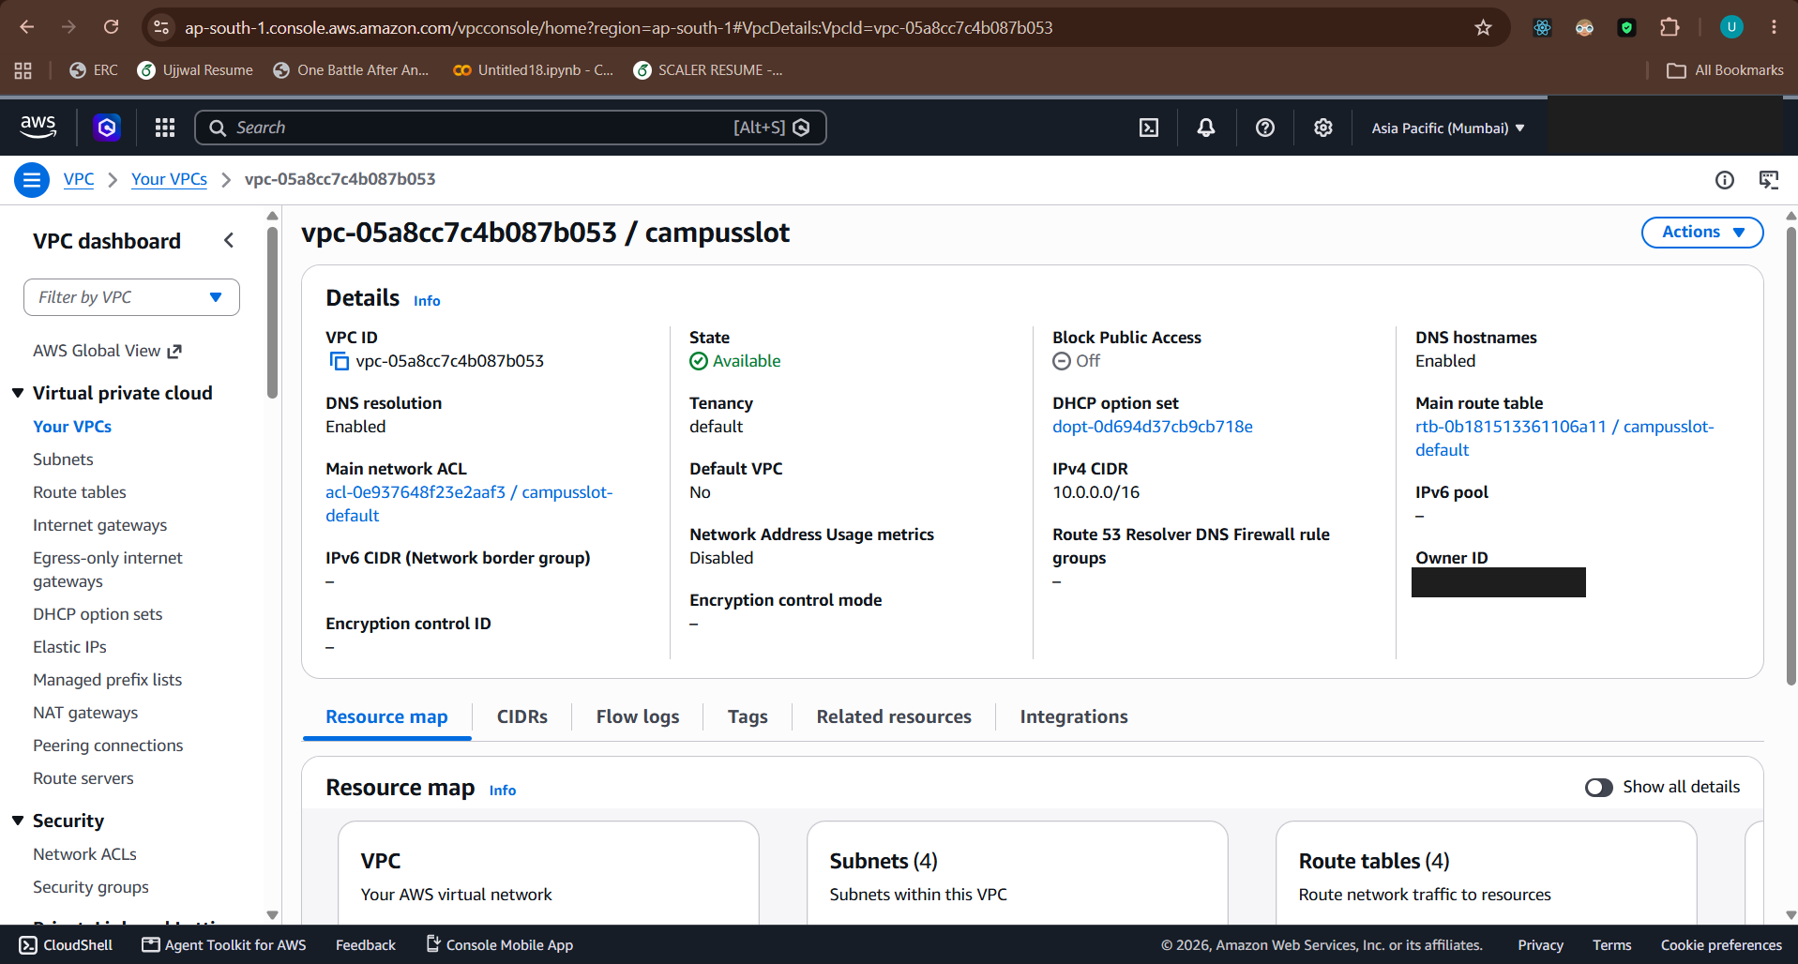
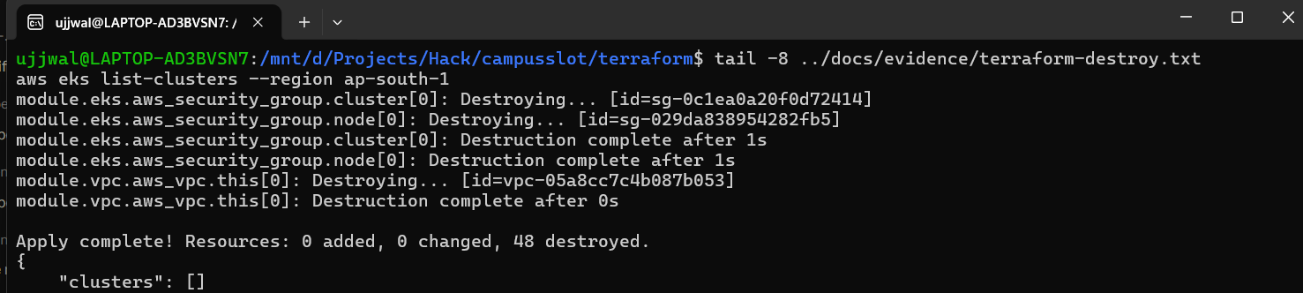
Cloud infrastructure built from code
A real network and Kubernetes cluster on AWS, built and then removed
Built, checked, destroyed
48 resources from code
Ran for about 45 minutes
About 6 US cents
Account checked: nothing left
First apply failed. I fixed the cause and wrote it down.
EKS cluster: Active
Plan: 48 resources to add
Destroyed: 48 resources removed
The network (VPC)
CampusSlot | Ujjwal Jain | 8 / 17
Notes:
Terraform describes the AWS network and a Kubernetes cluster as code. The plan listed 48 resources. I applied it for real, checked that the cluster and the node were healthy, and destroyed everything about 45 minutes later. The first apply failed, because I had not told the subnets to hand out public addresses, and I found that by asking EKS for the health of the node group. The network deliberately has no NAT gateway, to save money, and the README explains what a production design would do instead. A final check found nothing left running, and the measured cost was about six US cents of credit.

Slide 9
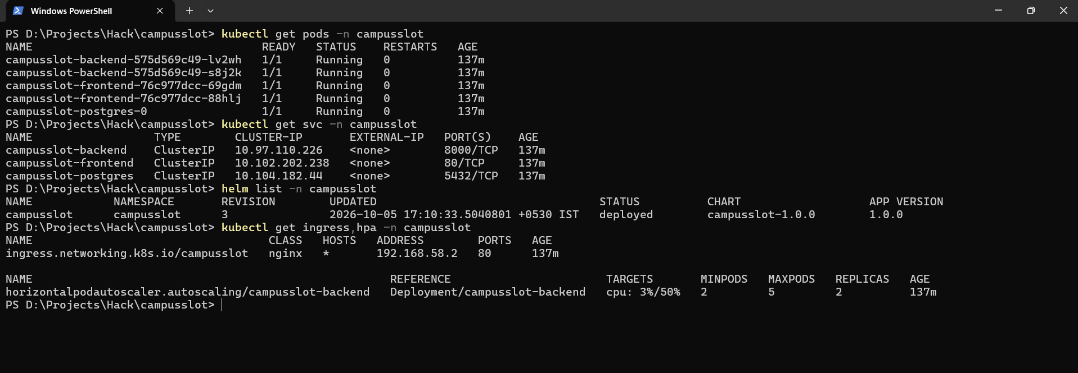
Running on Kubernetes with Helm
Two copies of the website and API, one entrance, and automatic scaling
The application, reached through the ingress
Pods running, services, Helm release, ingress and autoscaler
• Settings in a ConfigMap
• Password in a Secret, never in Git
• One entrance: / and /api
Autoscaling test, first sizing | What happened
Load starts | 2 API copies, CPU 3 percent
Under load | CPU 428 percent, grows to 5 copies
Load stops | Back to 2 copies about four minutes later
CampusSlot | Ujjwal Jain | 9 / 17
Notes:
The application is packaged as a Helm chart and installed into Kubernetes. There are two copies each of the website and the API, so one can fail without anyone noticing. A single entrance, the ingress, sends the root path to the website and the api path to the API. When I generated heavy load, the autoscaler grew the API from 2 to 5 copies, and it shrank back to 2 when the load stopped. The settings live in a ConfigMap and the database password lives in a Secret that is never stored in Git.

Slide 10
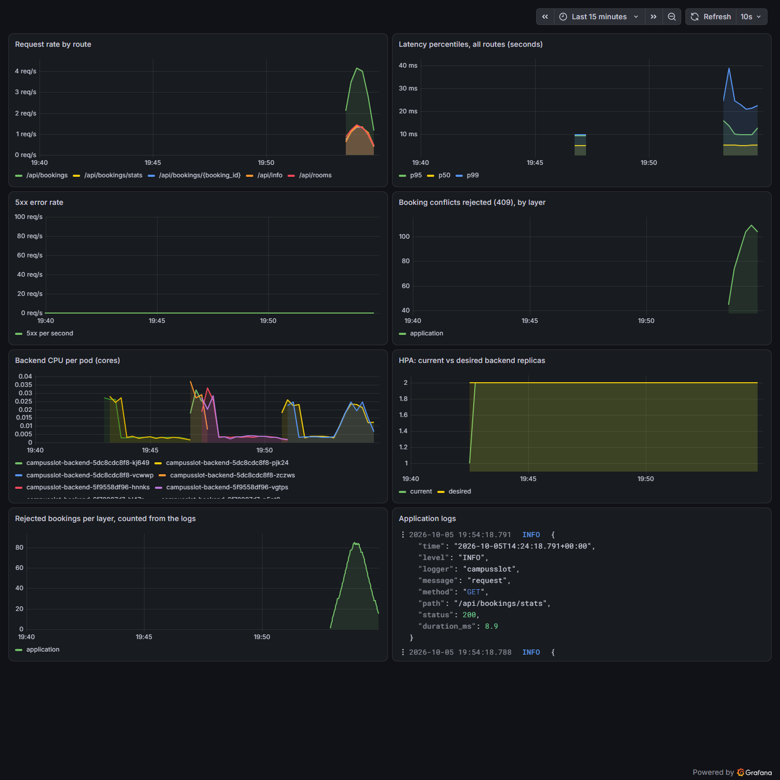
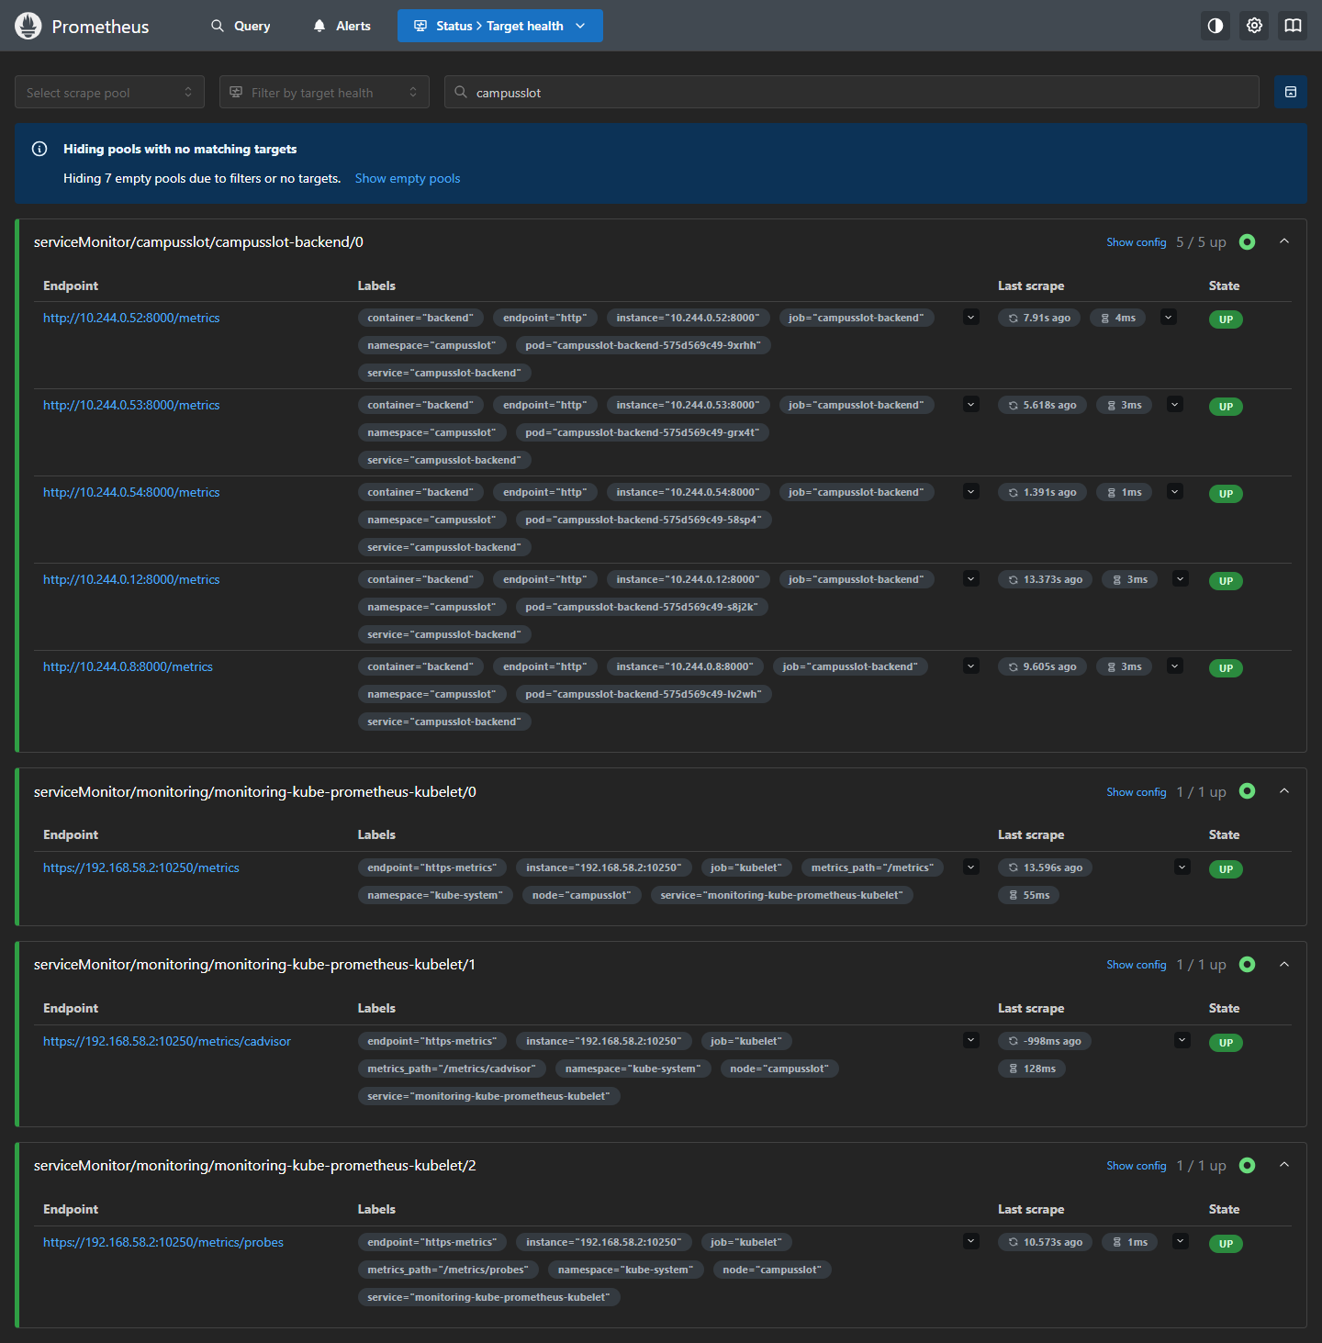
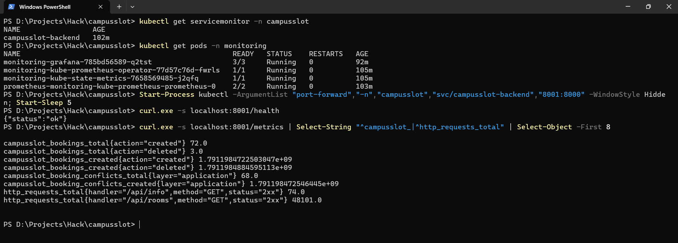
Watching the system run
Metrics and logs together on one dashboard
Prometheus: every API copy is up
The metrics endpoint
• Metrics: Prometheus
• Logs: Loki, collected by Alloy
• Check: 105 conflicts created, 105 counted in the logs
Grafana: requests, speed, errors, conflicts, CPU, scaling and logs
CampusSlot | Ujjwal Jain | 10 / 17
Notes:
Prometheus collects numbers from every API copy, such as requests per second, how long requests take, and how many errors occur. Loki collects the logs, which the application writes as structured lines. The dashboard shows both. For example, the panel at the bottom left counts rejected bookings straight from the logs, and in my test it counted exactly 105, the same number of double bookings that my traffic generator created. The scaling from 2 to 5 copies is also visible on the dashboard.

Slide 11
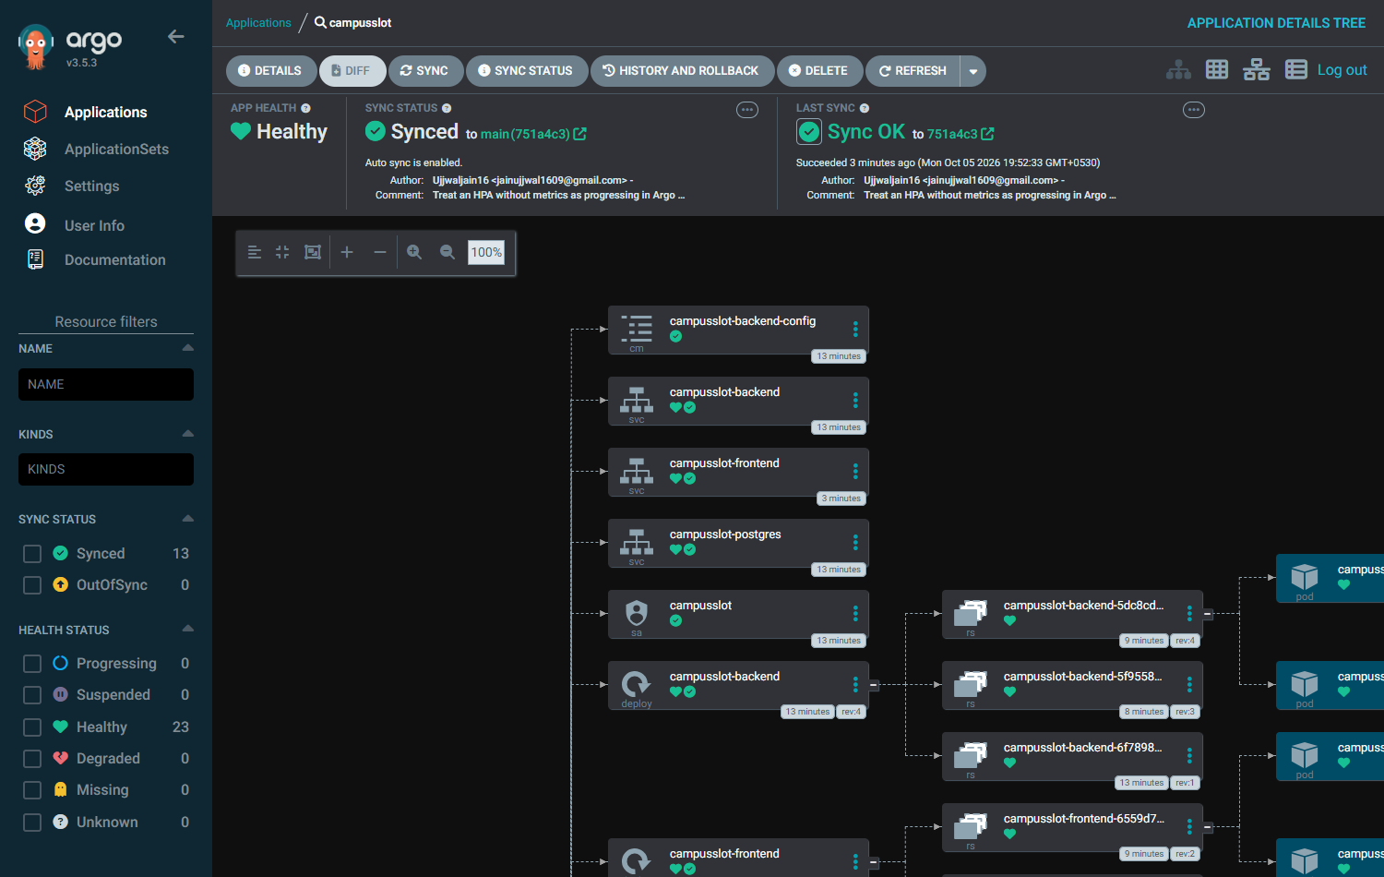
Self-healing deployment, and fixing broken things
Git is the source of truth, and I practised four real failures
What I broke | What I found
Wrong image name | Image cannot be pulled
Typo in a selector | Service has no endpoints
Wrong database address | Pod keeps restarting
Same address, no migration | Pod runs but is not ready
• Each failure: identify, investigate, root cause, fix, verify.
• Real transcripts for all four are in the repository.
Argo CD: Synced and Healthy
• A commit changes the cluster
• Manual changes are undone in seconds
CampusSlot | Ujjwal Jain | 11 / 17
Notes:
GitOps means the cluster follows what is committed in Git. I promoted a new build by changing one line in a file, and Argo CD rolled it out. When I edited a setting by hand and deleted a service, Argo CD restored both within four seconds. The demonstration also found a real problem: after a rollout the autoscaler needed a minute to see the new copies, and Argo CD wrongly called that a failure and retried. I taught it that this state means in progress. On the right are four failures that I caused on purpose, and for each one I identified the symptom, investigated, found the root cause, fixed it and verified the fix. In the last two, the same wrong database address produced two different symptoms, which is the main skill this exercise trains.

Slide 12
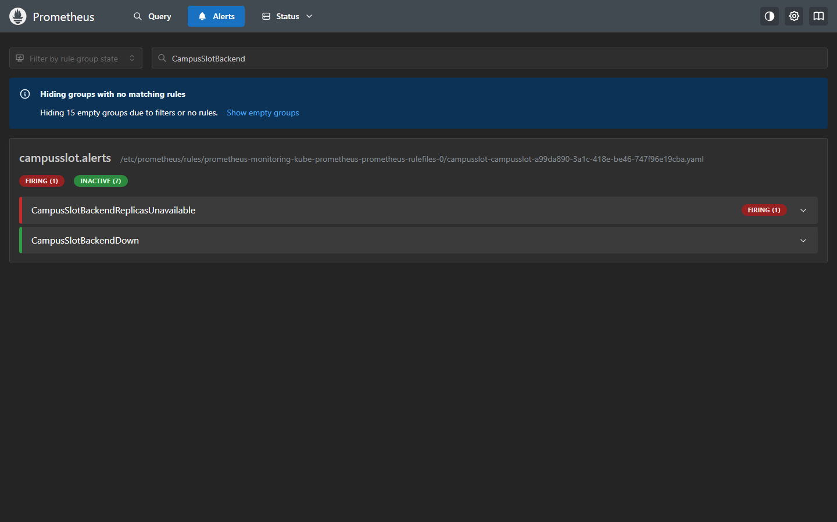
Measure, change one thing, measure again
Every improvement has a number from before and a number from after
What I measured | Before | After
Lost requests in a rollout | 8 of 8 rollouts | 0 of 6
Database errors seen by alerts | 0 of 18 | 16 of 16
Alert on a broken deploy | none | fires in 185 s
Pipeline, median | 238 s | 148 s
Restore after a mass delete | no backup | identical, 4 s
Broken release recovery | by a person | automatic, 72 s
Prometheus: the alert firing during the drill
• The method: baseline, one change, the same measurement again, then write down the trade-off.
• The samples are small and from one laptop. The documents in the repository say so.
CampusSlot | Ujjwal Jain | 12 / 17
Notes:
Meeting a checklist is the minimum. What I wanted to show is the habit behind it: measure, find the weak point, change one thing, measure again, and write down what it cost. The chart allowed no unavailable replicas during a rollout, but when I measured it, every rollout lost one or two requests. An eight second delay before a pod stops fixed that in six out of six repeats. When I killed the database, users got eighteen errors but Prometheus counted none, so my own alerts were blind to a database outage. I made the application answer with a handled error, and now all of them are counted. I also made an alert fire on purpose and resolve, I restored a deleted table from a backup and compared a checksum, and I deployed a deliberately broken release: Helm rolled it back by itself in 72 seconds and none of 4800 user requests failed. The numbers come from small samples on one laptop, and the documents say so.

Slide 13
Decisions, trade-offs and what I left out
Knowing what not to build is part of the job
8 s longer per pod in every rollout
the price of losing no requests
• Not done, on purpose
• Git revert vs Argo CD rollback
• Automated promotion
• Network policies
• Alert delivery (no Alertmanager)
• Write-heavy load test
• Why two workers gave no gain
• Backups outside the cluster
About a minute longer per pipeline run
the price of signed, verified images (143 s vs 202 s and 214 s)
Backup stays in the same cluster
covers mistakes, not the loss of the cluster
One database pod
a 6 s outage remains, now visible to the alerts
14 decision records in docs/adr explain the choices and what I would do in production.
CampusSlot | Ujjwal Jain | 13 / 17
Notes:
Every change costs something, and I wrote the cost down. Waiting eight seconds before a pod stops makes every rollout slower. Signing and verifying the images adds about a minute to every pipeline run, from three runs. The backup stays inside the cluster, so it protects against mistakes but not against losing the cluster. There is one database pod, so an outage of about six seconds remains, and I only made it visible. On the right is what I planned and chose not to do, so nobody has to guess. Fourteen short decision records explain the reasons for the main choices, with what I would do in production.

Slide 14
Does it hold up when it grows?
I loaded 200 thousand bookings, loaded one pod to its limit, and sized the pods from measurements
What I measured | Before | After
Pages read, overlap check, 200k rows | 2469 | 30
Day view, all rooms, 200k rows | 21 req/s | 113 req/s
One backend pod, room list | 153 req/s | 342 req/s
Pods needed for 60 req/s | 5 | 2
Memory reserved for those pods | 640 MiB | 192 MiB
• Tried and rejected
• Two workers: no gain, twice the memory, wrong metrics
• ETag on the room list: no gain
• Both removed from the code
What the numbers taught me
• The CPU limit that I wrote without measuring was the first bottleneck.
• Right-sizing did not shrink everything: the CPU request went up, because the old one was too low.
• Two ideas that I expected to help did nothing, so I removed them from the code.
CampusSlot | Ujjwal Jain | 14 / 17
Notes:
I wanted to know what happens when the data and the traffic grow, so I measured instead of guessing. With 200 thousand bookings, the question 'which bookings overlap this time' read the whole table, about two and a half thousand pages, and the cost grew with the table. Writing the same question as a range, with an index made for ranges, cut it to thirty pages and kept it flat. Through the application, the day view went from 21 to 113 requests per second. Then I loaded one pod until it stopped. It was throttled by the CPU limit I had written without measuring. Doubling the limit made it more than twice as fast. I also tried two ideas that I expected to help, more worker processes and caching, and neither did anything, so I removed them from the code. Finally, I sized the CPU and memory from what the pods really use. My old request was so low that 60 requests per second made the autoscaler run five pods, and with the measured request it runs two, with the same CPU reserved and a third of the memory. The sample sizes are small and the machine is a shared laptop cluster, and the documents say so.

Slide 15
From a change to a running system
I rehearsed the whole loop, and here is what I learned
1. Change
one line on the page
2. Commit and push
to GitHub
3. Pipeline
test, scan, build, push
4. Deploy
that exact commit
5. Verify
page, version, data
Result | Number
Automated tests | 47 + 7 + 12
Serious vulnerabilities | 0
Cloud resources built and removed | 48
Pipeline, full green run | about 3 minutes
What I learned
Test the system as it really runs.
Write the failures down, they teach the most.
A clean scan is not proof of safety.
Cost control is part of the design.
Git as the source of truth makes changes visible and reversible.
In my rehearsal the first run failed in my own test. I fixed the test, then the new version went live and I checked it from the outside.
CampusSlot | Ujjwal Jain | 15 / 17
Notes:
To finish, I rehearsed the demo end to end. I changed one line of text on the page, committed it, and the pipeline built, scanned and published new images. I deployed that exact commit, and then checked from the outside that the running service reported the same commit, that the page showed the new text, and that all the bookings were still there. The first attempt failed in my own smoke test, which called the API a few seconds too early, so I fixed the test and ran it again. What I learned is that a system has to be tested as it really runs, that failures are worth writing down, and that cost control is part of the design.

Slide 16
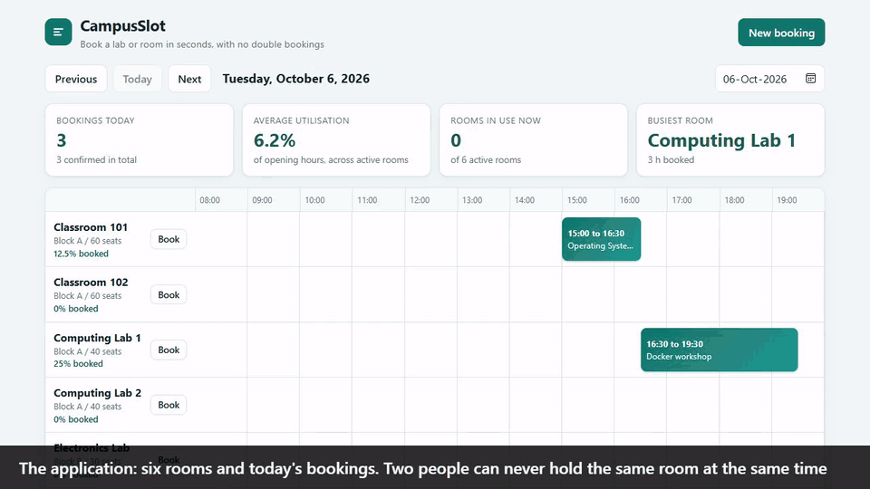

See it run: the recorded demo
A broken release is rolled back by itself, and no user request fails
The full recording: 4 min 22 s, with captions
1. The application, and a double booking that is refused
2. The pipeline and its green runs
3. A broken release, deployed live and rolled back by itself
4. Prometheus sees the unavailable replica
Scan to watch the full recording
github.com/Ujjwaljain16/campusslot, docs/demo/CampusSlot-demo.mp4
A 33 second highlight of the recording. The failure drill is sped up about ten times.
5.7 s
first failed probe
63 s
automatic rollback
0 of 1,600
user requests failed
CampusSlot | Ujjwal Jain | 16 / 17
Notes:
The course asks for a demo, and I recorded one that runs for four minutes and twenty-two seconds, with captions. The animation on this slide is a thirty-three second highlight, with the failure drill sped up about ten times. The recording shows four things in order. The application, and a real double booking that the system refuses with a 409. The pipeline, with its green runs. Then a deliberately broken release, deployed live: the new pod starts, but it listens on the wrong port, so it never becomes ready. Kubernetes reported the first failed probe after five point seven seconds, Helm rolled the release back by itself at sixty-three seconds, and in the drill's own probe none of sixteen hundred user requests failed. Last, Prometheus saw one replica unavailable during the failure. The commit and push step of the loop is not in the recording. It is in the rehearsal on the previous slide. The QR code opens the full recording on GitHub.

Slide 17
Thank you
Everything on these slides is in the repository, with the transcripts behind every number
47 + 7 + 12
automated tests
0
serious vulnerabilities in the images
48
cloud resources built and removed
0 of 1,600
requests failed in the rollback drill
Where to look
Repository: github.com/Ujjwaljain16/campusslot
README: 20 sections, then the engineering results
Recorded demo: docs/demo/CampusSlot-demo.mp4
Evidence: docs/evidence, real screenshots and transcripts
Decisions: docs/adr, 14 decision records
Questions?
Ujjwal Jain | 24bcs10173 | Section B
CampusSlot | Ujjwal Jain | 17 / 17
Notes:
Thank you. To sum up: a booking service that refuses a double booking, a delivery chain that tests, scans, builds and deploys it on every push, cloud infrastructure that I built from code and removed again for about six cents, and a cluster that I can watch and that heals itself. The four numbers on this slide are the ones I would want you to remember. Everything is in the repository: the README, the recorded demo, the screenshots and transcripts, and the decision records that explain what I chose and what I left out. I am happy to take questions, or to break something and fix it live.

