Slide 1

A JavaScript runtime environment running Google Chrome’s V8 engine
Runs over the command line
Node.js is an open source server framework.
Node.js allows you to run JavaScript on the server as well as command prompt.

Slide 2

Node.js can generate dynamic page content
Node.js can create, open, read, write, delete, and close files on the server
Node.js can collect form data
Node.js can add, delete, modify data in your database

Slide 3

Download the Windows installer from the Nodes.js® web site.
Run the installer (the .msi file you downloaded in the previous step.)
Follow the prompts in the installer (Accept the license agreement, click the NEXT button a bunch of times and accept the default installation settings).

Slide 4
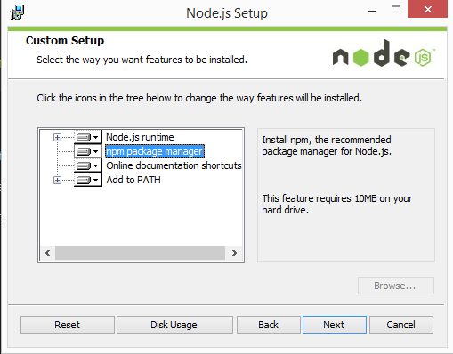
Restart your computer. You won’t be able to run Node.js® until you restart your computer.

Slide 5

Test Node.
  To see if Node is installed, open the Windows Command Prompt and type node -v. This should print a version number, so you’ll see something like this v0.10.35.
•Test NPM.
  To see if NPM is installed, type npm -v in Terminal. This should print NPM’s version number so you’ll see something like this 1.4.28
•Create a test file and run it.
  A simple way to test that node.js works is to create a JavaScript file: name it hello.js, and just add the code console.log('Node is installed!').

Slide 6

Update Node Version
  npm install -g npm-windows-upgrade
Update the Local npm Version
  npm install npm --g

Slide 7

Node.js includes 2 types of modules:
  Core Modules
  Local Modules
Core Module | Description
http | http module includes classes, methods and events to create Node.js http server.
url | url module includes methods for URL resolution and parsing.
path | path module includes methods to deal with file paths.
fs | fs module includes classes, methods, and events to work with file I/O.

Slide 8

1. Cross-Origin Resource Sharing (CORS) is a mechanism that uses additional HTTP headers to let a user agent gain permission to access selected resources from a server on a different origin (domain) than the site currently in use.
2. A user agent makes a cross-origin HTTP request when it requests a resource from a
different domain, protocol, or port than the one from which the current document originated.
Example of a cross-origin request:
  A HTML page served from http://domain-a.com makes an <img> src request for http://domain-b.com/image.jpg.
var cors = require('cors')
var app = express()
app.use(cors())

Slide 9

http://nodejs.org/
http://www.tutorialsteacher.com/nodejs/nodejs-modules

