Slide 1
Classifying severity of drought using meteorological data and machine learning models
Group Members:
Ayush Sharma (2020042)
Mortala Gautam Reddy (2020445)
Ujjwal Rastogi (20202546)
Yash Agrawal (2020551)

Slide 2

Motivation
Since global temperatures are rising, it makes sense to anticipate an increase in the likelihood of drought in many places. Therefore, we questioned whether we could accurately forecast such a crisis in the future and take the necessary precautions to prevent or deal with the calamity.

Slide 3
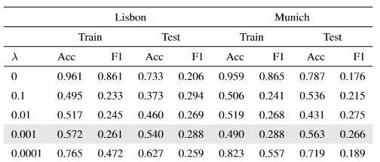
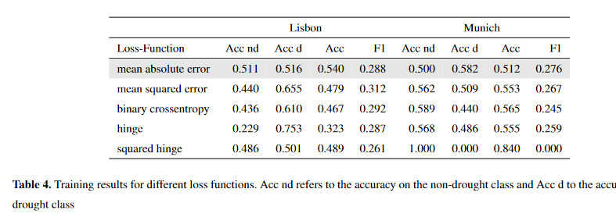
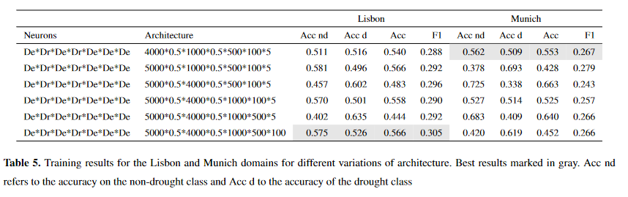
Literature Review
Applying machine learning for drought prediction using data from a large ensemble of climate simulations
This paper uses meteorological data to predict droughts with a lead time of 1 month using ANN’s. They use the meteorological data from the ClimEx Project (Leduc et al,2019) which consists of data for North America and Europe. They are solving a binary classification problem using Standardized Precipitation Index (SPI) as their output class. The paper goes into greater detail regarding where the data came from with specific sources for some of the features that they have used. They explain the reasoning behind how an ANN works and the metrics that they have used to evaluate their models. They ran their model in two different climate regions of Lisbon and Munich The authors have used L2 regularization in their ANN and investigated the effect of different loss functions and architectures, the results of which have been summarized below

Slide 4
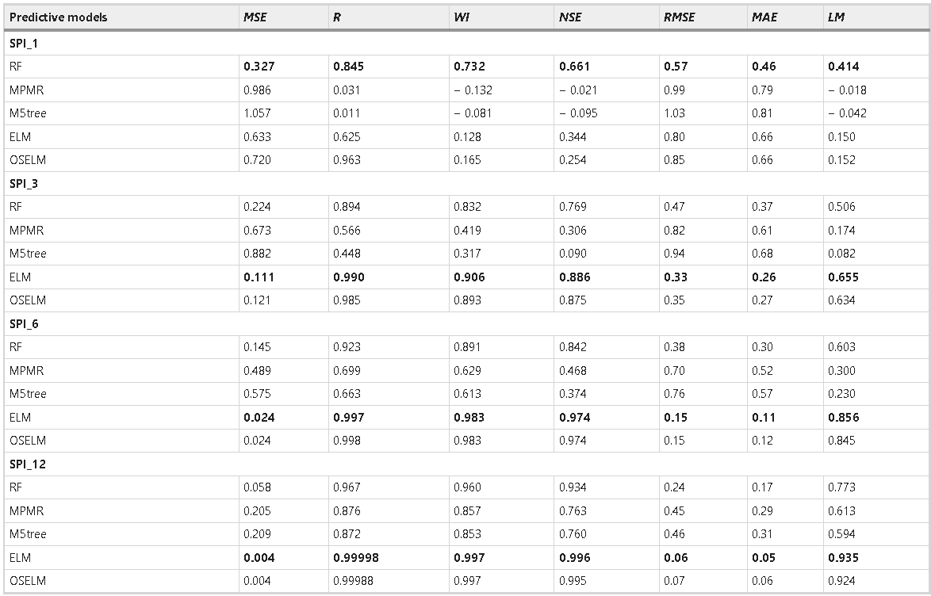
Forecasting standardized precipitation index using data intelligence models: regional investigation of Bangladesh
While the previous paper focused on ANN as the classification model, this paper instead focuses on models such as Random Forests, minimum probability machine regression (MPMR), M5 Tree (M5tree), extreme learning machine (ELM) and online sequential-ELM (OSELM). They too use the SPI as the drought indicator like the previous paper. The paper goes into detail of how all these models work as well as the metrics that they have used to evaluate these models. the metrics they have used are for every base station as the metric and according to them. The SPI was calculated for 1,3,6 and 12 months and the results were reported for each case. According to the authors RF was the best for SP1, and ELM was the best for SP3, SP6 and SP12.

Slide 5
Dataset Description
The dataset comprises of 18 weather indicators along with 29 soil indicators.
Train-Test-Validation splitting is in 80:10:10 ratio
Train | 2000-2016 | 80% | 19.3 Million
Validation | 2017-2018 | 10% | 2.27 Million
Test | 2019-2020 | 10% | 2.27 Million

Slide 6
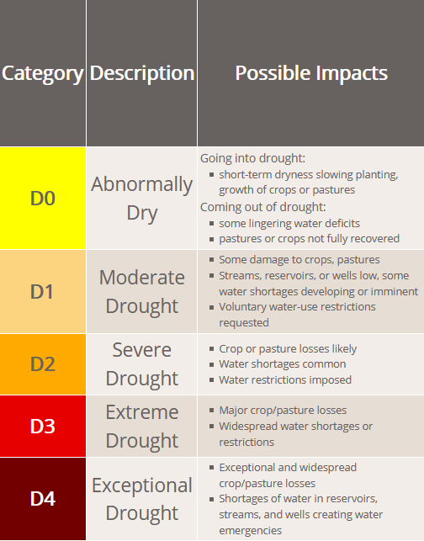
This dataset classifies six stages of drought, ranging from 0 (no drought) to 5. (exceptional drought).
The target variable is score, for which only weekly data is available.
(image source)

Slide 7
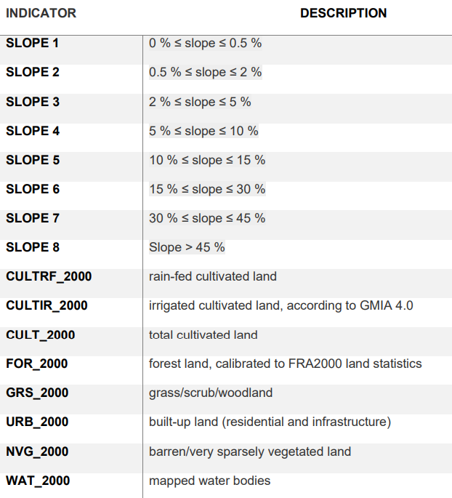
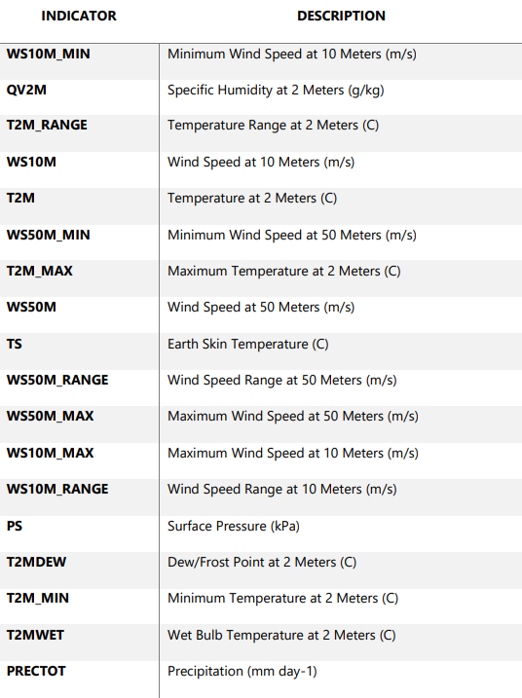
Soil Indicators
Meteorological Indicators

Slide 8
EDA
The T2M_Range, WS10M_Range and WS50M_Range attributes are all just the difference of the corresponding MAX and MIN values
The 8 slope attributes all add up to 1
The 4 Aspect Classes along with AspectUnknown add up to 1. Since, aspect here refers to the orientation of the land, so these 5 columns together tell the distribution of the orientation of the land in the 5x5 tiles used to measure them
The 8 land class attributes also show the same trend where CULT_LAND is the sum of CULTRF_LAND and CULTIR_LAND and the sum of the other 5 classes along with CULT_LAND is 100 which tells us the distribution of these land classes in the tile used for measurement

Slide 9
EDA
From the correlation map of 53 features, few regions had very high correlations.
These regions were found in the Temperature, WindSpeed, Slope, Aspect, Land Classes and Soil Quality attributes
These regions showed little to no correlation with other regions but were highly correlated amongst themselves

Slide 10
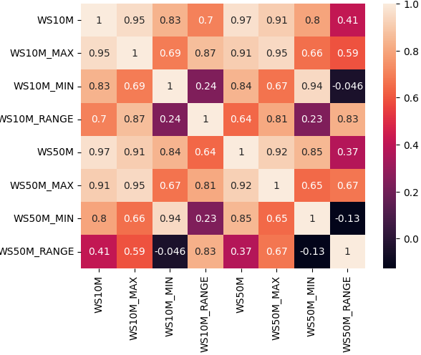
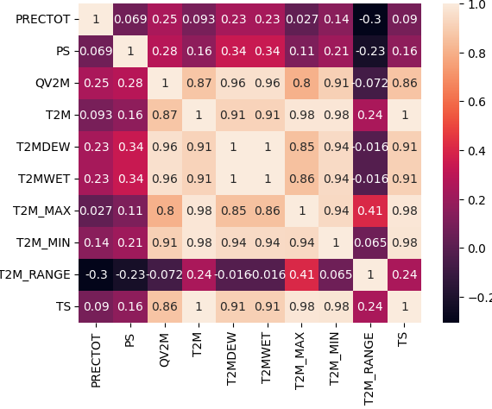
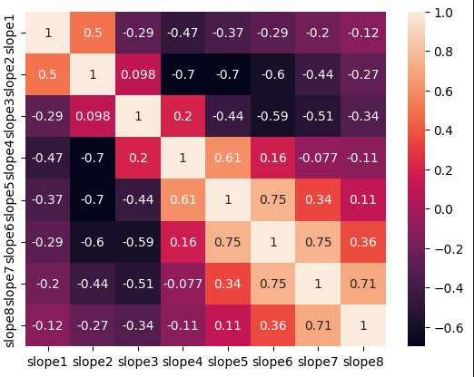
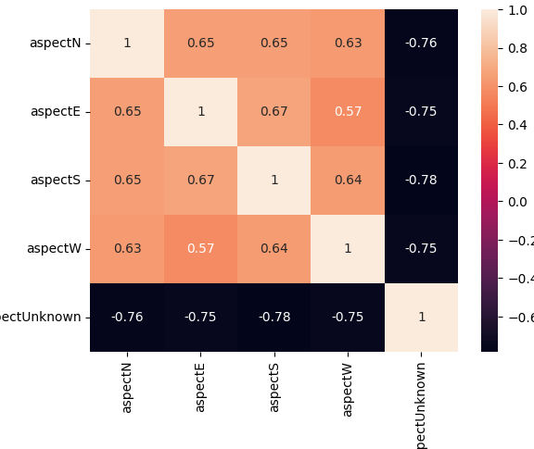
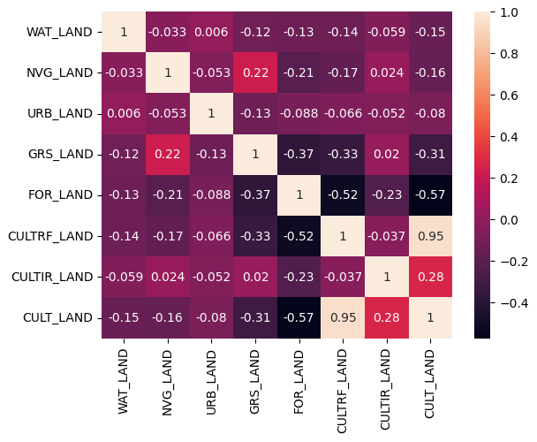
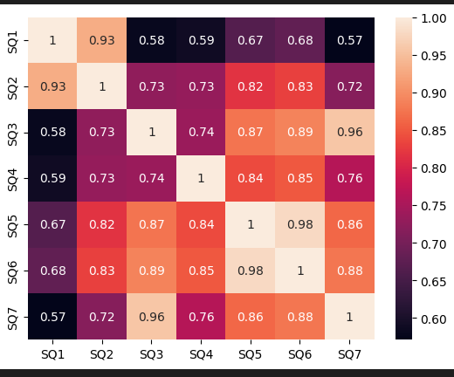
Heatmaps

Slide 11
Observations
QV2M or specific humidity is highly correlated with most of the other temperature attributes and the other temperature attributes have similar level of correlations
Wind speed attributes are all also correlated with each other to a large extent and interestingly all of them have positive correlations
Most of the slope attributes except for a few pairs have high correlations.
All of the aspect attributes are correlated with each other
For the Land classes, the attribute that stand out the most is Forest as it has strong negative correlations with most of the other classes

Slide 12
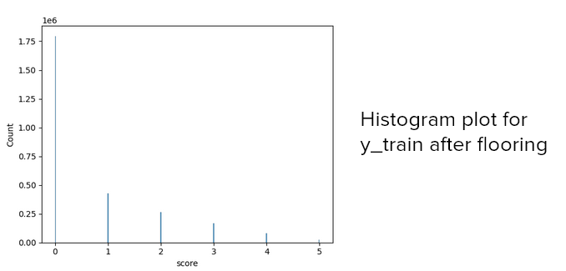
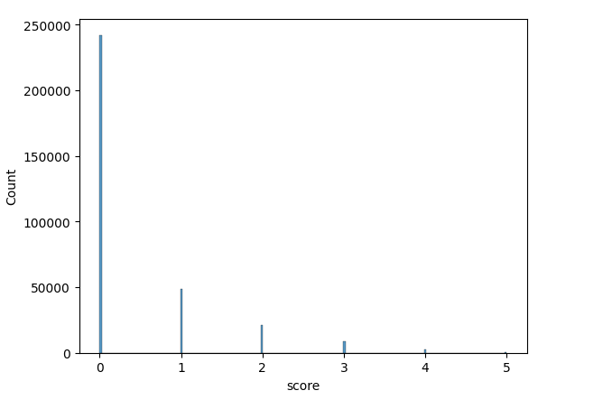
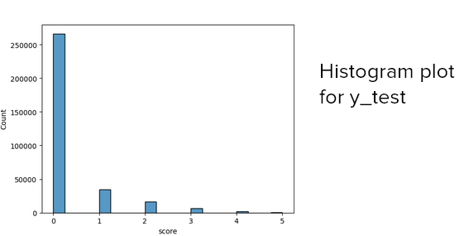
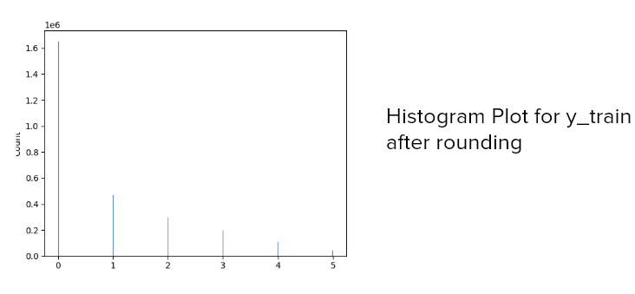
Data Visualization
Histogram plot for y_validation

Slide 13
Data Preprocessing
Since the meteorological data and soil data were both in different tables we first needed to merge them.
Merged the soil and meteorological data on the basis of FIPS id assigned to them using a python script.
Left joined soil data on meteorological table on the basis of FIPS id
This increased the size of dataset to 3x times it’s initial size.
All the null entries were discarded.
Reduced the dataset on date to gauge how older data would affect predictions
Applied PCA to further reduce the size of the dataset

Slide 14
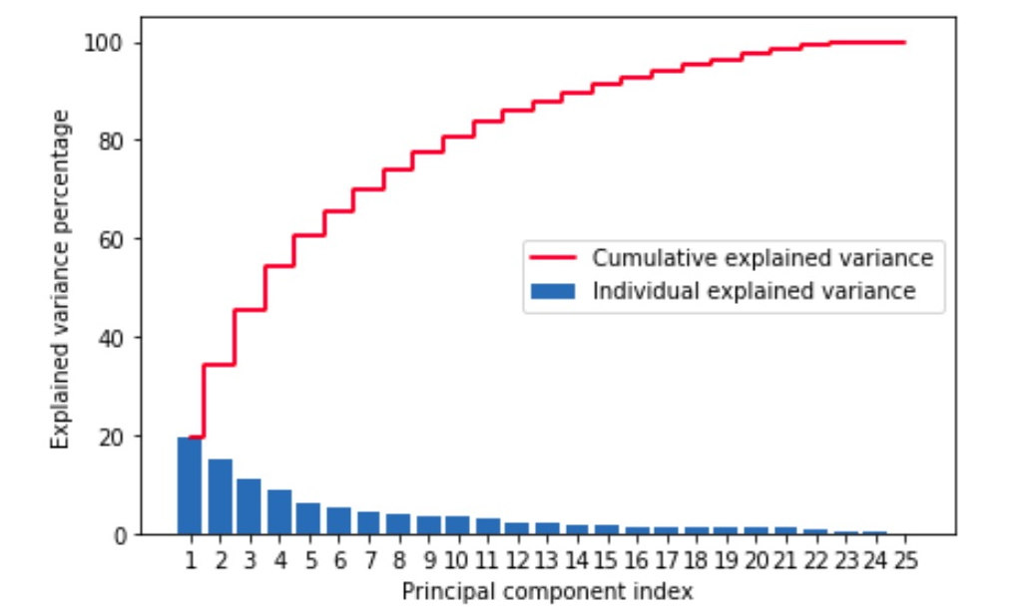
Data Preprocessing
Before Applying PCA , we checked the explained variance vs components graph to find the most optimal value of num_components.
Looking at this graph we can see that 80% of the variance has been captured by 8 components and therefore we reduced our dataset to 8 dimensions to ensure that information is preserved while at the same time reducing the size of the dataset

Slide 15
Loading the dataset and Training the model took hours!!
Hyperparameter tuning was not flexible
We shifted to Nvidia RAPIDS
Which provides GPU based algorithms of those found in sklearn
This helped us train more models and experiment more with the hyper parameters that would otherwise have not been possible.

Slide 16
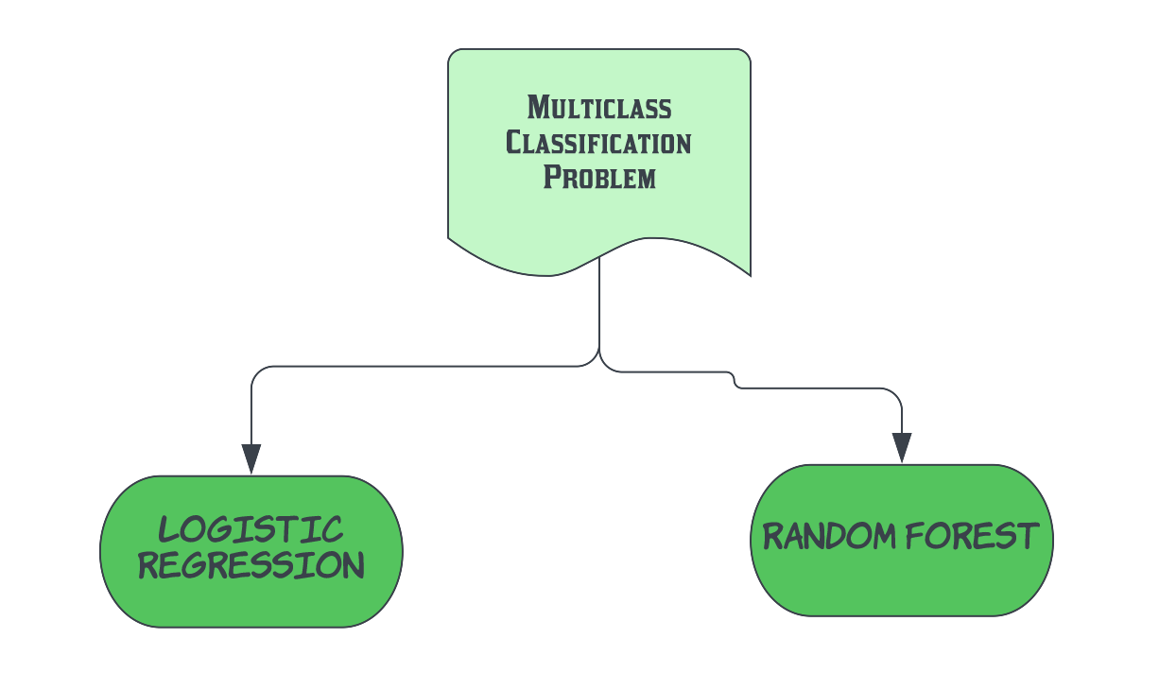
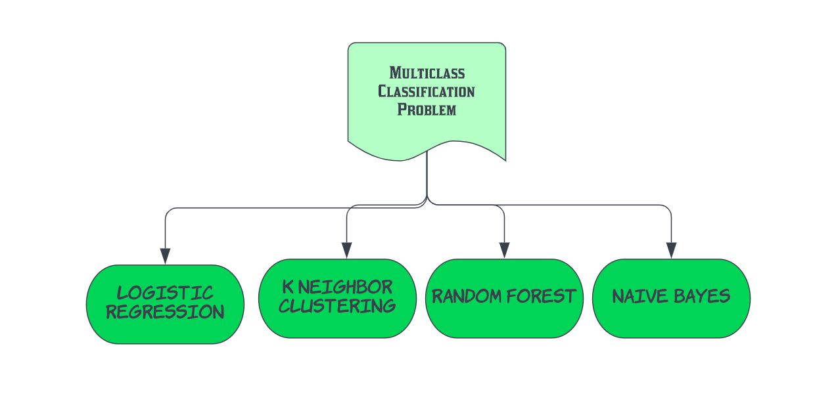
Methodology
Chosen Classifiers!!
Notes:
Multiple classification problem, the two chosen classifiers

Slide 17
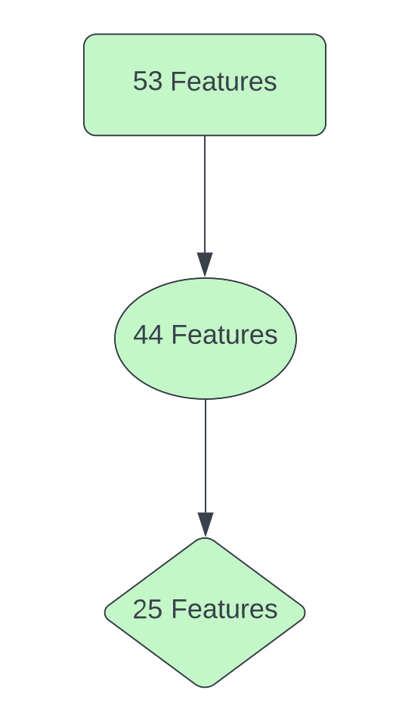
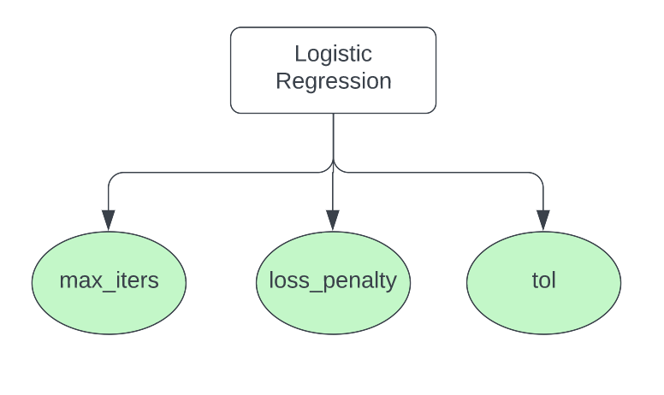
Methodology
Feature Selection
Logistic OVR Classification
Not Enough??
how long each classifier is trained
meaningful and non redundant features
Need to get some domain knowledge
Notes:
All features were assumed to be important
Removed features like date, FIPS, ID
With help of domain knowledge and correlation heatmap, selected 25 features

Slide 18
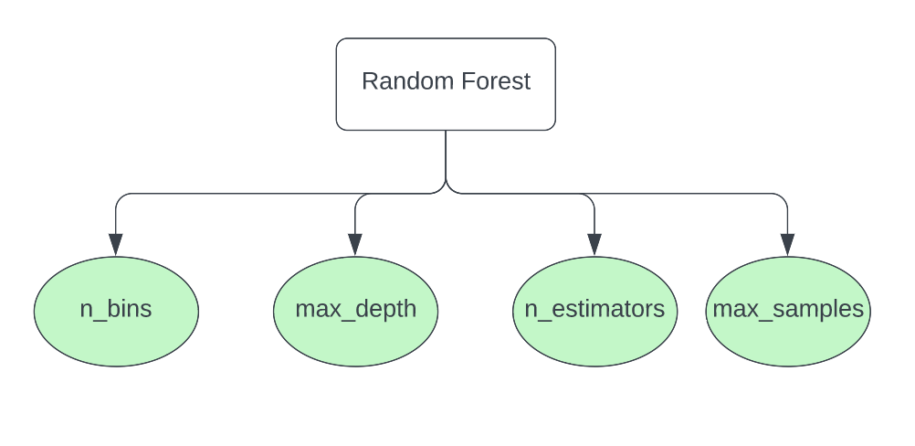
Methodology
Random Forest Classification
Need me the most?
control the growth of the tree
Notes:
According to the documentation, changing n_bins for large and skewed data

Slide 19
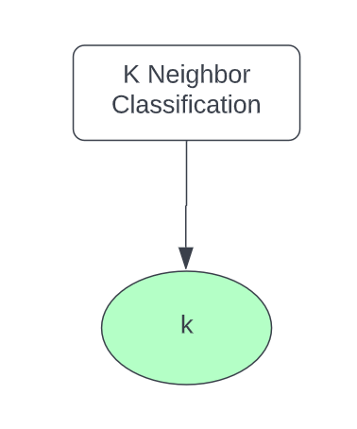
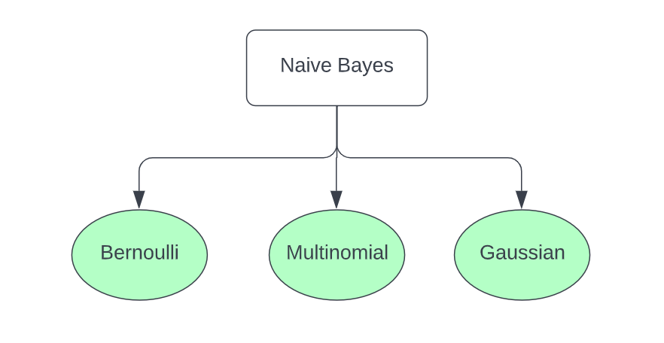
Methodology
K Neighbor Classifier
Gaussian Naive Bayes
Want to convert data in 0s and 1s ?
The Perfect Choice!!
Ooops!
I can not work on negative data
Number of clusters
Notes:
According to the documentation, changing n_bins for large and skewed data

Slide 20
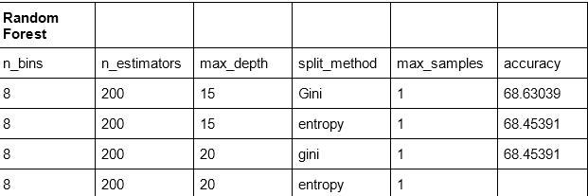
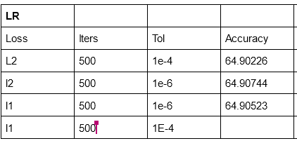
Results
Previously when we ran these 2 models, the accuracies weren’t that good on the training set but were somehow quite good on the testing dataset which is anomalous in nature and thus we hypothesized that perhaps weather and soil data from vastly different years may not be as useful in predicting drought for more recent years
We therefore reduced our dataset to years that were much more closer to each other and to the test data set to test this

Slide 21
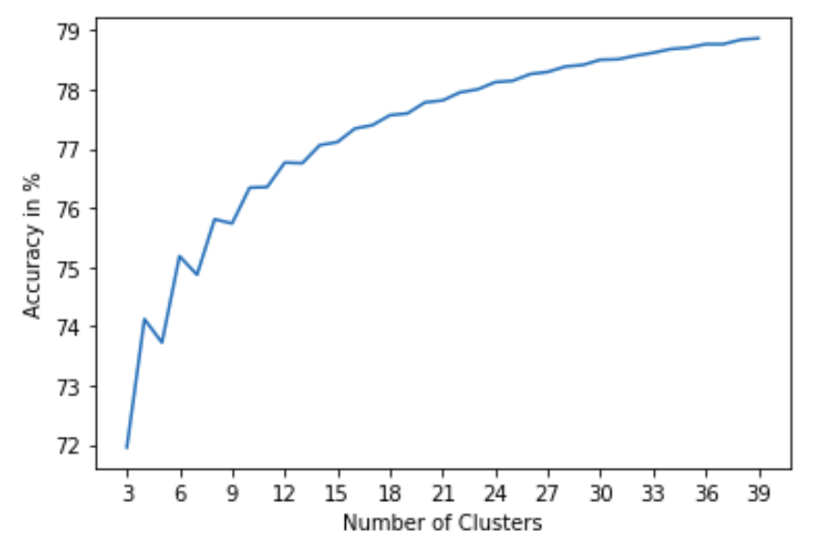
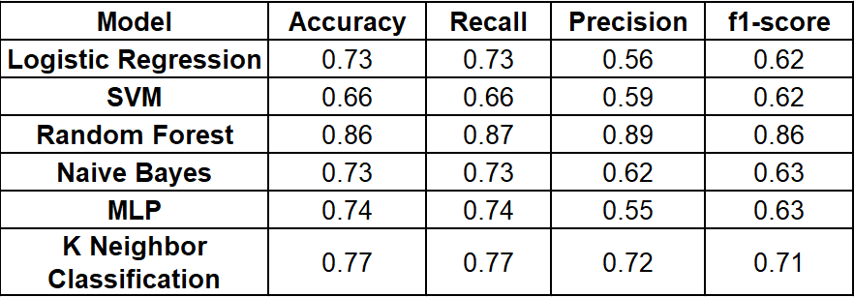
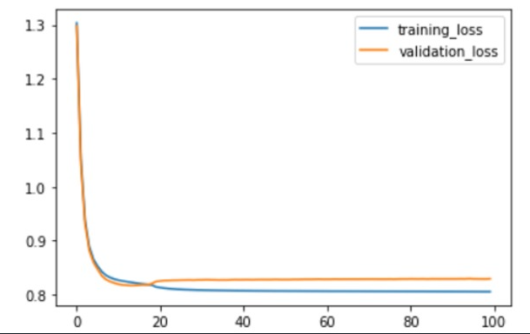
Results
Summary of metrics of all the models on train set
As we can see the accuracies on the training set went up for Logistic Regression and RandomForest , the same trend had been observed for the other classifier models

Slide 22
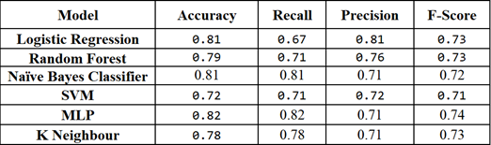
Results
Based on these results we came to the conclusion that our hypothesis was correct as we saw a noticeable increase in accuracies across all the models after reducing the dataset according to the date
The scores on the test_set are as follows

Slide 23
Timeline
(Proposed)
Data pre-processing [1 week]
Exploratory Data Analysis (performing experiments and applying baseline models) [2 weeks]
Apply different prediction models such as logistic regression, Random Forests, etc [5 weeks]
Report and presentation [2 weeks]
(Actually Followed)
Data pre-processing [1 week]
Exploratory Data Analysis (performing experiments and applying baseline models) [1.5 week]
Apply different prediction models such as logistic regression, Random Forests, SVM, K Nearest Neighbours, ANN (MLP), Naive Bayes [7 weeks]
Report and presentation [0.5 week]

Slide 24
Individual Tasks
• Gautam: Domain Knowledge, Random Forest, Naive Bayes, SVM, Report and PPT making, EDA, Result Analysis
• Yash: Domain Knowledge, Logistic Regression, Naive Bayes, SVM, Report and PPT making,
• Ayush: Data Preprocessing, Random Forest, K nearest neighbours, ANN (MLP), Report and PPT making, Data Visualisation
• Ujjwal: Data Preprocessing, Logistic Regression, K nearest neighbours, ANN (MLP), Report and PPT making, EDA
All of us has equally contributed in the entire project done until now. Almost all of the work was done in meetings together.

Slide 25
References
Trnka, M, Hlavinka, P, Možný, M, et al. Czech Drought Monitor System for monitoring and forecasting agricultural drought and drought impacts. Int J Climatol. 2020; 40: 5941– 5958. https://doi.org/10.1002/joc.6557
Belayneh, Anteneh & Adamowski, Jan. (2013). Drought forecasting using new machine learning methods. Journal of Water and Land Development. 18. 3-12. 10.2478/jwld-2013.
Aishwarya M Iyengar ,Deepika K ,Kanthi Utkarsha Bharat ,Mitaigar Divya ,Vaidehi M , (2019 ) " Drought Prediction using Machine Learning Algorithm " , International Journal of Advances in Computer Science and Cloud Computing (IJACSCC) , pp. 1-6, Volume-7,Issue-1
https://www.kaggle.com/datasets/cdminix/us-drought-meteorological-data
https://www.fao.org/soils-portal/data-hub/soil-maps-and-databases/harmonized-world-soil-database-v12/en/
https://github.com/brian546/predict_drought

Slide 26
Thank you!!

