Slide 1







Coursera Capstone project
Obianauju Udeh
Aug 24rd 2024

Slide 2

EXECUTIVE SUMMARY
Recently, survey was carried out in selected region to determine the trend of the IT industry particularly;
Programing languages
Database management, and
Interest in them
The impact of these trends in the industry
Low interest in the Database management due to other professions within the industry, becoming more attractive was discovered to be the cause of the decline.
The job needs to be made attractive to jobseekers once more

Slide 3



OUTLINE
Executive Summary
Introduction
Methodology
Results
Visualization – Charts
Dashboard
Discussion
Findings & Implications
Conclusion
Appendix

Slide 4



Table of contents
Inroduction
Methodology
Results
Programing language trends
Programing language trends – Findings & implications
Data Base
Data Base trends – Findings & implications
Dashboards
Current Technology trends
Future Technology trends
Demography
Discussion
Overall Findings & Implications
Conclusion
Appendix
Job postings
Popular languages

Slide 5

INTRODUCTION
We live now in a data driven world little wonder IT has taken center stage of professions globally
Our constant use of data birthed the need for skills to enable management of these data.
Every data generated must be stored somewhere like a library for easy retrieval and in the world of data, it is called a data lake.
A data lake or data base needs an administrator to make this easy retrieval process possible and the essential language skill needed for this is SQL
By the end of this presentation, you will understand in detail the trend of level of interest in;
Database trends and
Language trends
And why
This survey is intended for student who have the intention to join the IT industry

Slide 6

METHODOLOGY
Data Collection: The data used for this analysis was sourced from trusted sites on the internet and they include in no particular order; Surveys by technologies and demography, customer demography and sales, customer relationship management
Data wrangling: only relevant data was used for the project as due diligence was applied to cleaning and preparation of the data
Tools used include:
python
APIs
IBM cognos analytics

Slide 7
RESULTS

Slide 8
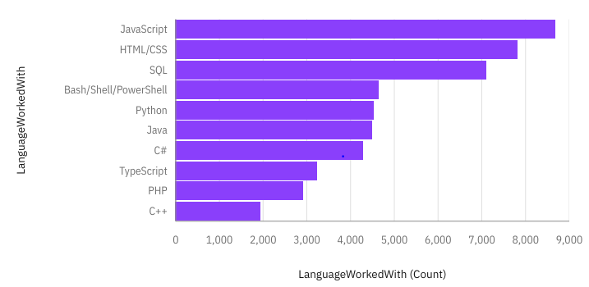
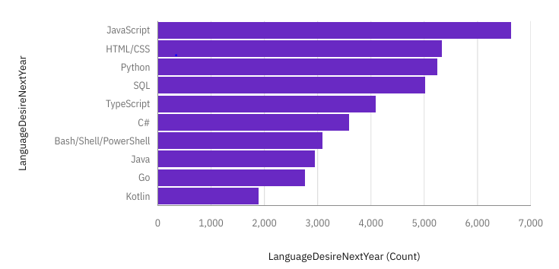
PROGRAMMING LANGUAGE TRENDS
Current Year
Next Year

Slide 9
PROGRAMMING LANGUAGE TRENDS - FINDINGS & IMPLICATIONS
Findings
Java script remains top trending language
Though the abovementioned language maintain top spot, there is a general decrease of total count in the languages in the future
Type script replaces Bash/shell/ power shell in the top 5 spot
Kotlin and GO joins the top 10 list to replace PHP and C++
Implications
The general drop of counts in the top three courses indicates gradual loss of popularity
Java maintains popularity among desired languages
There seems to be interest in learning multiple languages
For the management of already but still growing data, this improvement will enhance speed and efficiency in the job role

Slide 10
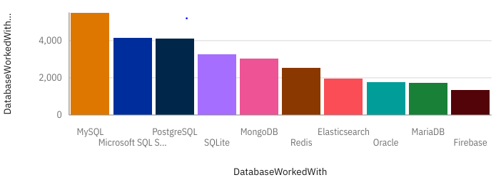
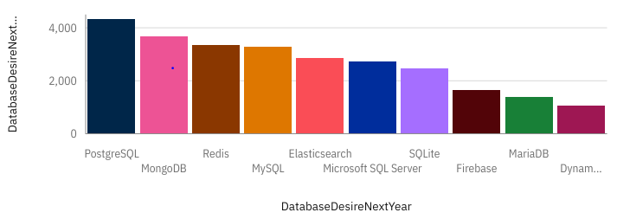
DATABASE TRENDS
Current Year
Next Year

Slide 11
DATABASE TRENDS - FINDINGS & IMPLICATIONS
Findings
Though MySQL, PostgreSQL and MongoDB seems to suffer decline in preference,
they still maintain a staggering lead in preferrerence
Firebase replaces Oracle on top 10 trends
ProgreSQL is set to take over topspot from SQL next year
Implications
ProsgraSQL and MongoDB indicates interest in Speed and open sourse database managent to the traditional ones
The decline in overall future database desire indicates a decline of interest in the qualification
Continuous decline of interest in this profession can result in absolute shortage of Labor in that field
The job needs to be made more attractive to the labor force.

Slide 12

DASHBOARD
Technology Trends by Time and Demography
https://github.com/Uju047/MProject/blob/main/Module%205%20Dashboard%203.pdf

Slide 13
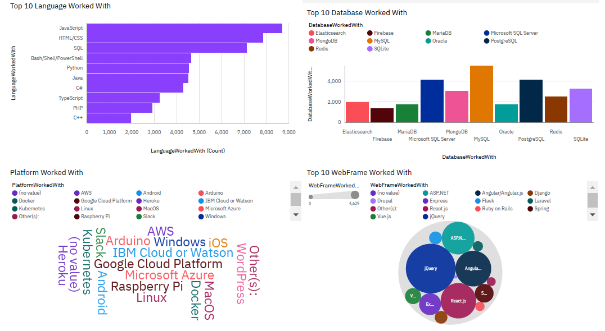
Current Technology trend

Slide 14
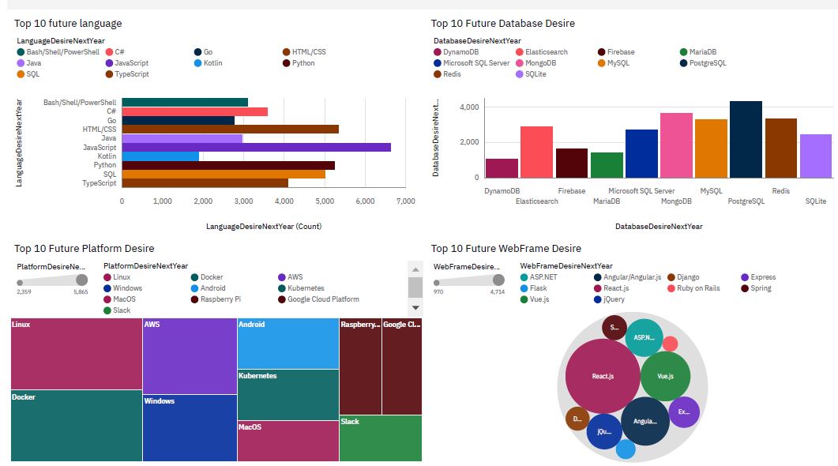
Future Technology Trend

Slide 15
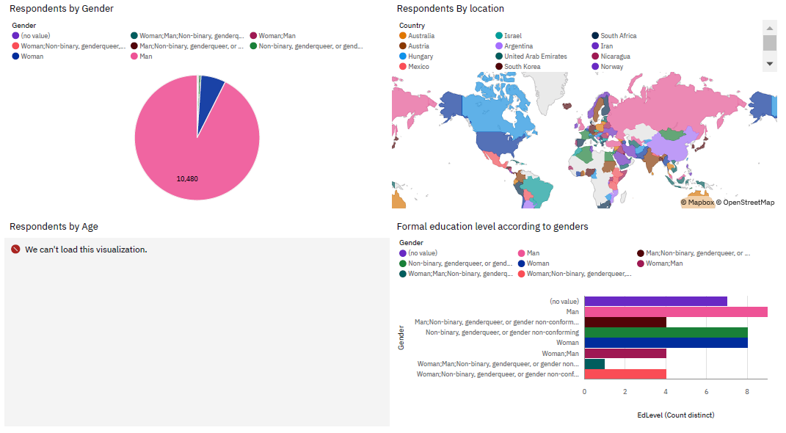
Demography

Slide 16
DISCUSSION

Slide 17
OVERALL FINDINGS & IMPLICATIONS
Findings
Java script currently dominates the language skill supply though the drop in future indicates interest in other languages
The impending take over from MySQL by ProsgreSQL indicates high need for competent efficiency in data management
The demography indicates that there are more skilled men for the job than women.
Their seem to be a big shift towards software development
Implications
The steep competition in DataBase management solutions shows the preference for efficiency in the need to better contend and manage the volume of data constantly generated.
The future emergence of GO and Kotlin indicates the need for continuous education as the industry is fast evolving and today’s knowledge will soon turn obsolete.
The consistent preference for Java script and HTML CSS over SQL though other SQL related languages are set to emerge indicates slow lack of interest in data base management.

Slide 18

CONCLUSION
The IT world is by all means highly competitive.
Though skills are gathered for better performance in database management, there is consistent lack of interest in it
There is more interest in other roles like software engineering probably because it’s more lucrative
It can only get better as there are still opportunities to maximize in the industry.
There is need to be in constant tune with trends something new comes up every day.

Slide 19

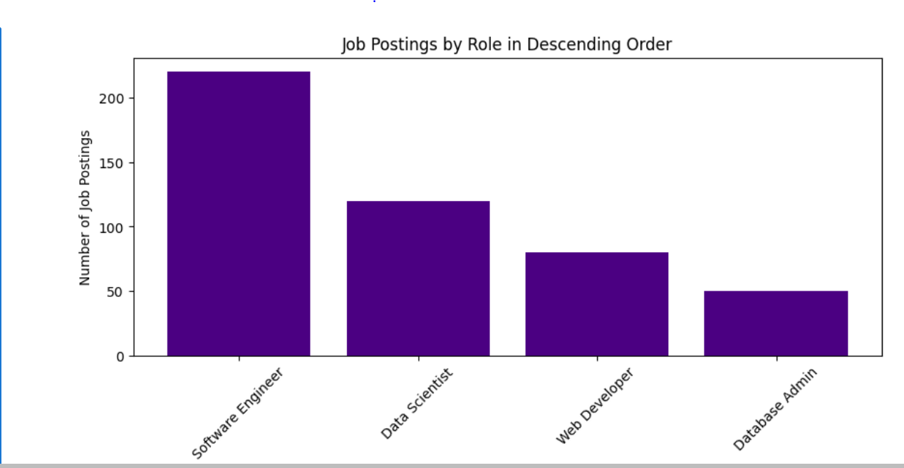
APPENDIX

Slide 20
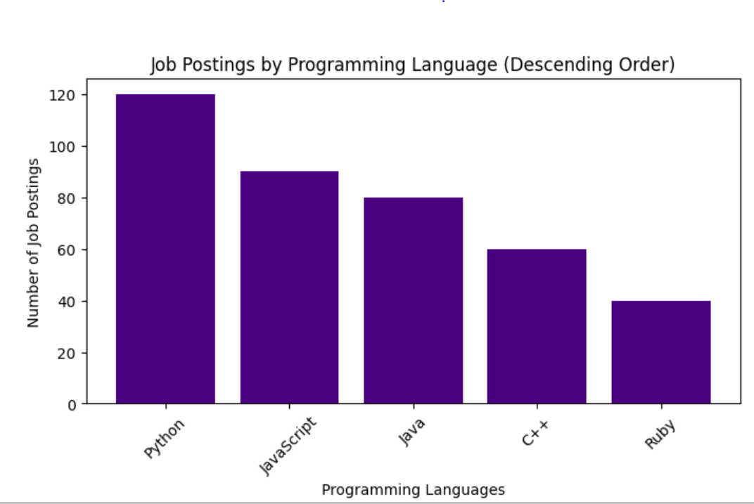
POPULAR LANGUAGES

Slide 21
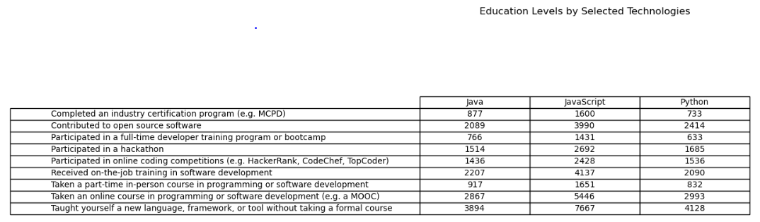
Education levels

Slide 22
Thank you

