Slide 1
Using APIs in R
Test Example: WikipediR, an R wrapper for the MediaWiki API (eg: Wikipedia)
Brian Waite
04 November 2018
MSDS 6306, Unit 4.3

Slide 2
Where to find:
WikipediR available at:
https://cran.r-project.org/package=WikipediR
Reference manual for usage:
https://cran.r-project.org/web/packages/WikipediR/WikipediR.pdf
What is there?
A variety of commands for retrieving pages in Wikipedia by category, by title, and metadata about users, their contributions, and latest updates to the site.
Note: This API has limited functionality. For example, it does not return the last updates to a specific page, but rather the last 50 updates made to all of Wikipedia

Slide 3
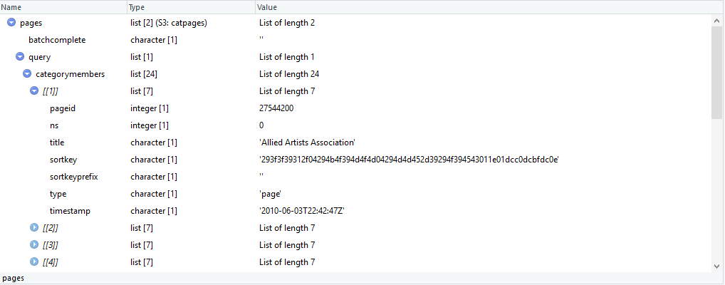
Test: Exploring Post-Impressionism
Running a query to return pages matching a Wikipedia category returns an object of class “catpages.” This is a unique object associated with the API Wrapper classes.
pages = pages_in_category("en","wikipedia",categories="Post-Impressionism")
Note that this is a bit messy and hard to interpret. You have to dig down multiple layers to see each attribute.

Slide 4
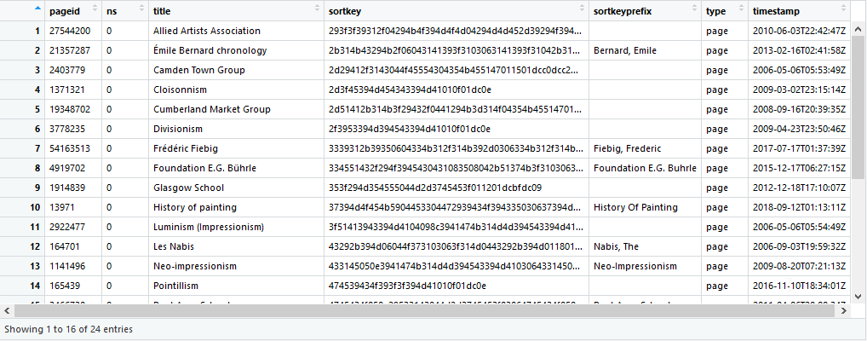
A better way!
Fortunately, the API offers an additional option flag for the same function. By adding the clean_response = TRUE flag, we can improve the ease of using the responsive data. The resultant object is of type data.frame.
pages = pages_in_category("en","wikipedia",categories="Post-Impressionism“, clean_response = TRUE)
Now the contents of the returned data.frame are much easier to read. More importantly, we can use all of our R toolkit natively on this data.frame object.

Slide 5
Some additional code to prove the point:
Create a Boolean mask to identify location of target value:
mask = pages$title == “Pointillism”
Apply the Boolean mask to obtain only the record of interest:
pageOfInterest = pages[mask,]
Get the content of the target page:
content = page_content(“en”, “Wikipedia”, page_name = pageOfInterest$title
Exemplar code available at: https://github.com/Ujustwaite/API_Assignment

