Slide 1
DDS Analytics:
Factors leading to attrition analysis

Slide 2

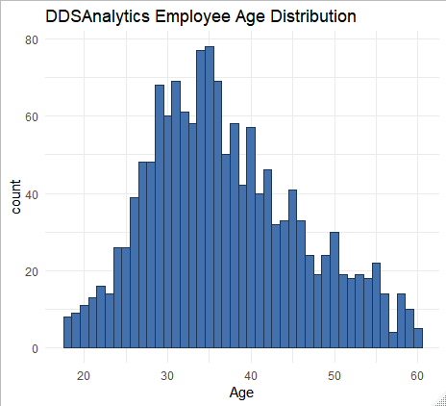
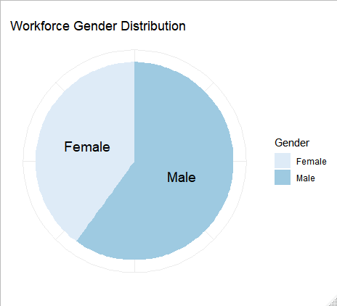
Overall Workforce Summary:
Total number of employees: 1470
Number of departments: 3
Number of work roles: 9
No “retirement wave”
Some gender disparity

Slide 3
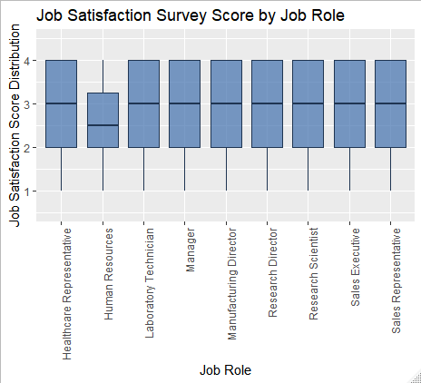
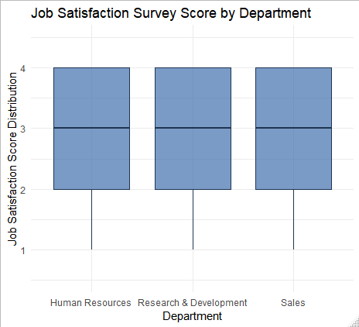
Job Satisfaction Survey:
No major deviations across departments. Let’s take a closer look.
Human Resources responses are 6.3% lower than others

Slide 4
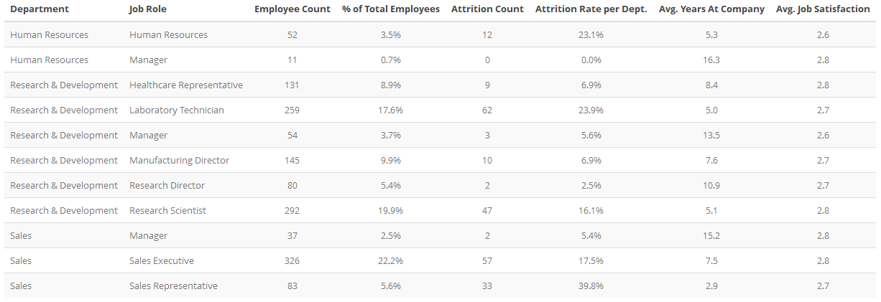
Job Role Statistics
Red highlight indicates job roles where attrition exceeds 20%

Slide 5
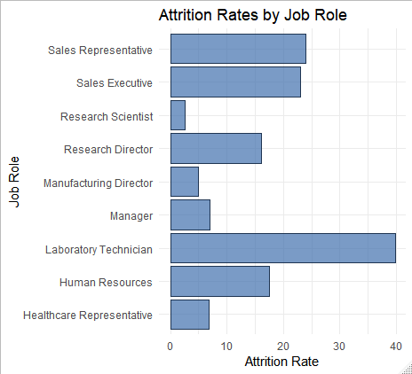
Attrition Rates by Job Role

