Slide 1
DDS Analytics:
Factors leading to attrition analysis

Slide 2
The Team: Introductions
Aditya Garapati
Brian Waite
Carl Walenciak

Slide 3
Specific Client Requests
Identify any job role trends that exist in the data set.
Identify factors that contribute to attrition

Slide 4
Workforce and job role analysis

Slide 5
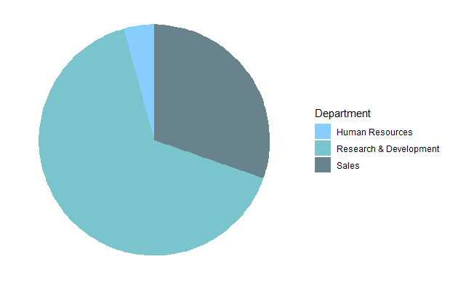
Overall Workforce Summary:
Total number of employees: 1,470
Attrition Count - 237
Number of departments: 3
Human Resources (HR) - 4.3%
Research & Development (R&D) – 65.4%
Sales – 30.3%
Number of work roles: 9
Median age: 36 years
Mean years at company: 7
Median monthly income: $4,900

Slide 6
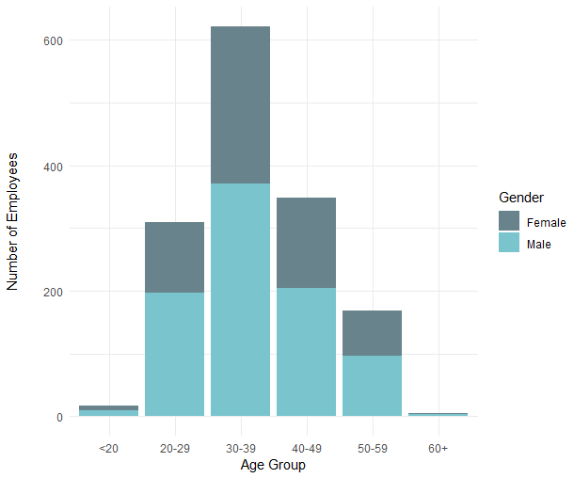
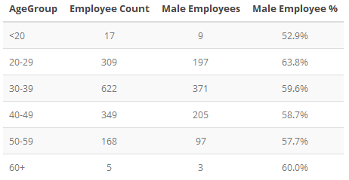
Overall Workforce Summary:

Slide 7
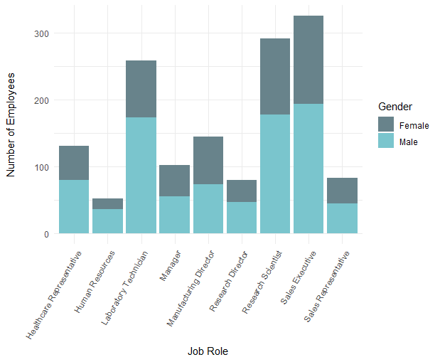
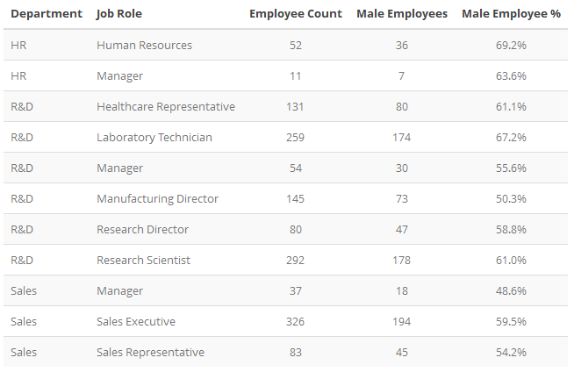
Overall Workforce Summary:

Slide 8
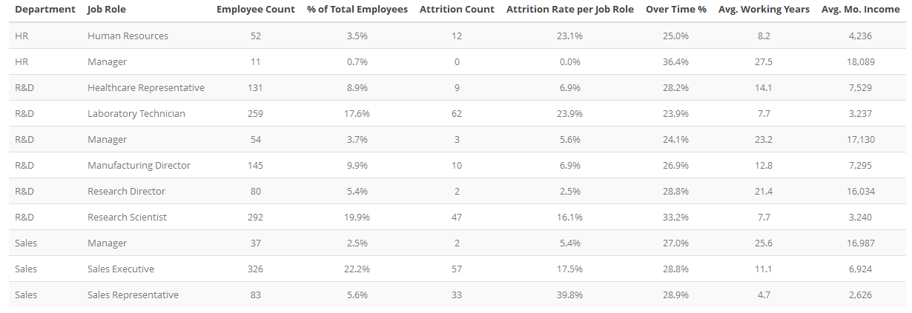
Job Role Statistics

Slide 9
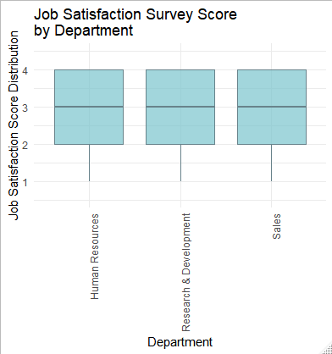
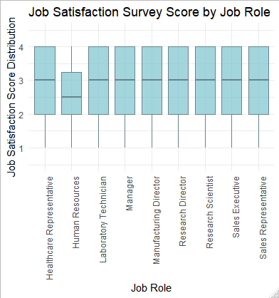
Job Satisfaction Survey:
No major deviations across departments. Let’s take a closer look.
Human Resources responses are 6.3% lower than others

Slide 10
Factors contributing to attrition

Slide 11
Identified Contributors to Attrition Rates – Two High Level Categories
Quality of Life Factors
Overtime
Environment Satisfaction
Frequent Business Travel
Job Involvement
Distance From Home
Relationship Satisfaction
Career Progression Factors
Number of companies worked for previously
Years since last promotion
Years in current role
Age
Job Role (for specific roles)

Slide 12
Job Role Statistics: Focus on attrition
Red highlight indicates job roles where attrition exceeds 20%

Slide 13
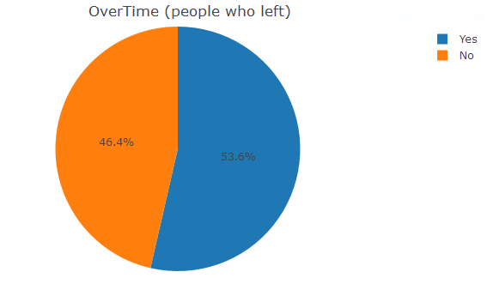
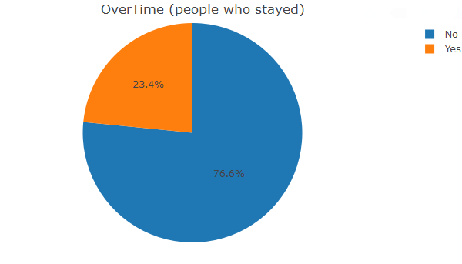
Significant Factor: Overtime
Employees who worked overtime tend to leave the organization in greater numbers indicating issues with overall quality of life.

Slide 14
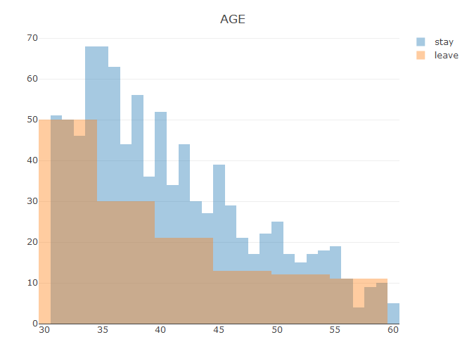
Significant Factor: Age
Younger employees are tending to leave more than
Older employees

Slide 15
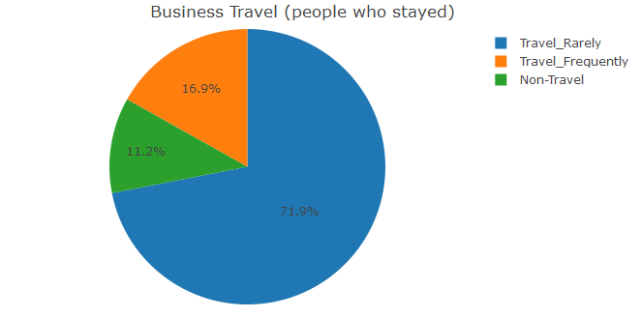
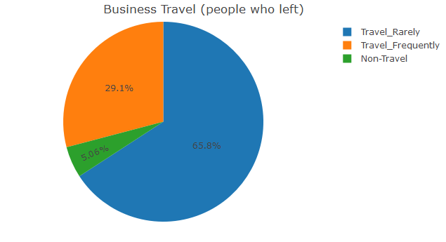
Other Factors: Business Travel

Slide 16
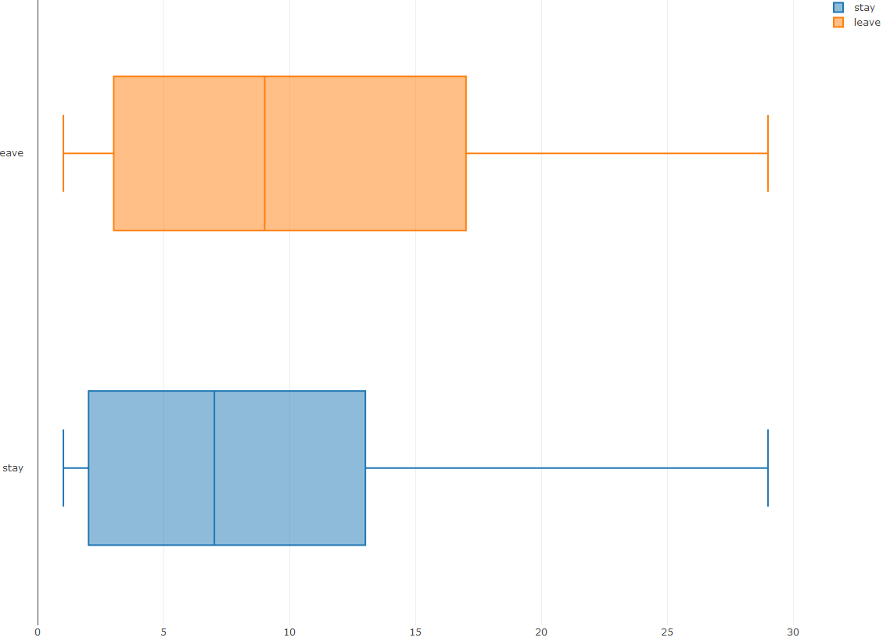
QOL Factors (distance from home)
The median distance is almost same
There is no appreciable trend to indicate that distance from home is a factor

Slide 17
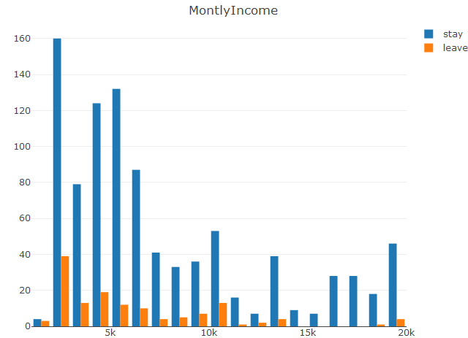
QOL factor (montly income)
Employees who receive lower income (lower pay structures) are tending to leave more

Slide 18
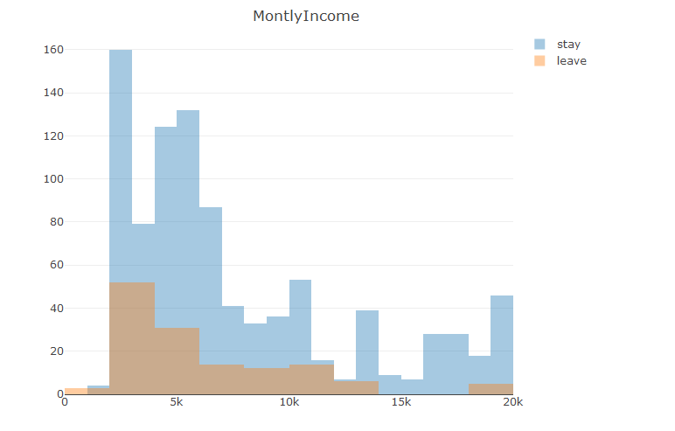
Monthly Income
The attrition data shows us a skewed distribution towards lower income categories , we believe this is a major factor for attrition

Slide 19

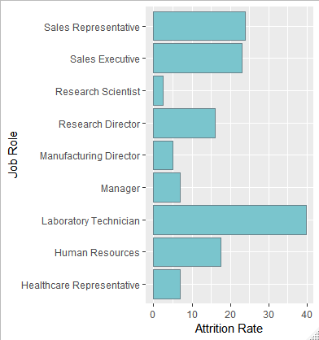
Attrition Rates by Job Role

Slide 20
Building a model to help mitigate attrition

Slide 21
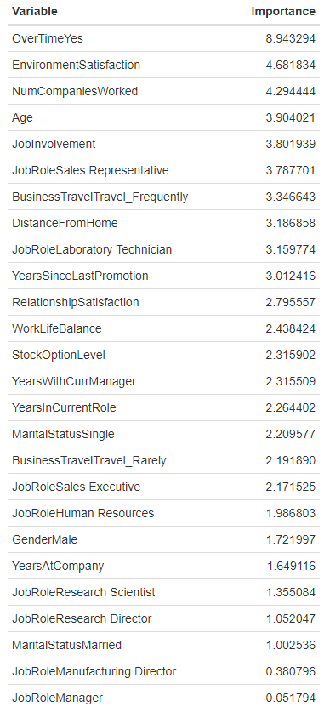
Building a Prediction Model for attrition
Top 10 Contributors to Attrition Risk
Overtime
Environment Satisfaction
Number of Companies Worked For
Age
Job Involvement
Job Role – Specifically Sales Representatives
Business Travel – Frequent Travelers
Distance from Home
Job Role – Specifically Lab Technicians
Years Since Last Promotion
Using logistic regression, we can build a model to help predict whether employees are at risk of attrition.

Slide 22
Model Performance
Precision: Metric accounting for false positives.
Recall: Metric accounting for false negatives.
Accuracy: “How many times does the model get it right?”
Note: This model is a prototype and is not a certain predictor of attrition. However, it may be used to identify contributing factors and target retention efforts to specific categories of employees or make policy modifications.
Precision: 0.91
Recall: 0.95
Accuracy: 0.87 → 87%

Slide 23
Conclusions
Overtime, Experience (a combination of age, career progression, and other lesser factors), and pay all seem to influence attrition rates.
This leads to younger, less experienced personnel being at higher risk of attrition.
We recommend to provide more incentives for younger work force in terms of pay and improve overall quality of life with less overtime stress to arrest attrition

