Slide 1
DDS Analytics:
Factors leading to attrition analysis

Slide 2
Overall Workforce Summary:
Total number of employees:
Number of departments:
Number of work roles:
Insert Age / Gender plots?

Slide 3
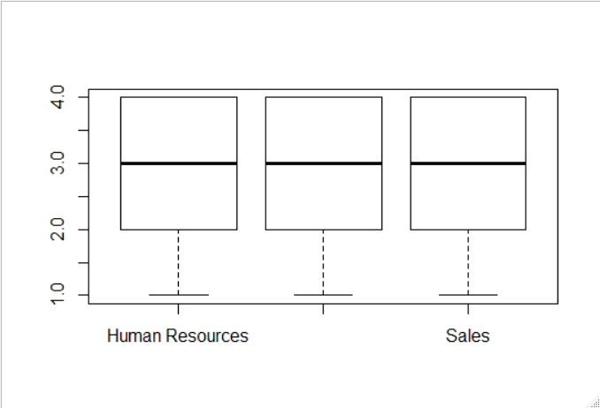
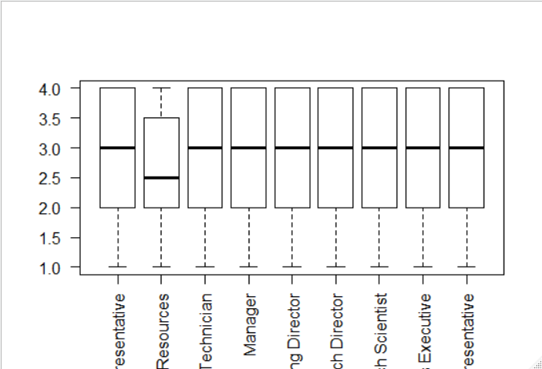
Job Satisfaction Survey:
Same across Departments – Plots just placeholders
Human Resources Work Role significantly lower

