Slide 1
DEVOPS CAPSTONE DEFENSE
BookFlow: Student Library Lending Tracker
Cloud-Native Microservices, CI/CD, Containerization, Kubernetes & Observability
Production Grade
FastAPI + React 18 + PostgreSQL
Immutable Pipelines
GitHub Actions + Trivy + GHCR
Kubernetes Native
Helm Charts + Prometheus + Grafana

Slide 2
CONTEXT & OBJECTIVES
2/10
Problem Statement & Solution Architecture
The Problem Space
The Cloud-Native Solution
• Campus Library Checkout Inefficiency
Manual book tracking causes lending delays, record mismatches, and untracked overdue loans.
• Fragile Legacy Deployments
Monolithic setups suffer from host port conflicts, environment drift, and single-point-of-failure downtimes.
• Lack of Operational Visibility
Zero real-time telemetry into request latency, database query bottlenecks, or service resource saturation.
✔ Containerized Microservices
FastAPI backend, React 18 frontend, and PostgreSQL containerized with non-root security.
✔ Strict Automated Quality Gates
Automated Pytest testing (16/16) and Trivy vulnerability gate (0 CVEs) in GitHub Actions.
✔ Declarative Kubernetes Orchestration
Helm package management, 2-replica High Availability, NGINX Ingress, and persistent storage.
✔ Continuous Observability
Prometheus metrics harvesting and Grafana dashboard for live request rates and memory profiling.

Slide 3
ARCHITECTURE STACK
3/10
Technology Stack & Toolchain
Application Core
Testing & Quality
CI/CD & Security
K8s & Observability
▸ FastAPI (Python 3.11/3.13)
▸ React 18 & Vite 5
▸ PostgreSQL 16 Engine
▸ Alembic Migrations
▸ SQLAlchemy ORM
▸ Pytest 8.3 Suite (16 Tests)
▸ SQLite In-Memory Mock
▸ Pre-Push Secret Scanning
▸ Vite Production Bundler
▸ Docker Compose Local Stack
▸ GitHub Actions Automation
▸ Trivy CVE Container Scanner
▸ GitHub Container Registry
▸ Immutable Git SHA Tagging
▸ Non-Root UID Hardening
▸ Kubernetes v1.31 Runtime
▸ Helm 3 Declarative Charts
▸ NGINX Ingress Controller
▸ Prometheus & ServiceMonitor
▸ Grafana Live Dashboards & HPA

Slide 4
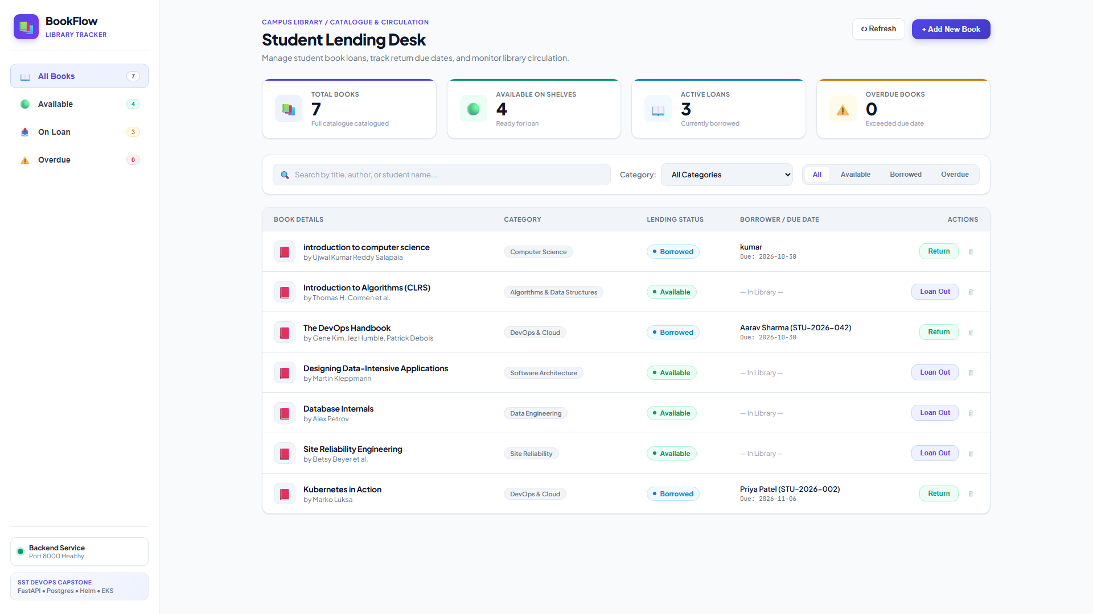
FRONTEND & API
4/10
Enterprise Application & Circulation Desk UI
Circulation Desk Features
• White Enterprise Palette
High-contrast clean layout inspired by modern SaaS standards (#F8FAFC canvas, crisp #FFFFFF cards, indigo accents).
• Live Library KPI Deck
Instant count of Total Books (7), Available on Shelves (4), Active Loans (3), and Overdue Books (0).
• Search & Dynamic Category Filtering
Fast client-side search across title, author, and borrower with multi-category chips.
• Interactive Loan & Return Workflows
Modals for lending books to students (with roll ID & loan period) and catalogue addition.

Slide 5
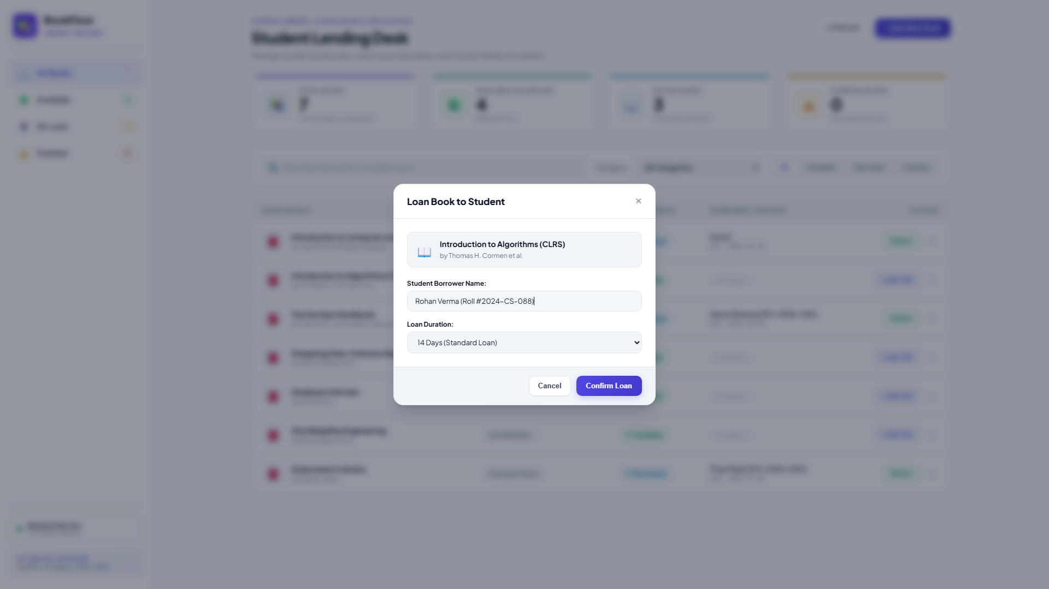
SECURITY & VERIFICATION
5/10
Quality Assurance & Student Loan Workflow
Automated Verification & Controls
✔ 16/16 Pytest Test Suite
Full coverage for CRUD, health, ready, and metrics routes in 1.32s.
✔ Zero Database Pollution
In-memory SQLite with StaticPool ensures 0 leftover test records.
✔ Non-Root Security
Backend runs as UID 10001 (appuser); frontend runs as UID 101 (nginx).
✔ Interactive Checkout Modal
Validates student roll IDs and dynamic loan period calculations.

Slide 6
AUTOMATED PIPELINE
6/10
Continuous Integration & Delivery Pipeline
Stage 1: Test Gate
Stage 2: Vulnerability Gate
Stage 3: GHCR Publishing
TRIGGER: PUSH TO 'MAIN'
▸ Checkout repository code
▸ Set up Python 3.11 environment
▸ Execute 16/16 Pytest tests (blocking)
▸ Set up Node.js 20 environment
▸ Run npm ci && npm run build (passed)
SECURITY FIRST
▸ Build Docker images for backend & frontend
▸ Run Aquasecurity Trivy CVE scanner
▸ Strict gate: exit-code 1 on HIGH or CRITICAL
▸ Scan Result: 0 High, 0 Critical vulnerabilities
▸ Guarantees clean container posture
IMMUTABLE ARTIFACTS
▸ Authenticate with GitHub Container Registry
▸ Tag images with exact Git commit SHA
▸ Push backend: <sha> to GHCR
▸ Push frontend: <sha> to GHCR
▸ Deterministic image deployment traceability

Slide 7

ORCHESTRATION & HELM
7/10
Kubernetes & Declarative Helm Architecture
Production Orchestration
• Custom Helm Chart
Modular chart in helm/bookflow with linted values (0 errors).
• High Availability (5/5)
2 backend replicas + 2 frontend replicas + 1 PostgreSQL stateful pod.
• Traffic Ingress Controller
NGINX Ingress routing root (/) to frontend and (/api, /metrics) to backend.
• Probes & Self-Healing
Liveness and readiness HTTP probes preventing traffic to unready pods.
• Persistent Storage
Kubernetes PVC mount ensuring PostgreSQL data durability across restarts.

Slide 8
RELIABILITY ENGINEERING
8/10
Kubernetes Hands-On Troubleshooting Labs
Lab 1: ImagePullBackOff Diagnosis
Lab 2: Missing Endpoints Diagnosis
▸ Fault Injected: Deployed broken manifest with non-existent tag :v999.999-broken.
▸ Observed Failure: Pod entered ErrImagePull and escalated to ImagePullBackOff (0/1 ready).
▸ Diagnosis Protocol: Inspected Kubelet events via kubectl describe pod, confirming 404 tag mismatch.
▸ Remediation: Patched deployment with valid image tag (ghcr.io/...:local-verified). Pod recovered to Running.
▸ Audit Evidence: Captured full CLI diagnosis log in evidence/m8-troubleshooting-image.txt.
▸ Fault Injected: Configured Service with typo in selector: app=bookflow-be-wrong.
▸ Observed Failure: kubectl get endpoints returned <none>; curl requests received 502 Bad Gateway.
▸ Diagnosis Protocol: Compared pod labels with Service spec.selector to isolate the label discrepancy.
▸ Remediation: Aligned Service selector to match pod labels; endpoints immediately populated 2 IPs.
▸ Audit Evidence: Captured full CLI diagnosis log in evidence/m8-troubleshooting-service.txt.

Slide 9
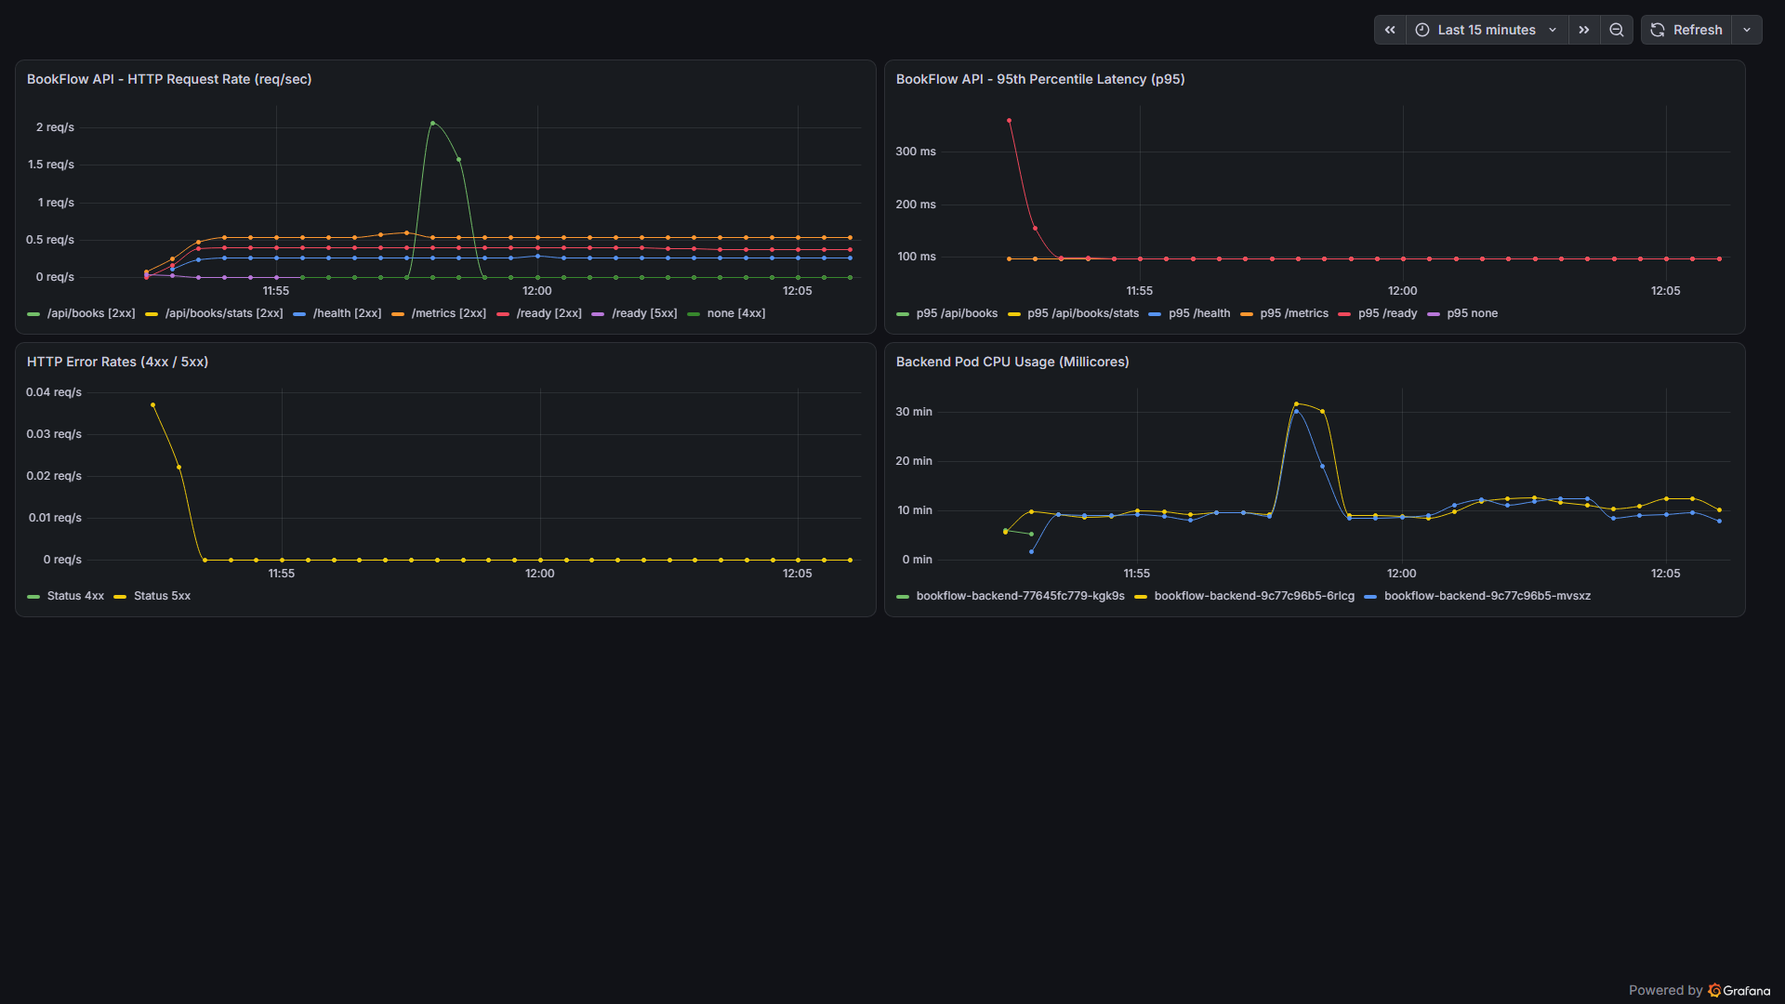
TELEMETRY & METRICS
9/10
Full-Stack Observability & Autoscaling (HPA)
Observability Architecture
• Prometheus Instrumentator
FastAPI middleware exposing http_requests_total, response latency histograms, and process metrics.
• Active Scrape Target
Prometheus operator scraping the backend service every 15s (Target Health: UP).
• Live 4-Panel Grafana Dashboard
Custom dashboard monitoring Request Rate (QPS), Request Latency (p95), 5xx Error Rate, and Process Memory.
• Horizontal Pod Autoscaler (HPA)
Kubernetes HPA configured with 60% CPU target utilization (scales from 2 to 5 pods under spike load).

Slide 10
SUMMARY & IMPACT
10/10
Capstone Deliverables & DevOps Mastery
✔ 100% Verified Local Stack
Docker Desktop Kubernetes running 5/5 healthy pods, NGINX Ingress on port 8088, and persistent PostgreSQL storage surviving pod restarts.
✔ Security First & Cloud Infrastructure
Non-root container execution (UID 10001 / 101), automated pre-push secret audit passed with 0 leaked patterns, and modular Terraform IaC architected for high-availability cloud deployment.
✔ Production CI/CD Automation
GitHub Actions pipeline with 16/16 Pytest blocking gate, Trivy CVE security checks (0 CVEs), and immutable GHCR image tags.
✔ Observability & 37 Evidence Artifacts
Prometheus metrics scraping with target status UP, live 4-panel Grafana dashboard, HPA dynamic scaling, and 37 comprehensive evidence files.

