Slide 1


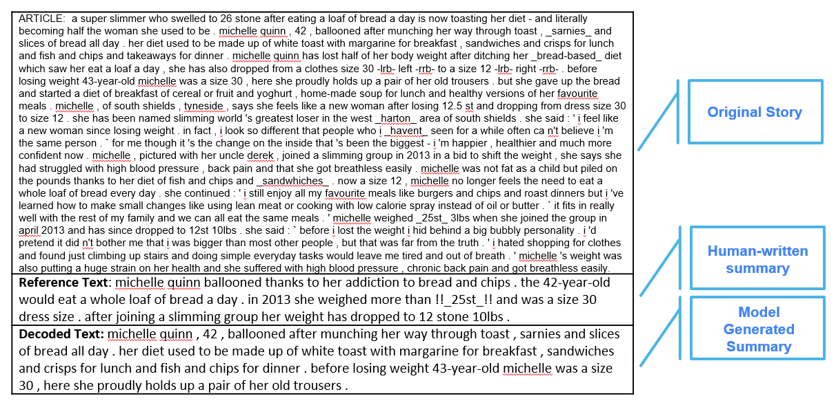

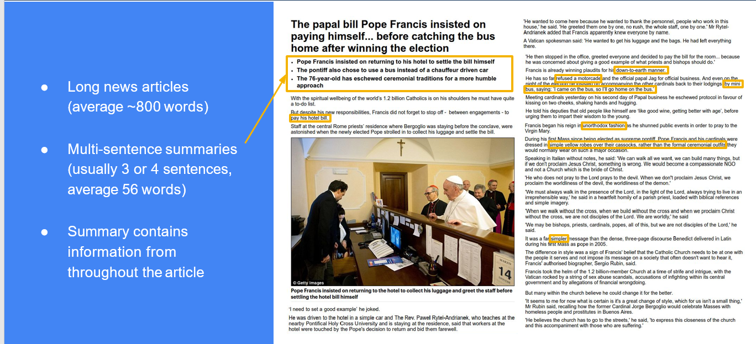
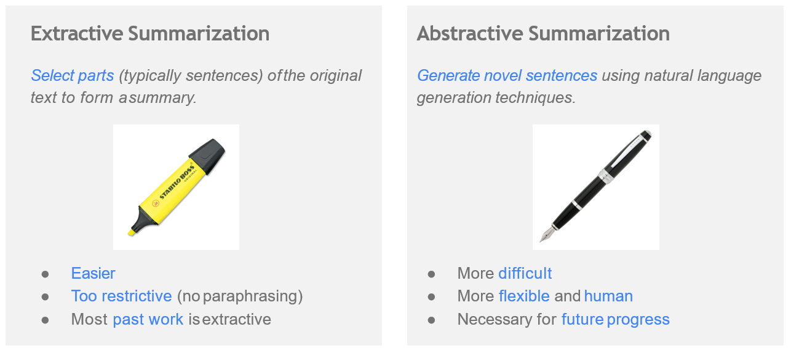
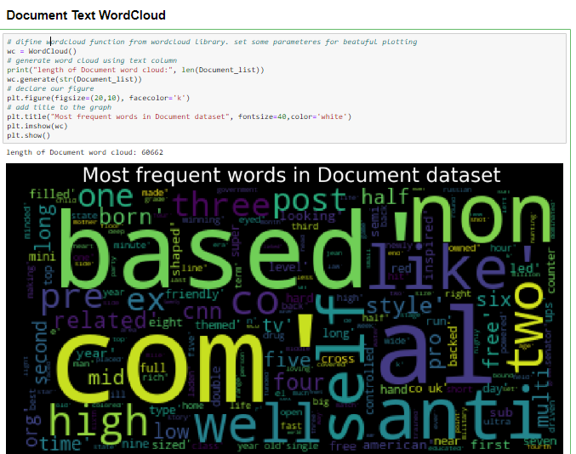
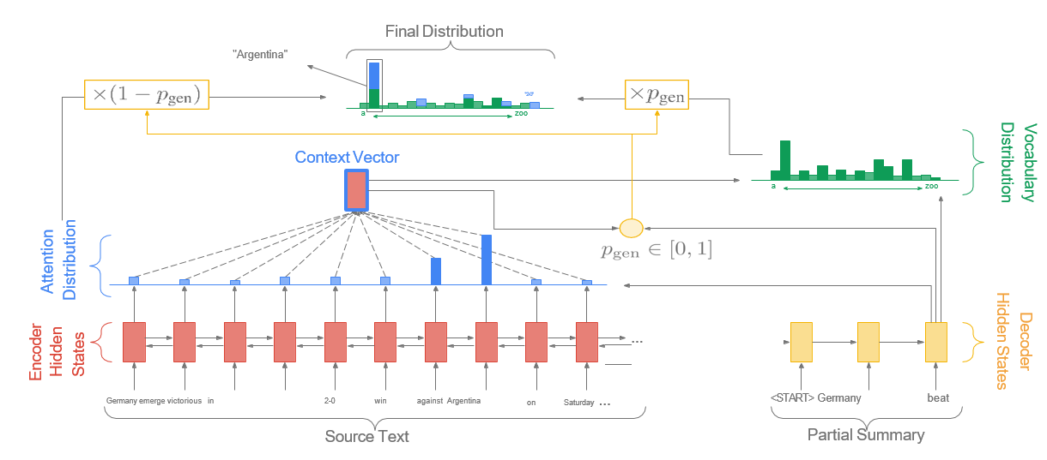
TEXT SUMMARIZATION
Ujwal Tandon, Shubham Rohatgi, Satvika Thakur, Gautam Gupta with guidance from Rajesh Jain
Abstract
Data Collection & Pre-Processing
Model Architecture
Model Outcome & Results
Automatic text summarization is basically summarizing of the given paragraph using natural language processing and machine learning. There has been an explosion in the amount of text data from a variety of sources. This volume of text is an invaluable source of information and knowledge which needs to be effectively summarized to be useful. In this review, the main approaches to automatic text summarization are described. We review the different processes for summarization and describe the effectiveness and shortcomings of the different methods. Two types will be used i.e.-extractive approach and abstractive approach. The basic idea behind summarization is finding the subset of the data which contains the information of all the set. There is a great need to reduce unnecessary data. It is very difficult to summarize the document manually so there is the great need of automatic methods. Approaches have been proposed inspired by the application of deep learning methods for automatic machine translation, specifically by framing the problem of text summarization as a sequence-to-sequence learning problem.
Data Set:
Pointer Generator Network
This algorithm helps to solve the challenge of OOV words and factual errors.It works better for multi-sentence summaries. The basic idea is to choose between generating a word from the fixed vocabulary or copying one from the source document at each step of the generation. It brings in the power of extractive methods by pointing (Vinyals et al. [2015]). So for OOV words, simple generation would result in UNK, but here the network will copy the OOV from source text. At each step we calculate generation probability pgen = σ(w T h∗h ∗ t + w T s ht + w T x xt + bptr)
Model Outcome
CNN
This dataset contains the documents and accompanying questions from the news articles of CNN. There are approximately 90k documents and 380k questions. Available 'questions/', which should be sufficient to reproduce the setting from the original paper, and 'stories/', which can be useful for other uses of this dataset.
Daily Mail
This dataset contains the documents and accompanying questions from the news articles of Daily Mail. There are approximately 197k documents and 879k questions. Available 'questions/', which should be sufficient to reproduce the setting from the original paper, and 'stories/', which can be useful for other uses of this dataset.
Model Results
Coverage
This concept was first applied by See et al. [2017]. The cause of repetitiveness of the model can be accounted for by increased and continuous attention to a particular word. So we can use Coverage Model by Tu et al. [2016].
The idea is that we use the attention distribution to keep track of what’s been covered so far, and penalize the network for attending to same parts again to
CAPSTONE PROJECT RESULTS IN COMPARISON WITH BENCHMARK RESULTS PRODUCED BY STANDFORD PAPER ON POINTER GENERATOR NETWORKS
 | Without Coverage |  | With Coverage
Vocabulary Size |  | 50,000 |  | 50,000
Dataset |  | Validation |  | Validation
Mode |  | Decode |  | Decode
System specification |  | Linux Machine |  | Linux Machine
Training Time |  | 3 days 3 hrs |  | + 3 hrs 50 mins
Iterations |  | 47,128 |  | 50,064
Validation Time |  | 6-7 hrs |  | 6-7 hrs
Evaluation Metrics | Benchmark Abigail See : Stanford Univ | Pointer Generator with attention | Benchmark Abigail See : Stanford Univ | Pointer Generator with attention
Rouge 1 | F Score | 0.3644 | 0.36645 (+0.00205) | 0.3953 | 0.39412 (-0.00118)
Rouge 1 | Precision |  | 0.3598 |  | 0.38598
Rouge 1 | Recall |  | 0.40253 |  | 0.43650
Rouge 2 | F Score | 0.1566 | 0.15627 (-0.00033) | 0.1728 | 0.16967 (-0.00313)
Rouge 2 | Precision |  | 0.15397 |  | 0.16701
Rouge 2 | Recall |  | 0.17168 |  | 0.18746
Rouge L | F Score | 0.3342 | 0.33199 (-0.00221) | 0.3638 | 0.35890 (-0.0049)
Rouge L | Precision |  | 0.32614 |  | 0.35174
Rouge L | Recall |  | 0.36455 |  | 0.39724
EDA
Conclusions
This review shows that Deep Learning based approaches are promising and give some hope in solving Abstractive text summarization which had been largely unsolved till now. But the problems with the metric and lack of dataset are a challenge to scalability and generalizing to multi-sentence summarization.
Contact
References
Ujwal @
Shubham @
Satvik @ 9711009200
Gautam @ 9899059131
[1] http://www.abigailsee.com/2017/04/16/taming-rnns-for-better-summarization.html
[2] https://github.com/abisee/pointer-generator
[3] https://machinelearningmastery.com/prepare-news-articles-text-summarization/
[4] https://arxiv.org/pdf/1704.04368.pdf
[5] https://towardsdatascience.com/understanding-encoder-decoder-sequence-to-sequence-model-679e04af4346

