Slide 1
Personal Fitness Workout Tracker
Steps | Calories | Heart Rate | Weekly Progress

Slide 2
Understanding Problem Statement
Manually tracking steps, calories, and heart rate is inconvenient and inaccurate — causing people to lose motivation to stay active.
There is a need for a simple, easy-to-use Personal Fitness Workout Tracker that can:
  Record the number of steps a user takes each day
  Calculate calories burned based on step count
  Track daily and weekly progress toward a fitness goal
  Present this information in a clear, understandable format

Slide 3
CO-1 Topics
Structure of Java program
Variables & constants
Data types
Scanner input
Arithmetic Operators
Typecasting
Output

Slide 4
CO-2 Topics
If statement
For Loop

Slide 5
CO-3 Topics
Methods
1-D Array

Slide 6
CO-4 Topics
Classes & objects; object creation using new
  class FitnessTracker; Scanner sc = new Scanner(System.in)
Instance vs static members
  sc.nextInt() (instance) vs calculateCalories() (static)
Static methods
  static double calculateCalories(int steps)
Constants
  static final int DAYS, STEPS_PER_CALORIE

Slide 7
CO-5 Topics
String abstraction
  String name = sc.nextLine();
String concatenation
  "Welcome " + name + "! Let's track your week."
String literals as data
  String[] dayNames = {"Mon", ..., "Sun"}; "Goal Met"

Slide 8
CO-6 Topics
Not used in the current program. Possible extension:
Collections & generics
  ArrayList<Integer> steps instead of int[] steps
Lambda & Predicate
  Predicate<Integer> goalMet = s -> s >= goal;
Stream pipeline
  steps.stream().mapToInt(Integer::intValue).sum()

Slide 9
Step Counter
Counts every step in real time using the phone or wearable's motion sensor.
  Live step count synced throughout the day
  Daily goal ring with progress percentage
  Distance (km) and active minutes estimated from steps
Today: 8,742 steps — 87% of 10,000-step goal, 6-day streak

Slide 10
Calorie Counter
Estimates calories burned by combining step activity, workouts, and resting metabolism.
  Real-time kcal burned, updated with activity
  Daily target based on age, weight, and goals
  Breakdown by workout, walking, and resting burn
Today: 540 kcal burned — 68% of 800 kcal target

Slide 11
Weekly Data — Steps & Calories

Slide 12
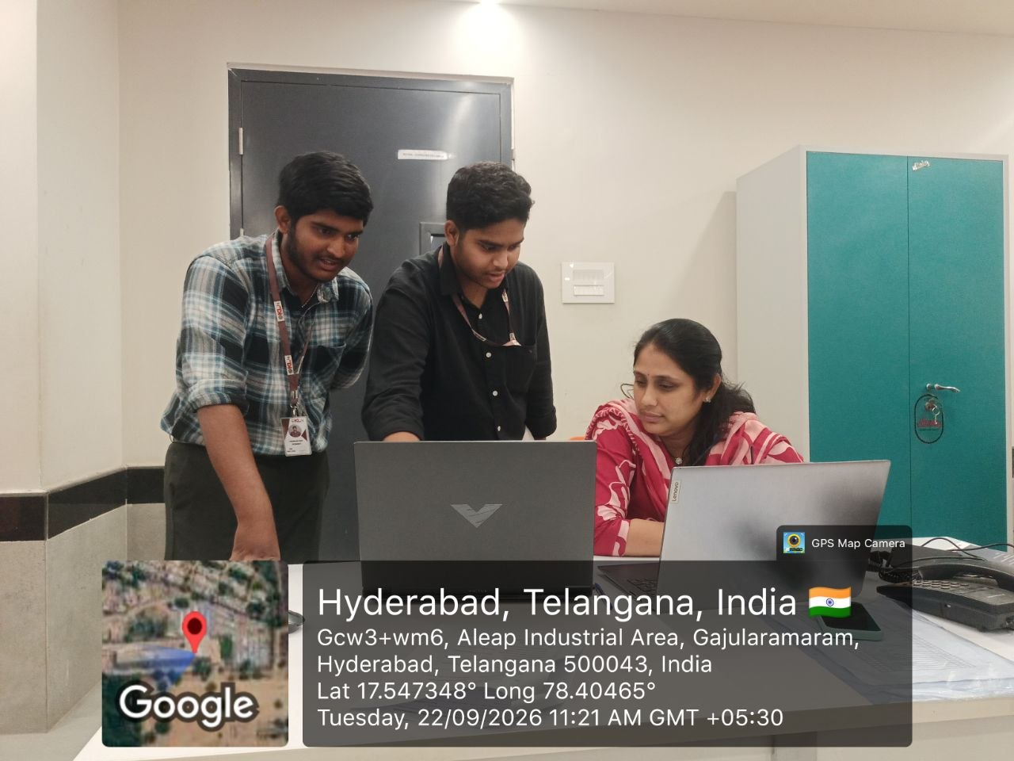
Git Hub Link (Yushwa deep Reddy -2620040077):- https://github.com/yushwa-ui
Git Hub Link (Ujwal Amogh-2620030640):- https://github.com/UjwalAmogh-2009
GEOTAG PHOTO :-

