Slide 1

MEDICAL INVENTORY OPTIMIZATION

Slide 2



Project Leadership
Sharat Manikonda
Director at Innodatatics and Sponsor
linkedin.com/in/sharat-chandra
Mihir Jain
Associate Data Scientist
linkedin.com/in/mihirjain0405
Bharani kumar Depuru
Director at Innodatatics and Chief
Data Scientist
linkedin.com/in/bharanikumardepuru

Slide 3

Contents
Business Objective and Business Constraints
Project Architecture
Data collection and description
Exploratory Data Analysis
Data Visualization
Summary of key Findings
Notes:
Change

Slide 4
Business Problem: Bounce rate is increasing significantly leading to patient
dissatisfaction.
Business Objective : Minimize bounce rate.
Maximize profit.
Business Constraint: Minimize inventory cost.
Maximize stock out and minimize overstock.

Slide 5
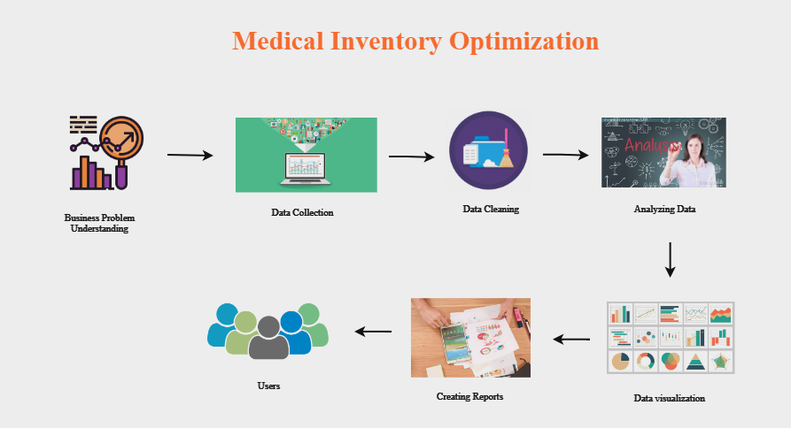
Project Architecture

Slide 6
Project Management Methodology for Data Analytics
1.Business and data understanding
2.Exploratory Data Analysis [EDA] 3.Data Visualization

Slide 7
Data Collection and Understanding
The data which was extracted consisted of 12550 records and 14 attributes which cover the information
related to medical inventory sales of the year 2022.
Data Dictionary:
typeofsales: ‘sale’ or‘return’ 9. final_sales: final sales of day
Patient_id: unique identifier 10. rtnmrp: mrp of items
Specialisation: types of specilaization 11. formulartion: types of formulation
Department: types of department 12. drugname: names of different drugs
Dateofbill: date of sales purchase 13. subcat: subcategory of drugs
Quantity: number of quantities 14. subcat1: subcategory1 of drugs
Returnquantity: number of quantity returned
Final_cost: finalcost after considering all factors

Slide 8
Exploratory Data Analysis [EDA]
The step to be performed before EDA is Data Cleaning. During this process I have found null values in
formulation and subcat attributes instead of removing them I have replaced with ‘0’ to not lose the data.
EDA is used for seeing what the data is saying. By performing EDA I have derived both statistical and
business insights.
In statistical insights the basic statistics such as mean, minimum, standard deviation, median maximum
were described to summarize the data and skewness, kurtosis are derived to know the distribution of data.
As a result I have seen that the attribute patientid was left skewed and it has shown that outliers are present
in the data.
In business insights few calculations are done to know the maximum sales and minimum sales and total
bounce rate.
As a result I have seen that few drugs need to be replaced and few drugs intake should be maximized to
gain profit.
Notes:
Change

Slide 9
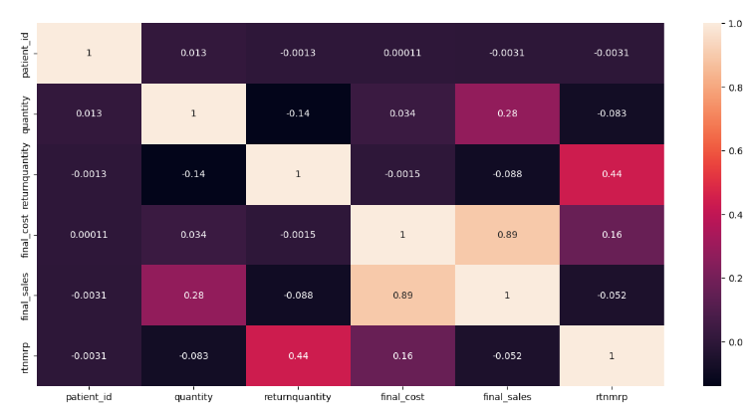
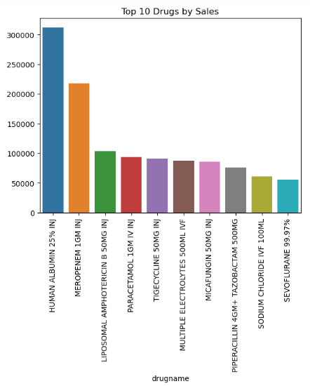
Data Visualization
Heat Map Bar Chart
From this map we can observe that final sales and final sales are From this bar diagram we can observe the top 10
Positively correlated i.e.,if final cost increases final sales also drugs which contribute to maximum sales. So
Increases. these drugs stock intake should be maximized.
Notes:
Add graphical

Slide 10
Summary of Key Findings:
The key Findings are:
The Drug ‘HUMAN ALBUMIN 25%INJ’ has highest sales compared to other drugs. So this drug stock intake should be maximized to avoid stockout.
The Drug ‘Sodium chloride ivf 100ml’ has no sales. So this drug need to be replaced with other drug to avoid overstock.
The drug ‘Meropenem 1GM INJ’ contribute to more profit when compared to other drugs.
There are few drugs which has more return rate they need to modified so as to satisfy patients or customers.
The overall bounce rate obtained is 12.74 means that 13% patients are tend to return the drugs after purchase. So we need to think about improvements to be done to satisfy the patients.

Slide 11


