Slide 1
GETTING STARTED WITH PYTHON
Installations
Rageeni Sah
sahrageeni4@gmail.com

Slide 2
Download and install Anaconda
  Link: https://www.anaconda.com/distribution/
PYTHON INSTALLATION

Slide 3
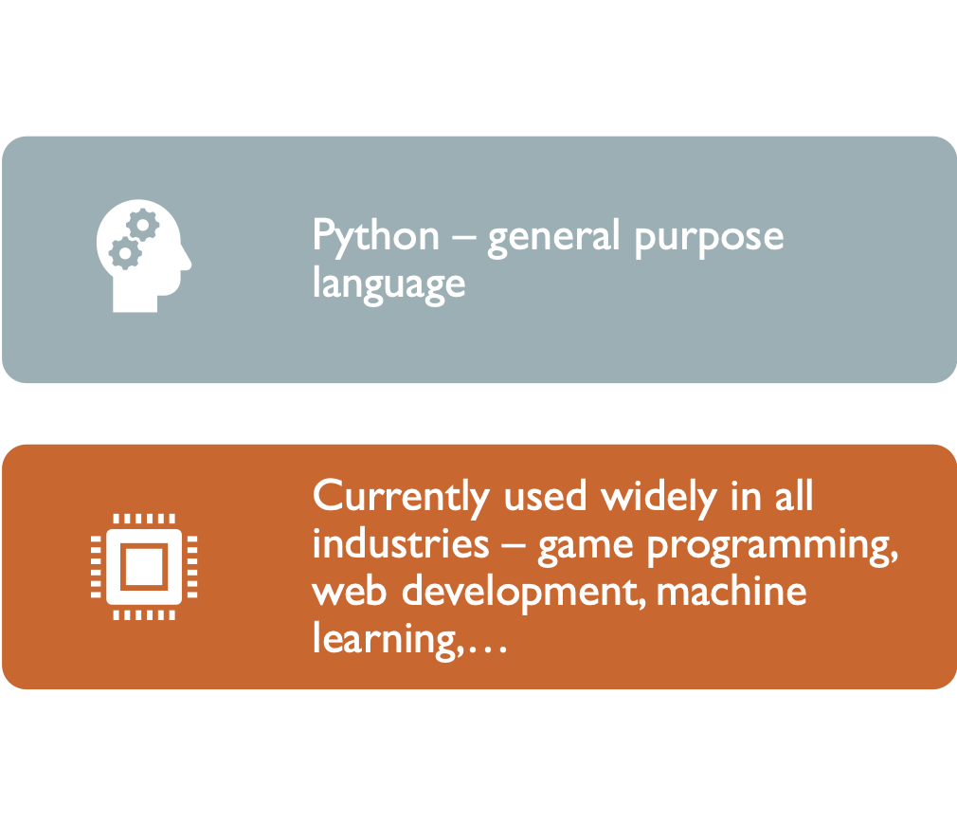
PYTHON INTRODUCTION

Slide 4
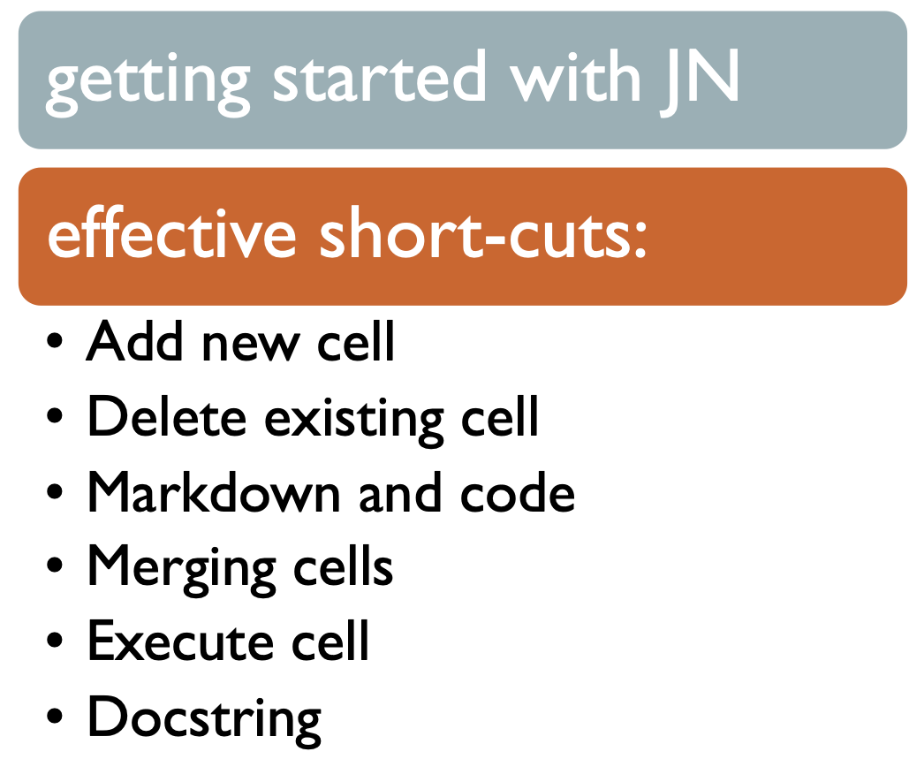
JUPYTER NOTEBOOK USAGES

Slide 5
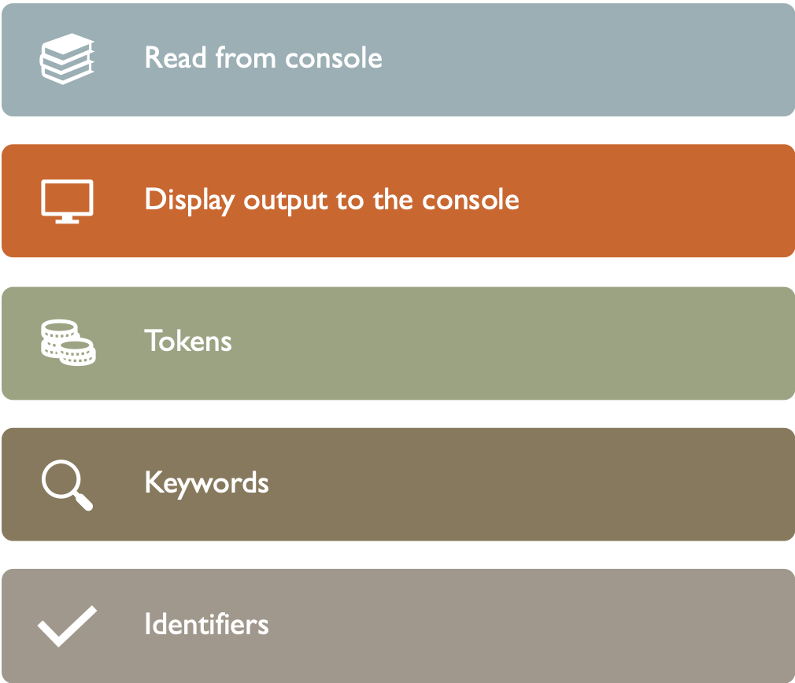
BASIC HANDS ON WITH JN

