Slide 1
Working with Numpy & Pandas
By – Rageeni Sah
sahrageeni4@gmail.com

Slide 2
Agenda
What is Pandas ?
Why pandas?
Data structures in pandas
Data-frame
Working with data-frame
Advantage of data-frame
Advanced concepts w/ data-frame
Hands-on

Slide 3
Introduction
Python is widely used open source programming language
Availability of varies libraries & packages accounts to python’s popularity
Supports libraries & packages for various industrial facets: web development, application development robotics, web scraping, AI/ML, etc.
numpy, matplotlib, seaborn, pandas, scikit-learn are few important packages for machine learning engineers & data analysts

Slide 4
Numpy
Numpy = Numerical python
General-purpose array processing package
Provided high dimension array packages and associated tools
Installation via. Pip command
!pip install numpy
List all functions in given library
Import <package>
Dir(<package>)

Slide 5
Arrays
Main object of NumPy package
Homogenous multidimension array
Usage :
>>>import numpy as np
>>>my_array = np.array([1,2,3,4],[1,2,3,4,5])

Slide 6
Array creations
There are multiple ways to create an array.
np.array(<python list, tuple>)
np.zeros((n,m)) ## (n,m) indicates shape of the 2D - array
np.ones((n,m)) ## (n,m) indicates shape of the 2D - array
np.arange([start,] stop[, step,])
np.linspace( start, stop,num) # Returns evenly spaced numbers over a specified interval
np.random.random(size)
np.empty(size)

Slide 7
Accessing elements - indexing
Single dimension indexing is accomplice as usual:
>>> x = np.arang(10)
>>> x[2] # returns ‘5’
>>> x[-1] # returns ‘5’
Multi-dimension arrays support multidimension indexing:
>>> x.shape = (2,5) # now x is 2-D array
>>> x[1,3] # returns 8
>>> x[1,-1] # returns 9

Slide 8
Accessing elements - indexing
Using fewer dimensions to index will result in a subarray:
>>> x[1] ## returns array([5, 6, 7, 8, 9])
array([5, 6, 7, 8, 9])
Thus, x[i,j] = x[i][j] is supported and later is considered to be less efficient.

Slide 9
Array operations
Basic operations are applied element wise.
The result is a new array with the resultant elements.
Operations like *= and += will modify the existing array
>>> import numpy as np
>>> x = np.arange(10)
>>> x # array([0, 1, 2, 3, 4, 5, 6, 7, 8, 9])
>>> x*2 # array([ 0, 2, 4, 6, 8, 10, 12, 14, 16, 18])
>>> x+2 # array([ 2, 3, 4, 5, 6, 7, 8, 9, 10, 11])

Slide 10
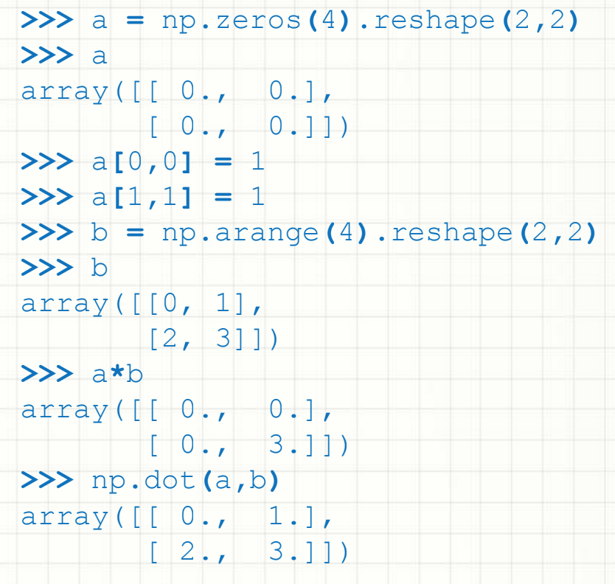
Array operations
Since multiplication is done element wise, you need to specifically perform a dot product to perform matrix multiplication

Slide 11
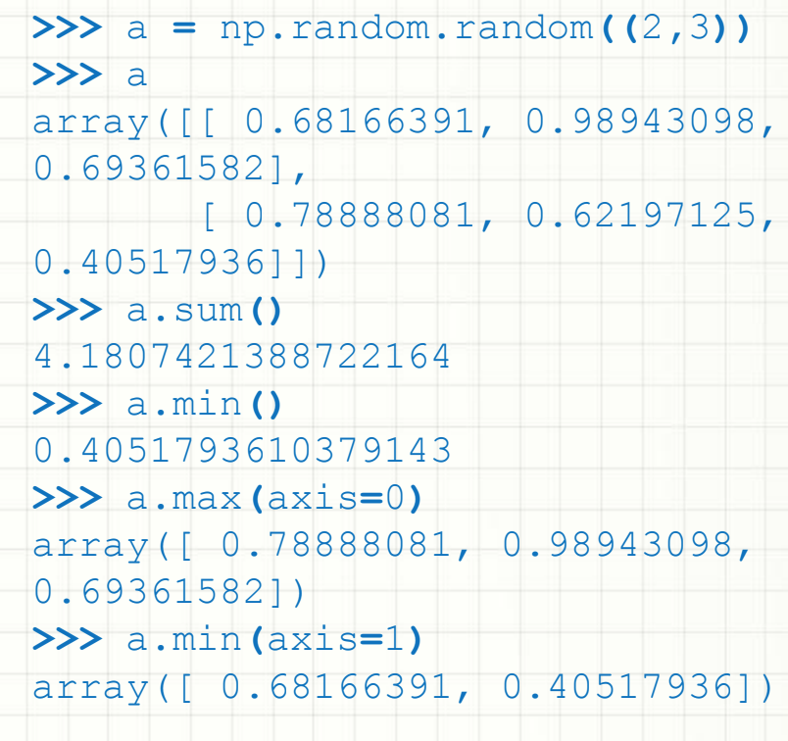
Array operations
Built-in methods: min(), max().sum(),exp().sqrt(),add().sin(),cos()

Slide 12
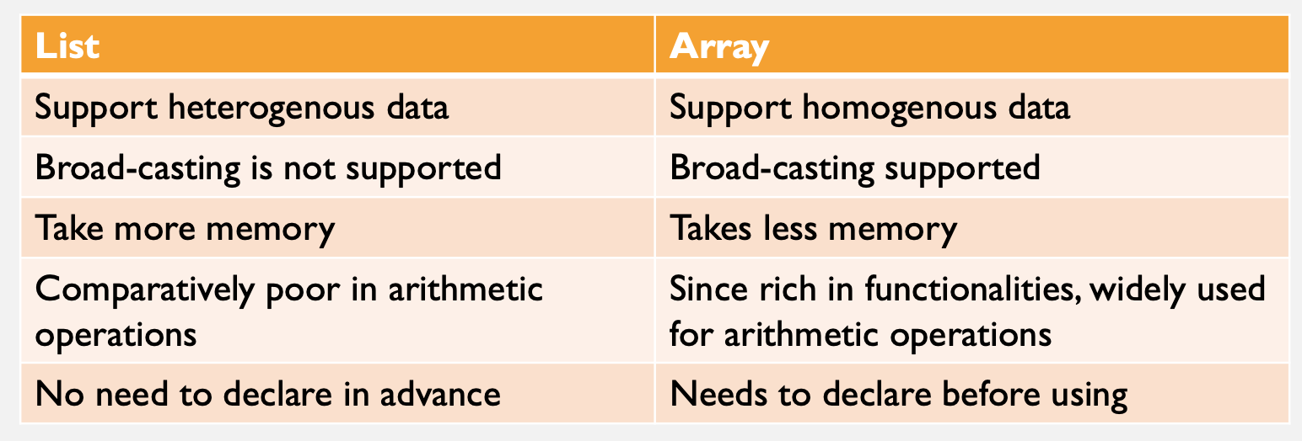
List vs. Array

Slide 13
Pandas
Pandas is an open source, high-performance, easy-to-use data structures and data analysis tools for the python programming language

Slide 14
What problem does pandas solve?
Python has long been great for data munging and preparation, but less so for data analysis and modelling.
Pandas helps fill this gap, enabling to carry out entire data analysis workflow in Python without having to switch to a more domain specific language like R.

Slide 15
Library highlights
Fast and efficient DataFrame object with default and customized indexing.
Tools for loading data into in-memory data objects from different file formats.
Data alignment and integrated handling of missing data.
Reshaping and pivoting of date sets.
Label-based slicing, indexing and subsetting of large data sets.
Columns from a data structure can be deleted or inserted.
Group by data for aggregation and transformations.
High performance merging and joining of data.
Time Series functionality.

Slide 16
Pandas package
Installation
>>> !pip install pandas
## load library
>>> import pandas as pd
>>> dir(pd) ## lists out all methods available in the package

Slide 17
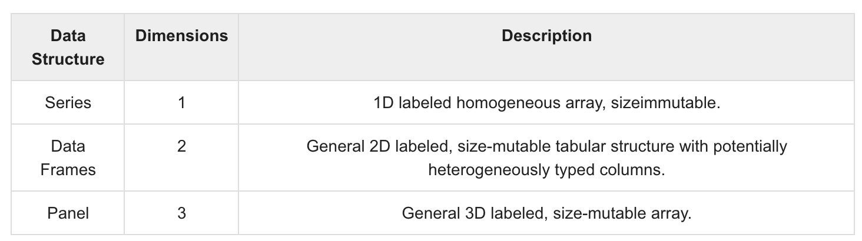
Pandas data structures
Pandas deals with the following three data structures −
  Series
  DataFrame
  Panel

Slide 18
Series
1 D labelled array capable of holding data of any time
Axis label is called index
A pandas series can be created using :
Data - data takes various forms like ndarray, list, constants
Index - Index values must be unique and hashable, same length as data. Default np.arrange(n) if no index is passed.
Dtype - dtype is for data type. If None, data type will be inferred
Copy - Copy data. Default False

Slide 19
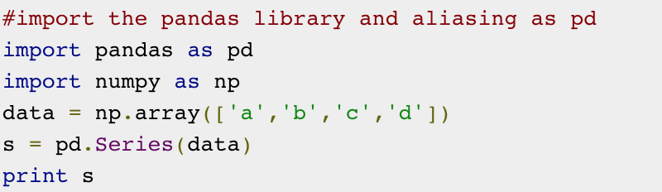
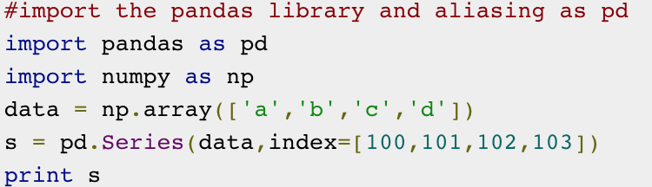
Series – identify the difference
If index parameter is not given, default value of range(n) is taken where n is length of the data

Slide 20
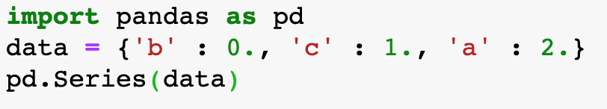
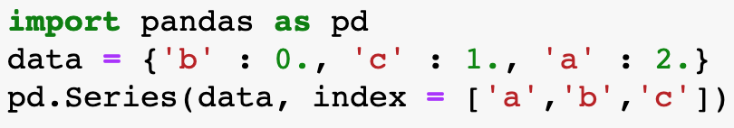
Series from dictionary
A dictionary can be passed a input data
If no index specified, dictionary keys are used as index of the series
Otherwise, specified keys are used as index of the series

Slide 21
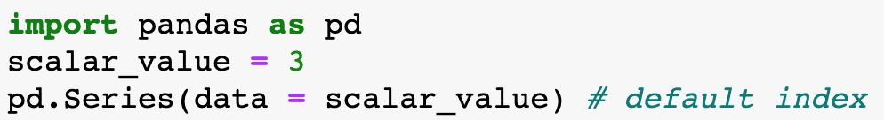
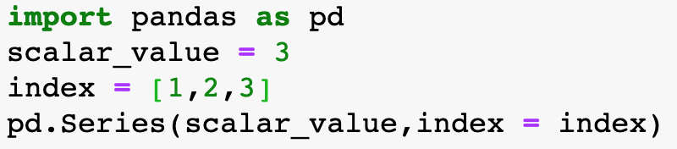
Series from scalar value
Length of the series is inferred based on the index length

Slide 22
Accessing data from series
Through position of the indexes
  ## fetching single value
  s[0] # output 1
  ## fetching multiple values
  s[:2] # returns [1,2]
Through label of the indexes
  ## fetching single value
  s[‘a’] # output 1
  ## fetching multiple values
  s[[‘a’,’b’]] ## returns [1,2]

Slide 23
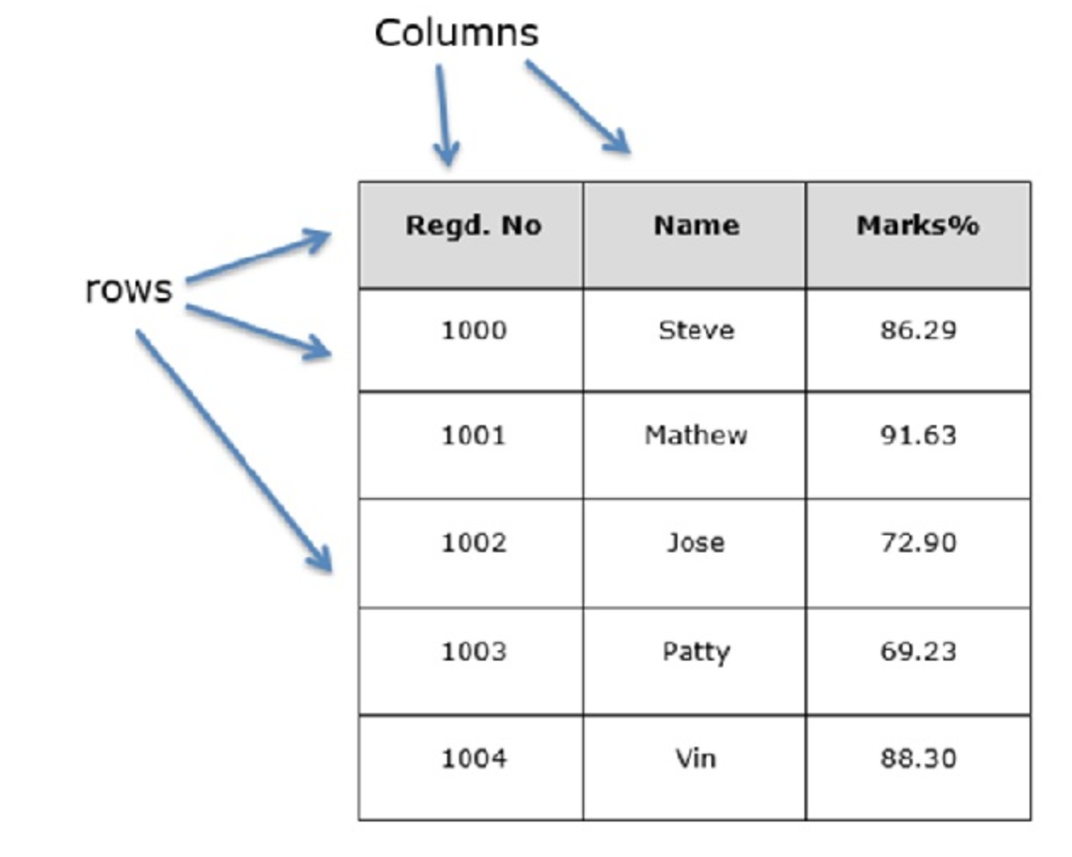
Data-frame
2-D data structure; data aligned in tabular fashion
Key features:
  Mostly columns are of different types
  Size – mutable
  Labels axes (rows and columns)
  Can perform arithmetic operations on rows and columns

Slide 24
dataframe
A pandas dataframe can be created using :
  Data - data takes various forms like ndarray, series, map, lists, dict, constants and also another DataFrame
  Index - For the row labels, the Index to be used for the resulting frame is Optional Default np.arrange(n) if no index is passed
  Dtype - For column labels, the optional default syntax is - np.arrange(n). This is only true if no index is passed
  Dtype - Data type of each column
  Copy - Copy data Default False

Slide 25
Methods to create dataframe
A dataframe can be created with following data as input:
  Lists
  dict
  Series
  Numpy ndarrays
  Another DataFrame

Slide 26
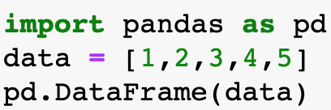
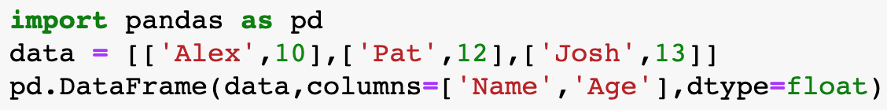
Dataframe using list
As index is not specifies, default index taken:arrange(5)
Size: 1 col +5 rows
As index is not specifies, default index taken: arrange(5)
Size: 2 col +5 rows

Slide 27
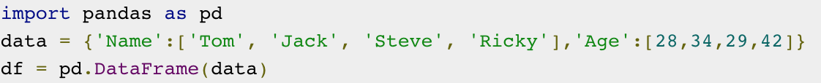
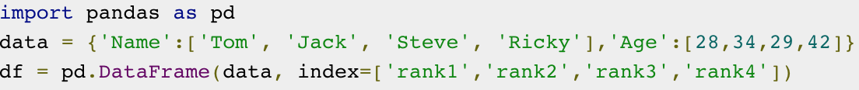
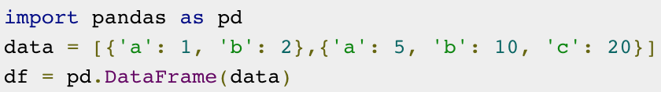
Create dataframe
Dictionary with default index
Dictionary with index
List of dictionary

Slide 28
Operations on dataframe
Selecting data (rows: columns)
Adding a new column
Deleting a column: del, pop, drop

Slide 29
Basic functionalities
Shape
Values
Size
Head
Tail
Columns
Rename
Info, describe, sort_index, sort_values

Slide 30
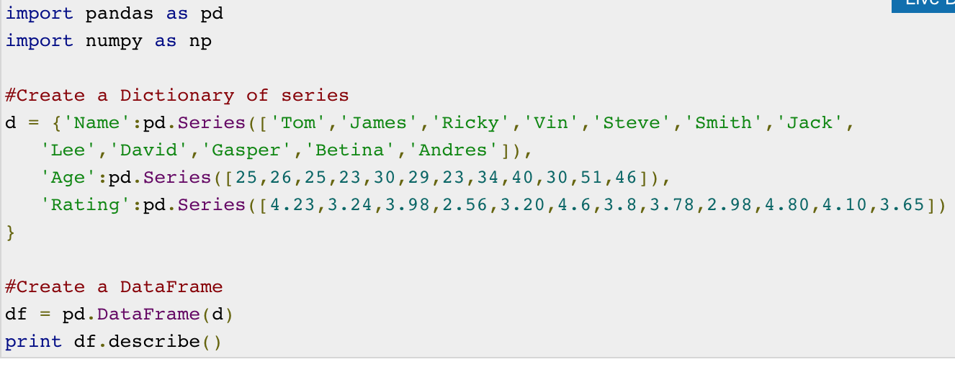
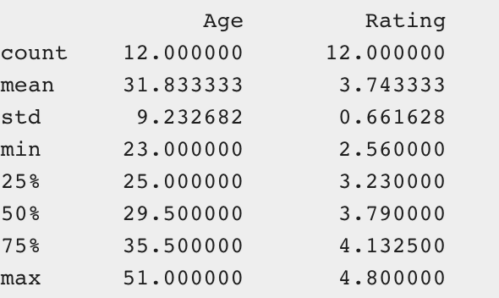
Summarizing data
The describe() function computes a summary of statistics pertaining to the DataFrame columns.
output

Slide 31
Function application
To apply UDF to pandas objects, one of the following methods is used
  Table wise Function Application: pipe()
  Row or Column Wise Function Application: apply()
  Element wise Function Application: applymap()

Slide 32
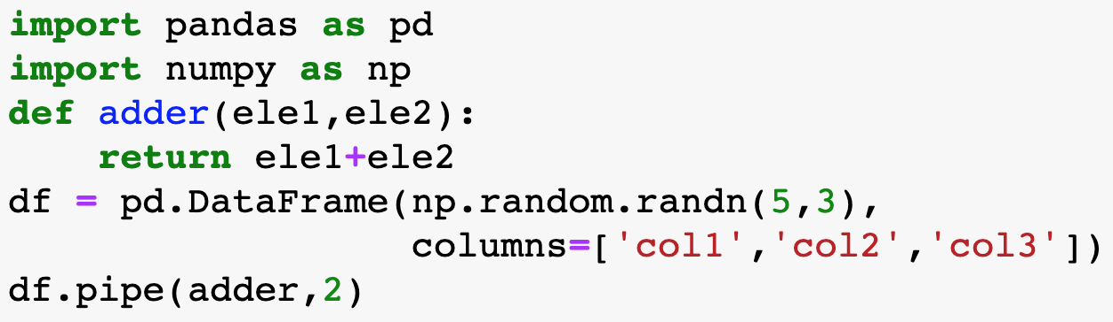
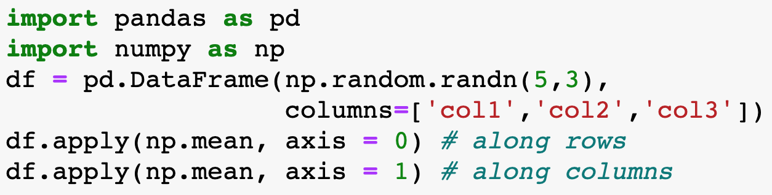
Function application
Pipe()
Apply()

Slide 33
Function application with apply() method
>>> ## run the code
frame = pd.DataFrame([[1,2,9],[4,5,3],[1,7,8]], columns=list('bde'), index=['Utah', 'Ohio', 'Texas'])
f = lambda x: x.max() - x.min() # diff of maximum & minimum number
print(frame)
####
print(frame.apply(f, axis = 0)) # index of the series is index of the dataframe
print(frame.apply(f, axis = 1)) # index of the series is dataframe’s column

Slide 34
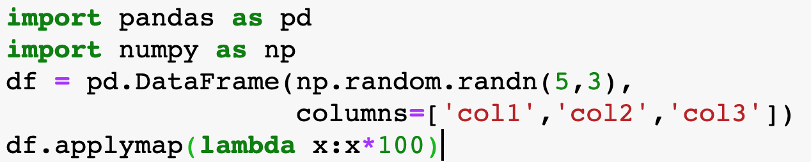
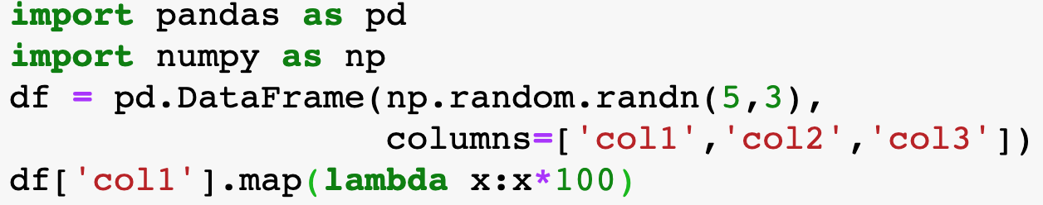
Function application
applymap() on DataFrame
map() on Series

Slide 35
iterations
iteritems() − to iterate over the (key,value) pairs
iterrows() − iterate over the rows as (index,series) pairs
itertuples() − iterate over the rows as namedtuples

Slide 36
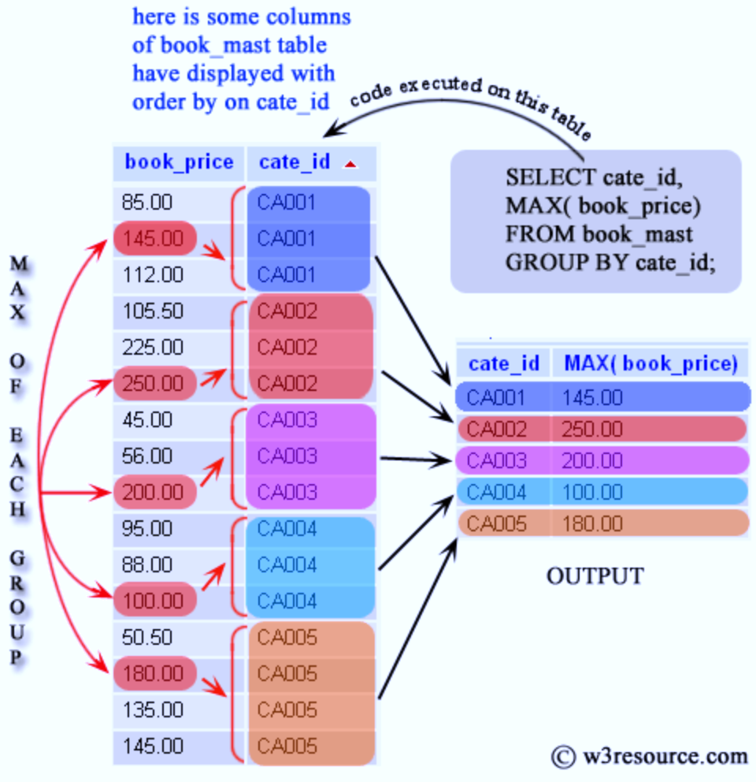
Pandas - groupby
Any groupby operation involves one of the following operations on the original object
  Splitting the Object
  Applying a function
  Combining the results

Slide 37
Groupby – apply functionality
In many situations, we split the data into sets and we apply some functionality on each subset. In the apply functionality, we can perform the following operations −
  Aggregation − computing a summary statistic
  Transformation − perform some group-specific operation
  Filtration − discarding the data with some condition
Splitting data groupby
  >>> import pandas as pd
  >>> ipl_data = {'Team': ['Riders', 'Riders', 'Devils', 'Devils', 'Kings', 'kings', 'Kings', 'Kings', 'Riders', 'Royals', 'Royals', 'Riders'], 'Rank': [1, 2, 2, 3, 3,4 ,1 ,1,2 , 4,1,2], 'Year': [2014,2015,2014,2015,2014,2015,2016,2017,2016,2014,2015,2017], 'Points':[876,789,863,673,741,812,756,788,694,701,804,690]}
  >>> df = pd.DataFrame(ipl_data)
  >>> df.groupby(’Kings’) # splits data into Kings unique group
  >>> df.groupby([‘kings’,’Year’]) # splits data by kings followed by Year; group by multiple columns
  >>> df.groupby(‘Kings’).groups # returns groups details on consol

Slide 38
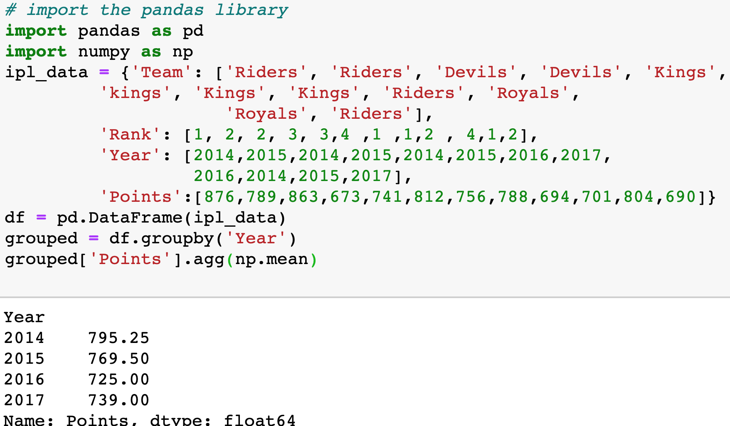
Groupby - aggregations
An aggregated function returns a single aggregated value for each group

Slide 39
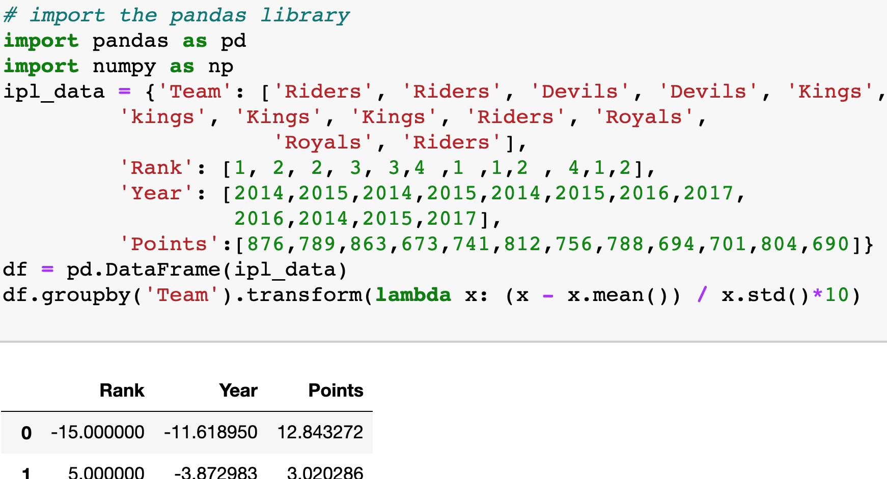
Groupby - transformations
Transformation on a group or a column returns an object that is indexed the same size of that is being grouped.

Slide 40
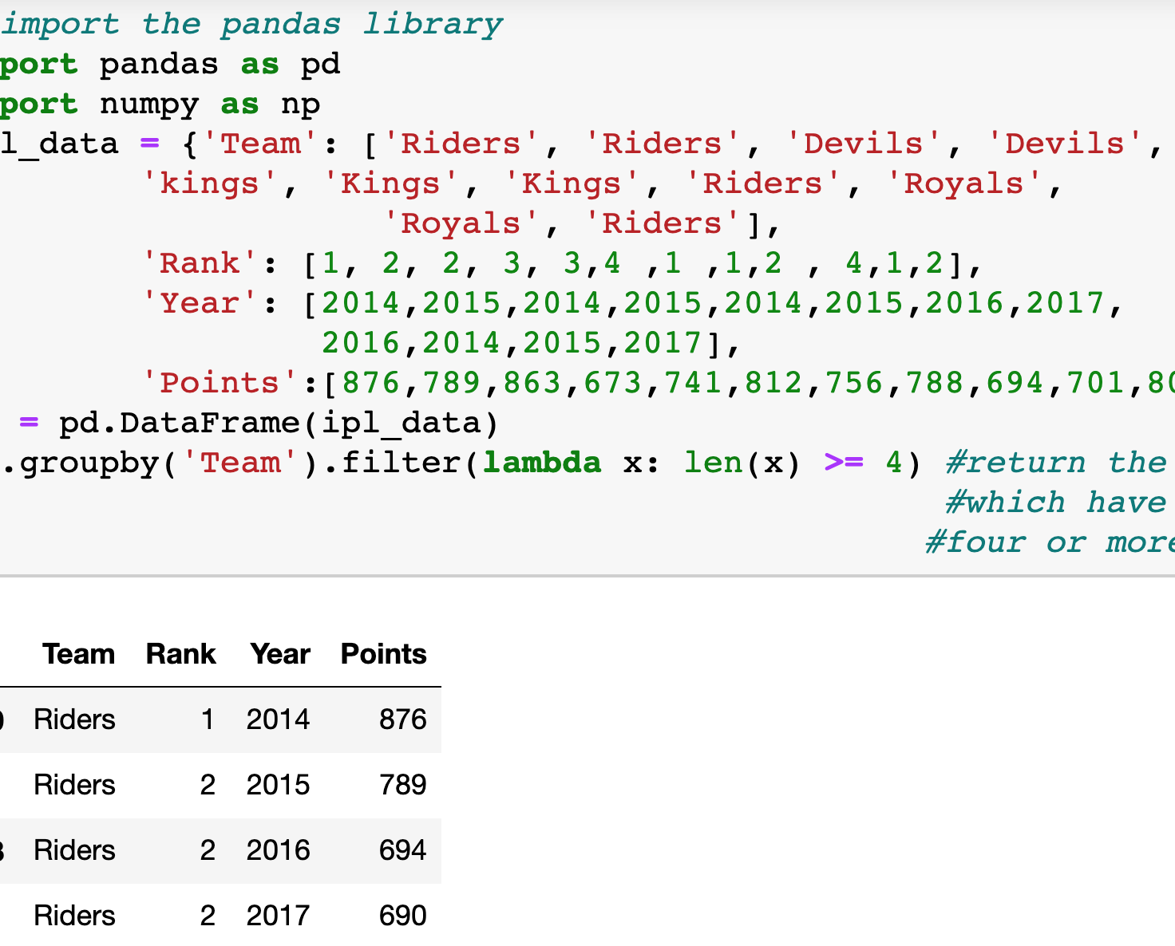
Groupby - filtration
Filtration filters the data on a defined criteria and returns the subset of data. The filter() function is used to filter the data.

Slide 41
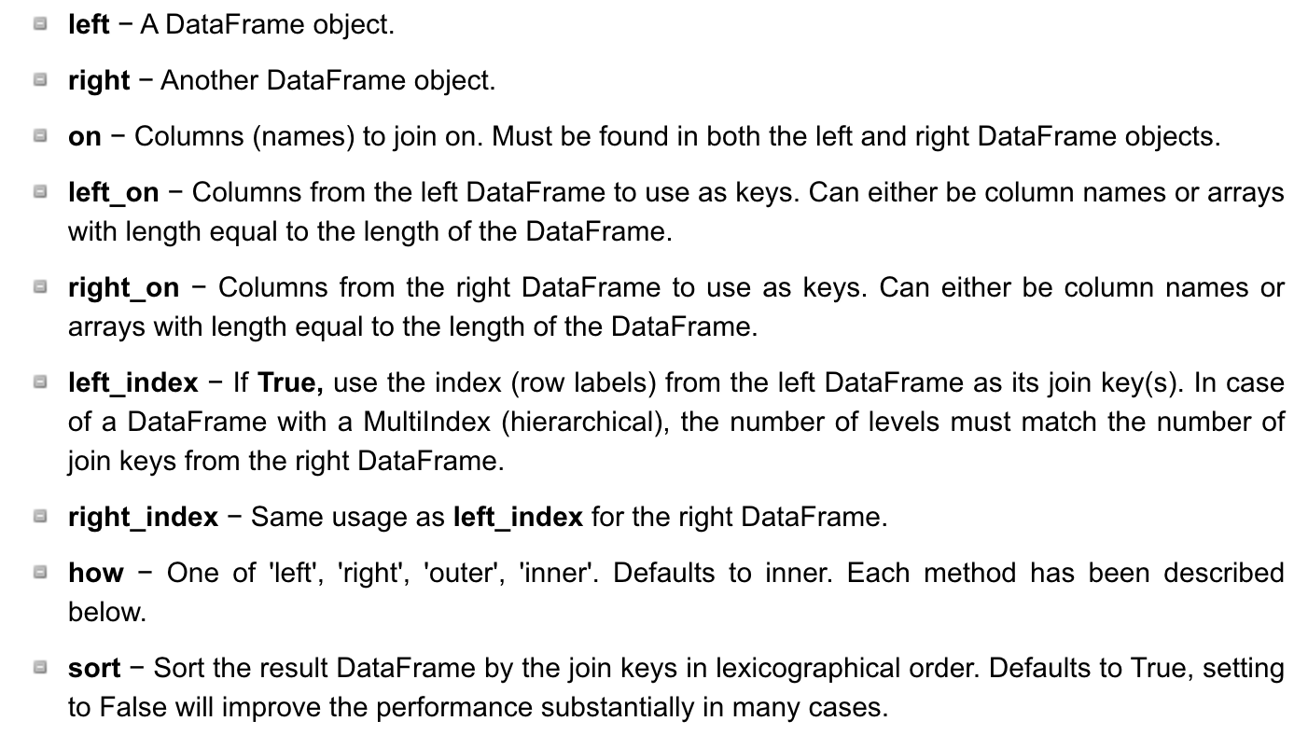
Pandas - merge
Pandas has full-featured, high performance in-memory join operations idiomatically very similar to relational databases like SQL
Syntax:
  pd.merge(left, right, how='inner', on=None, left_on=None, right_on=None, left_index=False, right_index=False, sort=True)

Slide 42
Hands on - merge
>>> import pandas as pd
>>> left = pd.DataFrame({ 'id':[1,2,3,4,5],
'Name': ['Alex', 'Amy', 'Allen', 'Alice', 'Ayoung’], 'subject_id':['sub1','sub2','sub4','sub6','sub5']})
>>> right = pd.DataFrame( {'id':[1,2,3,4,5],
'Name': ['Billy', 'Brian', 'Bran', 'Bryce', 'Betty’], 'subject_id':['sub2','sub4','sub3','sub6','sub5’]})

Slide 43
Hands on - merge
Print left and right
Merge on id
Merge on id & subject_id
Perform left join on key = id
Perform right join on key = id
Perform outer join on key = id
Perform left join on keys = (id, subject_id)
Perform right join on keys = (id, subject_id)
Perform outer join on keys = (id, subject_id)

