Slide 1
Python
decision making & loops controls
-Rageeni Sah
sahrageeni4@gmail.com

Slide 2
Making decisions and loop control
decision
making
simple if
if-else
nested if-else
loop control
while loop
for loop

Slide 3
simple if
Note: keywords are case-sensitive
Syntax:
if <condition true>:
  any task
WAP to read two numbers from a user and print a suitable message if first number is greater than second number.
Notations:
keywords
A condition can be any logical expression returning only one of these two Boolean values: either True or False

Slide 4
if-else
Syntax:
if <condition true>:
  task-1
else:
  task-2
        WAP to read two numbers from a user and print a suitable message if first number is greater than second number otherwise, ask to re-enter the numbers again such that the first number should be greater than the second number.
Notations:
keywords

Slide 5
Nested if-else
Syntax:
if <condition-1 true>:
  task-1
elif <consition-2 true>:
task-2
..
else:
  default task
Notations:
keywords

Slide 6
WAP to check if a number is even or odd.
WAP to assign grades to the student based on the scores obtained in the exam. The grades are allocated as follows:
    Grade ‘A’ if scores between 90-100
    Grade ‘B’ if scores between 80-89
    Grade ‘C’ if score between 70-79
    Grade ‘D’ if score between 60-69
    Grade ‘E’ if score between 50-59
    Otherwise, Grade ‘F’
3. Design a basic calculator program which takes minimum three inputs (2 operands and an operator) from the user to perform addition, subtraction, multiplication, division and modulo.

Slide 7
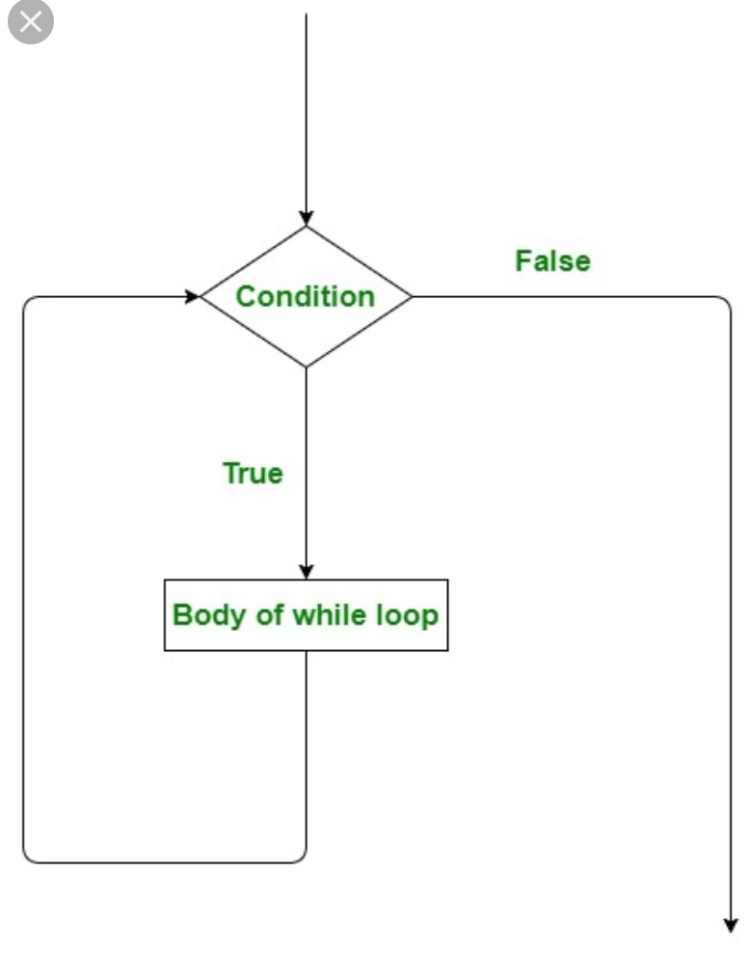
Structure of loop

Slide 8
for-loop
Syntax:
for <condition true>:
task
      OR
for <condition true>:
Task-1
else:
Task-2
        WAP to print each value in the given list:
Notations:
keywords

Slide 9
while-loop
Syntax:
while <True>:
task
        Print i as long as i is less than n;
Notations:
keywords

Slide 10
Break and continue
’break’ exits innermost loop while, ‘continue’ stops current iteration and continues with the next.

Slide 11
WAP to add from 1-100 and display final result.
WAP to display numbers from 1-10 except number 7.
WAP to read integers 1-10 from user and break the loop immediately if user enters anything other than integer.

