Slide 1
AirBnB Website Clone Portfolio Project
Webstack Portfolio Project - Pitch

Slide 2

Team Members
The three of us are working on this AirBnB Clone Project, and our names are;
Funmilola Ajayi
Ukamaka Okpala
Opeyemi Olumade

Slide 3

Description of the Project
This project is an AirBnB-like web-service built majorly with Javascript, React, Express JS, Node JS and MongoDB.
Airbnb Clone is an online vacation rental marketplace between the host and the travelers. A host can list their place and rent it to the travelers. Therefore, they can earn money with it instantly. The goal of this project is to deploy a recreation of the AirBnB website.

Slide 4
Learning Objectives
dfjsdlsjlfjfmkls

Slide 5

Technologies Used
Visual Studio Code for the editor
HTML/CSS/Javascript for frontend
NodeJS for Backend
React and ExpressJS for frameworks
MongoDB for Database

Slide 6
Challenges Already Identified
Collaborating with a remote team member can be challenging especially when one or all of us have challenges with network connectivity.
Electricity power outages which could delay the workflow.
Learning and adapting to React and NodeJS in order to finish the front-end and back-end in such a short period of time.

Slide 7
Schedule of Work
Chose frameworks and language we can use
Discussion of which project to choose
Trello Development
Started Development
We eventually chose AirBnB clone project
We resolved on using HTML/CSS/Javascript for front-end, Node.js for back-end and MongoDB for database
AUGUST |  |  |  | SEPTEMBER
We also prepared for our pitch/presentation video
Github Repository creation and utilization
Catching up of React to use it for front-end development

Slide 8
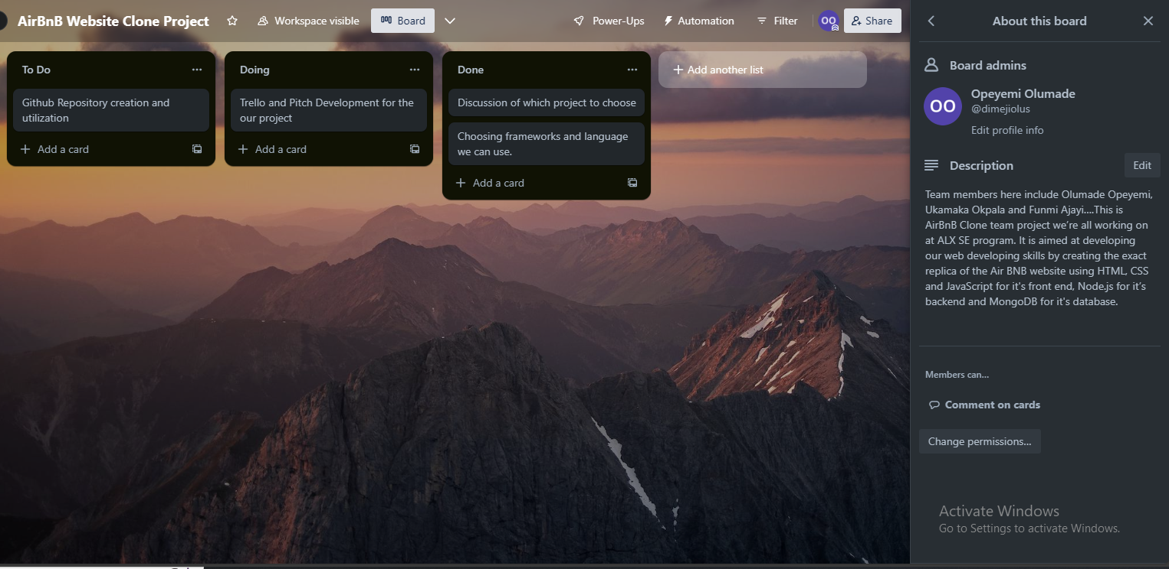

Slide 9

THANK
YOU

