Slide 1
UDP Full Training Sessions 08 March 14:00-16:00 10 March 10:00-12:00 14 March 14:00 – 16:00

Slide 2
Training Outline
Abbreviations and Definitions
Brief overview of purpose and benefits of the platform
Overview of user Responsibilities
Access and Data
System Navigation
Overview of Applicant Journey Status
Super Sponsor Scheme
Individual Sponsor Scheme
Overview of Sponsor/host Journey Status
UDP Do’s and Don’ts
Using the system
Incl:
Searching for records
The use of views – including how to edit / create a new view
Undertaking Checks and creating case notes
Creating and Amending Housing need record
Creating and Closing placement records
Updating journey status
Notes:
Covering a basic overview of system uses
Taking it back to simple basic ways to use the system – to avoid using shortcuts
We have seen over the past few months that different LAs work the system differently – we want to establish a one process for all
Will mention some of the recent updates but this training will not recover things like de-duplication – we are going back to basics here to cover the fundamental processes of the system
Some conversations about read only access- we can certainly look into that but in terms of access its either user access or (if we can) read only – if the user has access to all – its down to the LA to manage what they do in the system

Slide 3
Common Abbreviations
EOI – Expression of Interest
UDP – Ukraine Data Platform
HH – Household (usually beginning with FAM or WG)
HA- Host Address
CC- Contact Centre
WC – Welcome Centre / Initial Accommodation
SS - Super Sponsor
IS - Individual Sponsor
Definitions
Sponsor - A Sponsor is the person who sponsor’s the visa for the individual. For Super Sponsor that is the Welsh Government but for Individual Sponsor Scheme, that would usually be the host providing them with accommodation.
Host - A Host is the person providing accommodation for the household(s).
An individual can be both sponsor and host.
Notes:
Commonly used abbreviations – often questioned but helpful to be aware of
Sponsor / host definition – this has been a grey area a few times due to wording in the system

Slide 4
Ukraine Data Platform – Purpose and Benefits
Purpose of platform
To have a real time, single source of data to those providing support to Ukrainian citizens coming into Wales.
Benefits of platform
Centralised and simplified data
Safe and secure
Cross-agency
Ease of Reporting
Notes:
Purpose:
It’s important we provide a single source of truth to view the full journey progress. The system was designed so that we can ensure all parties are entering information into the same system.
We are aware that some information cannot be entered into the system and there are still some elements that need to be stored separately off the platform but it’s important that the core basic data is recorded correct for every Ukrainian applicant and every sponsor.
Benefits
– everything in one place for all entities
WG overhead for support
We’re able to successfully pull reports from the system
We can monitor misaligned data

Slide 5
Overview of User Responsibilities
It is the Data Champions responsibility to ensure that all users are fully trained prior to using the system
All system queries should be sent via the Data Champion to WG via the nation of sanctuary survey mailbox nationofsanctuarysurvey@gov.wales
Users should access the user guide and information hub regularly to ensure that they are up to date with the latest changes – any new processes will always be highlighted in the featured items on the home page
All users must ensure that data is kept up to date to avoid this having a knock on effect on funding, safeguarding and reporting
Always ensure that no sensitive information (including medical data) is added to the platform
Notes:
Can’t stress enough the importance of training – today’s training welcome’s all users but often we conduct a ‘train the trainer’ approach to data champions who are expected to then go onto share training materials with users effected and ensure all users are trained to sufficiently use the system
We have seen recently that different LAs are processing their data in different ways. We’ve also seen situations where the user guide has not been referred to and errors are being made in the system which can subsequently have an impact on the flows in the background and therefore a knock on effect on data and future releases
Importance of user guide and info hub!
Mention funding and year end – data needs to be kept up to date
Refused/ voided applications – we now have views for this

Slide 6
Ukraine Data Platform – Access and Types of Data
Who can access it?
Welsh Government
Digital Health and Care Wales
Public Health Wales
Contact Centre (hosted by Cardiff Local Authority)
Local authorities in Wales
Local health boards in Wales
What information is available via the Data Platform?
Names, addresses and other key demographic information for Ukrainians, hosts and sponsors.
Checks required and whether they have been undertaken
Accommodation requirements
Notes (this should not contain any medical or sensitive information)
What information is not available via the Data Platform?
Medical and sensitive data
Ongoing service provision (e.g schools, social care)
Capacity of welcome Centre's
Notes:
Key Points
Access
Non-Local authority staff working in welcome centres or temporary accommodation such as hotels will not have access to the data platform
System security permissions determine the information you see
Local authority staff will only see data for those allocated to their local authority area. This applies to applicants of both the individual and super sponsor schemes.
Remembering that there are certain responsibilities for who updates what data –CC staff manage any SS cases up to their point of arrival- contact centre staff also manage complex cases with a close liaison with the LA
LA’s are responsible for getting in contact with IS and hosts to obtain information where needed to ensure the platform is up to date
Data
The Welsh Government, local authorities and NHS health boards are all independent data controllers for the data they will access through the platform. Cardiff Council in it's role as the Contact Centre, are operating as a Processor under Welsh Government's instruction.
The system is should not include any medical or sensitive data.. This is where you may need to keep your existing system in place, particularly where you are sharing data with colleagues providing statutory services such as education or social service.

Slide 7
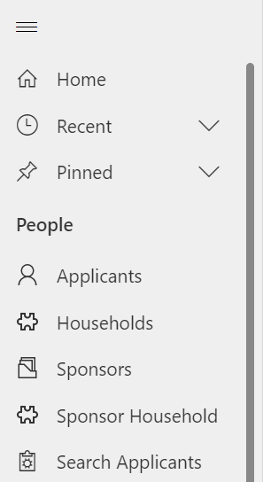
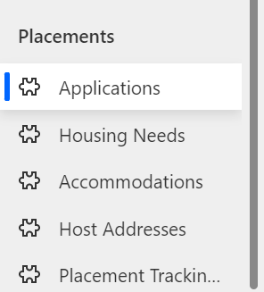
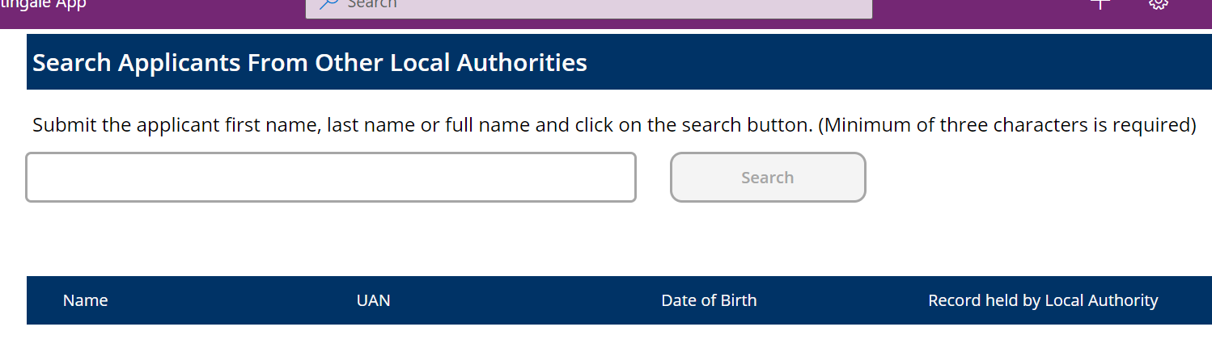
System Navigation
It’s important to become familiar with the navigation panel on the left hand side of the data platform
The Search Applicants tab is a great tool to be familiar with – this will allow you to find out where a record sits within the system regardless of which LA you are searching from
Notes:
Familiarity with the system navigation is really important
Knowing and understanding how to use the shortcuts within the navigation panel will help to move more freely through the system rather than clicking through lot of different records and tabs
If you didn’t already know about the full system search, I will show it on the system a little bit later on but the system holds the functionality to search records out of your area to see where they are sat within the system

Slide 8
Overview of Applicant Journey Status’
Super Sponsor Scheme | Individual Sponsor Scheme
SS01- New Visa Approved SS01A – Pending SS01B – Uncontactable SS01C- Complex Case Discussion | IS01 – Visa and Host Approved
SS02- Ready for WC Allocation | IS02 – Placed with host Family
SS03 – Welcome Centre Allocated | IS03 – Moved to Accommodation
SS04 – Informed of WC Arrangements | IS04 – Rematching Needed
SS05 – In Transit SS05A- In Isolation SS05B- Hospital Admission SS05C- Temporary Accommodation Pending Medical Discharge SS05D – No Show – Known SS05E – No Show – Unknown | IS05 – Move on
SS07- Housed in a Welcome Centre | IS21 – No Show – Known
SS08 – Welcome Centre Ready for Move on | IS22 – No Show – Unknown
SS09 – Move on Accommodation Allocated | IS23 – Uncontactable
SS10 – Moved on | IS99 – On Hold
SS11- Duplicate Record | IS100- Duplicate Record
Notes:
Covering the importance of the applicant journey status’ – setting these correctly can ensure that some system functionalities and flows work correctly and it ensures your views are filtered correctly
By now I’m sure you are all aware of the process for SS journey – SS01- SS05 are covered by CC and then LA take over at SS07 – at the present time the focus is shifting more towards the move on process and so those later status’ are becoming more frequently used
Same for the IS side of things - the likes of no show dropdown will eventually have some control over functions in the system so its important that the status are kept up to date

Slide 9
Overview of Sponsor/Host Journey Status
Sponsor/Host
HST001 –Applied
HST002- Approved
HST003 –Active
HST004 – Withdrawn
HST005 – Rejected
HST006 – Duplicate
Users should consider and review journey status’ for both applicants and sponsor/hosts regularly to ensure that the data reflects the current situation of the individual
Setting the journey status correctly will ensure correct system functionalities run in the background
Notes:
In recent updates over the last few months we have seen these status’ become more prevalent within the system – especially HST004 /005 /006
Functionality behind these allows for the system to deactivate these records to ensure that we don’t have any withdrawn / rejected or duplicate sponsors / hosts showing as available in the system
To note: if you see any sponsors in your active sponsor list that are marked as any of the above 3 – 004 / 005 / 006 – then this means they were probably marked as this prior to de-duplication updated – you will need to go in and select them as applied and save and then re select the correct dropdown and save – this will deactivate the record automatically – guidance in the table on the user guide

Slide 10
UDP Do’s and Don’ts
Do | Don’t
Ensure all duplicated sponsor records have been completed using the de-duplication process | Use the assign button to move records (unless you have created a new EOI host and need to assign it to your LA)
Keep all records as up to date as possible, ensuring all statuses and toggles have been set correctly | Deactivate any records within the system – especially things like placement tracking’s / applicant records
Set up personal views / use the views created by WG to ensure all data issues are corrected | Delete any records from the UDP – especially things like placement tracking’s /applicant records
Continue to send any queries or questions to the survey mailbox | Create new records other than EOI hosts/ sponsors
Refer to the user guide / information hub for all process instructions | Ignore the user guide / information hub – it’s there for you to use and refer to for all processes relating to the UDP
Notes:
Emphasis on importance of using the user guide and info hub – full of guidance / training videos and the full user guide which is also available to download
Emphasis to NOT deactivate OR delete anything within the system unless through the dropdowns to allow the functionality to process

Slide 11

Technical Support and feeding back
We always want to know how we can improve the system
Please:
Provide feedback on the system
Report bugs or issues
Via your Data Champion to: Nationofsanctuarysurvey@gov.wales
We also have an LA drop in session for all Data Champions every fortnight – please raise any issues with your Data Champion so they can bring these to the meeting.
Please:
Report any Data issues
Query any Data discrepancies
Via your Data Champion to: Data@gov.wales
Please also continue to send any wide policy/operational queries to: UkraineResponseQueries@gov.wales
Users liaise with their local champion to see whether there is a system issue.
If the problem cannot be resolved, you should contact the DHCW National Service Desk.
DHCW will pass the issue to Welsh Government or Microsoft to solve, depending on the type of issue.
You should check with local IT to ensure whether a local issue is causing the system issue
Notes:
Guidance on the support model in the annex of the user guide
WNSadmin@cardiff.gov.uk – is the contact centre contact – be mindful of the difference
CC will refer anything over to WG when needed

Slide 12
Let’s look at the data platform…

Slide 13
Points to take away with you…
Follow the processes as documented in the user guide.
If you have a problem, the user guide should be your first point of call.
Please keep your data up to date – it is used by more people than you may think.
Under no circumstances should anything be deleted or deactivated unless you are using the system functions that do this automatically (withdrawn/rejected etc).
If you have a suggestion to improve the platform please let us know via your data champion.

