Slide 1




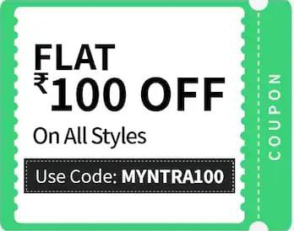






COUPONS
+
SHOP ON
END OF
SEASON SALE
UPTO
On 5xtra
Shop Now on 5xtra.com:
Get 50% cashback + coupons + UPTO 6% BACK
6% BACK
WWW.5xtra.com

