Slide 1


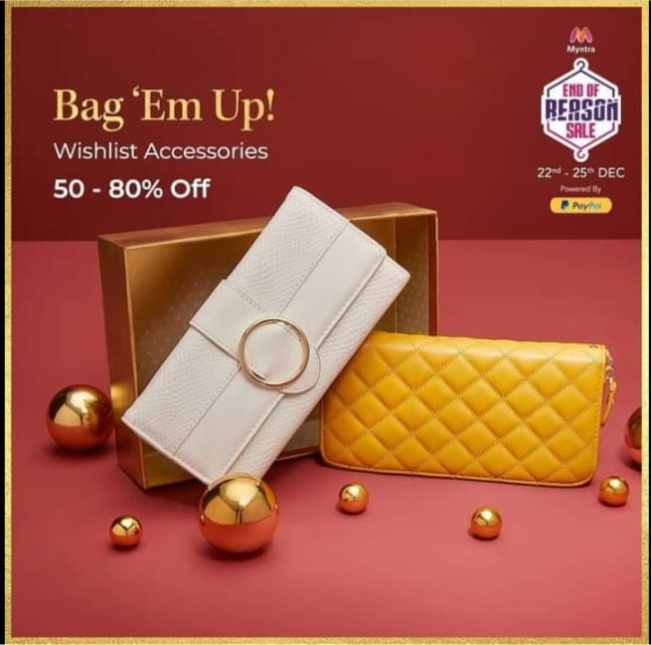
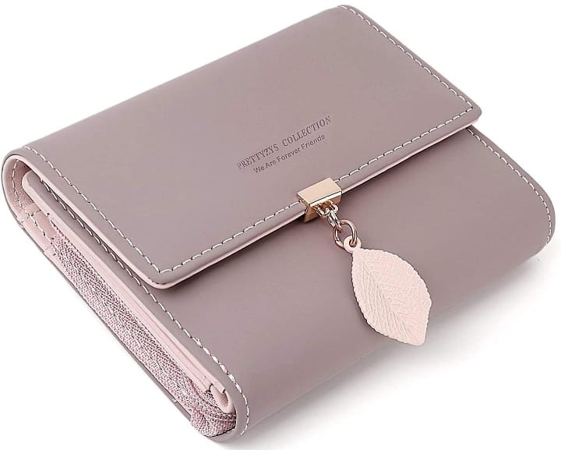

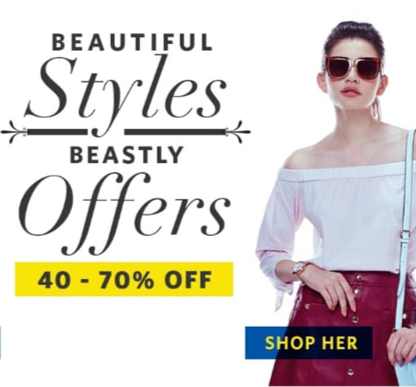





Top 5 Brands:
Baggit
Crazy Corner
Hidesign
JENNA
CALFNERO
Women's wallets are essential accessories designed to store and organize personal items such as cash, cards, identification documents, and other small belongings. They come in various sizes, styles, and materials to suit different needs and preferences.
Clutch Wallet: A larger wallet that often resembles an evening clutch. It can hold cards, cash, and other essentials and is designed for occasions when a larger bag isn't necessary.
Zip-around Wallet: This type of wallet has a zipper closure that wraps around three sides, offering added security and protection for its contents.
Card Holder: A compact wallet designed primarily for carrying cards, often with slots or pockets to hold a few bills as well.
Wristlet Wallet: A wallet that includes a detachable wrist strap, allowing it to be carried as a standalone accessory.
Materials commonly used for women's wallets include leather, synthetic materials, fabric, and canvas. Leather wallets are highly durable and develop a unique patina over time, while synthetic materials offer affordability and various design options.
HURRY UP
SALE!

