Slide 1




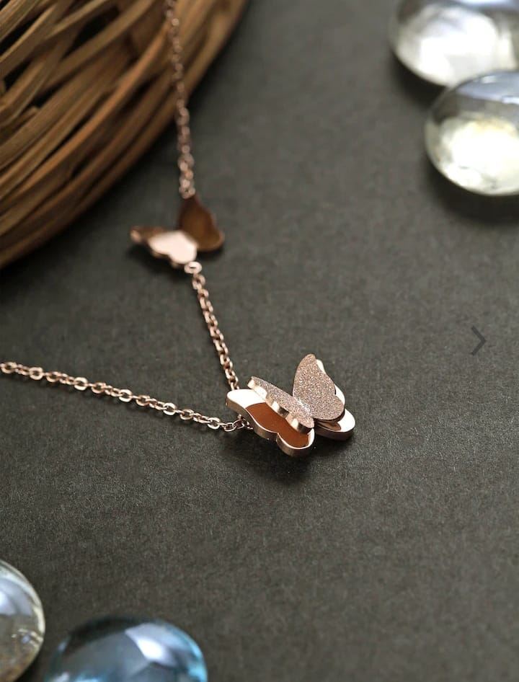



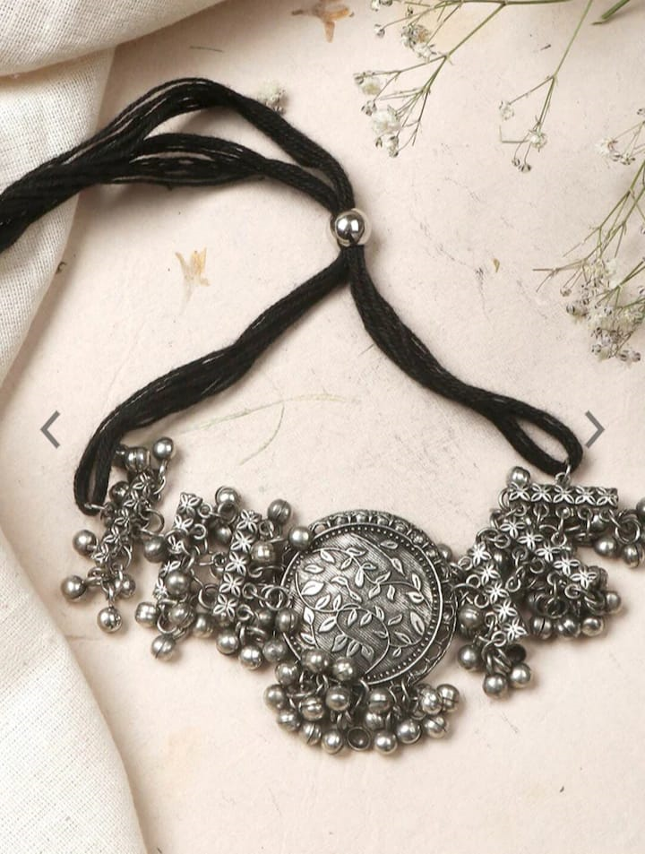
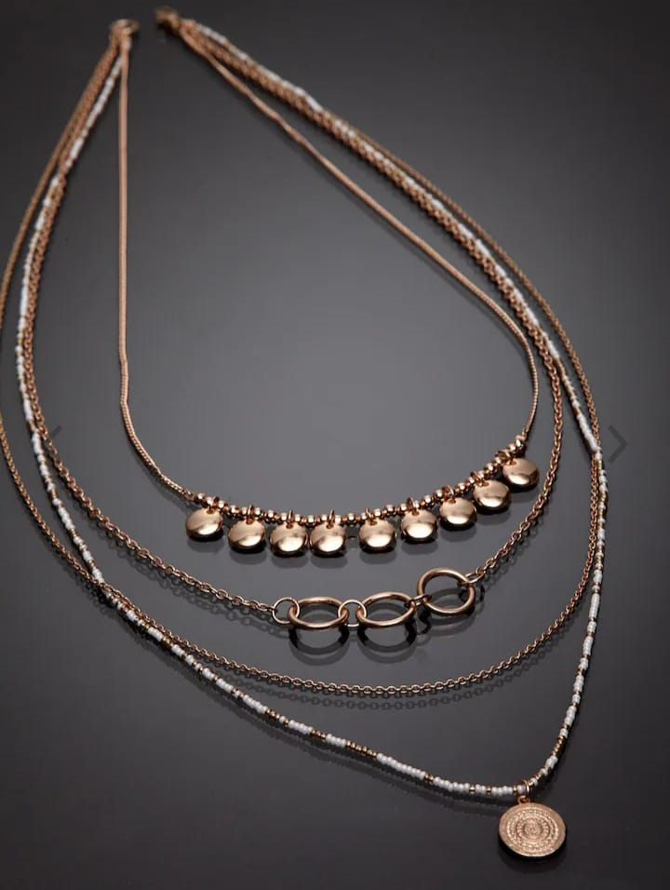


AAKRITI ART CREATIONS
AanyaCentric
ABDESIGNS
AccessHer
Accessorize
Pendant Necklace: This classic style features a single pendant hanging from a chain. Pendants can come in various shapes, such as hearts, crosses, initials, or gemstone-encrusted designs. They add a touch of elegance to any outfit.
Statement Necklace: If you want to make a bold fashion statement, a statement necklace is the way to go. These necklaces are typically large and eye-catching, often featuring oversized gemstones, beads, or intricate designs. They can transform a simple outfit into a glamorous ensemble.
Choker Necklace: Choker necklaces are worn snugly around the neck and can be made from various materials like leather, lace, or metal. They can be delicate and minimalistic or adorned with charms and gemstones. Chokers are versatile and work well with both casual and formal attire.
Layered Necklace: Layered necklaces consist of multiple chains of varying lengths worn together. This style adds dimension and visual interest to your neckline. You can create your own layered look by combining necklaces of different styles, textures, and pendant lengths.
Birthstone Necklace: Birthstone necklaces are a popular choice, as they add a personal touch to your jewelry. Each month has a designated birthstone, and wearing a necklace featuring your birthstone or the birthstones of your loved ones can be a meaningful and stylish choice.
HURRY UP
SHOP NOW
Only On 5xtra
WWW.5xtra.com

