Slide 1


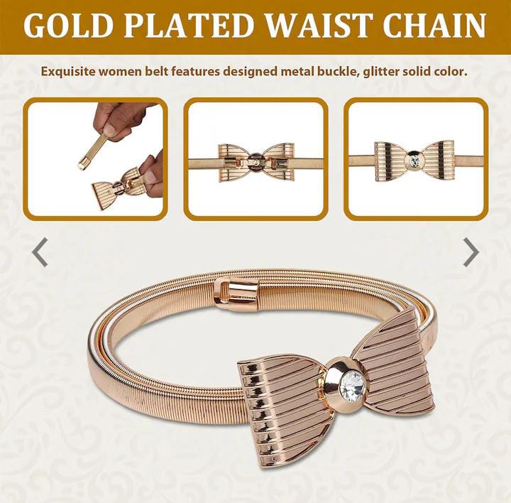
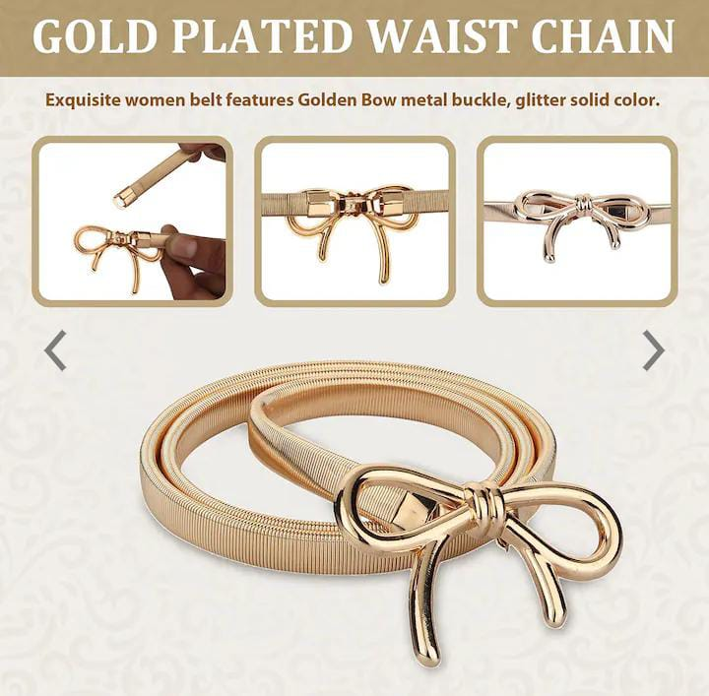



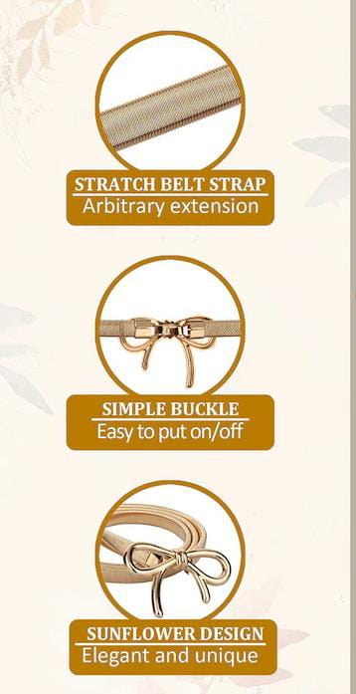
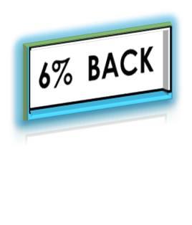
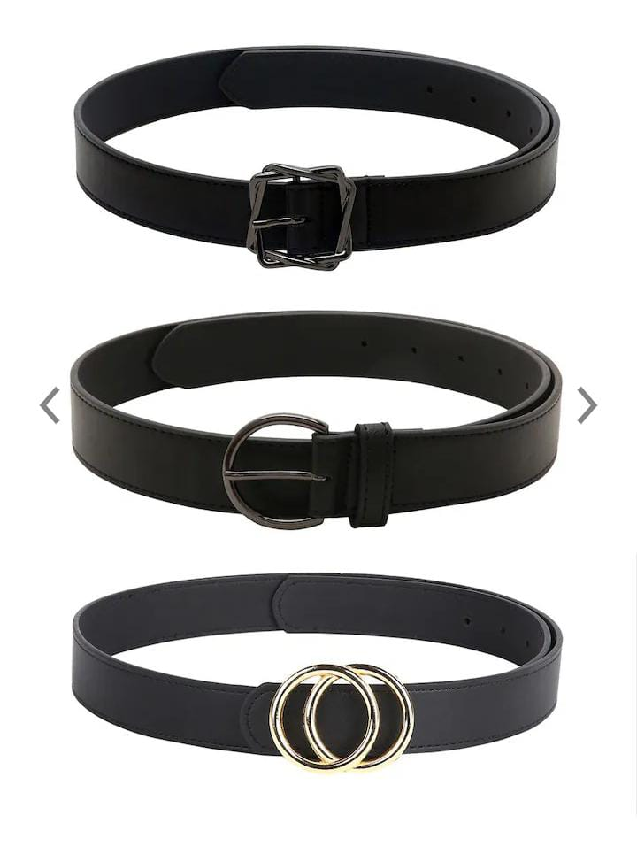


Top 2 Brands:
H&M
Tommy Hilfiger
AccessHer
Aditi Wasan
ALDO
Women's stylish belts are an essential accessory that can elevate an outfit and add a touch of flair to your overall look. Belts for women come in a wide variety of styles, materials, and designs to suit different fashion preferences and occasions.
HURRY UP
Chain belts: Chain belts are trendy and fashionable options that add a touch of edginess to an outfit. They are made of metal chains and can be worn at the waist or on the hips, depending on your preference. Chain belts can be paired with jeans, dresses, or skirts to give your look a stylish twist.
Braided belts: Braided belts feature intricate weaving patterns and are often made from leather or fabric strips. They add a bohemian or rustic vibe to outfits and can be a great accessory for casual or summer looks.
BIG
SALE!
Decorative belts: Decorative belts come in various styles and feature embellishments like studs, crystals, beads, or embroidery. These belts can add a pop of color, texture, or sparkle to an outfit and are ideal for special occasions or when you want to make a fashion statement.
Only On 5xtra

