Slide 1


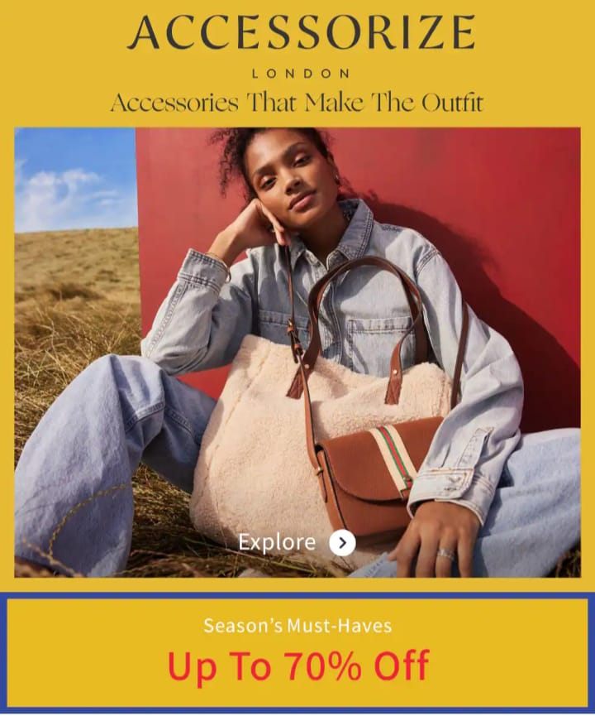
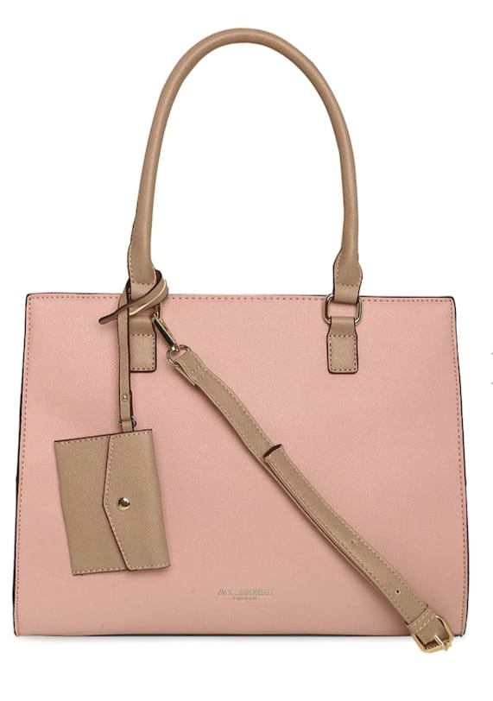




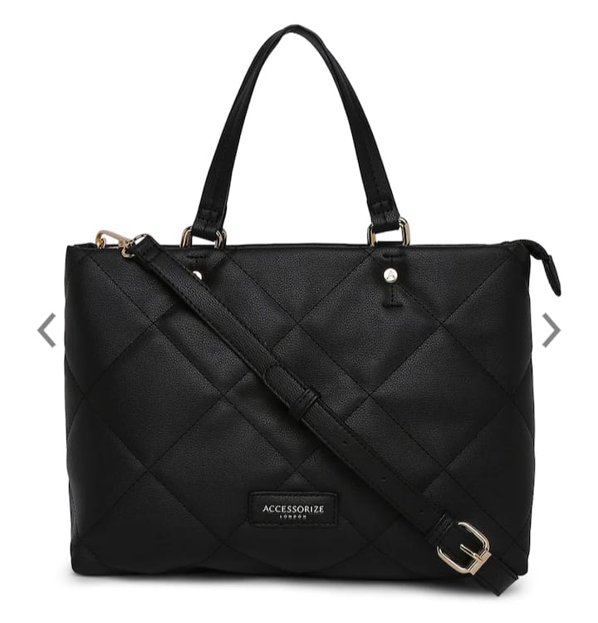

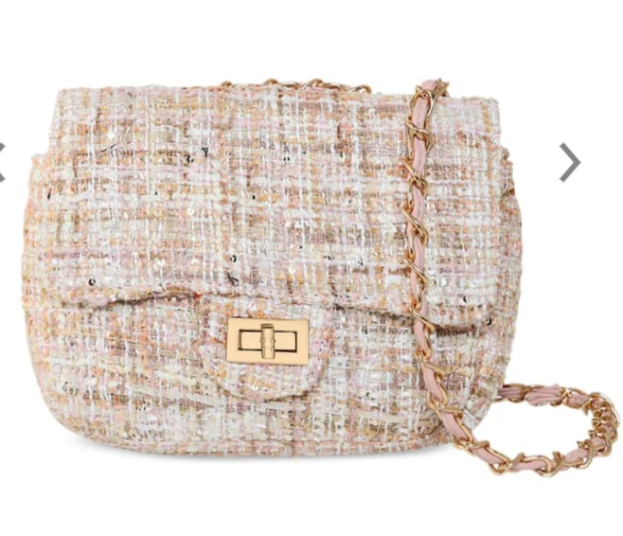


Top 5 Brands:
Kazo AccessHer Accessorize Addons
Aditi Wasan
Vintage stores: Vintage stores can be a treasure trove for finding special handbags with a unique flair. You may discover vintage designer bags or rare pieces from past decades that are no longer in production.
Custom-made handbags: Consider having a handbag custom-made according to your preferences. Some designers and artisans offer bespoke services where you can collaborate to create a truly special and personalized handbag
HURRY UP
END OF REASON SALE UPTO
Local artisans and craftspeople: Check out local craft markets, art fairs, or artisan communities in your area. These venues often showcase handcrafted bags made by local artists, giving you a chance to support local talent and find unique creations.
Remember to consider your budget, style preferences, and the occasion for which you need the handbag. It's also a good idea to read reviews, compare prices, and check return policies when shopping online to ensure a satisfactory purchase
Specialized boutiques: Look for specialized boutiques that focus on unique and one-of-a-kind handbags. These boutiques often carry limited-edition or handmade bags that can make a statement.
Designer collections: Many high-end fashion designers release special handbag collections featuring unique designs and materials. Explore the collections of renowned fashion houses to find special edition or limited-run handbags.
Only On 5xtra

