Slide 1
5xtra.com

Slide 2
Task:
To create all the accounts in
FACEBOOK
INSTAGRAM
LINKEDIN
QUORA
PINTEREST
YOUTUBE
TWITTER
May 16

Slide 3
Korapati Usha Rani
5xtra :
FACEBOOK:
https://www.facebook.com/profile.php?id=100092696648012&mibextid=ZbWKwL
Instagram:
https://www.instagram.com/usha_rani04q/
LINKEDIN :
https://www.linkedin.com/in/korapati-usha-rani-422b82276
QUORA :
https://www.quora.com/profile/Korapati-Usha-Rani?ch=3&oid=2195180978&share=3e886a6b&srid=hyUA2j&target_type=user
PINTEREST :
https://pin.it/3jEVXJa
YOUTUBE :
https://youtube.com/@korapatiusharani9613
TWITTER :
https://twitter.com/KorapatiURO11?t=NlQ8j_TFLEANBpMgo8yBRQ&s=08
May 16

Slide 4
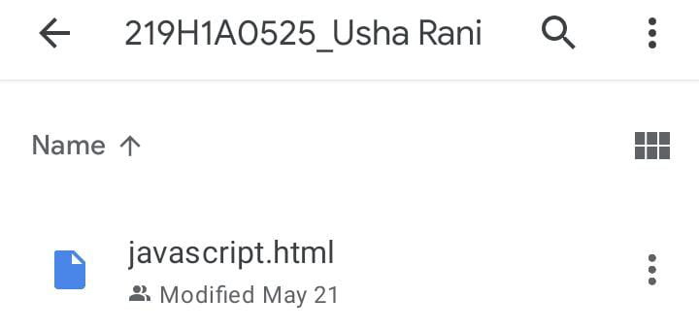
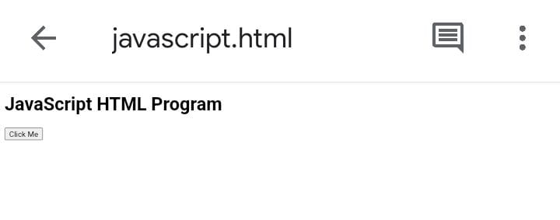
Technical session works:
Work-1:
HTML Java Script:
PROGRAM:
<!DOCTYPE html>
<html>
<head>
<title>JavaScript HTML Program</title>
</head>
<body>
<h1>JavaScript HTML Program</h1>
<button id="myButton">Click Me</button>
<p id="demo"></p>
<script>
// JavaScript code
document.getElementById("myButton").addEventListener("click", function() {document.getElementById("demo").innerHTML = "Button clicked!";});
</script>
</body>
</html>
OUTPUT:
May 20

Slide 5
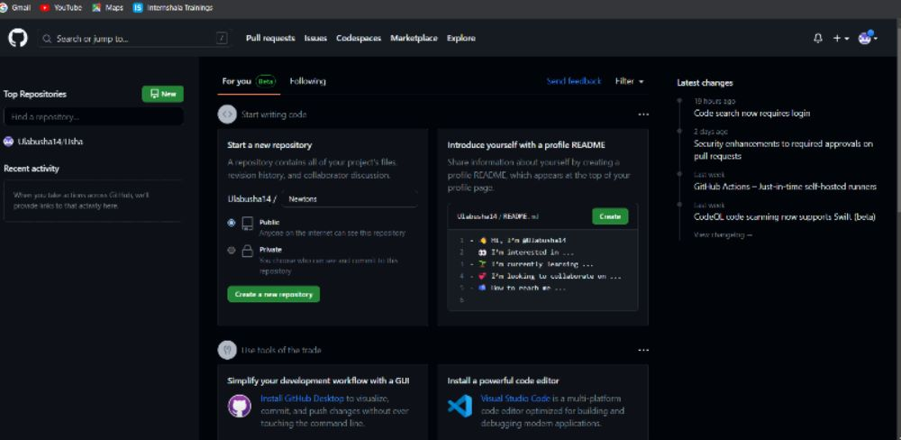
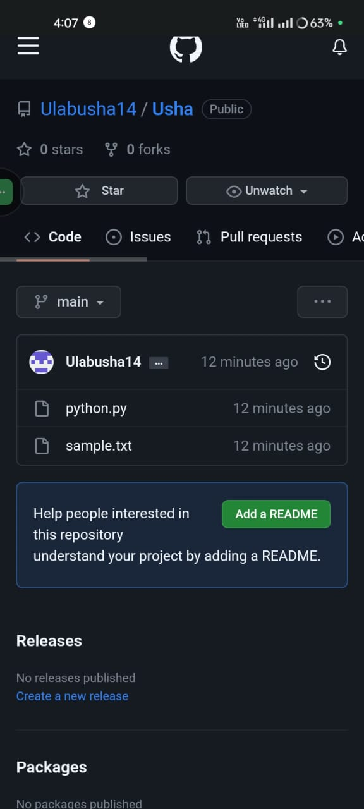
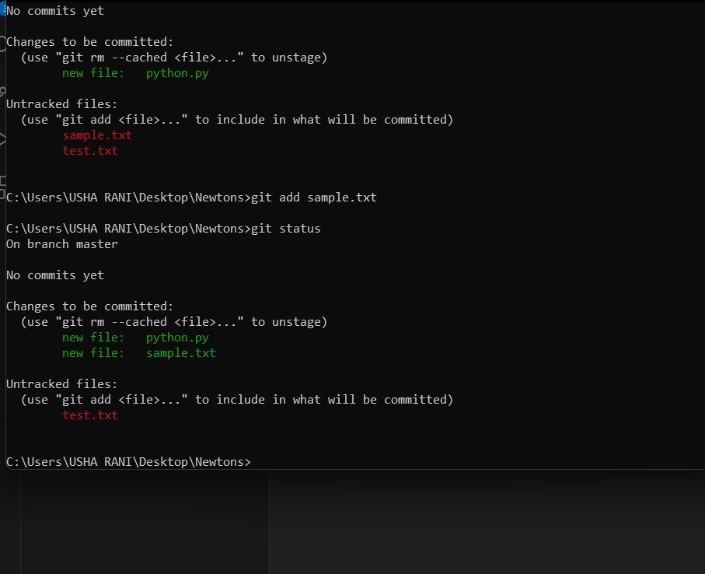
Work-2:
Git & GitHub:
Created account on GitHub:
1.create git hub account
2.create repository in git hub
3.download git hub software to your local system and install
4.create a Local repository (folder) in local system
5.create dummy files and move entire local folder into git hub (you have to move GitHub repository created in second step)
6.commands are
Git init
Git add sample.txt
Git commit -m “message”
Git push origin master
Commands:
May 21

Slide 6
Work-3:
HTML & CSS:
Task 1:
Implementation on all basic tags(pre, image, anchor, hr, br and inline style)
Task 2:
Implementation of font tag Instead of style tag
Task 3:
Task related to ordered and unordered list (ex: alphabets, numbers)
Task 4:
Implement the image given.
May 27

Slide 7

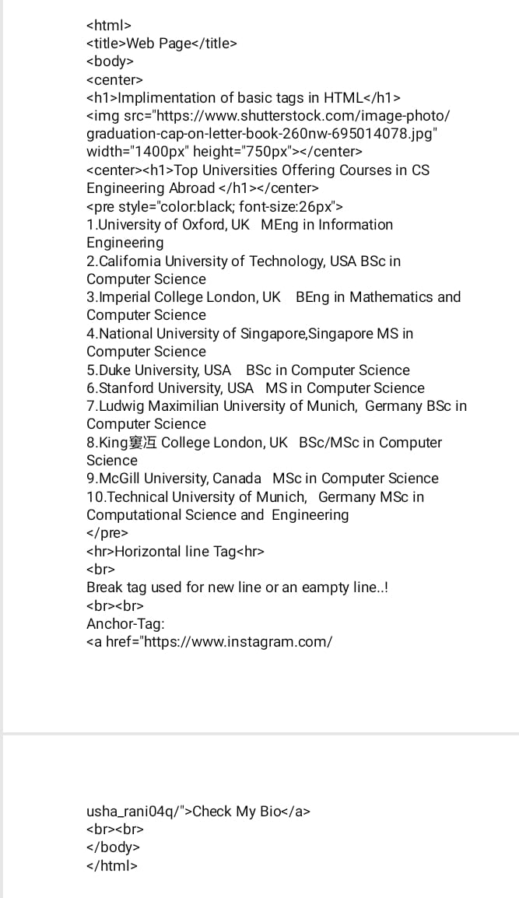
Task 1:
OUTPUT:
Program:
May 27

Slide 8
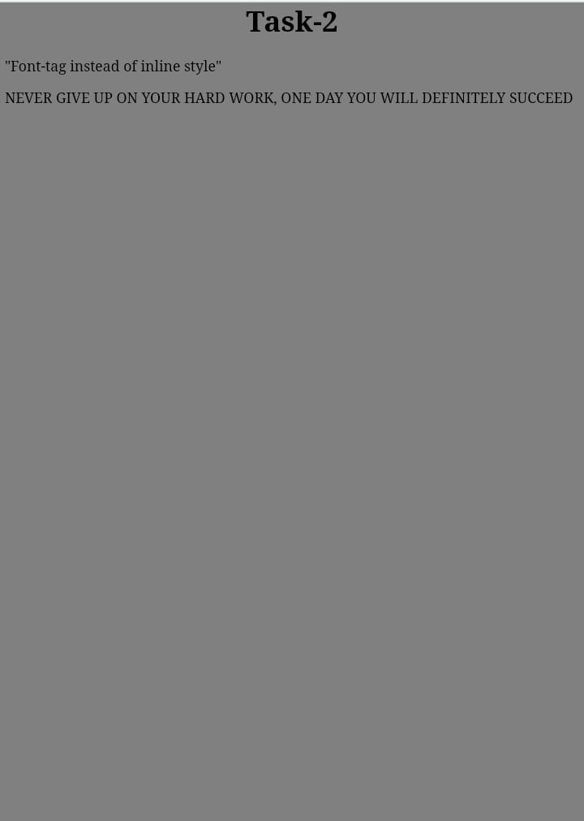
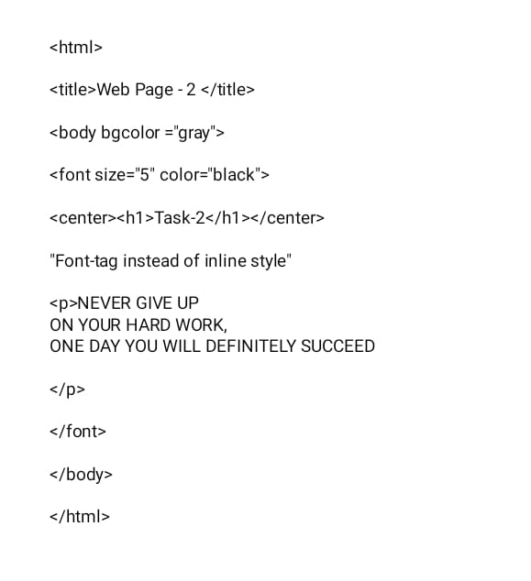
Task 2:
OUTPUT:
Program:
May 27

Slide 9
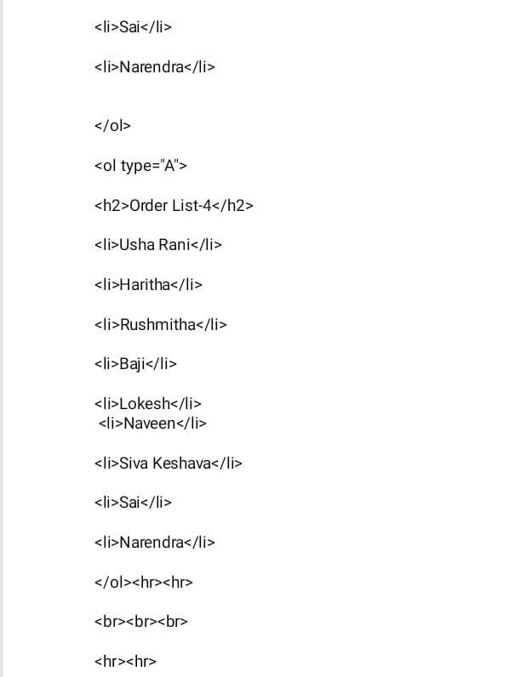
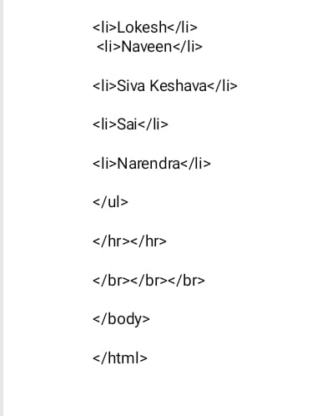
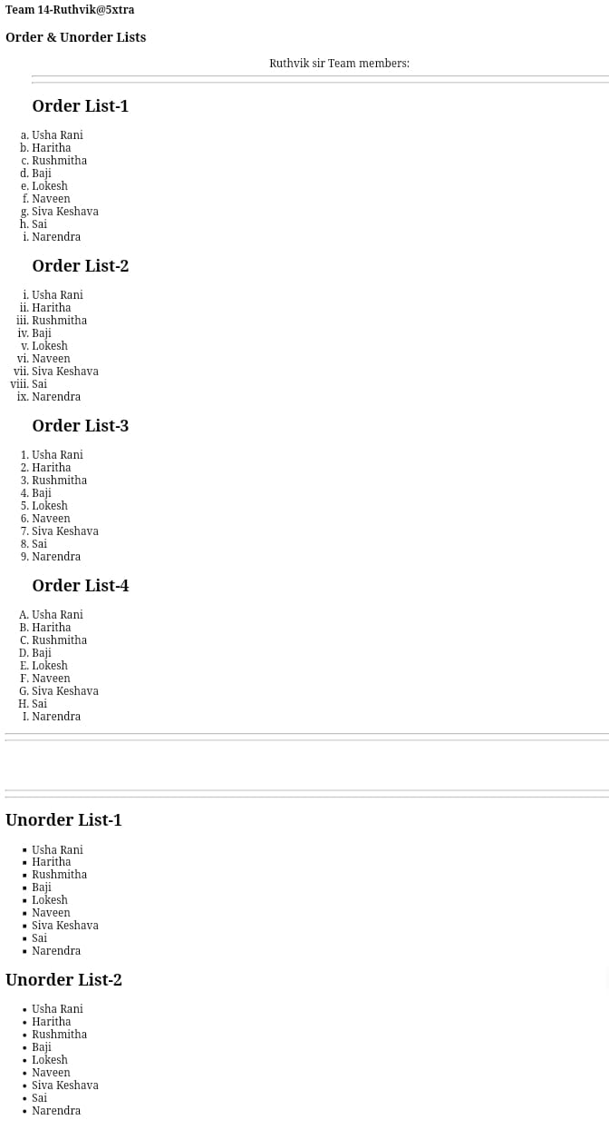
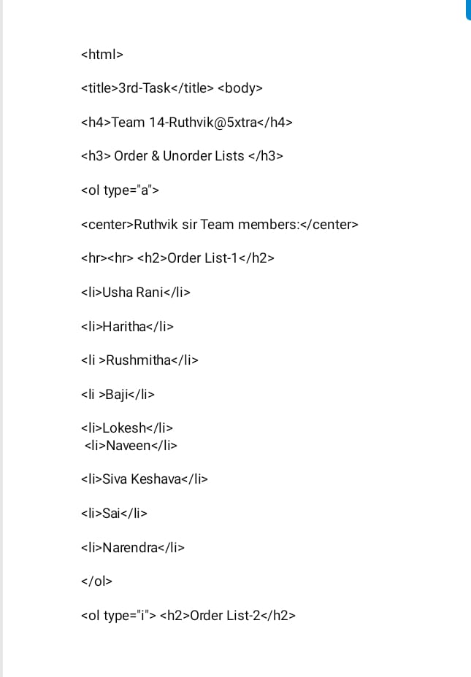
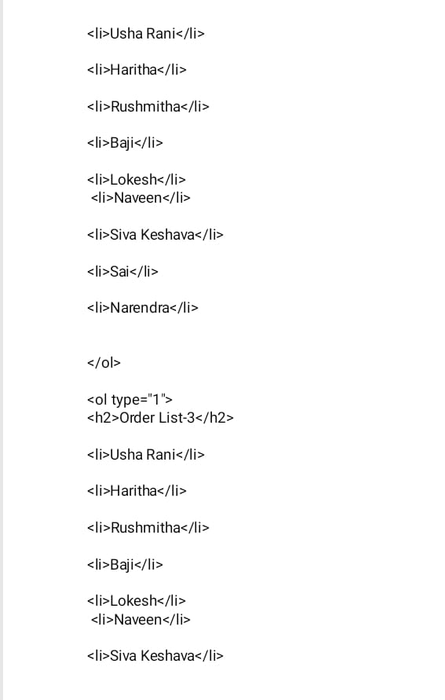
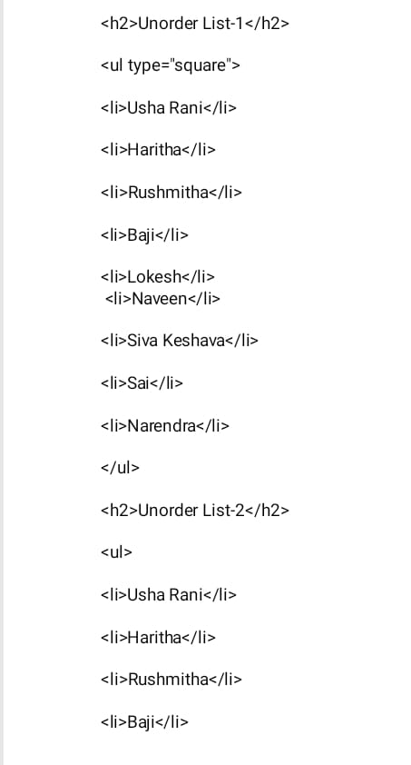
Task 3:
OUTPUT:
Program:
May 27

Slide 10
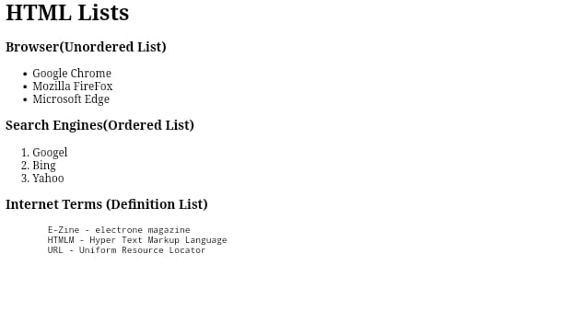
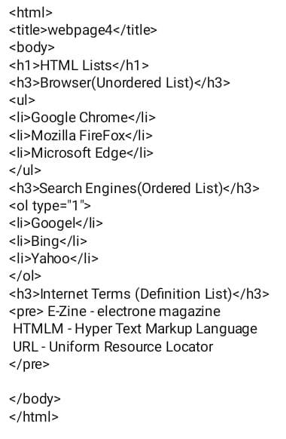
Task 4:
OUTPUT:
Program:
May 27

Slide 11
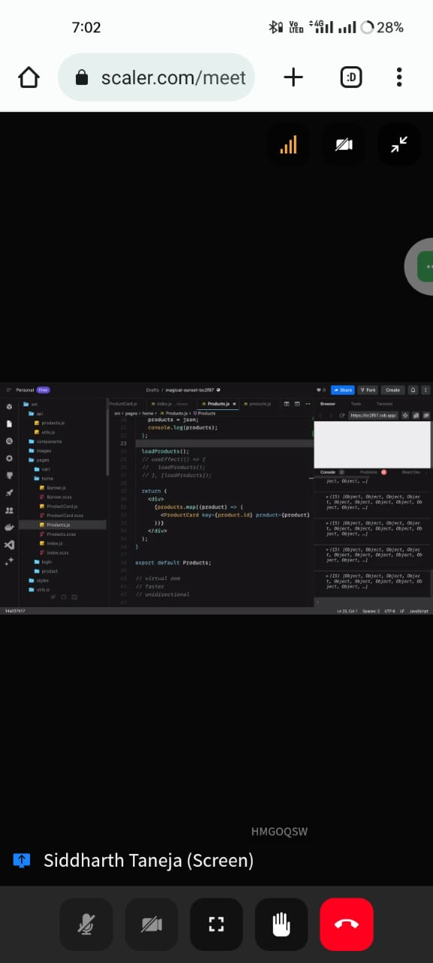
Work-4:
Class on React:
May 28

