Slide 1
WELCOME TO @5XTRA.com
Website of 5xtra.com: -http://5xtra.com

Slide 2

5Xtra All In One Fashions
#women'sclothes
#80sfashion
#men'sfashion
#women'sfashion
#kid'swear
#footwear
#koreanfashion
#fashion2016
#newfashion
#women'sethanicwear
#jewellery
#fashionstyle
#etc.....

Slide 3


Slide 4

5Xtra.com
"All-in-one fashion" typically refers to versatile clothing items or outfits that can be worn in multiple ways or for various occasions. These fashion pieces are designed to provide flexibility, convenience, and practicality, allowing individuals to create different looks without owning a large wardrobe. Here are a few examples of all-in-one fashion:

Slide 5


Convertible Dresses: These dresses come with detachable or adjustable elements such as sleeves, straps, or skirts, allowing you to transform the dress into different styles or lengths. They can be worn as a maxi dress, a midi dress, a cocktail dress, or even a top.
Jumpsuits: Jumpsuits are one-piece garments that combine a top and pants in a single outfit. They are often made from lightweight and comfortable fabrics, and they come in various styles such as wide-leg, fitted, strapless, or with sleeves. Jumpsuits can be dressed up or down depending on the accessories and footwear you pair them with.

Slide 6


Slide 7
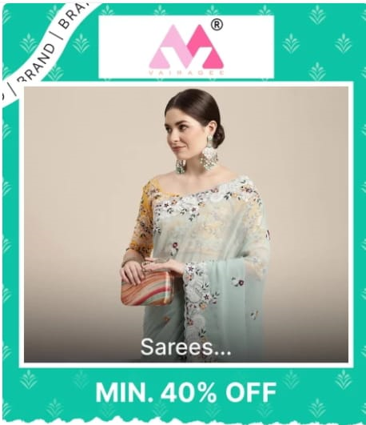
Wrap Dresses: Wrap dresses feature a front closure that can be tied or wrapped around the body, creating a flattering and adjustable fit. They are versatile and can be styled differently by adjusting the tightness of the wrap or changing the accessories. Wrap dresses are suitable for both casual and formal occasions.
Reversible Clothing: Reversible clothing items are designed with different patterns or colors on each side, allowing you to wear them in multiple ways. For example, a reversible jacket may have a solid color on one side and a pattern on the other, giving you two distinct looks with a single garment.

Slide 8
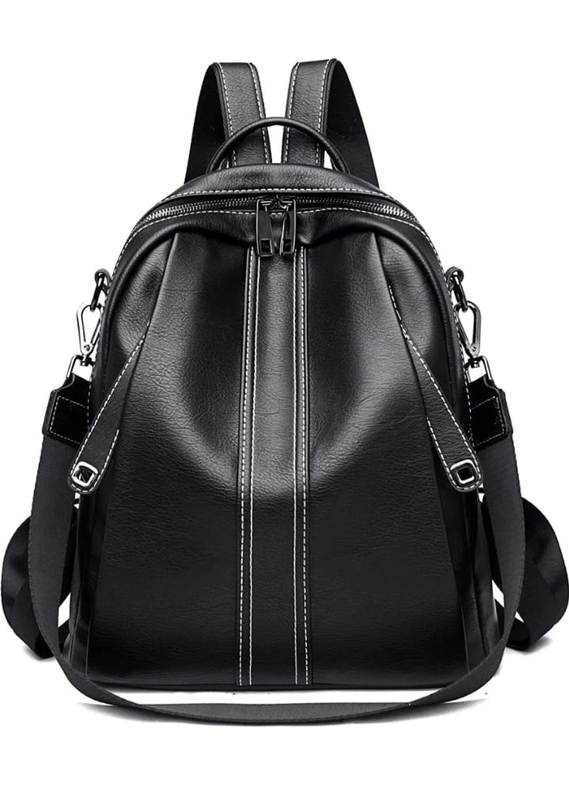
Convertible Bags: All-in-one fashion isn't limited to clothing; it can also apply to accessories. Convertible bags are versatile handbags that can be transformed into different styles. They may have adjustable straps or sections that can be removed or rearranged, allowing you to switch between a shoulder bag, crossbody bag, clutch, or backpack.
These are just a few examples of all-in-one fashion items. The concept of versatility and adaptability is at the core of all-in-one fashion, giving individuals the ability to maximize their wardrobe options with fewer pieces.

Slide 9
Website of 5xtra.com: - http://5xtra.com
INSTAGRAM: -
https://instagram.com/5xtrra?igshid=MzRlODBiNWFlZA==
FACEBOOK: -https://www.facebook.com/5Xtra?mibextid=ZbWKwL
TWITTER: -
https://twitter.com/5xtrra?t=qsoDiF7OzTqDq2YysfVLmQ&s=08
LINKEDIN: - https://www.linkedin.com/in/5-xtra-212ab5267
QUORA: - https://qr.ae/pyN7sS

