Slide 1



LAND COVER CLASSIFICATION USING DEEP LEARNING
Presented By: Uliana Harras

Slide 2









WHAT IS LAND COVER CLASSIFICATION?
Categorizing the Earth's surface into predefined classes such as water, vegetation, urban areas, etc. using satellite/aerial imagery.
2

Slide 3
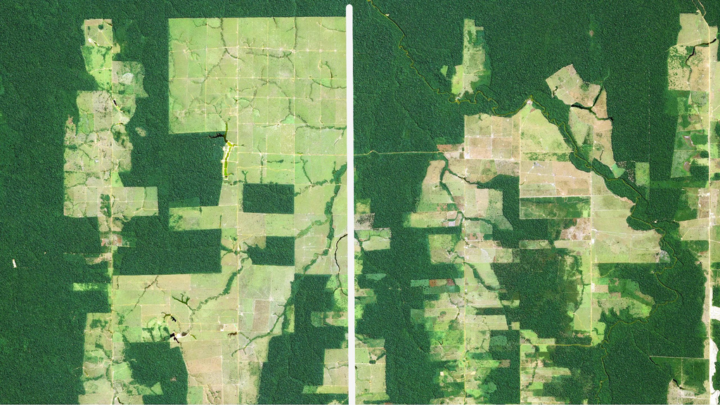
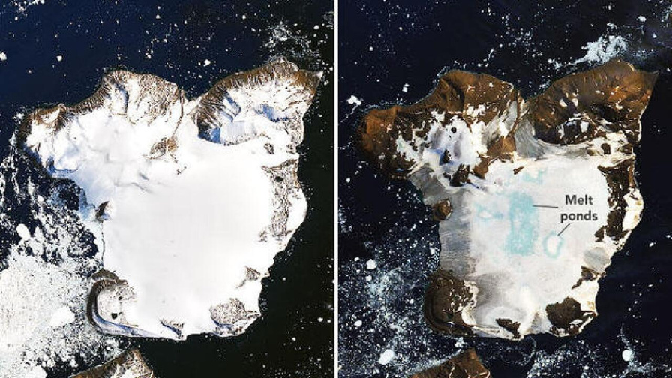
This task is crucial for:
Urban planning (Mapping urban infrastructure development)
Agriculture (Monitoring crop health and agricultural land use)
Resource management
Environmental monitoring (Observing deforestation, glacier melt, land degradation)
3

Slide 4
OTHER METHODS
Before ML and neural networks, land cover classification was based on statistical methods, spectral indices, and manual interpretation.
While these methods were effective for small-scale studies and simpler problems, they often struggled with large-scale, complex, or heterogeneous datasets.
4

Slide 5
MODERN APPROACHES
Modern approaches based on ML and deep learning have largely replaced these methods due to their scalability, flexibility, and accuracy.
However, they require labeled data and computational resources.
5

Slide 6
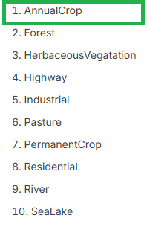

PROJECT OVERVIEW
Objective: Classify satellite images in land cover categories using Deep Learning.
Tools: Python (Pandas, NumPy, Matplotlib, TensorFlow, Json, PIL)
6

Slide 7
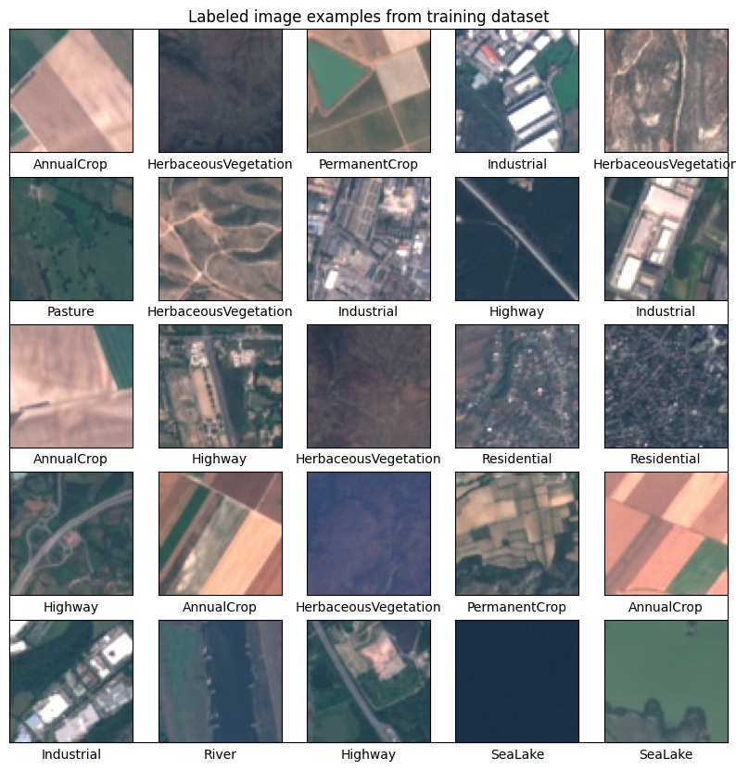
PROJECT OVERVIEW
Data: EuroSat Dataset
64x64 pixel RGB images collected from the Sentinel-2 satellite
Annual Crop
Forest
Herbaceous Vegetation
Highway
Industrial
Pasture
Permanent Crop
Residential
River
Sea/Lake
7
https://www.kaggle.com/datasets/apollo2506/eurosat-dataset/data

Slide 8
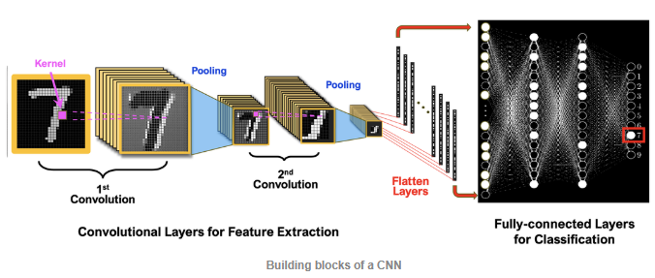
APPROACH
Convolutional Neural Network (CNN) is a type of Deep Learning. It’s designed to recognize patterns like shapes, textures, and objects in pictures.
Breaking the image into small parts.
Looking for simple patterns
Combining these patterns to identify the full object.
8
Image source: https://mriquestions.com/deep-network-types.html

Slide 9

RESULTS
My model performance
Human Performace
Accuracy
92%
90%
Time
30 seconds
9720 seconds
324 Times faster
9

Slide 10
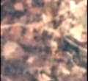

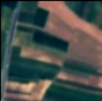

RESULTS
The most wrongly classified images: Permanent crop
My model performance
Human Performace
37%
32%
of incorrectly classified images
10

Slide 11


RESULTS
Human Performace
Wrongly classifying Sea/Lake as Forest/Vegetation.
The model performed very good in classifying Sea/Lake.
11% of wrongly classified images
11

Slide 12
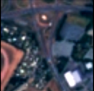
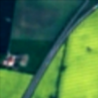
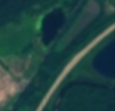
RESULTS
My model performance
Besides Permanent crop the model also often misclassified Highways (while for human is was a class with least mistakes made)
22% of wrongly classified images belong to Highway class

Slide 13



RESULTS
Both the model and human made least mistakes classifying Forests, Industrial and Residential areas
13

Slide 14
CONCLUSION
Deep Learning is a powerful tool for Land Cover Classification using satellite imagery. It is able to predict the class 324 times faster than a human with even higher accuracy (92% vs 90%)
14

Slide 15
THANK YOU!

Slide 16
Appendix
16

Slide 17
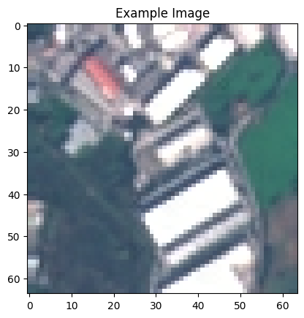
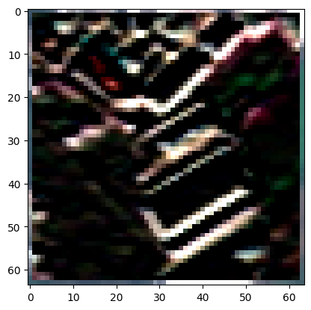
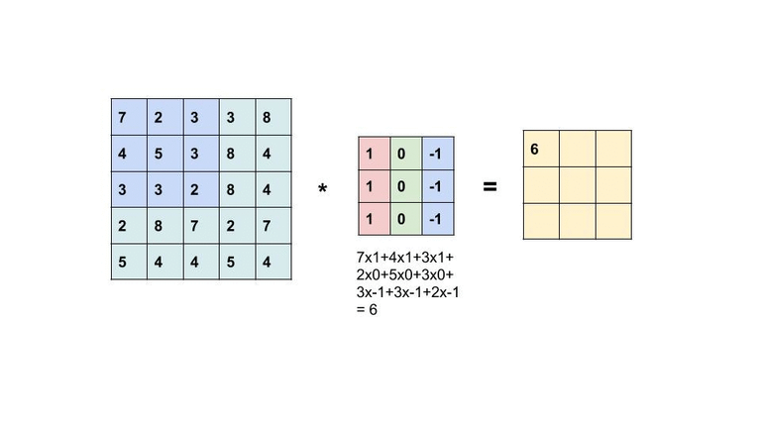
* KERNEL =
17

Slide 18
Method | Average Accuracy
Statistical Methods | ~60-75%
ML Methods | ~80-90%
DL Methods | ~90-98%
Spectral Indices | ~50-75%
Human | ~70-85% (non-experts), ~85-90% (experts)
18

