Slide 1
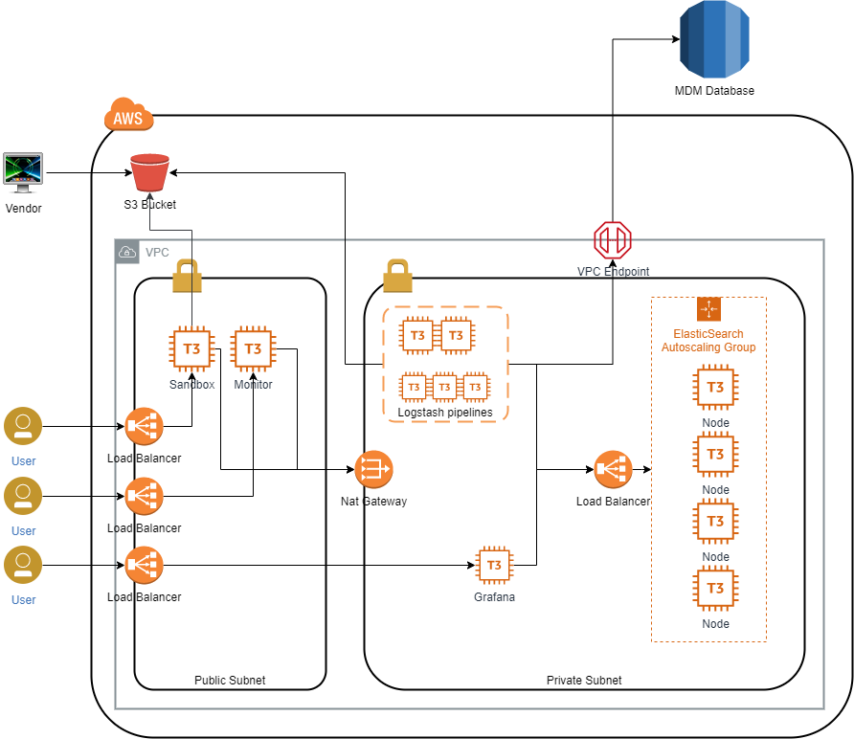

Slide 2
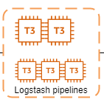
Main 10.0.1.113
Delivery 10.0.1.32
Network 10.0.1.6
Pinpads 10.0.1.47
Dmb 10.0.1.47
Connect
eval "$(ssh-agent -s)"
ssh-add /c/Users//carolina.montano/Desktop/RBI_NCR/160719_terraformKey.pem
ssh -A -i /c/Users/carolina.montano/Desktop/RBI_NCR/public_prod_05.pem centos@18.205.205.23
ssh 10.0.1.(xx)

Slide 3
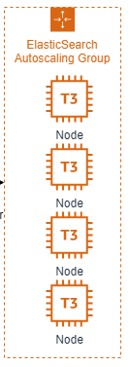
Main 10.0.1.11
Nodes
10.0.1.33
10.0.1.34
10.0.1.57

