Slide 1
AI for Data and Data for AI
Dan Roth
Oracle & The University of Pennsylvania
GRAIL-V, a CVPR Workshop
Denver, Colorado
June 2026

Slide 2

The Promise of Gen AI to Knowledge Access & Use
GenAI promises to bring in a new wave of innovation in knowledge access & use.
Users will solve their problems at the conceptual level – their terms & metrics
No need to learn domain specific query languages, database schemas
No need to spend time transforming data from one format to another
No need to be concerned with fusing diverse data

Slide 3







Knowledge Access & Use
Models cannot do it alone
External Data is essential for almost all applications
The key use case for LLMs is going to be that of
Orchestrating and supporting access and use of external data
Multimodal data that models will not see* prior to run time.
Reliably supporting decisions that depend on retrieving and using heterogenous data is hard
Healthcare
No more general-purpose data
The remaining data is owned by corporations, medical centers, people,…
It will stay external to the models
Strategic business analysis
Scientific discovery
[Coding] Agents
need access to
heterogenous knowledge sources
Banking
E-commerce
This Talk
Many Reasons:
Information Retrieval, Understanding Information Needs, Understanding the stored data, Using data.

Slide 4
AI for Data and Data for AI
AI for Data: Human Consumption
Data for AI: AI Agents Consumption
Data needs to be organized & presented differently
Instructions
Structure and Format
Visualization provides information to humans; less to agents.
Semantic Richness
Humans infer context from visual queues and commonsense
Metadata and Context
Granularity and Completeness
Error Handling, Trust and Verification
Data Preparation
Agents require a semantic layer, APIs with clear contracts

Slide 5
Why is it Hard?
Core Difficulties:
Retrieval
The importance of a Semantic Layer
Dealing with Structure
NL-2-[SQL,…]
Agentic Use
Multiple Knowledge Sources
Rich Documents
How to Present the Output?
Planning
Conflicting Information
Reasoning: Underlying some of the difficulties are the needs to support specific types of reasoning that evade general purpose models

Slide 6
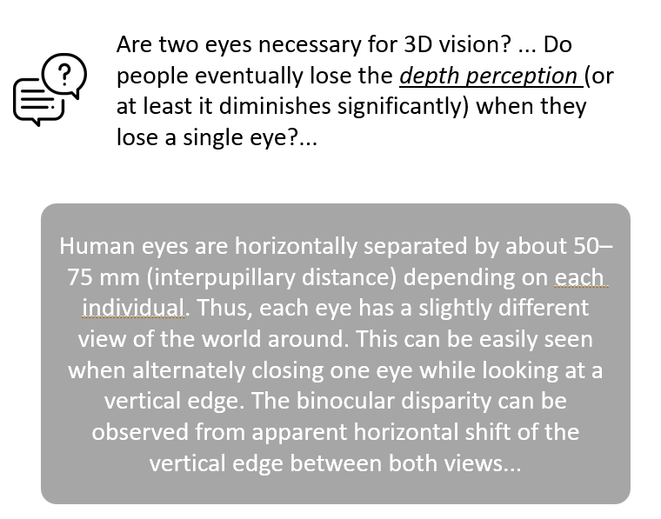
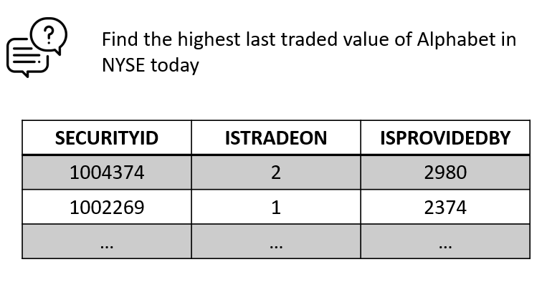
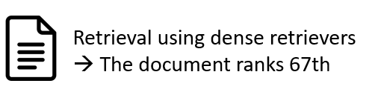
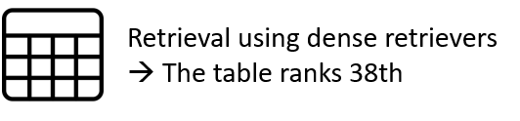
(1) Semantics Challenges to Retrieval
The semantic layer is a key ingredient of realistic solutions for both structured and unstructured data.
Even when we bring queries and data objects close together… “The Crowded Embedding Space.”, ICML’26
Myth: Dense Retrieval Works
Truth: Retrieval systems do well only when the language of the user query closely matches the target documents
Retrievers struggle to retrieve documents whose relevance to the query is implicit
E.g., retrieving docs with: (1) domain-specific jargon, (2) business logic, (3) tabular data
Semantic Layer: data objects have to be further enriched to facilitate better retrieval. LLMs can do it well, off-line; before queries are presented.
Chen et al. (COLM, 2025): EnrichIndex: Using LLMs to Enrich Retrieval Indices Offline
Many types of enrichments are needed – purpose, descriptions, QA, transaction-dependent, etc.
[Shen et al. “LogiCoL: Logically-Informed Contrastive Learning for Set-based Dense Retrieval EMNLP’25]

Slide 7
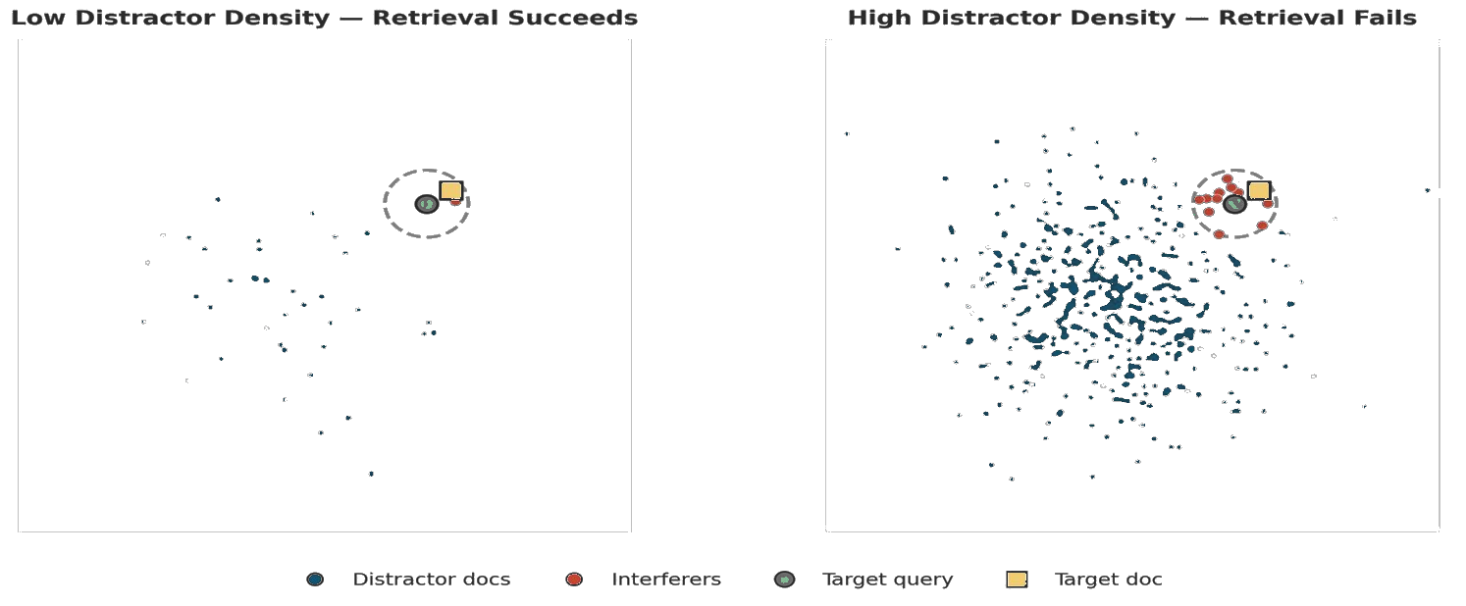
Inherent Goal Collision in Dense Retrieval
Shwan Ashrafi (Oracle AI) et al. The Crowded Embedding Space: Emergent Marginalization in Retrieval-Augmented Agents (ICML’26)
Retrieval Setting:
(a target document, query) d(x,q)= ∊ ; distractors documents distributed normally.
As distractor density increases, interfering documents saturate the retrieval ball around the target query, displacing the correct target from top-k results.
Notes:
The reason is the Dense retrieval is inherently difficult.

Slide 8
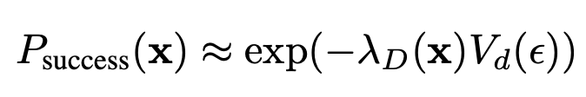
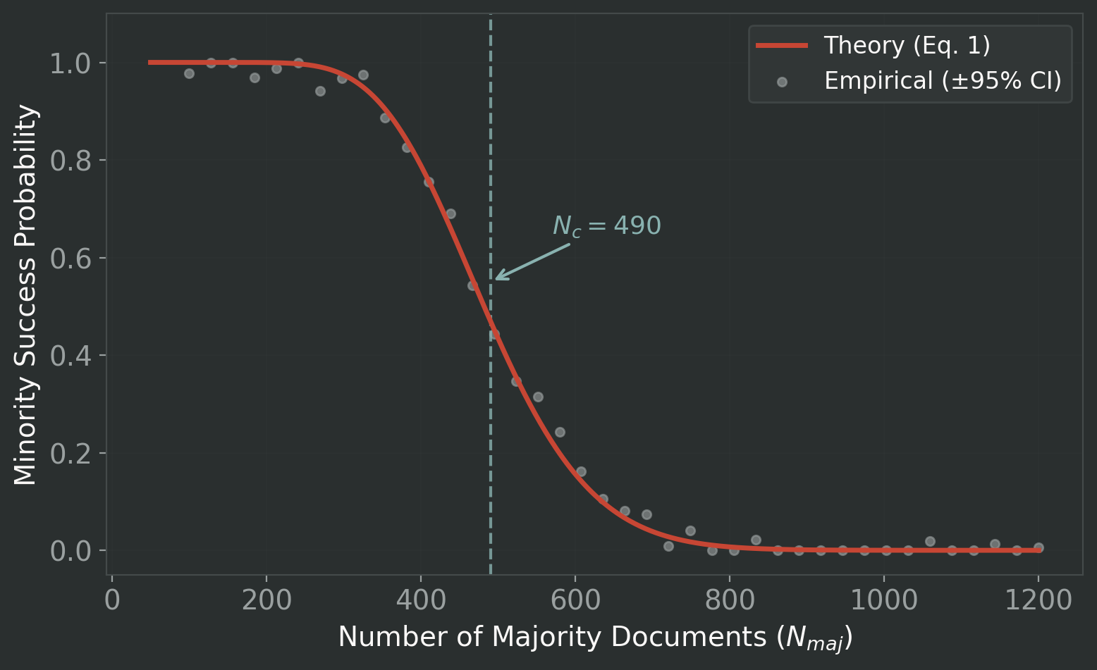
A Sharp Phase Transition in Retrieval
There exists a critical distractor population Nc beyond which target retrieval success collapses catastrophically as an abrupt phase transition.
This is not noise!
It is a fundamental geometric constraint of shared embedding spaces.
Target distance=1.5
Distractors ~ N(0,1)
L = 20
ε = 0.5
λ_D : Document intensity function
ε : Distance between query and target document
V_d(ε) : Volume of retrieval ball (d-dimension)

Slide 9
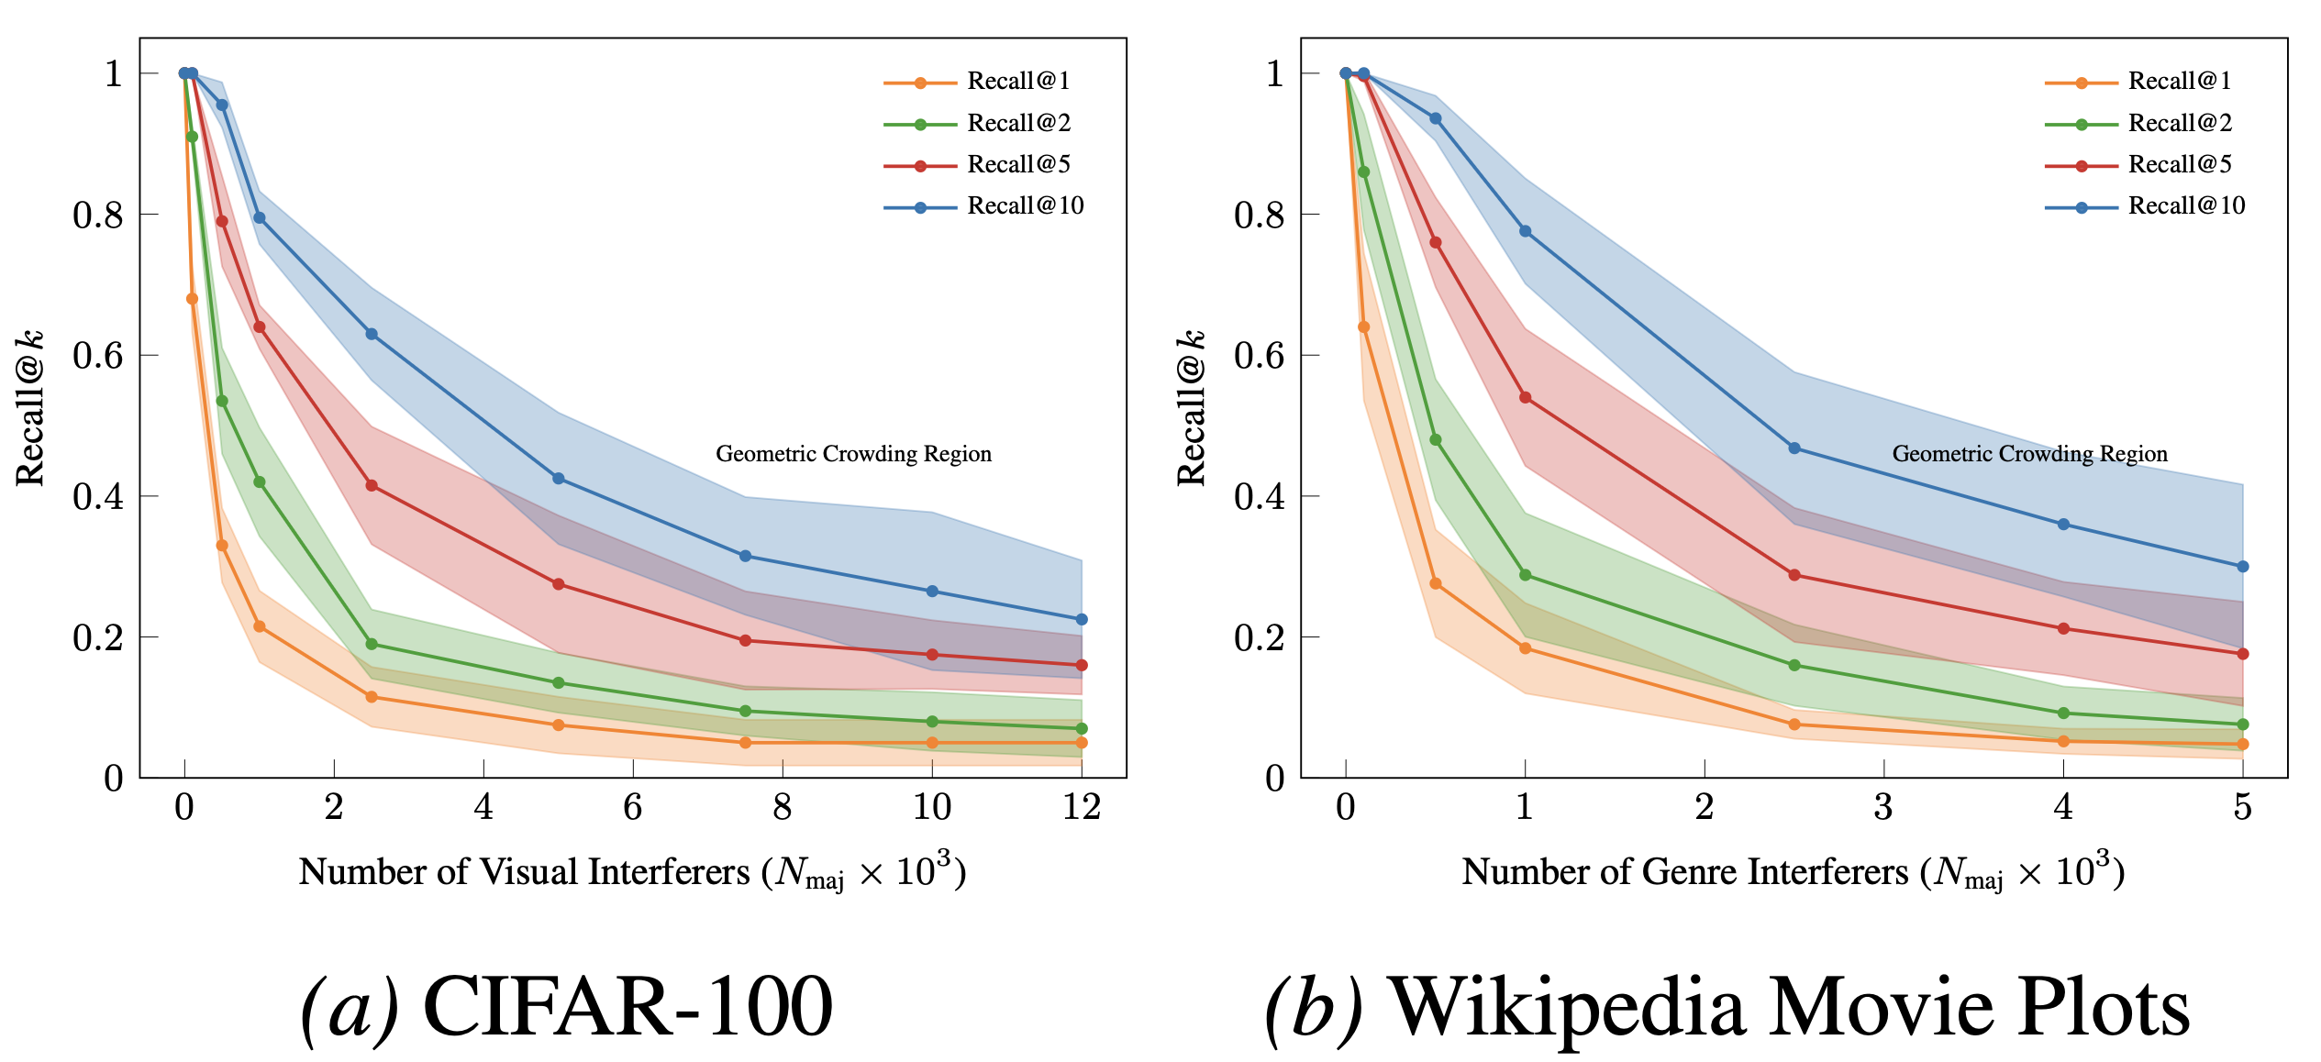
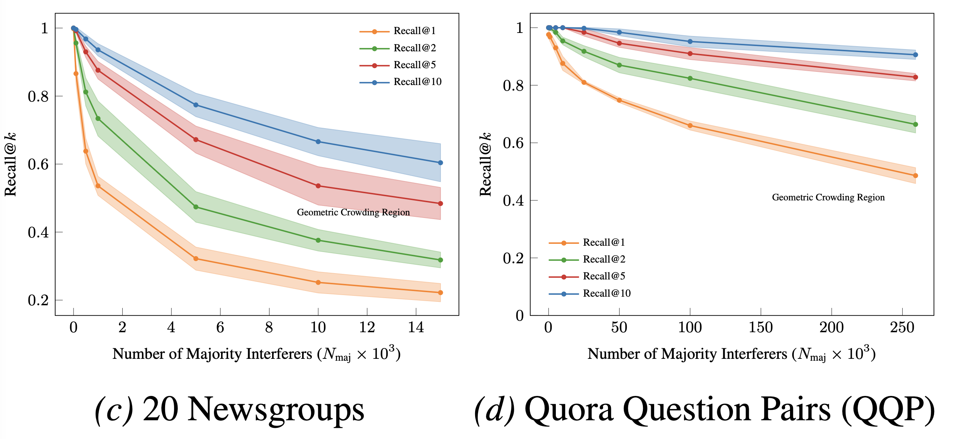
Dense Retrieval Collapse: Empirical Data
Vision · Semantic Text · Stylistic Text · Topical Text
The distractor crowding drives target retrieval collapse in every modality tested
Fixed, pretrained embeddings and no retraining.
Dataset | Query Selection | Target Selection | Pairing Strategy
QQP | 1st question of a duplicate pair | 2nd question of the exact same pair | 1-to-1 (Explicit)
20 Newsgroups | Minority topic document from the test split | Computed nearest neighbor from the train split | 1-to-1 (Computed NN)
Wiki Movie Plots | "Film Noir" plot | Any other "Film Noir" plot | 1-to-Many (Leave-one-out)
CIFAR-100 | "Otter" image | Any other "otter" image | 1-to-Many (Leave-one-out)

Slide 10
Towards Mitigation: Metadata Enrichment
Crowding is density-driven.
This failure mode is fundamental: it emerges from the fundamental interaction of population density, finite dimensionality, and nearest-neighbor retrieval.
Reranking cannot rescue the geometric collapse
Metadata – a component of the semantic layer
doesn't change the geometry, but it changes what competes in each retrieval neighborhood – hence an important component in a solution.
Metadata is not a retreat from semantic retrieval;
it is a density-aware complement that restores the capacity semantic search alone cannot guarantee.
Implementing metadata is not without challenges
Some metadata filters are difficult to implement: “Windows versions 8.1 and above”

Slide 11
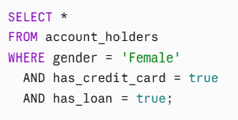
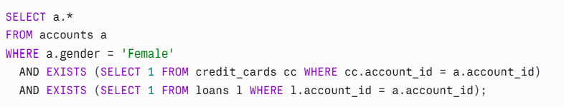
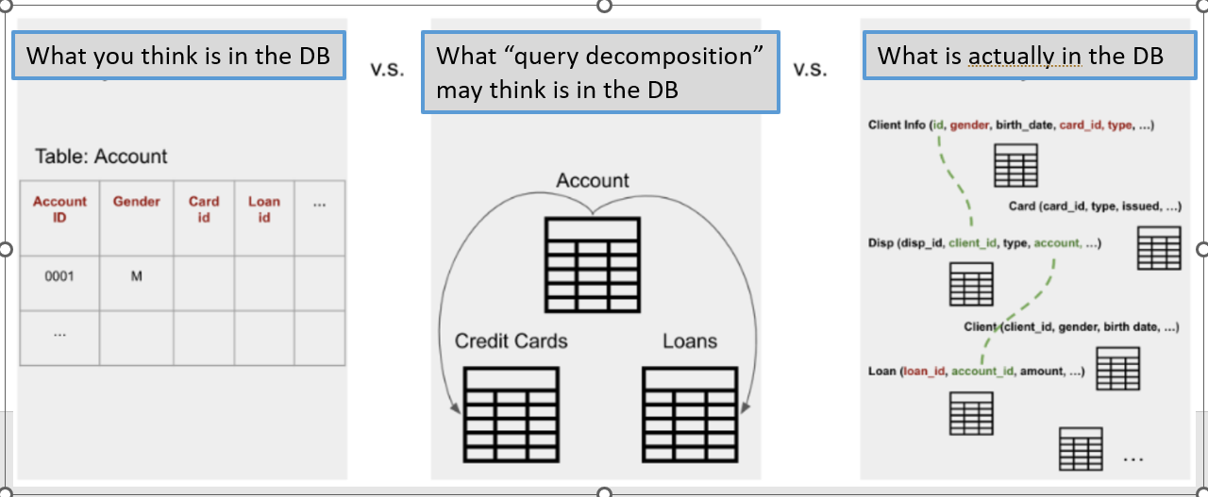
(2) Structural Challenges: Table Retrieval
Easy if there is a single table that is sufficient to answer the question
“Doable” if the query corresponds to how the information is stored
Text 2 [SQL]
Generally, the query may not align with how the information is organized across different tables; need to identify the join relationships while conducting table retrieval
Understand the data organization process
Who are the female account holders who own credit cards and also have loans?
Chen, Zhang, & Roth, Join-Aware Multi-Table Retrieval (ACL’24):
Chen et al. (ACL, 2025): Can we Retrieve Everything All at Once? ARM: An Alignment-Oriented LLM-based Retrieval Method

Slide 12
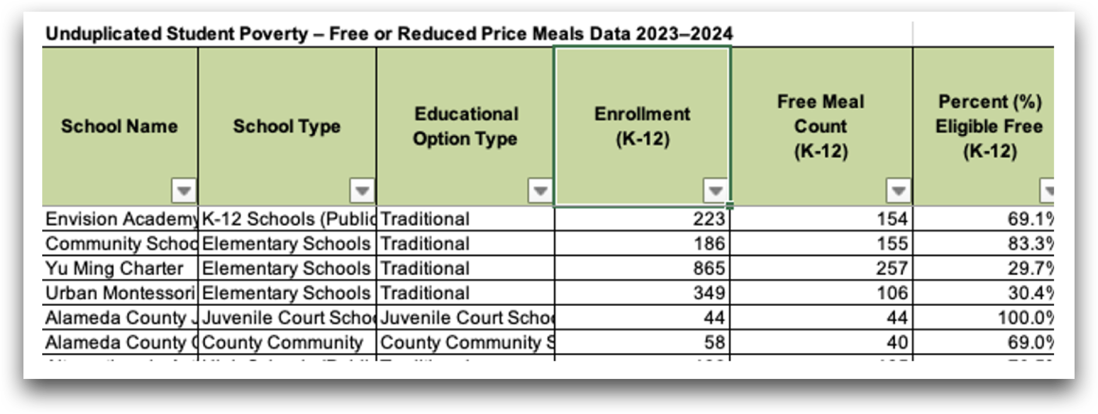
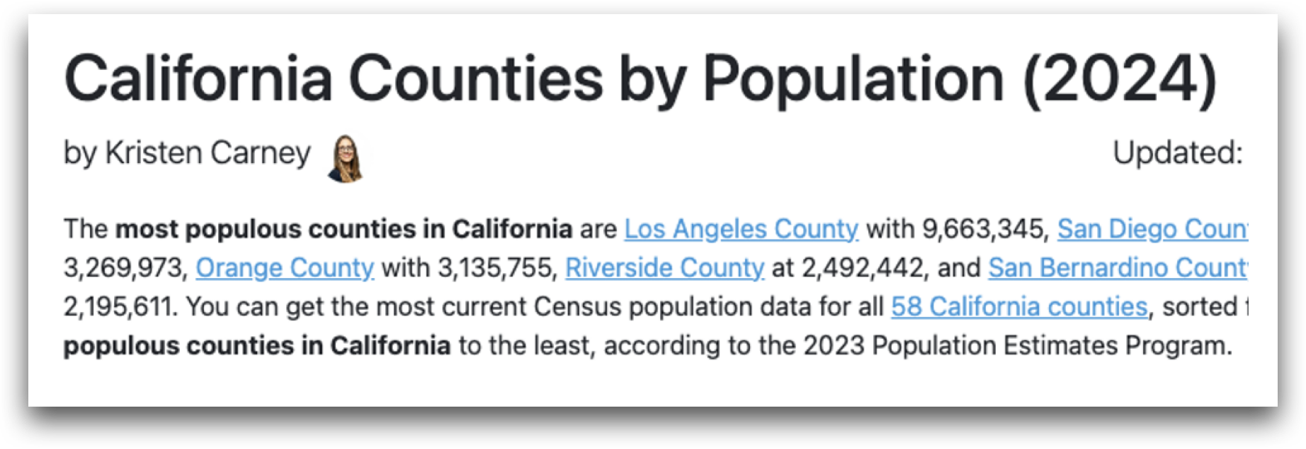
Information & Structural Alignment
What is the highest eligible free rate for K-12 students in the schools in the most populous county in California?
The table and document do not share overlapping information
→ cannot be connected to answer the user question!
Notes:
and perhaps retrieve one table and document for each concept. However, upon close inspection, we will notice that this is insufficient because the table and document do not share overlapping information, and thus cannot be connected to answer the user question.

Slide 13
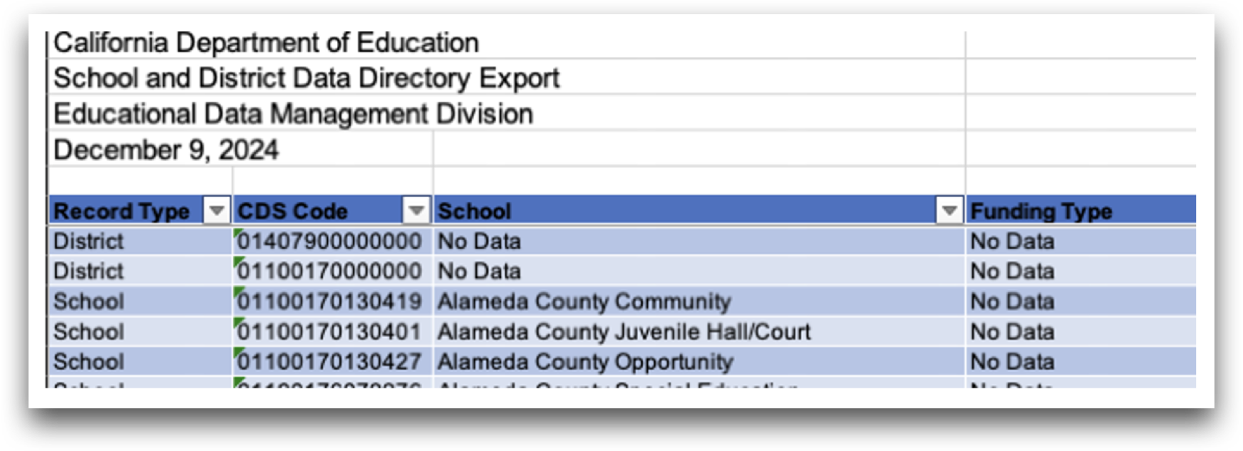
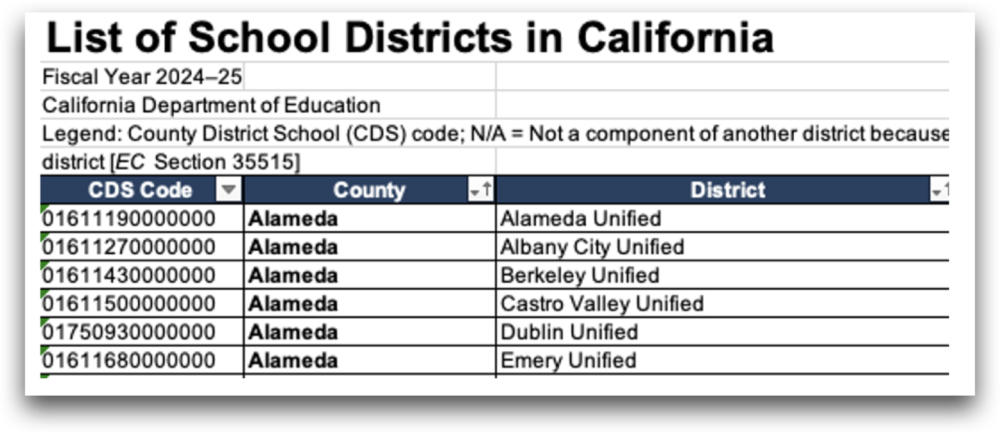
(2) Information & Structural Alignment
What is the highest eligible free rate for K-12 students in the schools in the most populous county in California?
Tables that are not explicitly mentioned in the user query but are essential l for connections!
Involves hypothesizing a KG at run time
Notes:
In fact, two more tables need to be retrieved to connect the two pieces of information even though they are explicitly mentioned in the user query.

Slide 14
(2) Information & Structural Alignment
“Standard” RAG isn’t sufficient – does not consider internal data organization
The top two data objects can be retrieved by semantic similarity to the decomposed parts of the query.
The bottom two table cannot.
Retrieving them requires an iterative process that considers joinability
Agentic RAG (ReACT) can get stuck, for the same reason.
Information alignment
What is the highest eligible free rate for K-12 students in the schools in the most populous county in California?
Optimal retrieval system
Involves hypothesizing a KG at run time
This is a form of Enrichment, but some of it needs to be done at run-time, given a query. (But we can cache it)
More can be done – e.g., with the use of query logs
Peter Chen et al. : Log-augmented generation:
Scaling Test-Time Reasoning with Reusable Computation (ICLR’26)
Linear programming solvers to select top-k objects that maximize query-object relevance and object-object compatibility for each expanded group
(: whether object is selected; : whether object connects with object )
Structural alignment
Notes:
Therefore, an optimal retrieval system should consider both information alignment and structural alignment.

Slide 15
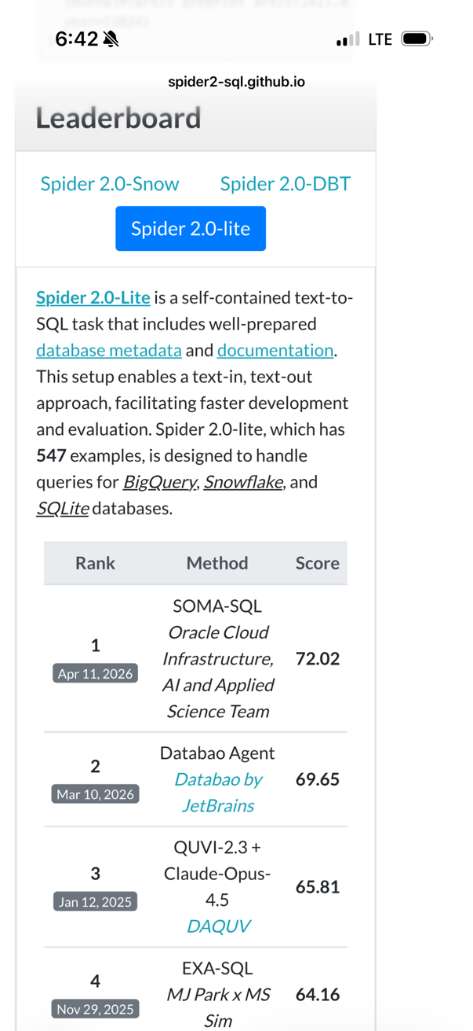
Where are we in NL-2-SQL?
ARCHER: recently introduced Text-to-SQL benchmark with complex arithmetic and reasoning tasks
9/19/25: A vanilla GPT-5 based baseline: 44.23%
Oracle AI Agentic system: 54.96%
[NEWS] OCI AI Science wins first place in the 2025 competition!
A vanilla NL2SQL system: [NL Query→ LLM → SQL] is not sufficient [in most cases].
Performance is dataset specific; failures are due to both retrieval and generation
Gaps between vanilla models and advanced systems ~20-50%
*Metric: measured as % correct execution
Look at the absolute results!
Look at the absolute results!

Slide 16
Why is it Hard?
Many exciting problems to think about
In order to access the knowledge we need, and do it efficiently, it is essential to
(1) Develop an abstract semantic layer on top of existing data sources (to bring the data closer to the needs), and
(2) Structure: Understand how the data is organized so that we can plan well
On the Query side:
Semantic similarity:
Queries and data objects are not “similar”, and even when they are often it’s not sufficient.
Complex queries:
Require decomposition that is often structure aware
On the Data (base) side:
Schemas could have a complex structure
Difficult to retrieve the right tables.
Naming:
Often ambiguous and uninformative
Entity linking
Reasoning: Queries could require supporting specific types of reasoning that evade general purpose models
Aggregation of information, temporal references and reasoning, counterfactuals,…

Slide 17
ORACLE AI Solution: SOMA-SQL [Somayajula, Liu, et al.’26]
Synthetic Query Log and Probing for Multi-source Ambiguity Resolution
NL Question: "What were the top-performing regions in New York last quarter?“
Query-level ambiguity – underspecified intent:
New York: city, state, NYSE value
Schema-level ambiguity – unspecified reference:
Last quarter: calendar, fiscal, rolling 90 days
Contextual ambiguity – questions assume domain knowledge or business logic absent from both the question and the schema,
Top Performing: revenue, growth rate, closed deals
SOMA-SQL Workflow:
Detect ambiguity dimensions
Taxonomy cues + K-SQL disagreements
Resolve with evidence
Synthetic-log MCQs + database probes
Generate evidence-backed SQL
Repair/select after assumptions are resolved
Different choices impact filters, joins, and time windows.
Net effect: an ambiguous question becomes an evidence-backed intent, not a silent guess.

Slide 18



Differentiator #1: Synthetic Query Logs
SOMA-SQL converts historical SQL into MCQ-style disambiguation tool
OFFLINE: Construct Synthetic Query Log
Validated
SQL log
Detailed
NL intent
Ambiguous
NL wording
K SQL
variants
MCQ
record
intent anchor
fully specified NLQ
remove details
interpretation samples
stored resolution
Validated SQL anchor
SELECT r.region_name,
SUM(o.revenue) AS total_revenue
FROM orders o ...
WHERE c.state = 'New York'
AND fiscal_q = '2024 Q1'
Stored MCQ record
How should “performing” be ranked?
A) Revenue ✓
B) Profit
C) Deal count
Detailed NL intent
List top-5 regions in New York State ranked by total revenue in fiscal quarter Q1’24.
Ambiguous user wording
Find top-5 performing regions in New York last quarter?
Candidate variants
A SUM(o.revenue)
B SUM(o.profit)
C COUNT(o.deal_id)
ONLINE: Retrieve MCQs to Resolve a New User Question
New user question
“Can you help me find the top-performing region last quarter?”
Retrieve relevant MCQ
How should “performing” be ranked? → Revenue
Use as generation context
Inject clarification into planning and SQL generation; produce intent-conditioned SQL
Key takeaway: historical SQL expressions provide useful clarification knowledge for disambiguation

Slide 19
Differentiator #2: Ambiguity-Driven Probing
SOMA-SQL probes plausible interpretations against DB & uses it to repair the final SQL.
ONLINE: Resolve Ambiguity with Database Evidence
Ambiguous question
“show me churn for enterprise customers last quarter”
Generate
Competing probe SQLs
Execute & Resolve
With probe report
Repair
Final SQL
Ambiguity: What does “churn” mean in this database?
1
Canceled subscriptions
2
Inactive accounts
3
No recent purchase
SELECT COUNT(DISTINCT s.customer_id)
FROM subscriptions s JOIN customers c USING(customer_id)
WHERE c.segment='Enterprise'
AND s.status='canceled'
AND s.cancel_date >= :q_start
AND s.cancel_date < :q_end;
SELECT COUNT(DISTINCT a.customer_id)
FROM accounts a JOIN customers c USING(customer_id)
WHERE c.segment='Enterprise'
AND a.last_activity_date < :q_start
AND a.account_status='active';
WITH last_order AS (
SELECT customer_id, MAX(order_date) last_dt
FROM orders GROUP BY 1)
SELECT COUNT(*) FROM customers c LEFT JOIN last_order lo USING(customer_id)
WHERE c.segment='Enterprise' AND lo.last_dt < :q_start;
4,821
137
94
Probe report selects strongest evidence
Canceled subscriptions has the strongest schema-supported signal.
Final SQL uses resolved intent
Apply cancellation filters; remaining probes remain audit evidence.
✓
SQL
Key takeaway: ambiguous terms are resolved from database evidence, not guessed, combined for final SQL.

Slide 20
Consistent Gains Across Diverse NL2SQL Benchmarks
Average EX across 5 benchmarks, 4 SQL dialects, 2 languages, and 3 backbone models.
▲ +9.3
▲ +12.8
▲ +16.7
+9.3 to +16.7 Execution Accuracy gain over strongest baseline
Values are execution accuracy (EX%). Gains shown above SOMA-SQL bars are relative to the second-best method.
Benchmarks: Spider 2.0 Lite, BIRD, Archer-en, Archer-zh, BEAVER.

Slide 21
Why is it Hard?
Core Difficulties:
Retrieval
The importance of a Semantic Layer
Dealing with Structure
NL-2-[SQL,…]
Agentic Use
Multiple Knowledge Sources
Rich Documents
How to Present the Output?
Planning
Conflicting Information
Reasoning: Underlying some of the difficulties are the needs to support specific types of reasoning that evade general purpose models

Slide 22
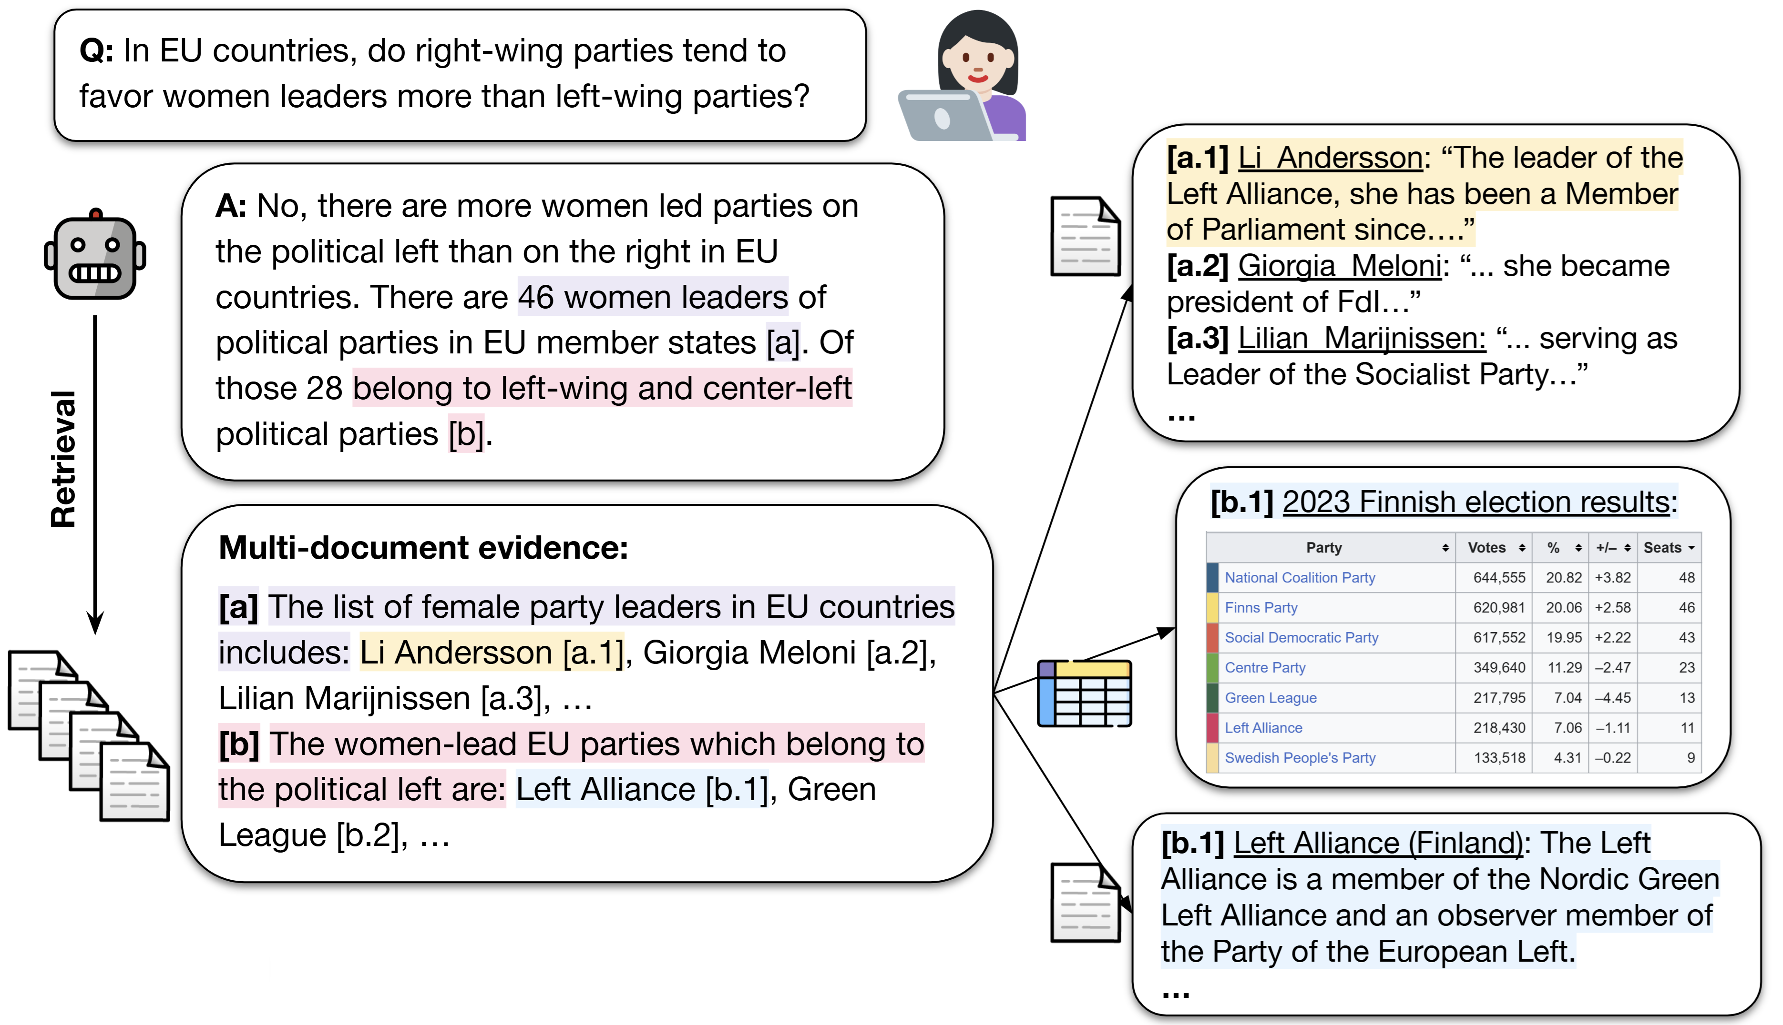
Using Multiple Information Sources
(More) Natural and Complex question answering
Decomposition into intermediate questions & Planning
Retrieval from heterogeneous information sources: Text, Tables, Lists, Images
Aggregation and Reasoning over intermediate answers.
Q: In EU countries, do right-wing parties tend to favor women leaders more than left-wing parties?
Tomer Wolfson et al.: The MoNaCo Benchmark (TACL, 2025)
Notes:
Choosing the tools is only one step – we also need to use it

Slide 23
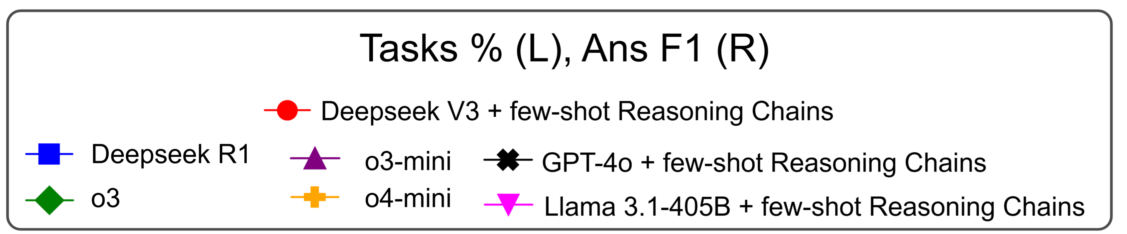
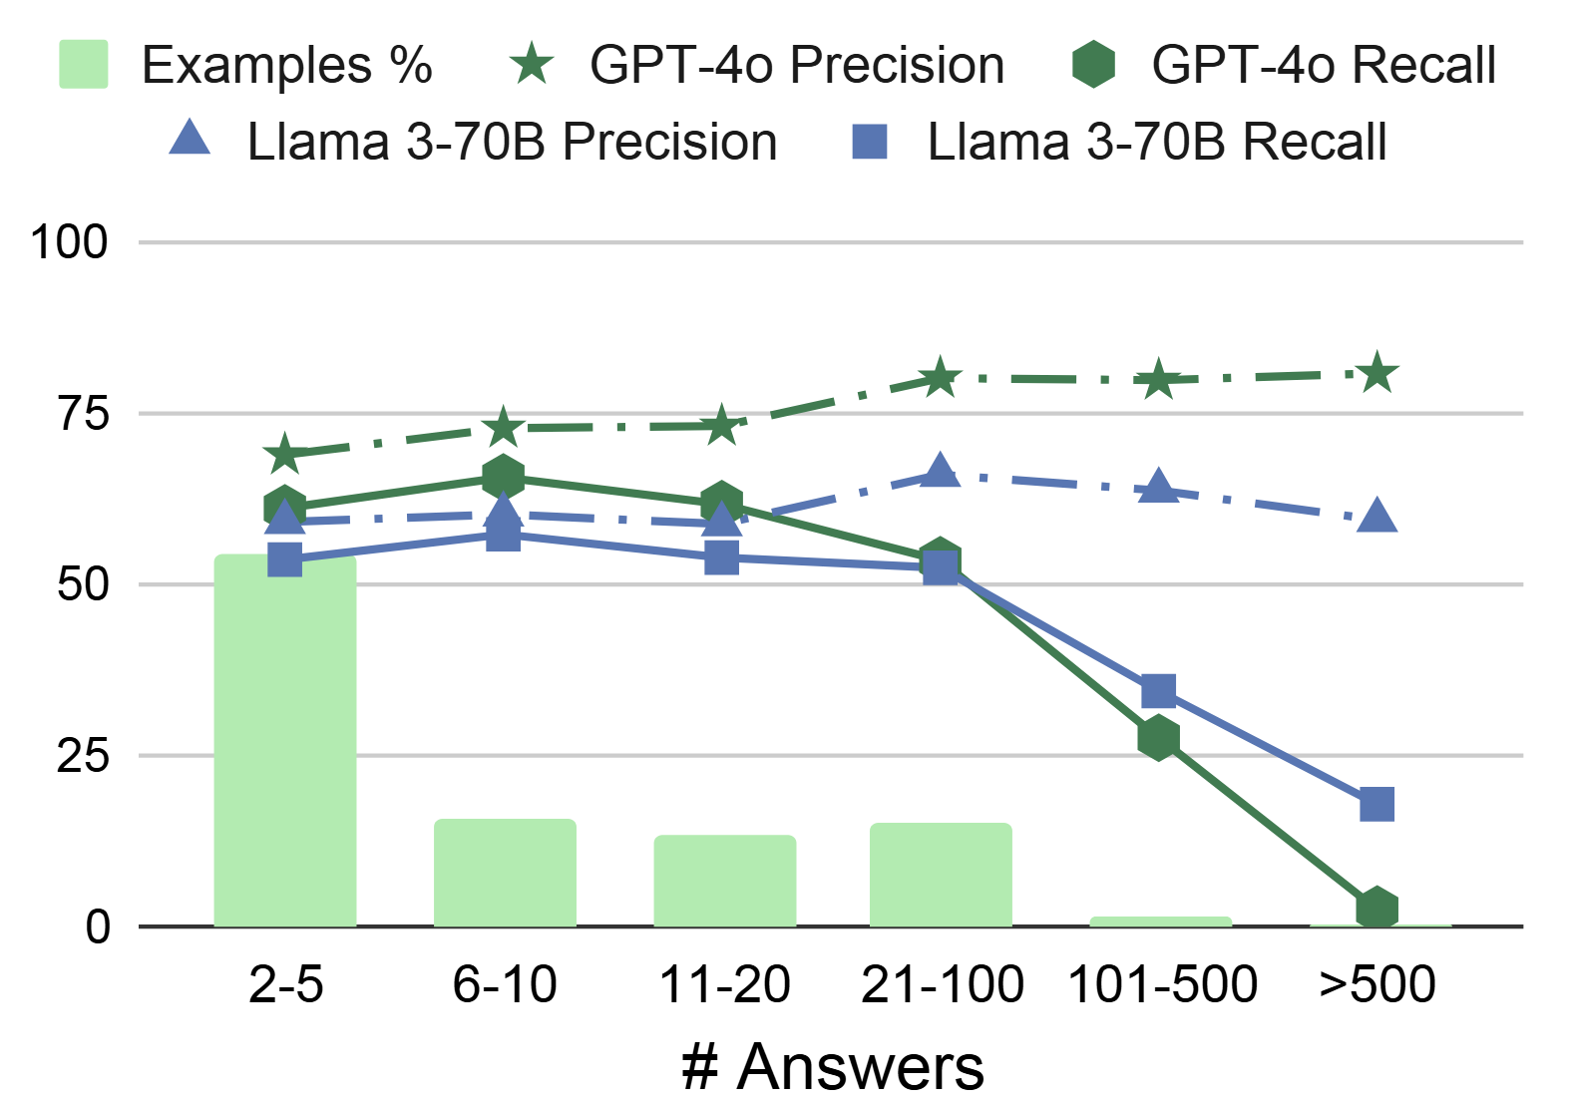
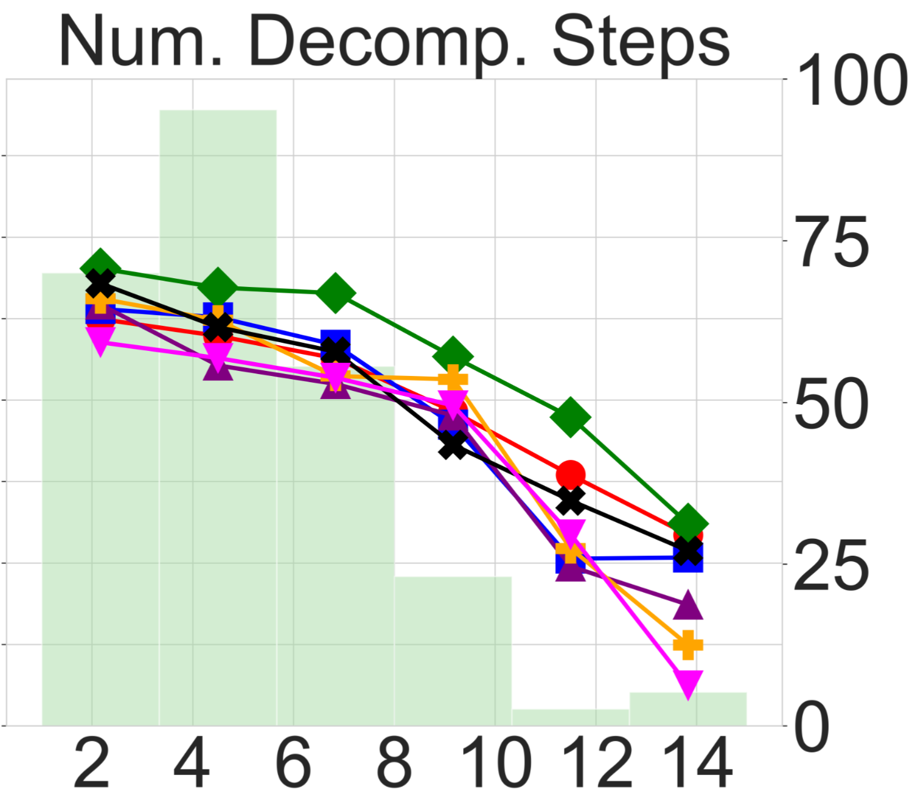
Models Struggle on Multi-Step Reasoning
Frontier LLMs suffer as a function of:
more reasoning steps (left) as well as more intermediate answers (right)

Slide 24

A Realistic Electronic Health Records Example
Show me all my patients whose seizure frequency increased by more than 50% over the past 3 months, list their current medications, flag any that are non-adherent, and summarize what we discussed in their last visit.
F1
F2
Show me all my patients whose seizure frequency increased by more than 50% over the past 3 months, list their current medications, flag any that are non-adherent, and summarize what we discussed in their last visit.
F3
Get seizure frequency trends
Function: getSeizureTrends(patientList, timePeriod)
F4
Get current medications
Function: getCurrentMedications(patientList)
Check adherence
Function: checkMedicationAdherence(patientList)
Perhaps the key challenge to agentic approaches today
But it all depends on retrieving the information needed
Summarize last visit
Function: getLastVisitSummary(patientList)
Notes:
The best segue to this is by looking at a realistic example that requires agents, but information seeking agents. This is from my collaboration with Epilepsia Clinicians

Slide 25
The Rich Data Challenge
In many cases relevant information is not exposed during retrieval
Too costly to do everything at inference time
Ingestion becomes a bottleneck – a form of entrichment
Pre-process documents and enrich with (expected) relevant knowledge
[Sourati et al. ACL’26]: Visually Rich Documents
Retrieval over structured documents requires both semantic understanding and explicit structural reasoning.
Layout, section hierarchy, element types, and cross-page links carry meaning, and must be captured at ingestion time.
Once structure is discarded at ingestion, no retrieval strategy can recover it.
Build an explicit, holistic document representation during ingestion
Exposes to retrieval information & structure that otherwise would not be accessible .

Slide 26
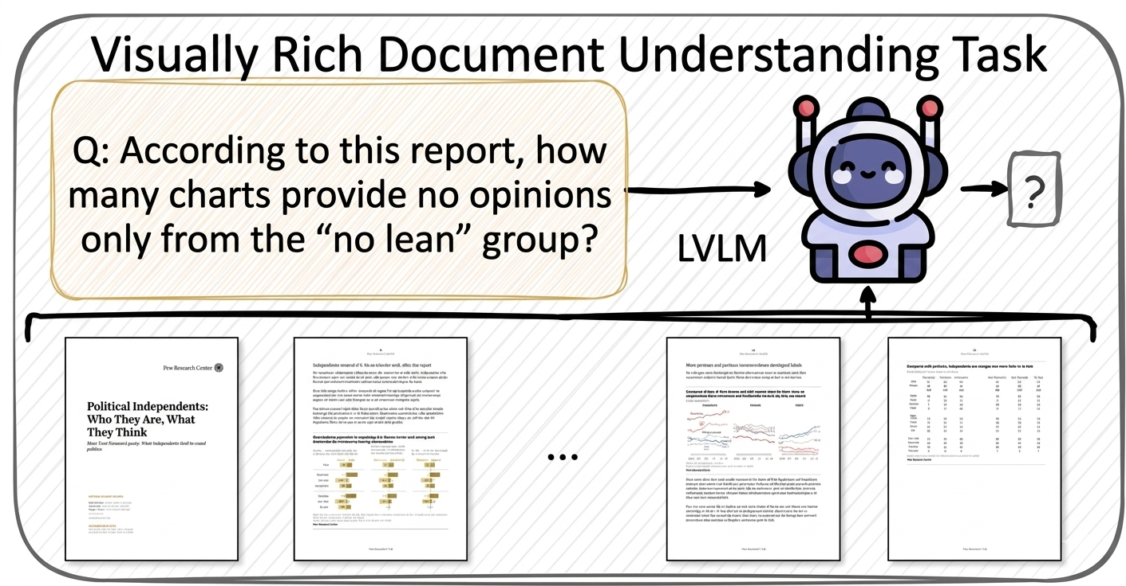
Visually Rich Document Understanding
Documents combine text, figures, tables, and charts
Meaning depends on layout and reading order
A caption only makes sense next to its figure
A table cell only makes sense under its header

Slide 27
Off-Line & Inference-Time Processing
Ingestion:
VLM processing page by page.
For each page, extract visible elements:
paragraphs, tables, figures, section headers, footnotes,
Generate rich metadata for each:
Positions; types; content; summary
Generate two indices:
Symbolic index: structured properties and explicit relationships.
Neural index: Vector embeddings of the self-contained summaries of all nodes.
Inference:
Uses an LLM agent to iteratively search across both indices, with three tools:
NeuroSemanticSearch(query):
Standard embedding similarity search.
SymbolicGraphQuery:
Structured queries over the document graph.
Contextualize:
Given a node, expand to related content via graph structure. (Louvain community detection)

Slide 28
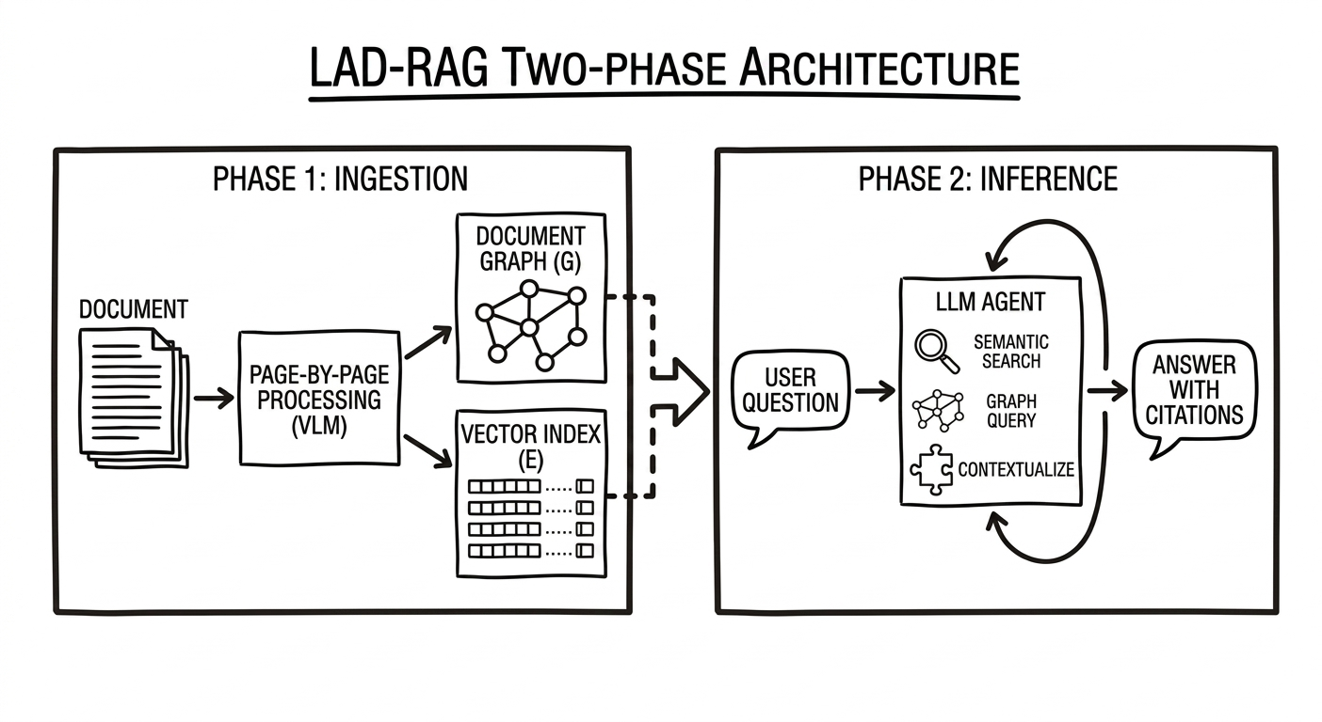
Off-Line & Inference-Time Processing
LAD-RAG consistently outperforms all retrieval baselines across multiple benchmarks (multiple models) both at Retrieval evaluation and end-2-end QA performance.

Slide 29
Planning & Optimization
There is a lot to say about the computational issues underlying planning
Constraint Optimization Problem: Models cannot do it well without translation to external solvers [Wang et al.’26]
Planning for accessing, aggregating & organizing data for AI
The challenge: Planning to access multiple knowledge sources is typically done with incomplete information

Slide 30
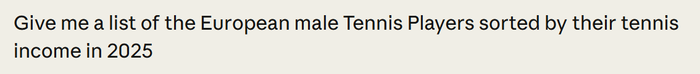
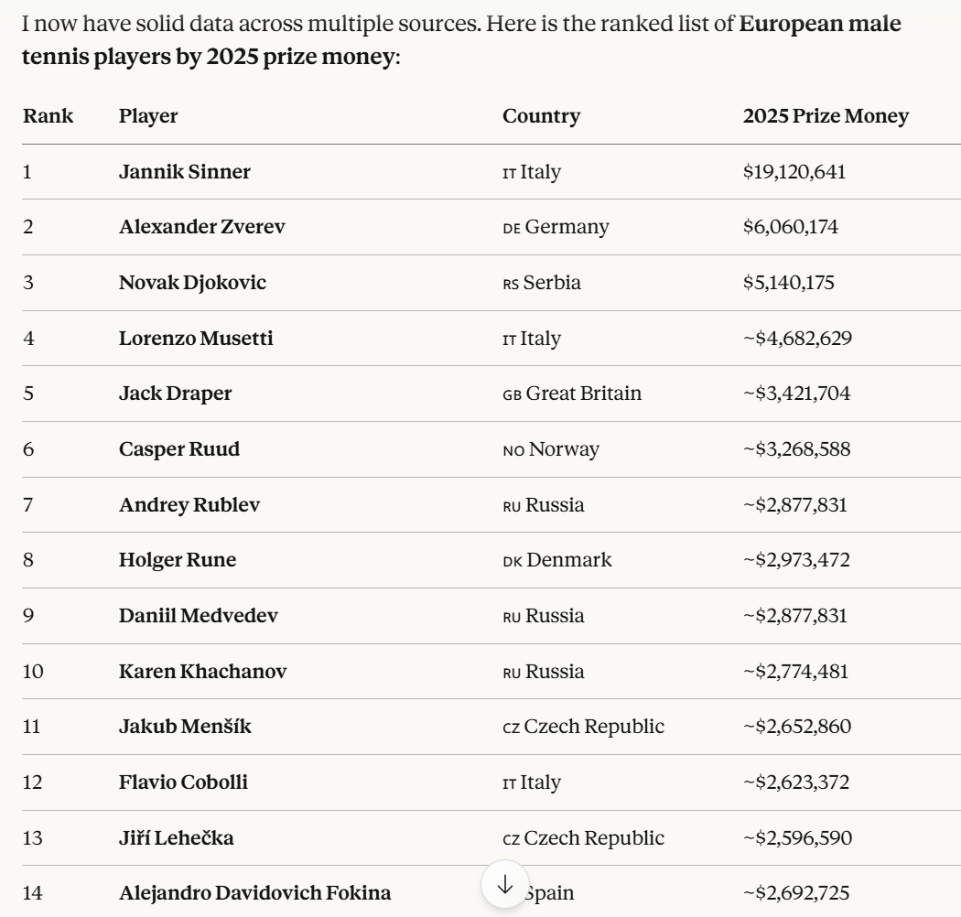
And How About Coding Agents?
One key difficulty is planning: some plans are easier to execute than others.
Should we start with a list of tournaments or players?
Depends on understanding the data in the domain
Anyone missing?
Which is bigger?
Which is bigger?
Identical Income?
Which is bigger?
Coding Agents are doing things faster than we can
But they are prone to errors & high cost
From safety to mistakes – especially when the tasks involve knowledge retrieval and use

Slide 31
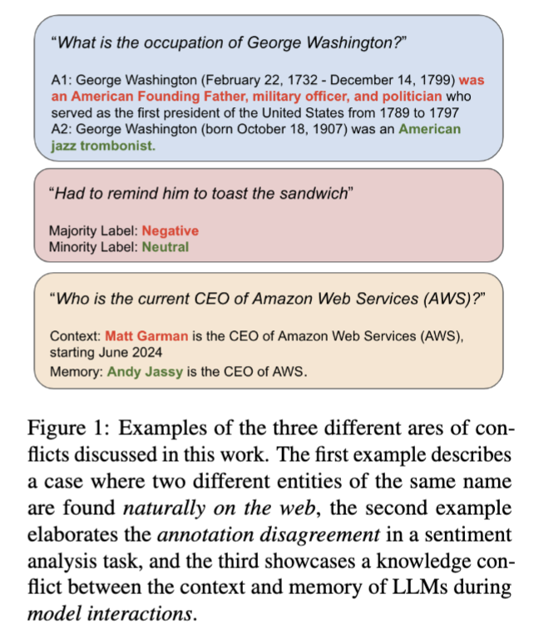
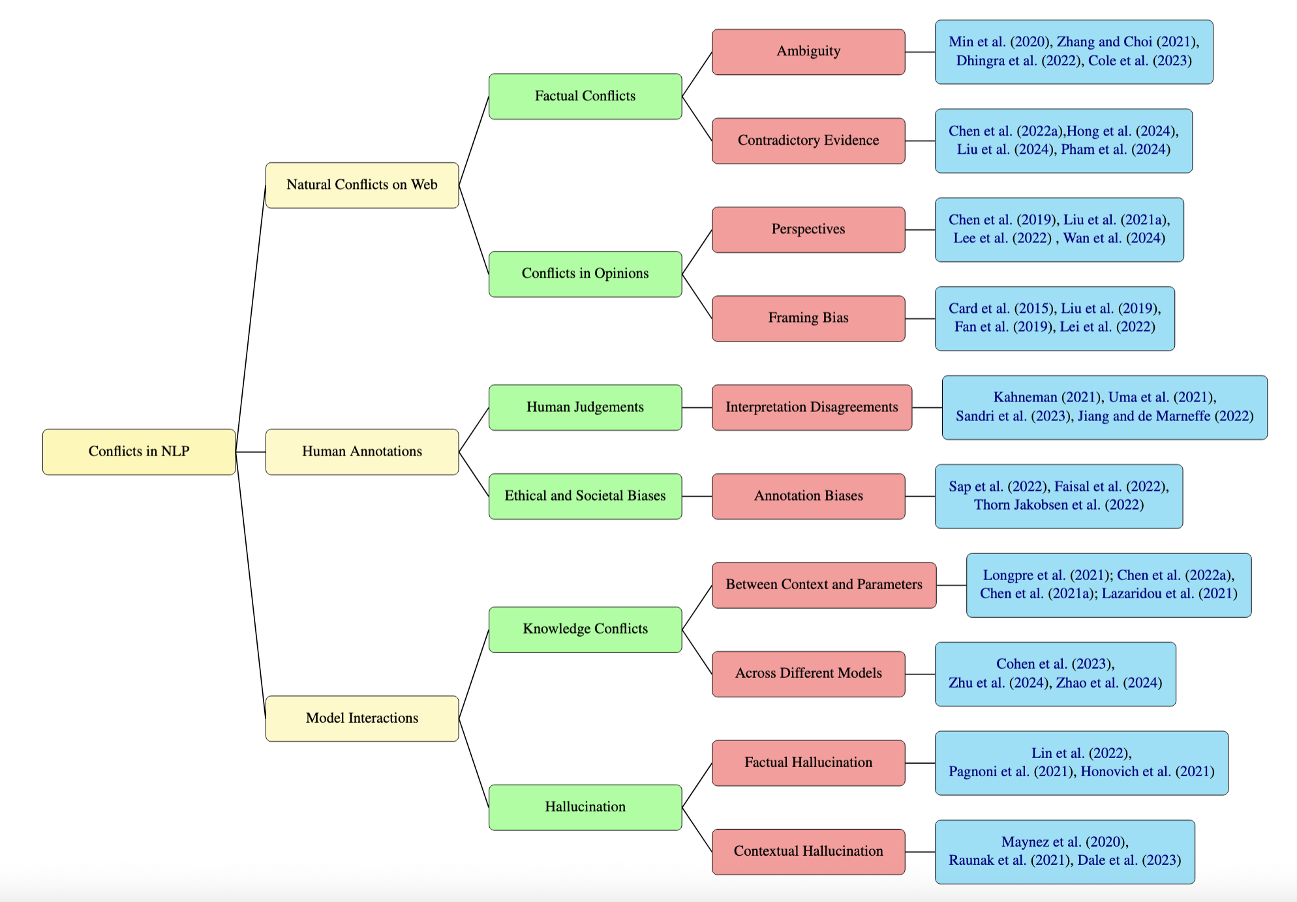
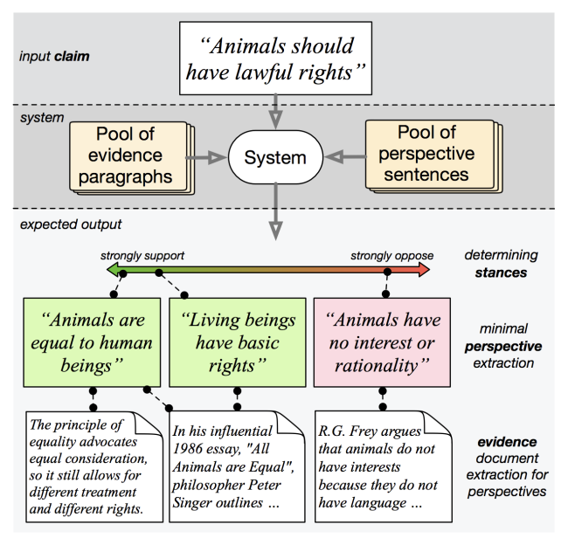
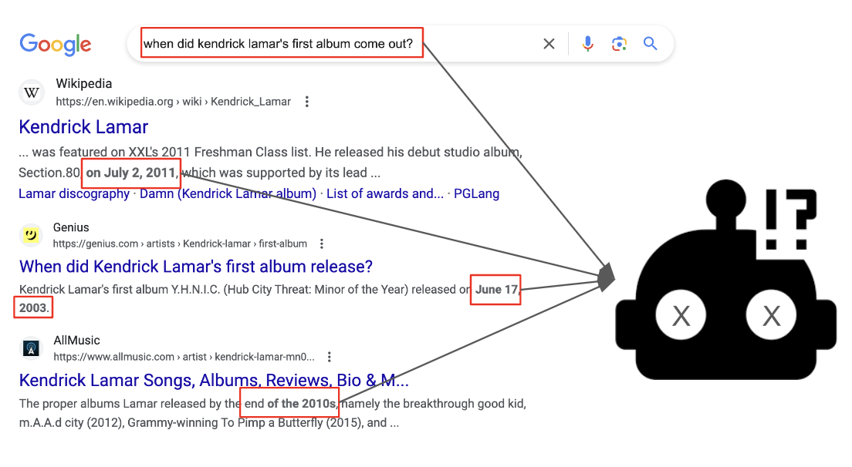
Conflicts, Perspectives, and Mis-/Disinformation
Sihao Chen, et al. Seeing things from a different angle: discovering diverse perspectives about claims. NAACL 2019.
Conflicts in Texts: Data, Implications and Challenges, Liu & Roth, EMNLP 2025
Siyi Liu et al., Open domain question answering with conflicting contexts. NAACL 2025

Slide 32
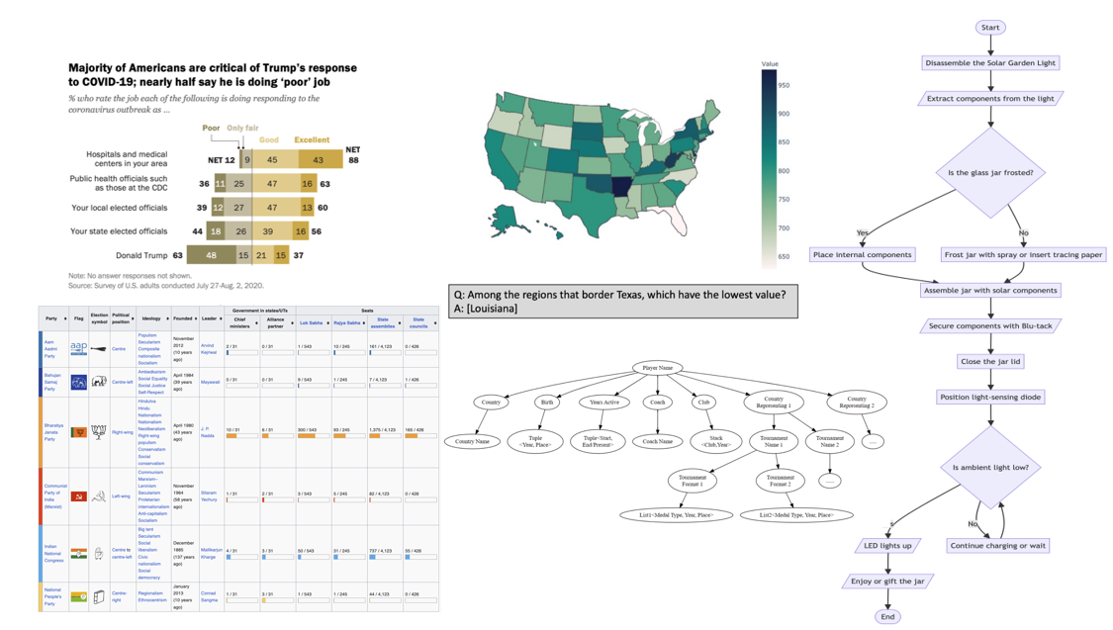
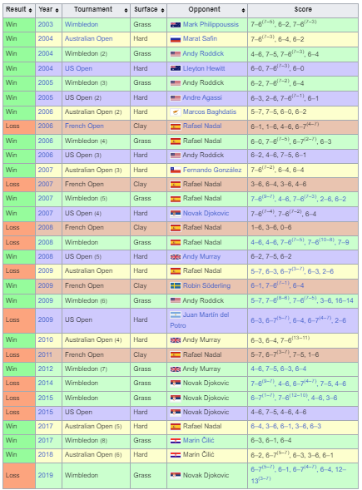
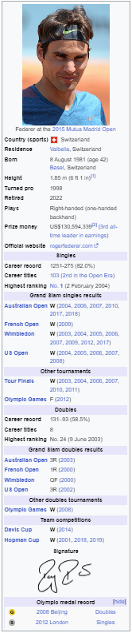
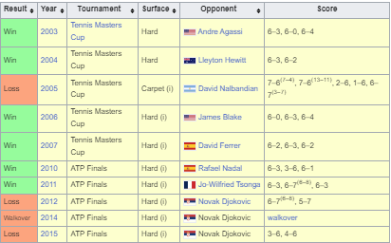
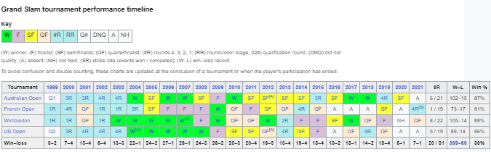
Conclusion
Thank You!
Real-world data is often multimodal, temporal, multilingual, and it is still challenging to access, understand, and use it reliably
The key use case for LLMs is going to be that of
Orchestrating and supporting access and use of external data
Multiple heterogenous knowledge sources that models will not see prior to run time
And the consumers are going to be both humans and AI agents.
There is work to do in core problems – from retrieval, to structure, to planning and dealing with conflicting information.
With Vivek Gupta, et al.

