Slide 1

Modelado matemático, basado en cadenas de Markov, para servicios de video en vivo soportados por redes híbridas P2P-CDN”
Presentan:
Muñoz Ruiz Ulises
Ortiz Islas José Manuel

Slide 2
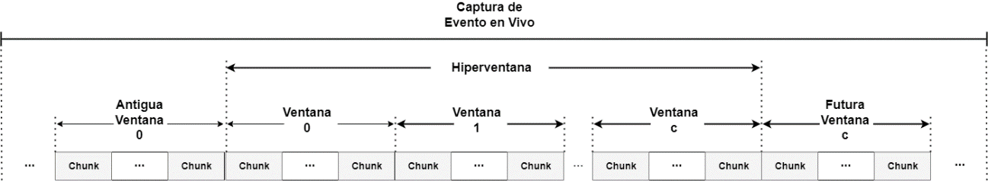
Escenario analizado

Slide 3


Poblaciones promedio de peers
$$c=24, λ=0.04, θ=2x{10}^{−3}$$
$$c=32, λ=0.04, θ=2x{10}^{−3}$$

Slide 4


$$c=24, λ=0.04, θ=6x{10}^{−3}$$
$$c=32, λ=0.04, θ=6x{10}^{−3}$$

Slide 5
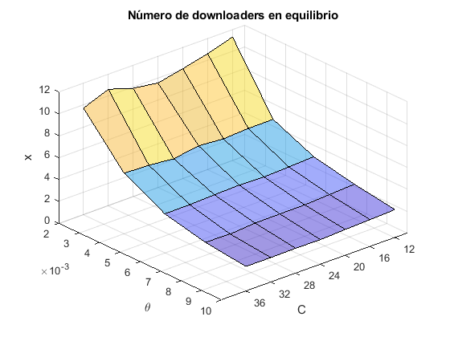
Poblaciones promedio de peers 3D
$$c=variable, λ=0.04, θ=variable$$

Slide 6
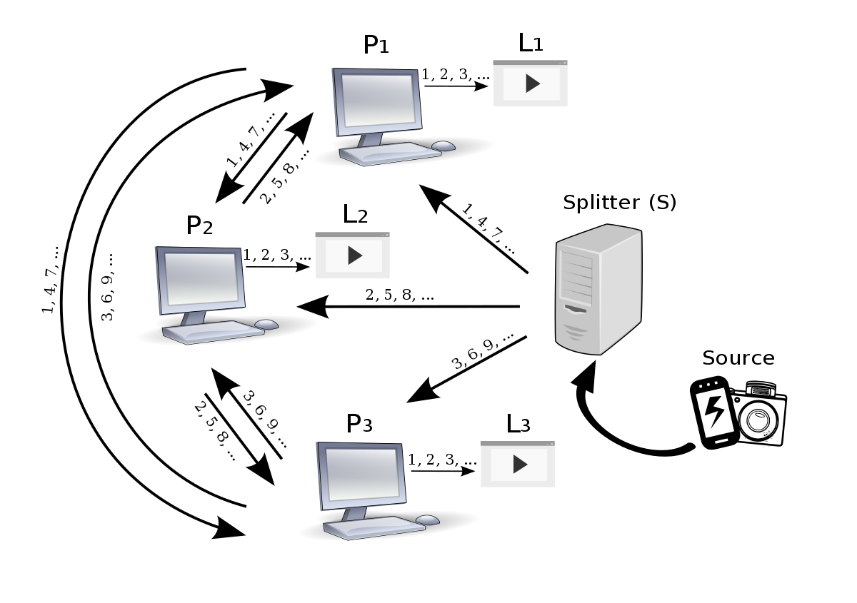

Ancho de Banda Consumido
Ancho de banda de descarga
$$B_{d}^{i}=min⁡\{C_{ω}∗X_{i},\sum_{k=i+1}^{c}{\frac{μ_{ω}∗X_{k}∗X_{i}}{\sum_{j=0}^{k−1}{X_{j}}}}+\frac{μ_{s}∗X_{i}}{\sum_{j=0}^{c−1}{X_{j}}}\}$$
Abundancia
$$B_{d}^{i}=C_{ω}∗X_{i}$$
Penuria
$$B_{d}^{i}=\sum_{k=i+1}^{c}{\frac{μ_{ω}∗X_{k}∗X_{i}}{\sum_{j=0}^{k−1}{X_{j}}}}+\frac{μ_{s}∗X_{i}}{\sum_{j=0}^{c−1}{X_{j}}}$$

Slide 7



$C_{ω}∗X_{i}$> $B_{d}^{i} penuria$
$$B_{u,p}^{i}=\sum_{k=i+1}^{c}{\frac{μ_{ω}∗X_{k}∗X_{i}}{\sum_{j=0}^{k−1}{X_{j}}}}$$
$$B_{u,s}^{i}=\frac{μ_{s}∗X_{i}}{\sum_{j=0}^{c−1}{X_{j}}}$$

Slide 8


$C_{ω}∗X_{i}$> $B_{d}^{i} penuria$
$$B_{u,p}^{i}=min⁡\{C_{ω}∗X_{i},\sum_{k=i+1}^{c}{\frac{μ_{ω}∗X_{k}∗X_{i}}{\sum_{j=0}^{k−1}{X_{j}}}}\}$$
$$B_{u,s}^{i}=C_{ω}∗X_{i}−B_{u,p}^{i}$$

Slide 9


Anchos de Banda
$$c=24, λ=0.04, θ=2x{10}^{−3}$$
$$c=32, λ=0.04, θ=2x{10}^{−3}$$

Slide 10


$$c=24, λ=0.04, θ=6x{10}^{−3}$$
$$c=32, λ=0.04, θ=6x{10}^{−3}$$

Slide 11
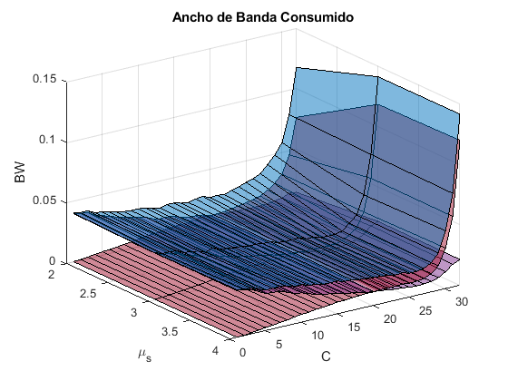
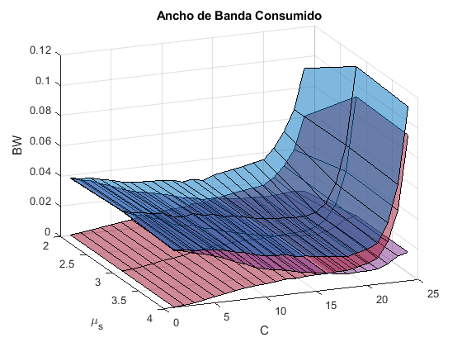



Anchos de Banda con $μ_{s}$variable
$$c=24, λ=0.04, θ=2x{10}^{−3}$$
$$c=32, λ=0.04, θ=2x{10}^{−3}$$

