Slide 1



Robot Arm project
Team :
Yousef Mokhtar Abdelkream hamdy
Ahmed mohamed fouly Ali Nour Eldin
Mostafa Mohsen saber Basem zain
Ahmed mostafa

Slide 2

CONTENTS
Cad
Design
Matlab
Simulation
Buying
component
Embeded
code

Slide 3
Matlab simulation01
-Writing the code
-simulation

Slide 4
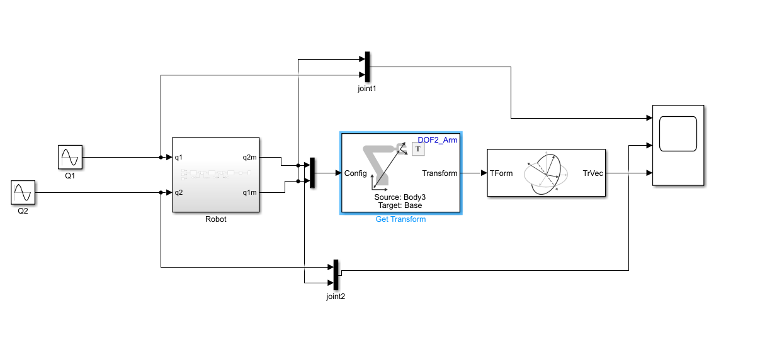
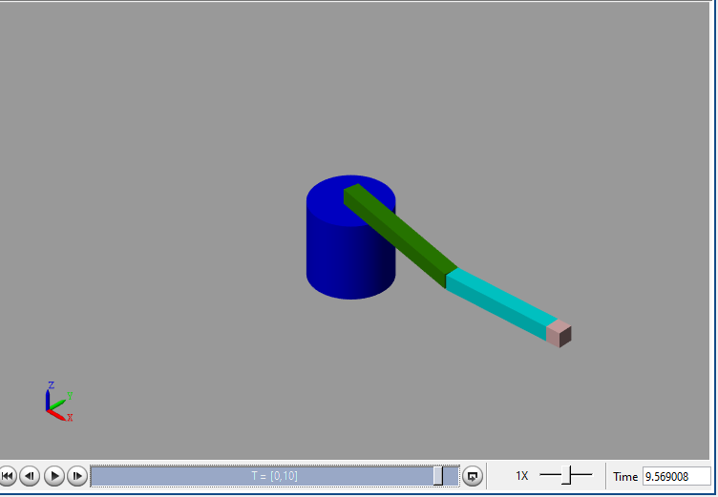
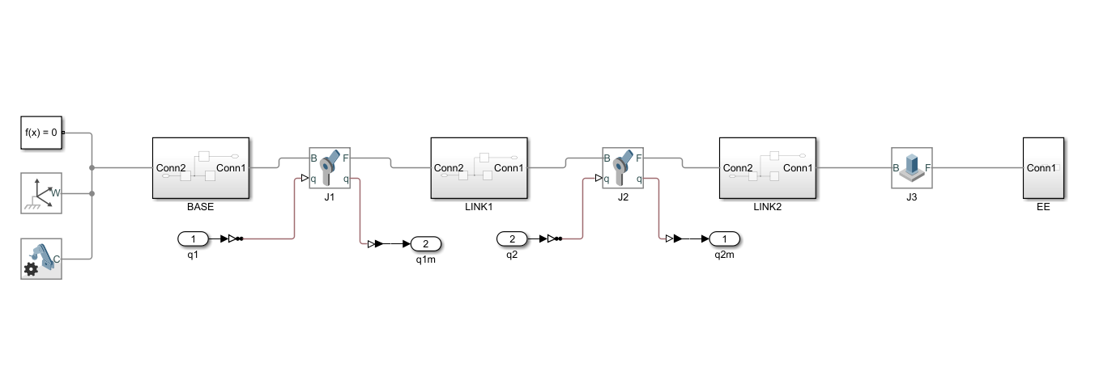
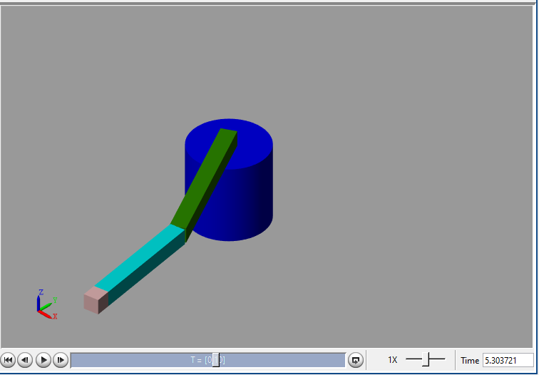
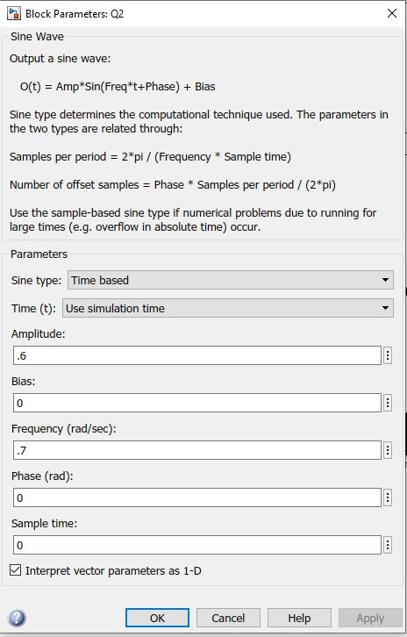
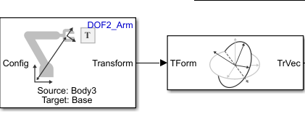
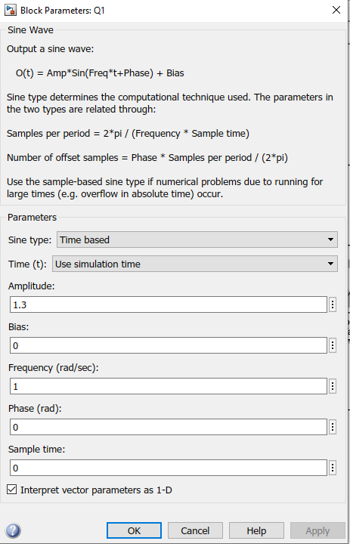
Matlab code
Robot
Forward kinamatics

Slide 5
Design 02
-CAD Design Assemply
- Assemply parts

Slide 6

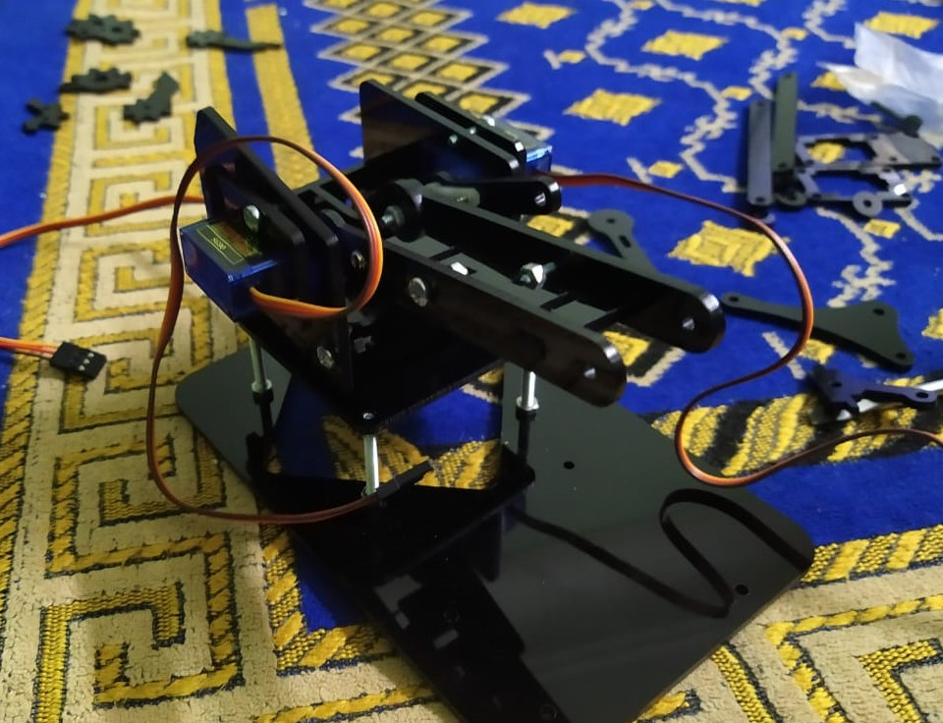
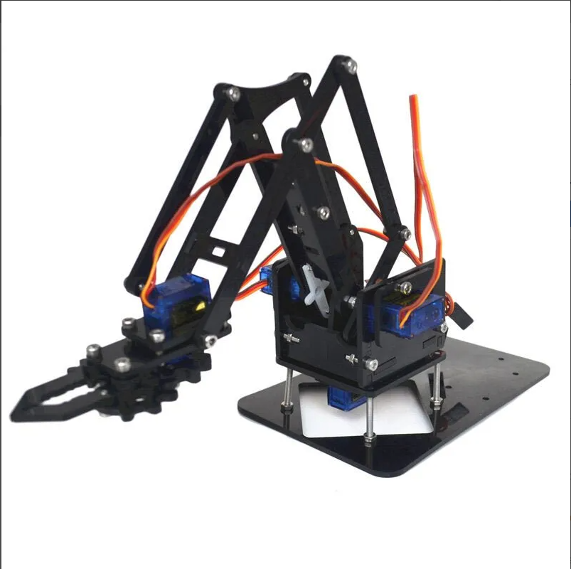
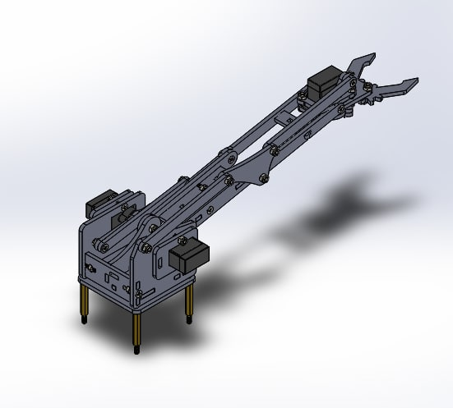
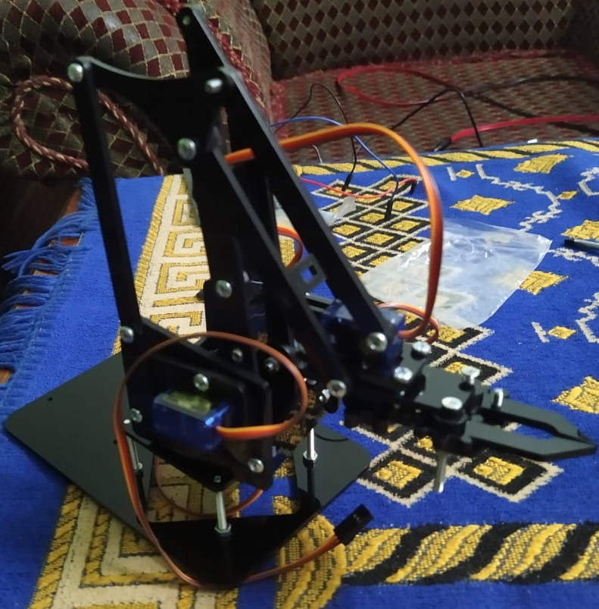
Assemble Parts
Process
At this stage, we assembled the parts piece by piece and connected them together with screws

Slide 7
Embeded c 03

Slide 8
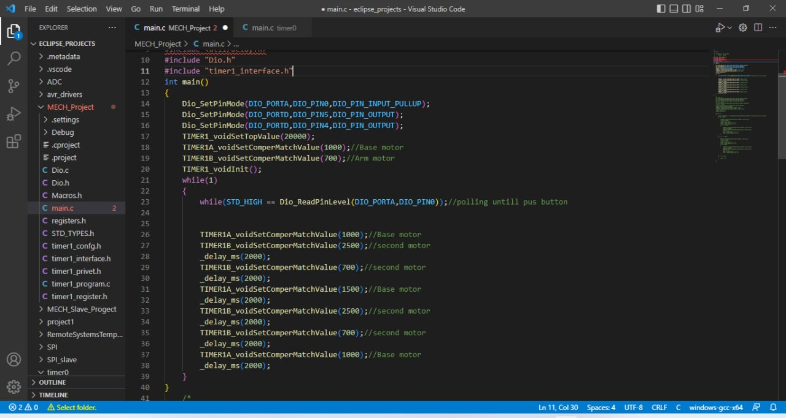
Embeded C
Process
At this stage, We programmed a code using the C language to control the operating angles of the motor

Slide 9
Buying component 04
we buy our servo motor sg90s from “Diyelectronicsegypt”

Slide 10
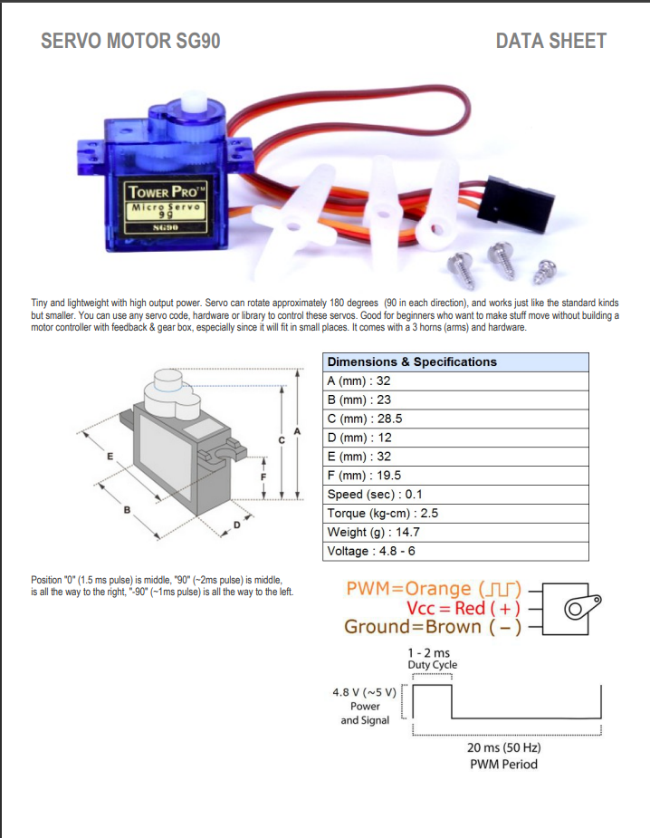

Slide 11
Thank you for listening to

