Slide 1
JOB PORTAL
TS- WEB/CC/AI TRACK CAPSTONE PROJECT
Presented By:
19KA1A0257-D.M.PAVITHRA
19KA1A0248-U.APARNA
3. 19KA1A0445-P.DEVI PRIYA
Guided by
R. Uma Maheshwari

Slide 2
OUTLINE
Abstract
Problem Statement
Aims , Objective & Proposed System/Solution
System Design
System Development Approach
Project outcome
Conclusion
References

Slide 3
Abstract
Finding jobs that best suits the interests and skill set is quite a challenging task for the job seekers. The difficulties arise from not having proper knowledge on the organization’s objective, their work culture and current job openings. In addition, finding the right candidate with desired qualifications to fill their current job openings is an important task for the recruiters of any organization. Online Job Portals have certainly made job seeking convenient on both sides.
Job Portal is the solution where recruiter as well as the job seeker meet aiming at fulfilling their individual requirement. They are the cheapest as well as the fastest source of communication reaching wide range of audience on just a single click irrespective of their geographical distance.
The web application “Job Portal” provides an easy and convenient search application for the job seekers to find their desired jobs and for the recruiters to find the right candidate. Job seekers from any background can search for the current job openings. Job seekers can register with the application and update their details and skill set. They can search for available jobs and apply to their desired positions.

Slide 4
Problem Statement
This project is aimed at developing a web-based and central Online job portal for the HR Group for a company.
This document provides details about the entire software requirements specification for the online job portal. The project Online Job portal is aimed at developing a web-based and central Recruitment Process System for the HR Group of a company

Slide 5
Proposed Solution
In simple words, Job boards provide the essential service that connects the candidates to the company. Based on the candidate's qualifications and resume, many job boards pre-screen the candidates for the company.
The recruiters can post the available job positions and their requirements with detailed descriptions containing the salary on the job boards. So if a candidate is interested in that position, they will simply apply for the post.

Slide 6
SYSTEM ARCHITECTURE
USER
LOGIN/REGISTER
LIST OF JOB
VIEW JOB DETAIL
APPLY
SEARCH JOB

Slide 7
SYSTEM DEPLOYMENT APPROACH
FRONTED DEVELOPMENT
HTML
CSS
BOOTSTRAP

Slide 8

PROJECT OUTCOMES

Slide 9
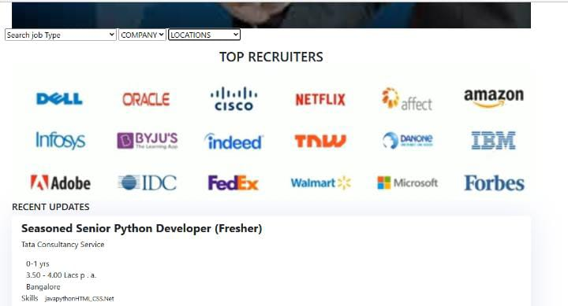

Slide 10
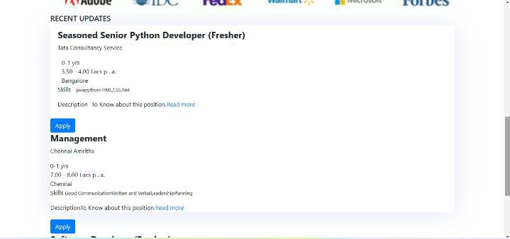

Slide 11
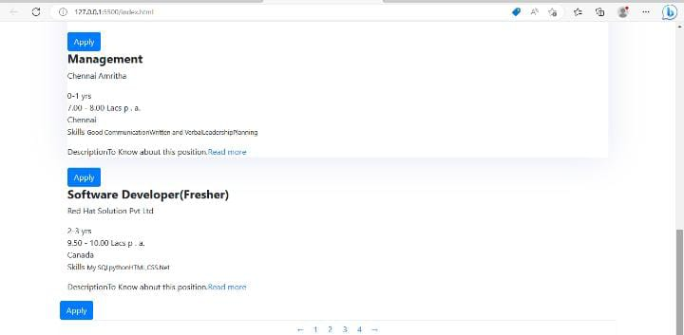

Slide 12
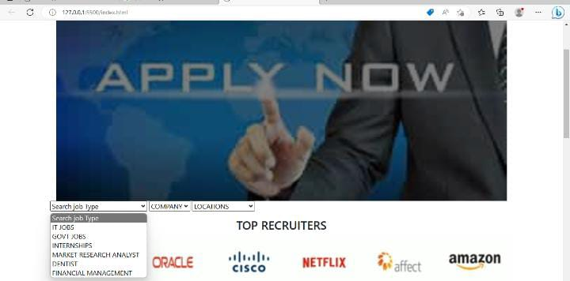

Slide 13


Slide 14
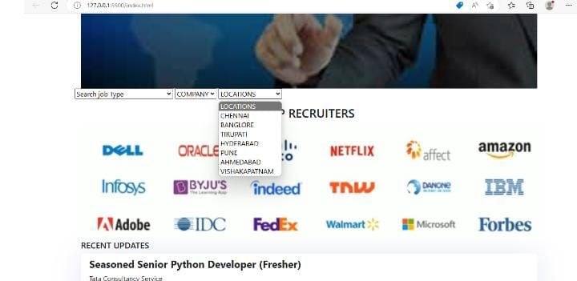

Slide 15
CONCLUSION
Job Portals stands as a revolutionizing element in the sphere of recruitment. They act as a communication bridge between applicants and recruiters facilitating their requirements. This application helps organizations to have a greater exposure to the candidate pool and also job seekers facilitating wide search of jobs matching their interests. The android application provides flexibility to the jobseekers to view the openings and applied jobs without the need to carry a laptop.
It provides user friendly interface which facilitates in reaching wide range of audience. The application has achieved all the requirements that were initially set in the requirements gathering phase. Starting from requirements elicitation to design, construction, implementation and testing, I have gained a very good experience working with various technologies at every phase.

Slide 16
REFERENCES
https://www.researchgate.net/publication/361465446_Application_using_MERN_Stack
https://blog.bitsrc.io/build-a-full-stack-banking-web-app-with-plaid-the-mern-stack-508914ce5694
https://javascript.plainenglish.io/create-a-fullstack-banking-application-using-react-e8c96d74cd39

Slide 17
THANK YOU

