Slide 1
Genie answers questions. LensS runs collections
LENSS COLLECTIONS INTELLIGENCE · ON DATABRICKS
PROOF, MEASURED
94.9%
of figures in answers reconciled exactly to the query result
96.5%
groundedness, scored on every answer by an independent AI judge
Genie is the query engine inside LensS. Everything around it turns Genie into a governed collections product: it knows what to show before anyone asks, checks every number it gives, follows the conversation across quick and deep answers, protects the data, and proves its quality, cost and safety at any time.
22
business rules held as data, in one table that every view reads
9
Ten things LensS adds, strongest first, on the next slides.
audited stages traced for every single question
Quality figures from the LensS test environment, on demo data.
Notes:
Open with the headline: Genie is the engine, LensS is the product. The proof panel: these are measured on every answer, not claimed. The next slides go through ten additions, strongest first.

Slide 2
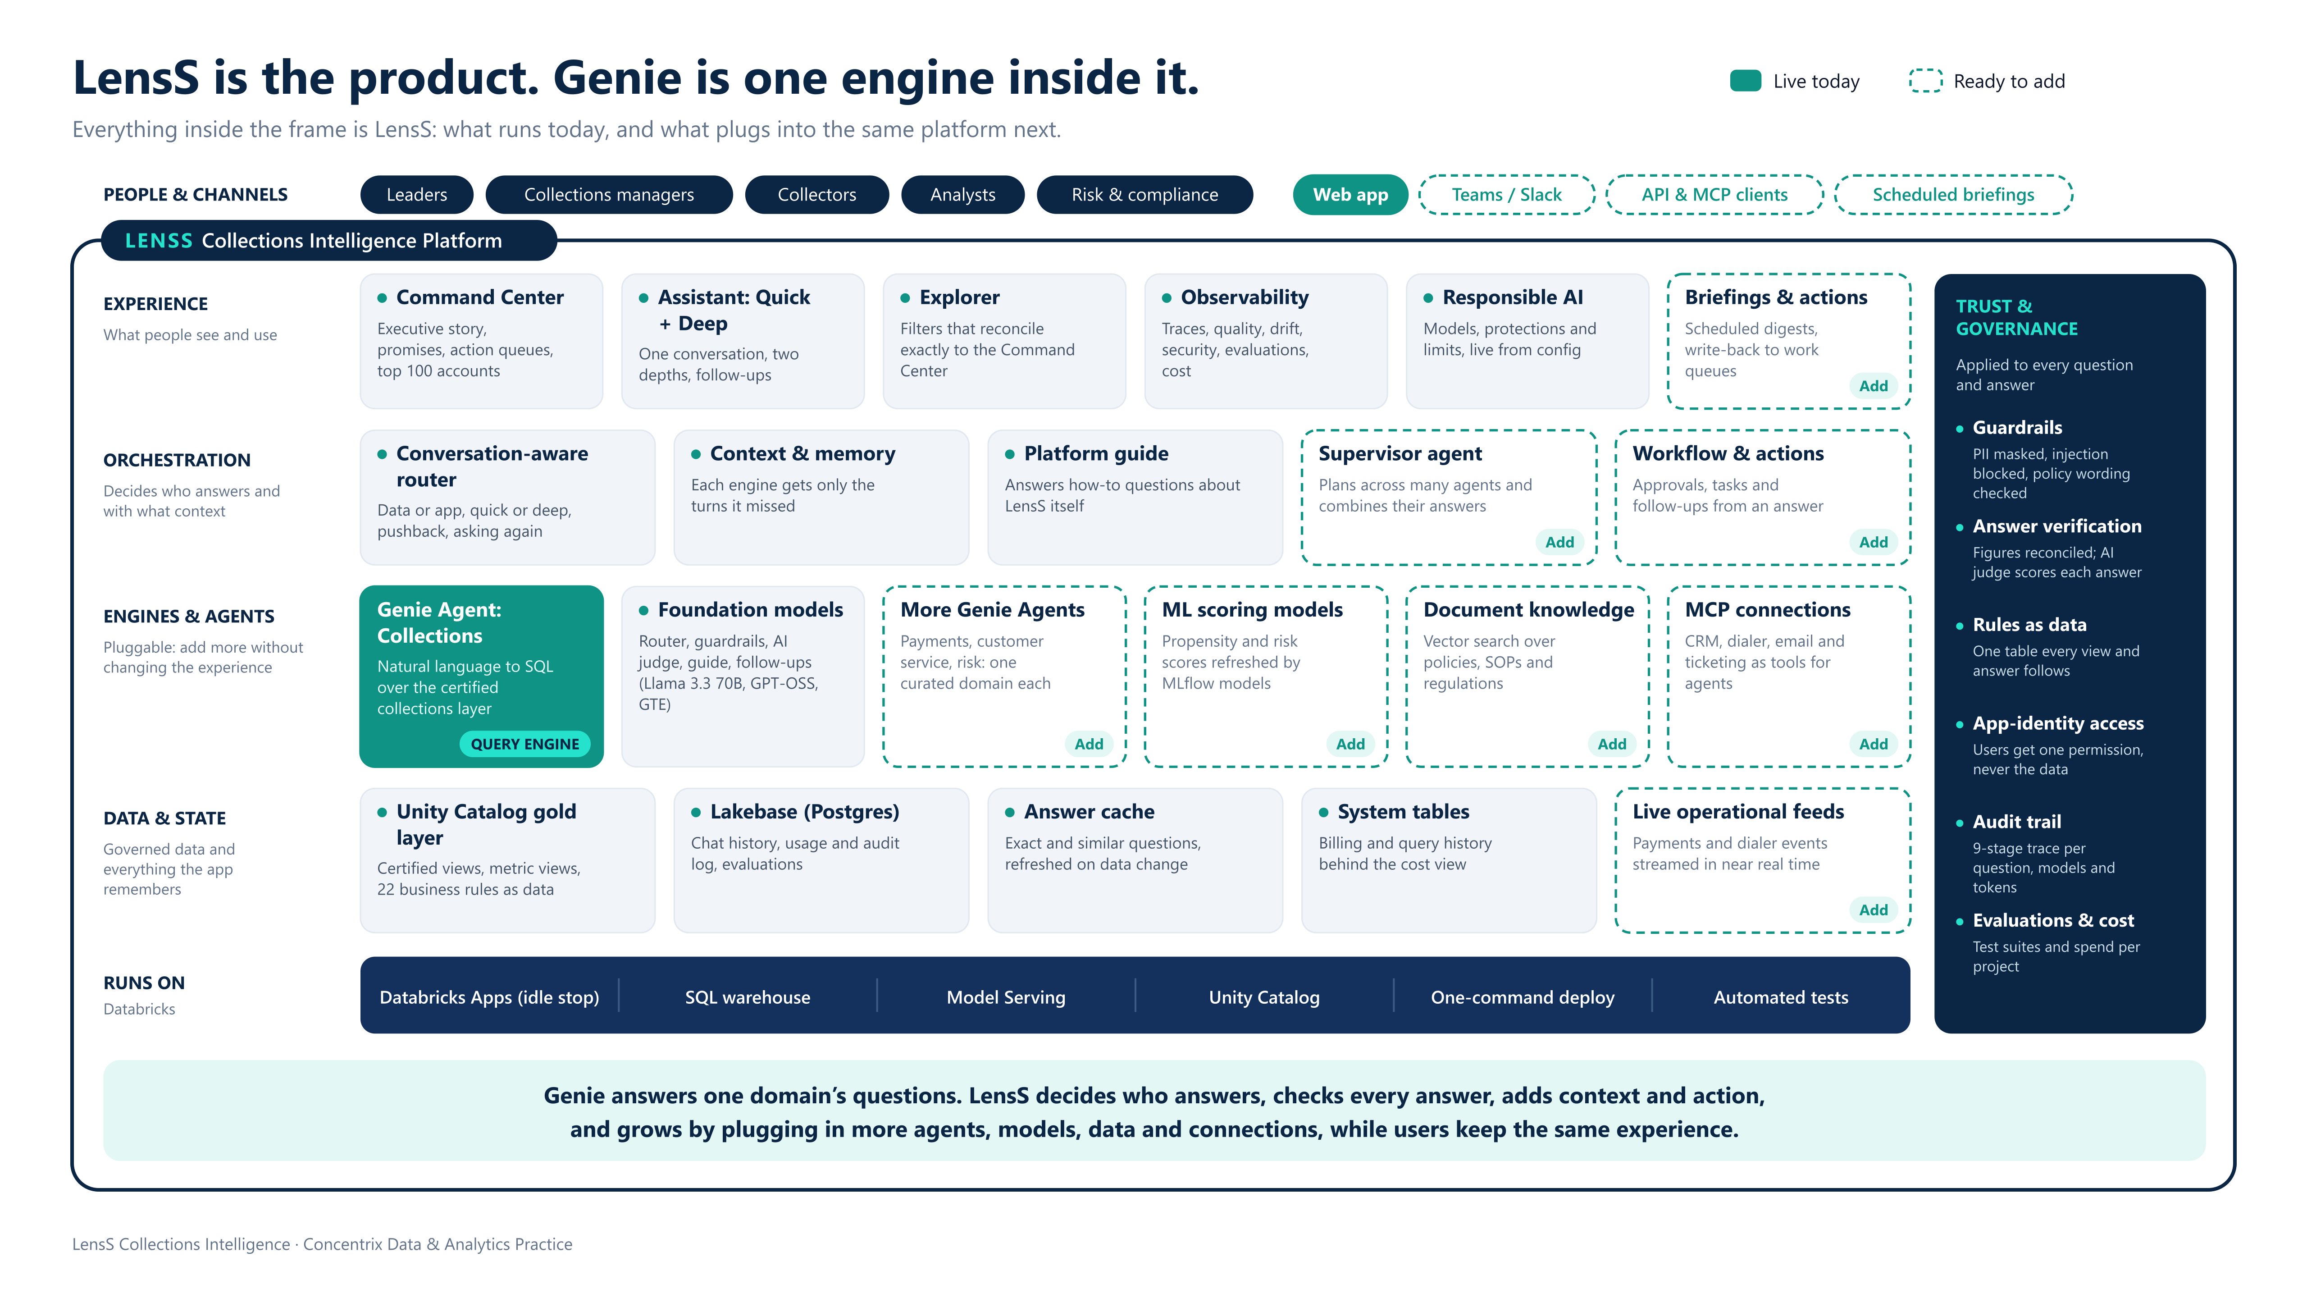
Notes:
LensS is the product; Genie is one engine inside it. Solid teal is live today; dashed is ready to add on the same platform without changing what users see. Live today: Command Center, Assistant (Quick + Deep in one conversation), Explorer, Observability, Responsible AI; a conversation-aware router that decides who answers and how deep and gives each engine only the context it is missing; the Collections Genie Agent plus AI models for routing, guardrails, quality checks and the in-app guide; a certified Unity Catalog layer with 22 rules as data, Lakebase, an answer cache and billing data; trust and governance on every request; running on Databricks Apps (auto-stop after 60 idle minutes), SQL warehouse, Model Serving, one-command deploy and automated tests. Ready to add: a supervisor agent, more Genie Agents (payments, customer service, risk), MCP connections to CRM, dialer, email and ticketing, ML scoring models, document knowledge, and new channels (Teams/Slack, API clients, scheduled briefings).

Slide 3
What runs today, and where LensS grows
Genie is one tile in the frame. Everything around it is LensS, and the platform is built to take more.
LIVE TODAY
READY TO ADD
Experience: Command Center, Assistant (Quick + Deep in one conversation), Explorer, Observability, Responsible AI.
Orchestration: a conversation-aware router that decides who answers and how deep, and gives each engine only the context it is missing.
Engines: the Collections Genie Agent, plus AI models for routing, guardrails, quality checks and the in-app guide.
Data and state: certified Unity Catalog layer with 22 rules as data; Lakebase for history, audit log and evaluations; answer cache; billing data.
Trust on every request: PII masked, injection blocked, every figure checked, full audit trail, evaluations and cost tracking.
Runs on Databricks: Apps with 60-minute auto-stop, SQL warehouse, Model Serving, one-command deploy, automated tests.
A supervisor agent that plans across several agents and combines their answers.
More Genie Agents: payments, customer service and risk, each a curated domain.
MCP connections to CRM, dialer, email and ticketing, so agents can look things up and take action.
ML scoring models and document knowledge: refreshed propensity and risk scores; policies, SOPs and regulations searchable.
New channels: Teams / Slack, API clients and scheduled briefings.
Why it matters A Genie app alone is a question box. LensS decides who answers, checks every answer, adds context and next actions, and grows by plugging in more agents, models, data and connections. That is why LensS is a product, not a Genie front end.
Notes:
Left: what is live today, layer by layer, matching the picture. Right: what plugs in next. Close on why this makes LensS a product.

Slide 4


Answers you can trust, from one assistant that follows the conversation
The two biggest differences: every number is checked, and quick and deep analysis work as one conversation.
1 Answers you can trust and audit
2 One assistant: Quick + Deep combined
Genie alone: writes SQL over whatever tables it is given. Nothing tells you whether a given answer is right.
Genie alone: quick chat and agent mode are separate. The user picks the mode, and switching loses the thread.
A certified data layer. Genie never reads raw data: it answers from certified views and metric views that encode recovery, roll-forward, promises and target achievement.
22 business rules as data. One table holds every threshold (e.g. high risk ≥ 0.70). Change it once and every view, figure and answer follows.
Every view describes itself. Its business question, grain and rules, plus 37 example questions covering every source, so different wordings get the same answer.
Every answer is checked. 94.9% of figures matched the query exactly; an AI judge scores faithfulness, relevance and completeness (96.5% groundedness).
The query is shown. The certified view and SQL behind every answer.
One conversation, two depths. Each engine is given the turns it missed.
A router decides in about 1 s: data or app question, quick or deep, and whether the user is pushing back or asking again.
The user says or does | LensS responds
“This isn’t enough” | A fresh, deeper analysis, never the same answer again
“Why is the third one so high?” | Resolves “the third one” from the last answer
Asks the same question again | Offers a fuller analysis, or shows the earlier answer
Gets a thin quick answer | “Go deeper” is offered automatically
“No, you do it” after a how-to | Understood as pushback, not as an attack
A wrong number in collections means the wrong action on a real customer.
The user’s own Quick or Deep choice is kept, unless they ask for more.
Notes:
Trust first: certified layer, rules as data, and every answer checked twice. Then the assistant: Genie has separate modes; LensS makes them one conversation and reacts the way a good analyst would.

Slide 5



Insight before anyone asks, with safety and an audit trail built in
Leaders get the story and the action list without typing; risk teams see every control and every answer’s trail.
3 The Command Center
4 Safety and compliance
5 Full audit trail
Genie alone: a blank question box; value depends on knowing what to ask.
Genie alone: answers what it is asked; no checks on what goes in or comes out.
Genie alone: no per-question trace, quality trend or usage view for the owner.
Where we stand: collected vs target, days left, month-end outlook and likelihood.
Promises end to end: ₹168.4M promised; ₹52.7M broken and ₹28.3M kept so far; ₹87.5M still to come.
What holds us back: issues ranked by money at stake, with the likely driver.
This week: action queues for promises at risk, high-value accounts and accounts nearing 180+ days.
Top 100 accounts: ₹4.0M recoverable, a next step for each.
Every figure opens its accounts and continues in the assistant.
Personal data masked (emails, phones, cards, Aadhaar, PAN…) before a question is processed or stored, and removed from answers.
Prompt injection and jailbreaks blocked before any data is queried. Abusive language blocked.
Policy wording: no forecasts stated as fact, no unsupported causal claims.
A live Responsible AI page: models used and when, every protection in force, quality results and known limits.
A 9-stage trace per question: routing, guardrails, cache, plan, data, verification, answer, delivery, log; models, tokens and time.
Quality over time, with a review queue for low scores and 👎 with reasons.
Latency, routing, drift and security views.
Automated evaluations: accuracy, guardrail, policy and routing suites with history.
Databricks cost since day 1, by service, this project only.
Command Center figures are from the demo data.
Notes:
Command Center: the answer and the action list in seconds. Safety: visible controls for risk and compliance. Audit: the owner can answer “is it working, right, safe, and what does it cost?” with evidence.

Slide 6





Built for collections, secure to roll out, and cheap to run
Everything a production rollout needs, beyond the question box.
6 Built for collections
7 Users never touch the data
8 Faster and cheaper to run
DPD buckets, roll-forward, promise outcomes, contact strategy, over-contact risk, like-for-like strategies and collector scorecards. A recommended action for every priority account; vulnerable and disputing customers first. No forecasting: the outlook comes from the promise pipeline.
With Genie alone, every user needs the Genie space, the warehouse and the tables. With LensS, users get one app permission; the app’s own identity does the rest. Access is a group: remove someone and everything goes.
An answer cache (exact and similar questions) answers repeats instantly and refreshes when data or Genie changes. The app stops itself after 60 idle minutes. The cost tab shows spend by service.
9 A complete product
10 Enterprise delivery
THE TAKEAWAY
Genie is one component. LensS is the governed, measured, secure collections product built around it, ready for real users from day one.
Saved chat history, an Explorer that reconciles exactly to the Command Center, 👍/👎 feedback into review, PDF export with charts, “answer ready” alerts, voice input, and a built-in guide so Genie is never asked about the app.
One-command deploy of data, views, rules, Genie space (as code), database, app and permissions. New versions run side by side with instant rollback. Every release passes a 30-check smoke test, a 40-case routing evaluation and live conversation tests.
Notes:
Points six to ten: domain fit, a simple and safe access model, cost control, a complete product experience, and repeatable, tested delivery.

Slide 7
Genie alone vs LensS on Databricks
Same engine underneath; very different outcome for the business.
Capability | Genie on its own | LensS on Databricks
Answers questions in natural language | Yes | Yes, Genie is the engine
Governed, certified collections data layer | Built separately by the team | Included: certified views, metric views, 22 rules as data
Every figure checked against the data | No | Reconciliation plus an AI quality judge
Quick and deep analysis in one conversation | Separate modes and memory | One conversation; the router picks the depth
Understands pushback, “not enough”, asking again | No | Yes
Dashboard and action lists without asking | No | Command Center, action queues, top 100 accounts
PII masking, injection blocking, policy checks | No | On every question and answer
Per-question audit trace | No | 9-stage trace: models, tokens, timing
Quality, drift, evaluations, cost dashboards | No | Observability, 8 areas
Users need data and Genie access | Yes | No: one app permission only
Answer cache and idle stop | No | Yes
Repeatable deploy, tested releases | Manual | One command, automated tests
“Couldn’t we just build a Genie app?”
A Genie app gives you the question box. To match LensS, a team would also build:
The governed data layer and rules table
Answer verification and the AI judge
The Quick + Deep router with shared context
The Command Center and action logic
Guardrails and the Responsible AI view
Tracing, evaluations and cost views
Access model, cache, idle stop, history
Deploy and test automation
That is the product. Genie is one component of it.
Notes:
Walk the table quickly, then land the objection: a Genie app is only the question box; everything listed is what LensS already is.

