Slide 1
App-controlled LEGO robotic arm
Benjamin Schaefer, Christoph Ulrich
HTWG Konstanz, Ubiquitous Computing Lab
Mobile Computing WS2018/19
URL: http://uc-lab.in.htwg-konstanz.de
Notes:
Why – how – what
Happy evening everybody, Ulli and I would like to introduce our project "App-controlled LEGO robotic arm" today.

Slide 2






Motivation
State of the Art
Construction
Kinematics
Application
Demo
Notes:
For this, we first want to focus on our motivation for the project. Afterwards, we will briefly discuss the "state of the art". Next we will, as the name suggests, go into the design and a few key figures of the arm. In order for the arm to be properly controlled, we will also go into the forward and reverse kinematics. After that we will introduce you to our app and finally we will show a little demo of our arm.

Slide 3
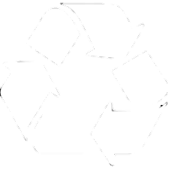
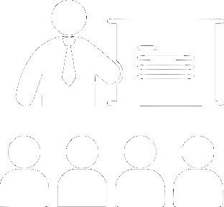

Motivation
Material recycling
Use in teaching
Easy start
in robotics
Notes:
Since we are very interested in robotics, we wanted to develop our own arm. This arm can also be used later in teaching for illustrative purposes, or also for exercises in the robotics lectures. Furthermore, the arm offers a lighter and playful introduction to robotics. In addition, a positive side effect was that existing and disused hardware could be reused from the robotic lab

Slide 4
Correlation
Binning
Navigation
Chamfer Matching
Sonar
Estimation
Coordinate transformations
Occupancy Grid
Odometry
ROS
Camera
Infrared
Orientation
Markov Localisation
Laser Scanner
Dead
reckoning
Kalman-Filter
IMU
Least Mean Squares
Autonomous
Kinematics
OpenSLAM
Resampling
Point Cloud
Radar
Position hypothesis
Algorithms
LiDAR
GPS
Octomaps
Dynamics
Sensors
Classification
Probability
Mechanics
Position
Pose Graph
Particlefilter
Tracking
Motion Model
Weighting
Simulation
Sensor Model
Ground Truth
Notes:
Bzgl. „easy start in robotics“ -> Robotik enthält viele (komplizierte) Aspekte (einige sind auf der Folie genannt). Mit unserem Projekt geben wir nen Einblick in die typischen Aspekte, mit denen man oft in Berührung kommt (die farblich hervorgehobenen), ←→ wiederum Vorteil für Lehre
------
Here are just a few things to do with robotics. Some of the first points you will encounter are the "Coordinate Transforamtions", "ROS", "Kinematics" and "Sensors". Our project provides a perfect start to these points.

Slide 5
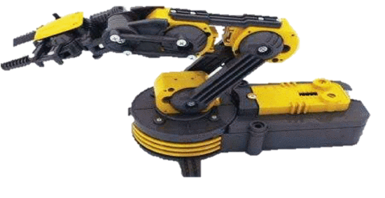
State of the Art
Notes:
There is a wide selection of arms to buy. These go from very cheap to very expensive. There is also a wide range of arms in terms of angular resolution and repeatability. Meanwhile, there are also some DIY projects to find on the Internet.
As already stated in the motivation, however, we wanted to collect our own experiences and therefore decided to build our own arm.

Slide 6
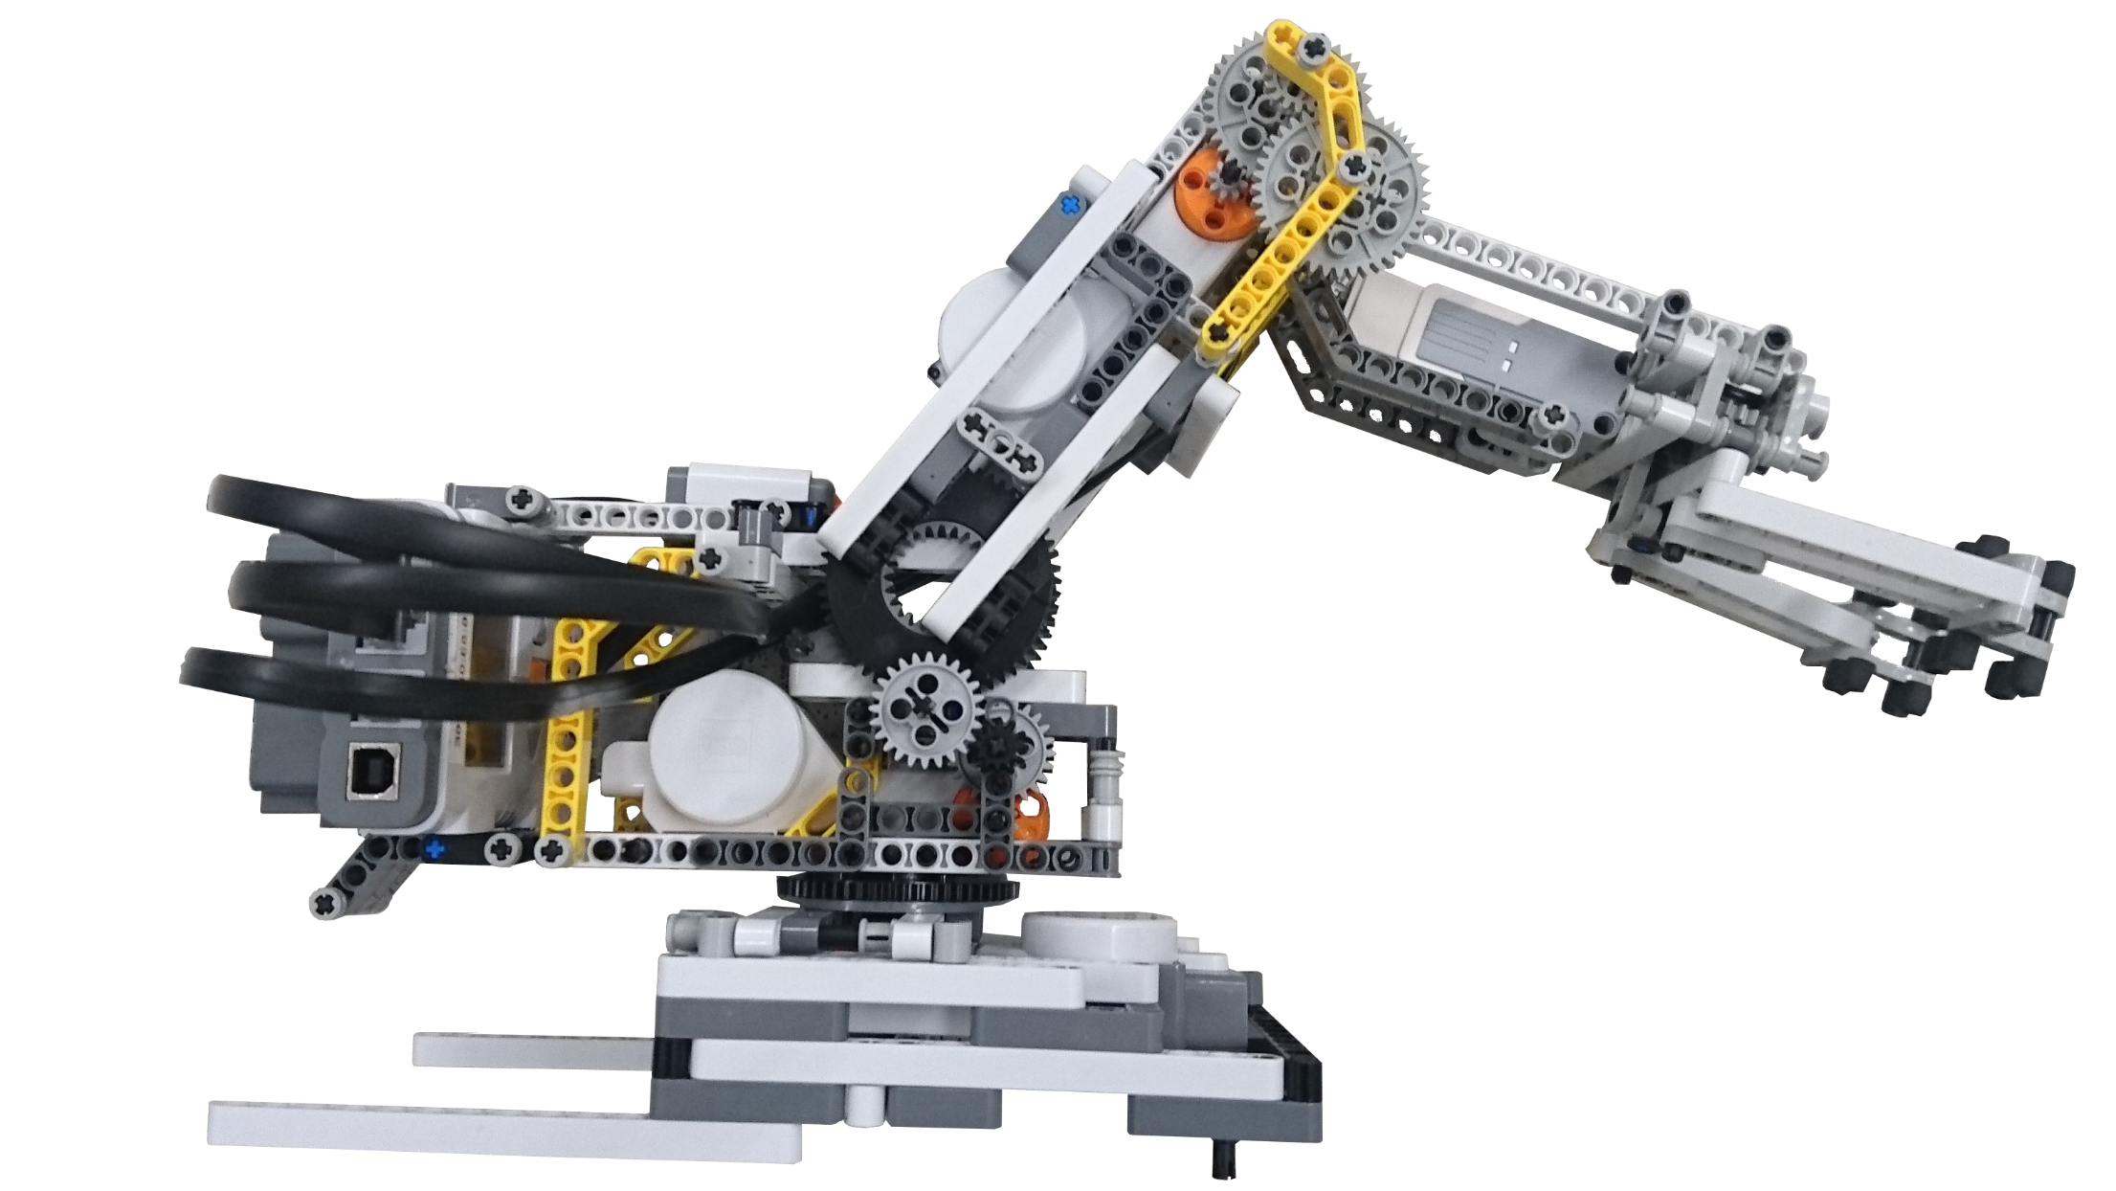


Construction
~ 200 gr.
~ 150 gr.
Repeatability of +/- 1°
Notes:
For the people who are not in the first row, you can see here our finished prototype. This one offers 3 DOF, which you can see here. So that the arm can be fully controlled, 2 NXTs were installed. One of them can be seen here, the second one was placed below. In the current design and with the current translation, the arm can lift about 150g. Considering the weight of the arm of about 200g, the arm can lift about 75% of its own weight. However, it should be noted that this is only the weight of the arm. The base weighs much more, but the weight for the load capacity of the arm is irrelevant.
Furthermore, we found out after first tests that we have a repeatability of about 1 degree.

Slide 7
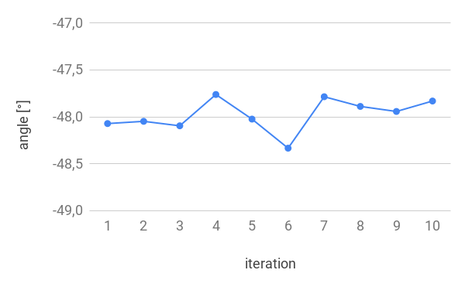
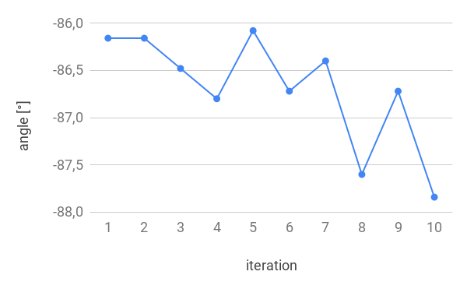
Android Application
Christoph Ulrich, Benjamin Schaefer
Ubiquitous Computing Lab
7
Notes:
Auf Achsenbedeutung eingehen!
The two diagrams show the repeated approach of the calibration position. The left image shows the lower joint, the right image the upper joint. After every 10 repetitions, the lower joint shows a repeatability of about 0.5 ° and the upper joint of 1 °. It should be noted, however, that at the lower joint a ratio of 1 to 42 was installed and in the upper joint only from 2 to 25.
However, this is only the theoretical approachability. Since the arm is made of Lego technology, the arm has some gear backlash. (wobble on the arm). The gear backlash has the biggest impact when the arm is orthogonal to the ground.
Now I would like to hand over to Christoph, who introduces you to the kinematics and the app.

Slide 8




Forward Kinematics
$$T_{3}^{0}=T_{1}^{0} ∗T_{2}^{1} ∗T_{3}^{2}$$
$$T_{i}^{i−1}=Tl\left(0, 0, d_{i}\right)∗R(z, Θ_{i})$$
$$T_{i}^{i−1}= \begin{matrix}cos(Θ_{i}) & −sin(Θ_{i}) & 0 \\ sin(Θ_{i}) & cos(Θ_{i}) & 0 \\ 0 & 0 & 1\end{matrix} \begin{matrix}l_{i}∗cos(Θ_{i}) \\ l_{i}∗sin(Θ_{i}) \\ 0\end{matrix}$$
$$\begin{matrix}0 & 0\end{matrix}\begin{matrix} 0 & 1\end{matrix}$$
$p_{World}=T_{3}^{0} ∗{\begin{matrix}(\begin{matrix}0 & 0\end{matrix} & \begin{matrix}0 & 1\end{matrix}\end{matrix})}^{T}$
Notes:
To control the arm reliably -> forward and inverse kinematics.
Goal forward -> determine pose of tcp when a set of joint angles is given
Concatenation of n transformation matrices (coordinate systems), n -> number of joints
Tr matrix (DH) -> translation and rotation
Z rotation , translation parts -> x -> l * cos, y -> l * sin

Slide 9








Inverse Kinematics
y
$$α=atan2(y,x)$$
$$Θ_{2}$$
Law of Cosines
$$α$$
$$β$$
p
$$l_{2}^{2}=l_{1}^{2}+{|p|}^{2}−2∗l_{1}∗\left|p\right|∗cos(β)$$
x
$$χ$$
$$Θ_{3}$$
$$β, χ$$
$$Θ_{1}= α−β,Θ_{2}= π−χ$$

Slide 10






Inverse Kinematics
$$α=atan2(y,x)$$
$$Θ_{3}$$
Law of Cosines
$$χ$$
p
x
$$β$$
$$l_{2}^{2}=l_{1}^{2}+{|p|}^{2}−2∗l_{1}∗\left|p\right|∗cos(β)$$
$$α$$
$$Θ_{2}$$
$$β, χ$$
y
$$Θ_{2}= α−β,Θ_{3}= π−χ$$
Notes:
Goal: calculate the set of joint angles when a tco pose is given
Just give idea about geometrical approach , not following every line

Slide 11
Application - Architecture

Slide 12
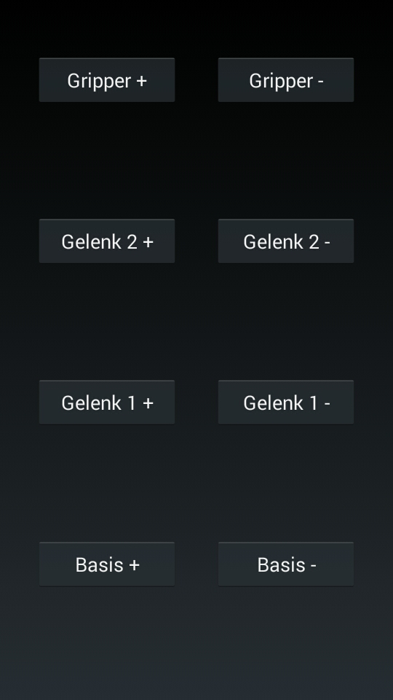
Android Application
Christoph Ulrich, Benjamin Schaefer
12

Slide 13
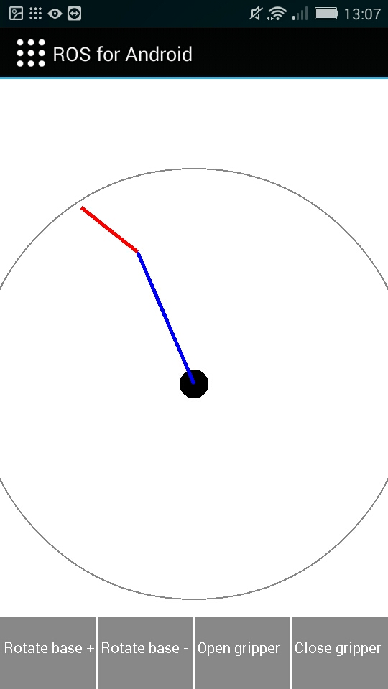
Android Application
Christoph Ulrich, Benjamin Schaefer
13

Slide 14
Application - Pipeline
onTouch Event
GUI
touchPoint(x,y)
Inverse Kinematics
joint angles
ROS ActionClient
update
Forward Kinematics
motor position
update
joint angles
Motors
power
ROS NXT Node
effort
ROS ActionServer

Slide 15

Thanks for your attention. Questions?
Benjamin Schaefer, Christoph Ulrich
HTWG Konstanz Department of Computer Science
Ubiquitous Computing Lab
Alfred-Wachtel-Str. 8
D-78462 Konstanz (Germany)
Phone: +49 7531-206 0
URL: http://uc-lab.in.htwg-konstanz.de
Twitter: /UCLabHTWG
Facebook: /UCLabHTWG

