Slide 1
ConceptNet
A practical commonsense reasoning tool
http://conceptnet5.media.mit.edu/

Slide 2
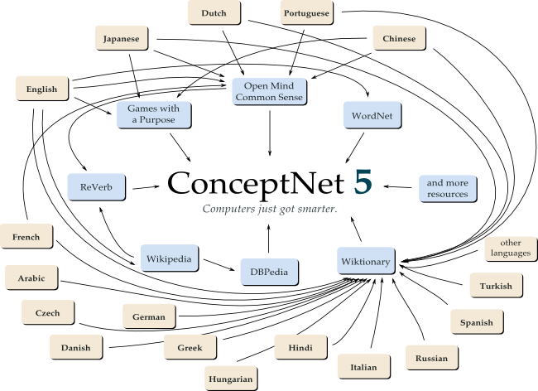

Slide 3
Commomsense knowledge spans a huge portion of human experience, but is
typically omitted from social communications
ConceptNet invests in making associations, even ones whose value is not immediately apparent

Slide 4
The knowledge base is a semantic network presently consisting of over 1.6 million assertions of commonsense knowledge encompassing the spatial, physical, social, temporal, and psychological aspects of everyday life.
ConceptNet is generated automatically from the 700 000 sentences of the Open Mind Common Sense Project — a World Wide Web based collaboration with over 14 000 authors.

Slide 5
ConceptNet contains everyday basic knowledge:
Cultural knowledge:
saxophone UsedFor jazz
A saxophone is used for jazz.
And scientific knowledge:
plutino can cross neptune s orbit
Plutinos can cross Neptune's orbit.
It would not adequately represent human knowledge if it didn't contain other languages besides English, as well:
本 MadeOf 紙
本は紙でできている。 (A book is made of paper.)

Slide 6
History
2006 ConceptNet 2 knowledges mainly extracted from texts
2007 ConceptNet 3 knowledges added by web users
2008 ConceptNet 4 becomes multilingual
2012 ConceptNet 5 collects more knowledges from more sources

Slide 7
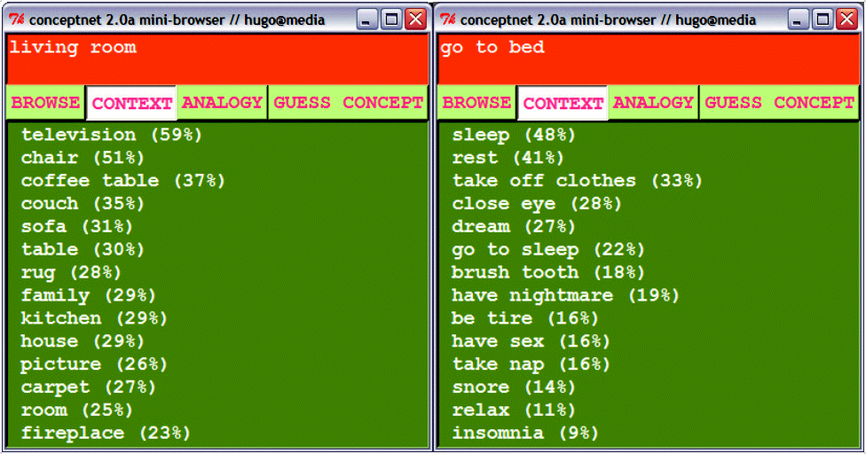
Legăturile în ConceptNet 2.0

Slide 8
Relation types
Relation Example sentence pattern
IsA NP is a kind of NP.
MadeOf NP is made of NP.
UsedFor NP is used for V P.
CapableOf NP can V P.
DesireOf NP wants to V P.
CreatedBy You make NP by V P.
InstanceOf An example of NP is NP.
PartOf NP is part of NP.
PropertyOf NP is AP.
EffectOf The effect of V P is NP|V P.

Slide 9
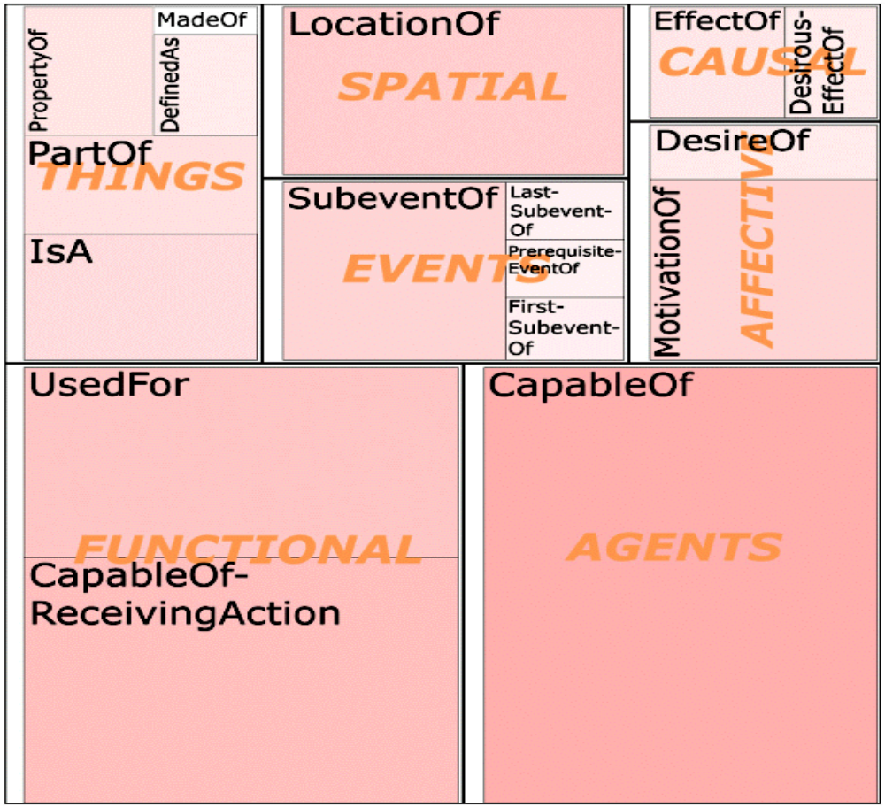

Slide 10
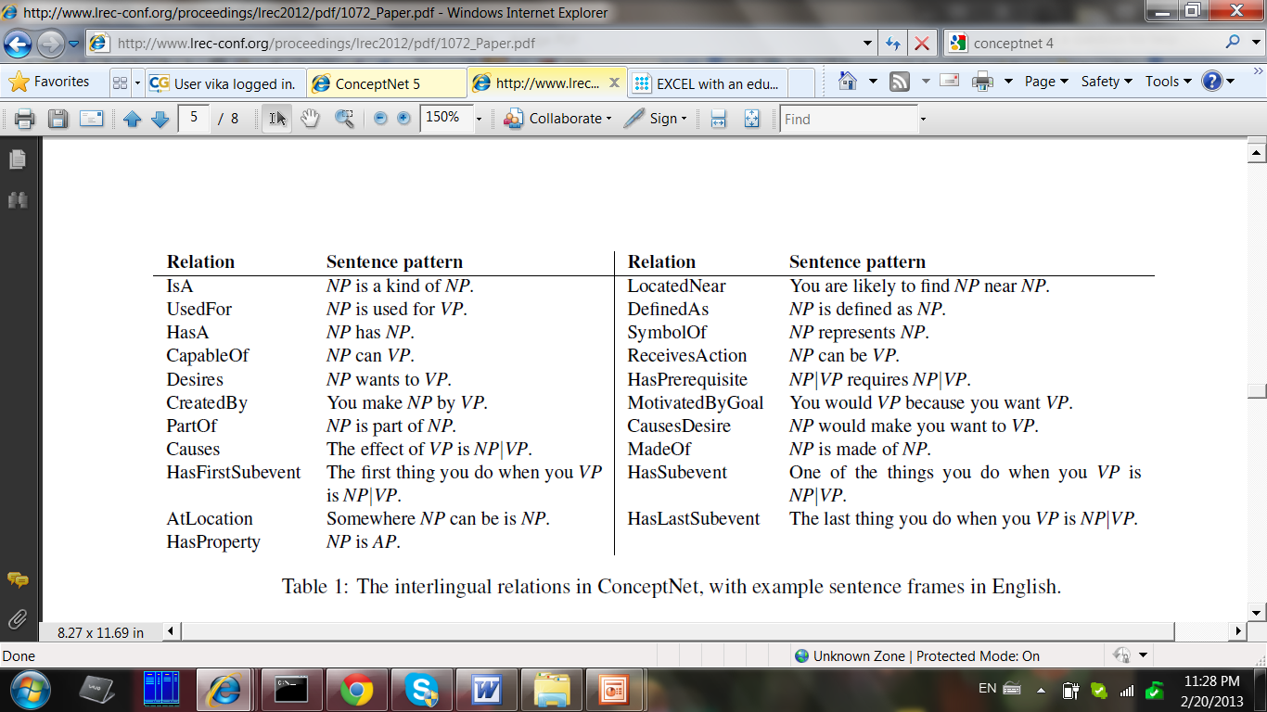
Relation types

Slide 11
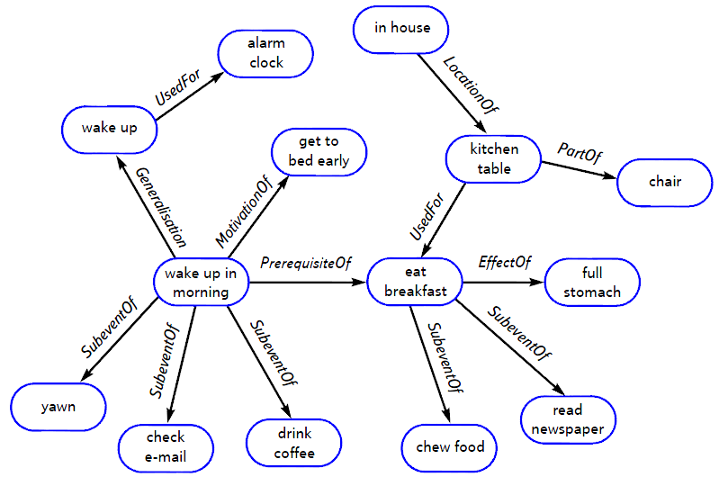

Slide 12
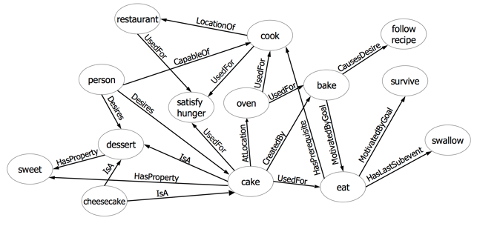

Slide 13
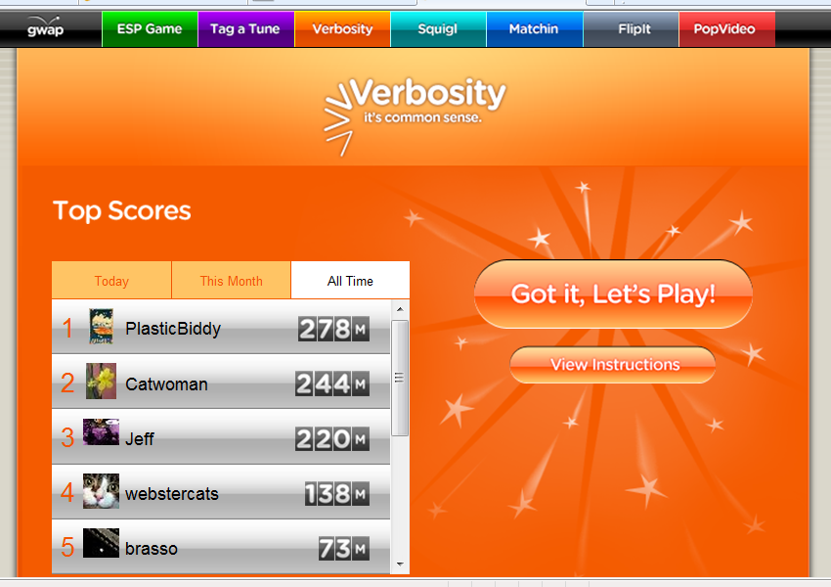
Game with a purpose

Slide 14
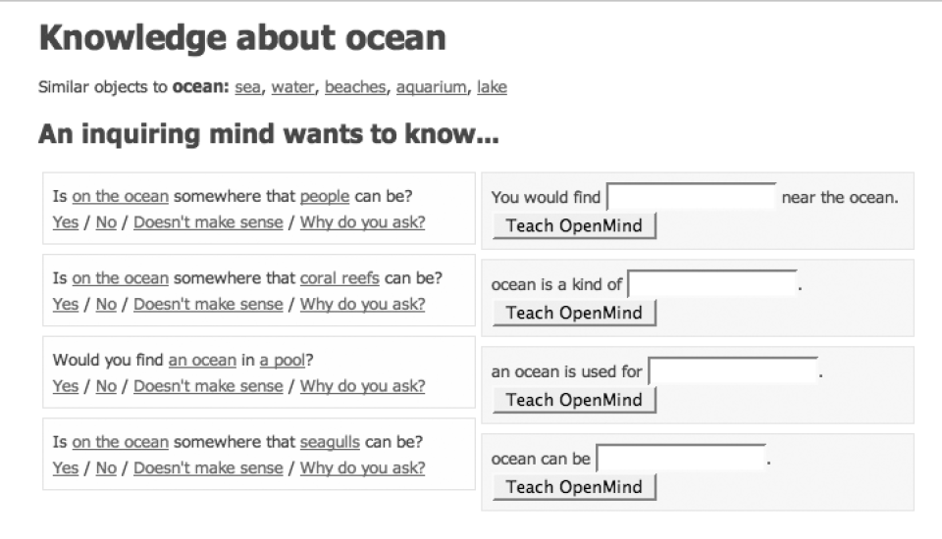
OpenMind interfața cu utilizator

Slide 15
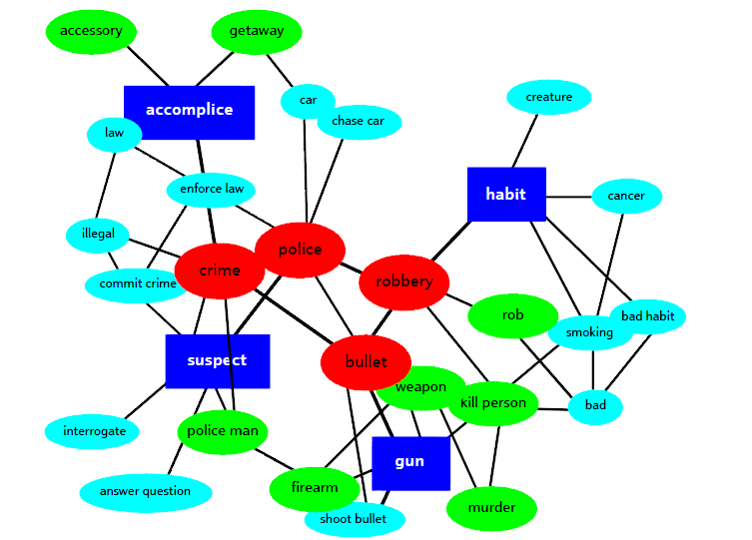

Slide 16
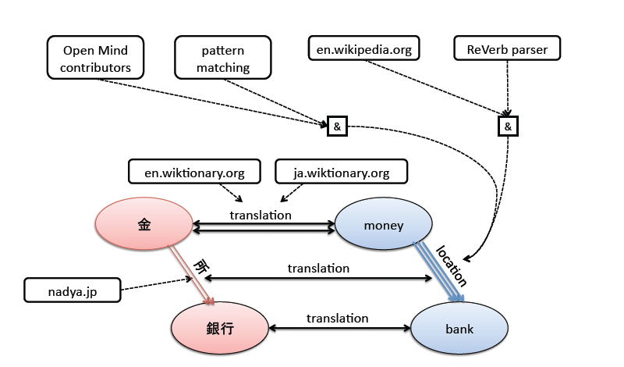
Links

Slide 17
Conclusion
ConceptNet’s forte is making practical inferences across real-world texts
Analogy-making is another fundamental cognitive task
http://conceptnet5.media.mit.edu/downloads/

