Slide 1


Slide 2
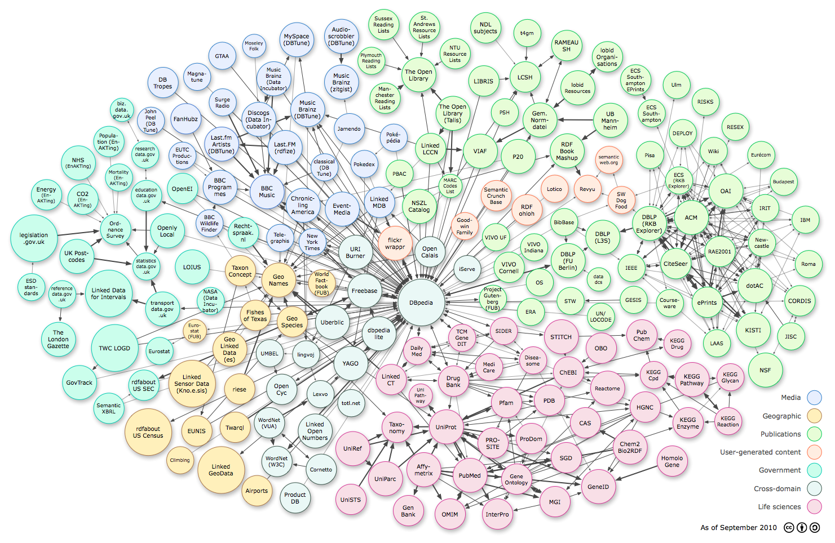
SPARQL Protocol and RDF Query Language
Limbajul de interogare la RDF data

Slide 3
Exemplu:
PREFIX foaf: http://xmlns.com/foaf/0.1/
SELECT ?name ?email
  WHERE { ?person a foaf:Person .
    ?person foaf:name ?name .
    ?person foaf:mbox ?email .
    }

Slide 4
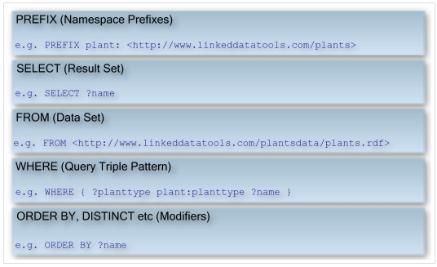
Forma generală

Slide 5
Datele: triplu
<http://example.org/book/book1> <http://purl.org/dc/elements/1.1/title> "SPARQL Tutorial" .
Interogarea:
SELECT ?title
WHERE { <http://example.org/book/book1> <http://purl.org/dc/elements/1.1/title>
?title .
}

Slide 6
Datele: triplu
<http://example.org/book/book1> <http://purl.org/dc/elements/1.1/title>
"SPARQL Tutorial" .
Interogarea:
SELECT ?title
WHERE { <http://example.org/book/book1> <http://purl.org/dc/elements/1.1/title>
?title .
}
Query Result:
?title "SPARQL Tutorial”

Slide 7
Datele: triplu
<http://example.org/book/book1> <http://purl.org/dc/elements/1.1/title> "SPARQL Tutorial" .
Interogarea:
PREFIX dc: <http://purl.org/dc/elements/1.1/>
SELECT ?book ?title
WHERE { ?book dc:title ?title }

Slide 8
Datele: triplu
<http://example.org/book/book1> <http://purl.org/dc/elements/1.1/title> "SPARQL Tutorial" .
Interogarea:
PREFIX dc: <http://purl.org/dc/elements/1.1/>
SELECT ?book ?title
WHERE { ?book dc:title ?title }
book title
http://example.org/book/book1 "SPARQL Tutorial"

Slide 9
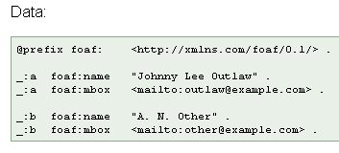
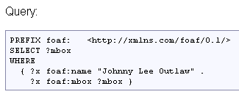
Exemplu cu ‘blank node’

Slide 10

Exemplu cu ‘blank node’

Slide 11
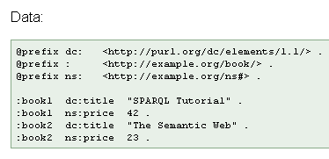
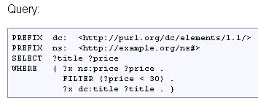
Default prefix

Slide 12

Default prefix

Slide 13
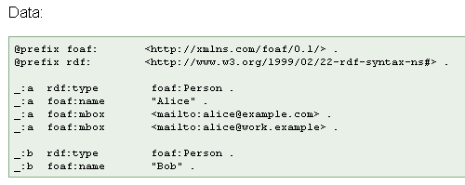


Slide 14


Slide 15


Slide 17
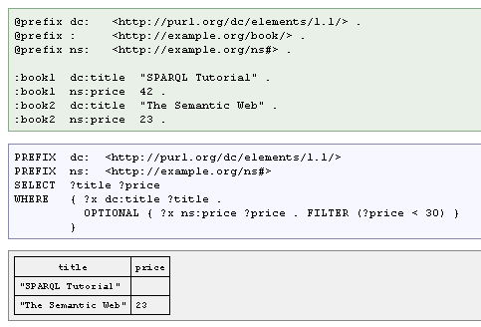
Exemplu de restricţii - Constrains

Slide 18
Exemplu de restricţii - Constrains

Slide 19
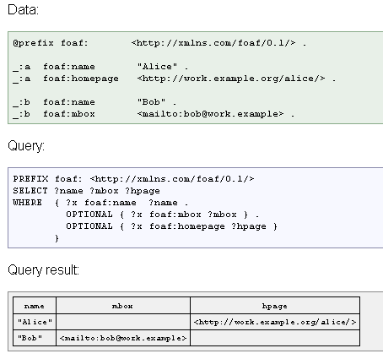
Date opţionale

Slide 21
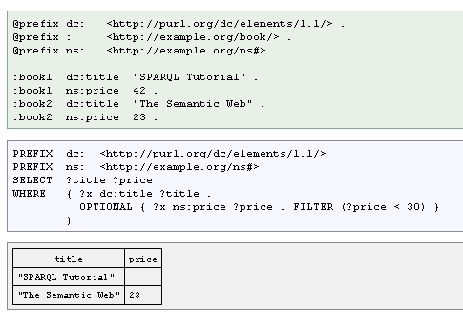
Date opţionale cu restricţii

Slide 22
Date opţionale cu restricţii

Slide 23
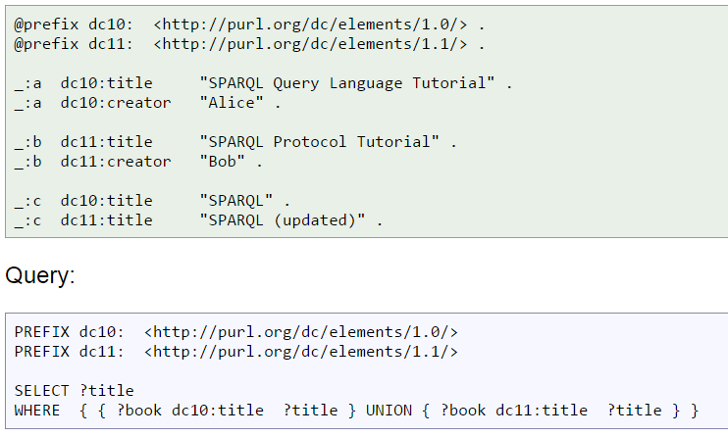
Reuniunea rezultatelor

Slide 24
https://www.w3.org/2009/Talks/0615-qbe/
https://www.w3.org/2001/sw/DataAccess/rq23/
http://www.linkeddatatools.com/introducing-rdfs-owl

