Slide 1
Information System Security Awareness
Notes:
Ladies and gentlemen, let me introduce myself, i’m the SCPO WAGNER
I am here today to make you aware of the security of information systems, because you are all
The first link in the chain of protection.
Indeed, as the security of IS is increasingly strengthened, it is increasingly difficult for an attacker to reach them directly,
This requires technical skills and time,
Therefore to respond to this problem cybercriminals will try to bypass protections by attacking
You, the user.
That is why it is necessary for all users like you and me to be aware of the risks, to be aware of the
Good practices to prevent this.
These last elements lead us to our presence here for this particular awareness we will focus on one threat, the phishing.

Slide 2
Information System Security
Phishing
1
Definition of phishing and its interest for attackers
2
The different vectors
3
Means of protection
Notes:
Concerning phishing, let’s see together what it is and what is its interest for the attackers,
The means used by the latter to achieve their ends, and to finish some means or rather the right ones
Practices to guard against it.

Slide 3
Information System Security
1
Definition of phishing and its interest for attackers
Phishing
Notes:
What is phishing?
Phishing is a cyberbullying technique that aims to steal sensitive personal information, such as passwords, credit card numbers or online account data, using false communications that appear to come from legitimate sources.
Concretely we attack the human being, in most cases attackers attack many users,
they pretend to be trusted providers, such as banks, postal services, and so on, and they wait for it to bite.
For attackers, the interest of phishing is to be able to access sensitive information that can be used for
malicious, such as identity theft, financial fraud, or access to password-protected systems.
For users, the dangers of phishing are numerous. Besides the risk of loss of sensitive data, phishing can
also result in computer contamination with malware, which can make the system vulnerable
to other attacks.
Malware
blackmail

Slide 4
Information System Security
2
The different vectors
Phishing
Notes:
Phishing emails: cybercriminals send an email that seems to come from a trusted source
(like your bank or streaming service) and asking you to click on a link or enter your login information
Phishing websites: cybercriminals create websites that look like trusted websites
(like your bank or streaming service) and asking you to enter your login information
or download a software.
Phishing SMS: cybercriminals send an SMS that seems to come from a trusted source (like your bank or streaming service)
and asks you to click on a link or enter your login information.
Phishing phone calls: cybercriminals call and pretend to be a trusted source (like your bank or streaming service)
and ask you to disclose your personal information.

Slide 5
Information System Security
3
Means of protection
Phishing
Notes:
Here are some of the best ways to protect yourself from phishing attacks:
Be vigilant when you receive emails or messages from people or entities you do not know. Do not click on any links or attachments contained in these communications.
Pay attention to the URLs of the websites you visit. If the site address does not appear legitimate, do not enter your login information or personal data.
Be aware of phishing threats on social networks and do not click on suspicious links or messages.
Keep your software and operating system up to date with the latest security updates.
Never share your login information or sensitive personal data with third parties. If you have any doubts about the legitimacy of a request for information, contact the entity in question directly to verify the request.
Report -> transition to incident response

Slide 6
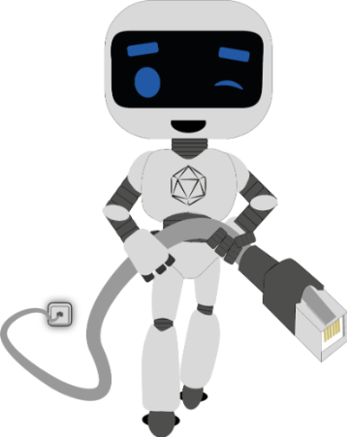
Information System Security
?
Notes:
To conclude,
We users are the pillars of the ISS, and a set of users aware of the dangers of the digital world constitutes a first Rampart
In protecting our systems and data.
Thank you for your attention,
Do you have any questions?

