Slide 1
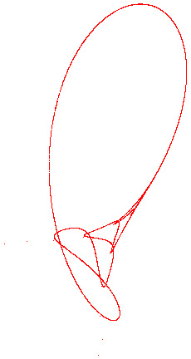
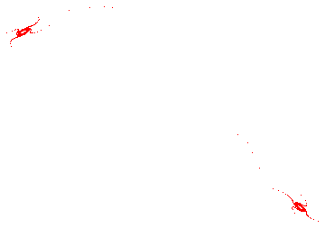
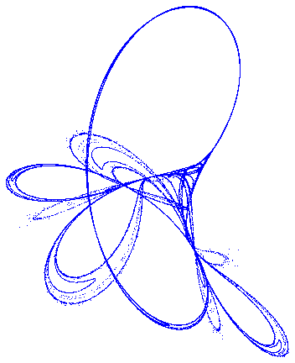
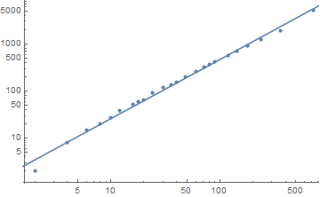
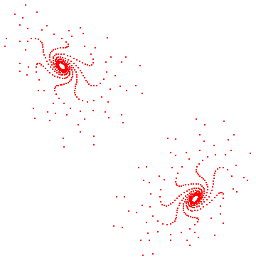
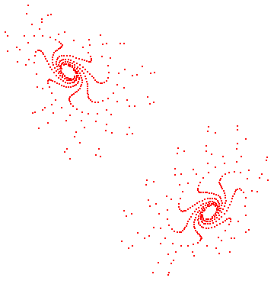
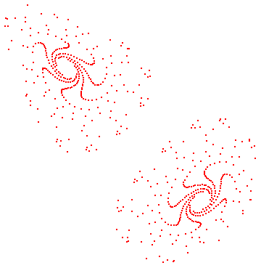
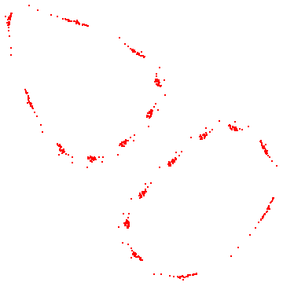
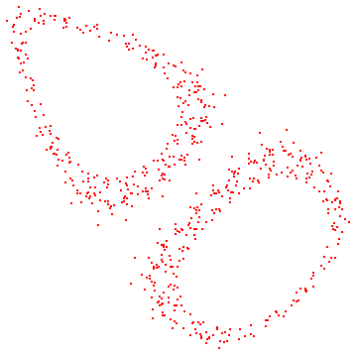
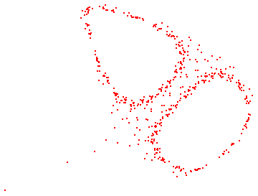
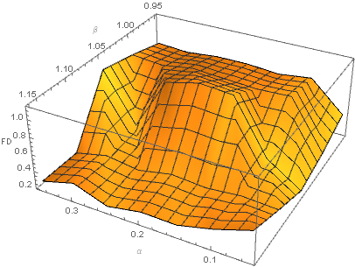
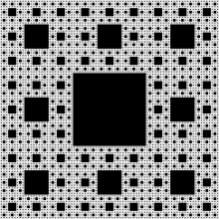
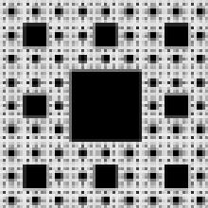
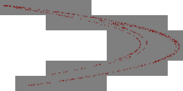
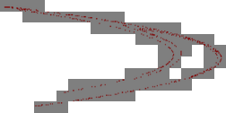
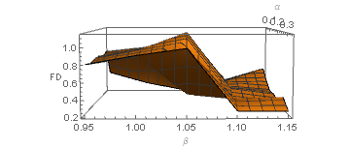
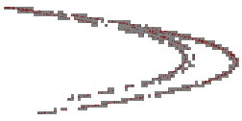
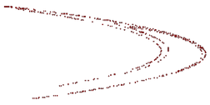
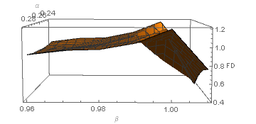
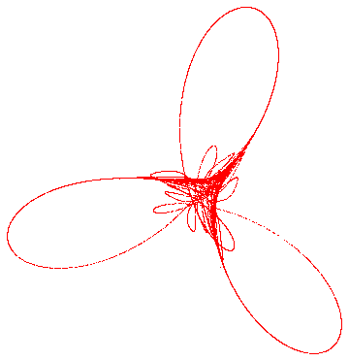
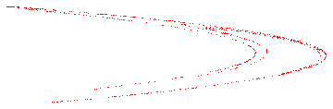
Charlie Bushman
May-June 2018
Complexities of Chaotic Systems:
Calculating the Fractal Dimensions of Chaotic Systems to Determine Patterns in Complexity over Changes in Parameters
Chaotic Systems and Fractals
Results
We will be looking at dissipative chaotic systems and how to make use of their periodicity, and the fractals arising from this property, to determine their complexities. Many of these terms, even if they are things you have heard in other contexts, need to be carefully defined for this project so we'll begin with some definitions.
1. Dissipative Chaotic Systems:
A system is a chunk of the universe that we decide to look at in great detail. A pool table, for example, is a system wherein there are some point-like masses and a rectangular boundary. This is a good system to consider because it is largely isolated from its environment (meaning stuff around it, like air or a lamp, doesn't have much effect on what happens) and it exhibits some chaotic behaviors. A chaotic system can be (over)simply defined as one in which very small changes in initial conditions can result in vastly different dynamics within the system. Take the pool table; when you're starting a game and you have to break the triangle, it never breaks the same way twice. This is because tiny changes in the angle and speed at which you hit the cue ball cause completely different things to happen in the system. A pool table is also a dissipative system because there is a force taking energy out of the system: friction. This just means that the particles in the system will continue to slow down over time. We will see why this is important in the next definition.
2. Periodicity:
An odd but very cool feature of chaotic systems is that they are periodic. This means that if a chaotic system with one "object" in it starts at point A it will eventually return there with the same velocity it had when it started. However, this feature has to be amended for dissipative chaotic systems because the path traced out by the "object" in a dissipative chaotic system is going to get smaller and smaller with each period meaning that instead of returning to point A it will return to point A' which will just be a lower energy state version of A. This means that it will be tracing out the same pattern but smaller and smaller each time. And this leads us into fractals...
3. Fractals (Fractal Dimensions):
A fractal is a curve or geometric figure that is self-similar at any scale. This means that it should look the same whether you're looking at the whole thing or just a tiny piece of it. A relatively simple example of this is shown in Figures 1.1 and 1.2. Fractals can be found in lots of interesting places in nature and one of those is dissipative chaotic systems. To quote the last definition: " it will be tracing out the same pattern but smaller and smaller each time.“
The results on individual trials (that is, on maps that were generated with fixed parameters) were excellent and matched researched data to within error bars. For the Henon map, I generated it with α = 1.4 and β = 0.3 and was expecting a resultant fractal dimension of roughly 1.23. Using the squaresMethod[], I got a value of 1.25 ± 0.02 which is correct according to my researched value. The graph to the left shows the log-log plot. I then ran the correlation function on the same generated map and got 1.23 ± 0.01 which is, again, correct within error bars. I then repeated the same process but this time with a Tinkerbell map generated with parameters a = 0.9, b = -0.5, c = 2.3594, and d = 0.5. By running the squaresMethod[] on this, I found a FD of 1.36 ± 0.01 which is a little off from my researched value of 1.41. I then ran the correlation function and found 1.38 ± 0.02 which is closer to the result I wanted but still not quite it. I believe the cause of these errors are the densely packed area in the middle of the map (see the figure in the bottom left of the poster). The squaresMethod[] and even the correlation function work on discrete distance values so in small areas like that it is easy to imagine things going wrong.
a
b
c
Log-log plot of the results from the squaresMethod[] run on the Henon map
The x axis shows the size of the squares being overlaid on the image and the y axis shows the number of squares that have points within them. The linearity of the results means that the map exhibits similar space filling capacities on many different scales. While this is not proof that the map is a fractal, it is very strong evidence in favor of it.
d
e
f
The second half of this project is focused on determining if there is any pattern to changes in the FD of these systems over changes in parameters. The first test I ran was to change only the β value for the Henon map while keeping α constant at 1.4. The results were just about as random as could be expected and did not give much hope of finding patterns. I used a range of β values with steps that varied in size from 0.0001 to 0.001 and the results seemed random at all levels of resolution. I then tried the Tinkerbell map, varying the c value while keeping the other three constant and I received equally unpromising results. My final attempt was to vary both the α and β values to see if there might be some pattern that is dependent on both parameters. The results of this can be seen in the 3D plot to the right. It does at first glance, appear quite random, but there are also some interesting trends especially along the β axis. For the most part, the FD seems to change randomly with β but not to change much with α, especially at the extremes of the plot (not so much along the ridge in the middle). To examine this further, and to see if it is just a coincidence or if there actually is a pattern here, I took the range from β = 0.95 to β = 1.00 and made a similar graph with this higher resolution over a smaller range. The results of this can be seen below and appear somewhat promising in suggesting a trend in the fractal dimension dictated by the β parameter.
Six stages in the evolution of the Henon map over change in the β value with α = 0.2
The values of β in the six stages are a: 0.991, b: 0.992, c: 0.995, d: 0.997, e: 0.9991, f: 0.9996. These values don’t have any particular significance or meaning and in fact are somewhat deceiving. The actual progression of the system is much less ordered than the progression given by the chosen values here. These values are handpicked to give a good sense of the diversity of maps that exist in this small range.
The Tinkerbell Attractor for a = 0.9, b = -0.6013, c = 2, and d = 0.5
According to some, these are the parameters that gave this map its peculiar name of Tinkerbell. Those who believe this origin story say that the map bears a resemblance to the swirly thing over the castle in the opening of Disney movies. Whether or not you believe this story, the map itself is probably the coolest looking thing in this project.
This is the Sierpinski carpet. The second image is the top left corner of the first image and the third image is the top left corner of the second image. No matter how many times we repeated this process (ignoring the quality of the image) we would continue to get an identical picture.
Methods
A plot of the fractal dimensions for the Henon map over a range of α values from 0.0 to 0.3 and β values from 0.9 to 1.1 by steps of 0.05
At first glance, this plot appears to be a very random distribution of fractal dimensions (FD) but on closer inspection there do appear to be some similarities in FD along the β axis.
There are two main functions that are used throughout the body of this project. The first of these is the squaresMethod[] which employs something known as the box counting technique to calculate the fractal dimension of an image. This method works by taking in an image then overlays boxes of varying sizes over the image and counts the number of points in each box and sums these, each divided by the total number of points. In this way, with different size boxes being overlaid on each iteration, it can find the space filling capability of the fractal at many scales. If the image is indeed a fractal then the results of this method should be an exponential where the exponent should be the fractal dimension or it would be the slope of a log-log plot.
Discussion
This whole project really comes down to the two graphs to the left. The only reason anyone would be interested in this work for practical reasons is if I can actually find a pattern that would give some sort of predictive power over the complexity of a system. And in order to have predictive power, we need to have a function or a trend that can describe the exact relation between the FD and one or more of the parameters.
Whether or not I have actually succeeded in finding such a pattern is not entirely clear and would require more simulations to verify but it does appear, just on the bases of these two graphs, that there might be a pattern. The top graph is a plot of the fractal dimension versus the two parameters for the Henon function. It is oriented so as to best exhibit the trends in FD vs β. I created the bottom graph with a smaller β range that is contained within the red square. In other tests of this sort, where I enhance the resolution to look at a smaller section, I usually get results that are just as erratic as the original results but within that smaller window. This case is different though, because here, the enhanced resolution looks almost identical to the original. This may mean that there is a trend linking the FD and β values which could be found for any α. It’s also possible that I just picked some particularly nice looking points and got a deceptively nice looking graph as a result. There is certainly evidence elsewhere in the project to refute the patterning found here.
The fractal dimension of a chaotic system is not actually one well defined quantity because there are a number of different "dimensions" that a chaotic system has and that can be measured. In this notebook we will be looking at the fractal dimension as if the path of the system is simply a fractal pattern. This means that we will be measuring it using both the box counting method and the correlation function in Section 2.0.
4. Complexity:
Complexity is a term that can take a huge variety of meanings throughout physics and even in the context of fractals. In this project, we will be defining complexity as the amount of space that a chaotic system's path fills. Basically this means that, if we consider the path of a fractal to be a one dimensional curve, then the amount of 2D space that it fills is the complexity of the system.
The reason we might care about being able to calculate the complexity of a chaotic system is that while the system itself is chaotic, changes in its complexity may not be and may instead follow some sort of trend or function. If this is the case, then it would allow us some sort of predictive capability over chaotic systems.
The Henon and Tinkerbell Maps
For this project I focused on two 2D chaotic attractors: the Henon attractor and the Tinkerbell attractor. These are two relatively well known chaotic systems that have been the subjects of many studies so finding information on them is not difficult. To study these structures, we first need to have a way to generate them and for that we will be using mapping functions. The basic idea behind a mapping function is that it is a function that takes in a coordinate and then applies some transformation to it that translates physically to the movement of a particle over a specific time step. The function is used over and over again to create a list of points that trace out the path of the particle over time. This method is preferable to actually tracing the path of the particle because a path cannot be input into the correlation function.
The Henon map works on the equations:
x = 1 – α*x’^2 + y’
y = β * x’
In these equations, α and β are the parameters that are input to the mapping function (the Tinkerbell map has four parameters: a, b, c, & d). X’ and Y’ are the initial coordinates of the system and the system then evolves to X and Y. These then become the ‘initial’ coordinates and the system evolves again from there.
These systems could also be modeled with differential equations but for our purposes using a mapping function is far preferable. For one thing, with a mapping function the definition of the lines in the image is very easily set and adjusted which comes in handy in avoiding precision errors. Also, more importantly, the mapping function can return both an image and a list of coordinates through which the system moved which allows me to use two different techniques to determine the fractal dimension of a system (discussed in the Methods section).
Animation of the squaresMethod[] being run on the Henon Map
The squaresMethod[] works by overlaying boxes of varying sizes over the image and counts the number of points in each box and sums these, each divided by the total number of points. In this way, with different size boxes being overlaid on each iteration, it can find the space filling capability of the fractal at many scales.
A higher resolution graph of the FD with both the original and the higher res being viewed for best perspective on the β axis
There appears to be a consistent trend in these values whether being viewed at the larger resolution or the smaller one, which is five times more detailed. If the FD exhibited chaotic behavior, the randomness should be resolution independent so this is indication that there does actually exist a functional relation between the β parameter and the fractal dimension.
The second method does something very similar but takes a slightly more mathematical approach to it. The input is a list of points now. Instead of overlaying boxes, it looks at each point individually and counts up all the points within an input radius. It then does the same dividing and summing as the box counting method. Over a range of radius inputs, this should provide an exponential curve with an exponent that is the fractal dimension.
There is also a third method that the second relies on to work properly. It is a function that determines the radius of gyration of the input cluster. This is important to determine because the correlation function starts giving variable results once the input radius reaches and surpasses the radius of gyration.
The main reason to have two different methods for making the same calculation is that it will provide an easy check on the accuracy of both of them; if they come out the same it is probably working, otherwise it probably isn't. And while these two methods are similar in how they go about calculating the fractal dimension, they are certainly different enough that there would have to be many things going wrong in the simulation for both methods to provide inaccurate results.
It is also worth noting that these methods, especially the squaresMethod[], were designed for and tested on fractals with FDs between 1 and 2. For images that have very few points on them because the system escapes to infinity too quickly, these methods may give results that don’t make much sense such as an FD below 1. However, in the cases where we might get these results, the comparisons between FDs is more important than the FDs themselves so it is only important that they provide comparatively accurate results. I believe they do provide such results just based on numerous observations of expected and calculated values of various systems.
The major takeaway from this project is uncertain at best which is not ideal, but it does warrant further investigation into the subject. Perhaps more importantly, this project sets solid groundwork for this continuing investigation. I now have a very easy to use method with verified results to determine the fractal dimension and thus the complexity of chaotic systems. Possibilities for further research include looking more for patterns between parameters and the fractal dimension of a system, looking for ways to better deal with problems in the methods for calculating fractal dimensions, and looking into what the various types of fractal dimensions of a system are (yes, there are many of them!) and if there are any patterns to be found in these FDs with parameters.
The Tinkerbell Map for a = 0.9, b = -0.5, c = 2.3594, and d = 0.5
The graininess of the image is the result of it being generated by a mapping function. If it had instead been modeled by differential equations, the path would appear as a solid line and would not be visibly broken up in places.

