Slide 1

LateNite
Charlie Bushman &
Rachel Hodes
Notes:
Hi hi I’m LateNite

Slide 2


THE PROBLEM

Slide 3
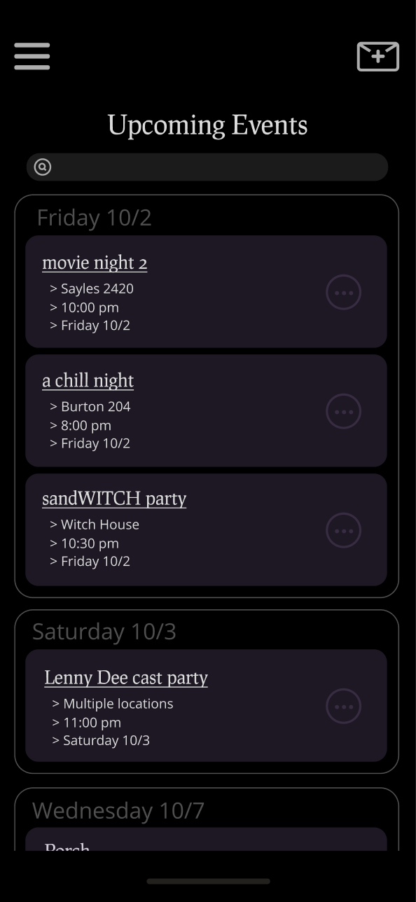
What is LateNite?
An invite creation tool and event organization system
Create compelling invites
Integrate tools: polls, Spotify, Venmo
Easily edit groups
Share events with friends
Notes:
Charlie
Latenite is that solution
An invite creation and event organization tool that incorporates all the technologies and features students already use into one platform
Spending less time on logistics while still being able to create...

Slide 4




DIFFERENTIATION
LATENITE
FACEBOOK
- High customizability
- Intuitive event creation process
- Has logistics features
- Easy shareability
- Used more often at other LACs
- Intuitive event pages
- Less creative control
- Guests must have FB
EMAIL
GROUPME
- Typically used for student org event planning
- Strong logistics-based features
- Formal feel
- Current preferred medium
- Somewhat creative
- Academic feel
- Difficult to organize, find, and share invitations
Notes:
Rachel
Figure out way to present differently? Tomorrow’s project

Slide 5

Latenite is multiplatform:
Web/iOS/Android
Speedup to dev work
Spotify, Venmo, Giphy integrations with more to come
Development framework means LateNite can be accessed from any device
Tech stack automates data flows, 3rd party integrations and security
Notes:
Charlie
In designing LateNite, we prioritize flexibility and simplicity, both in implementation and usage
Development framework means multiplatform
Also combines fast development with industry leading security and efficiency of data transfer
In use, our 3rd party integrations enable users to streamline all their favorite apps into one workflow
And can be paired with many existing platforms like email and SMS or web and mobile
LateNite is flexible and simple

Slide 6
ROADMAP
Prototyping of MVP features
Feature integration and testing
Premium feature development
1
3
5
2
4
6
Front end and UI development
Carleton release
Premium release
Notes:
Rachel
In progress, in house
Examples: 3rd party integrations, invite creation tool, friends and groups
Consultants
Beta testing over summer
August 2021 - Carleton release
Lots of marketing, 30% monthly user acquisition projected
August 2022 - Premium release
Premium features: More colors, fonts, backgrounds; creative flexibility

Slide 7
COST BREAKDOWN
 | 2021-Q4 | 2022 | 2023
Servers & Hosting | $40 | $280 | $200
Labor | $500 | $2,500 | $500
Sales & Marketing | $800 | $1,800 | $1000
Running Total Costs | $1,340 | $5,920 | $7,620
Notes:
This shows a breakdown of cost over the next few years, a couple of points worth noting here:
Breakeven point soon after premium feature release in 2022 Q4 or early 2023
50% expenditure at that point, flexibility in projections (not being wrong), boost sales and marketing or speed up development
This doesn’t account for revenue, which we expect to start in 2022 Q4 or 2023 Q1

Slide 8


THE TEAM
Charlie Bushman Co-Founder
Class of 2021
Physics Major
He/Him
Rachel Hodes Co-Founder
Class of 2021
Cognitive Science Major
She/Her
Notes:
5 years of software interning experience that will help me to build LateNite
Experience with Muze

Slide 9
OUR PHILOSOPHY
Building shareability into a powerful product for college students
maximize organic growth
=
Notes:
Rachel

Slide 10
Thanks :)
Notes:
How do we conclude?

Slide 11
Projections for August 2021:
Carleton release
$1,500
10 users
~30%
Total projected expenditures
Starting with a dedicated base...
User acquisition per month
Notes:
Charlie
Table it
Hit on
Breakeven point soon after premium feature release in August 2022
50% expenditure at that point

Slide 12
Projections for August 2022:
Breakeven point
$5,500
750 users
45%
Total projected expenditures
Acquired and growing
Starting budget remaining
Notes:
Turn into speech

