Slide 1
Computational and Experimental Optimization of a Trebuchet
Charlie Bushman, Kyle Fraser-Mines,
Jack Heinzel, Axel Stahl

Slide 2
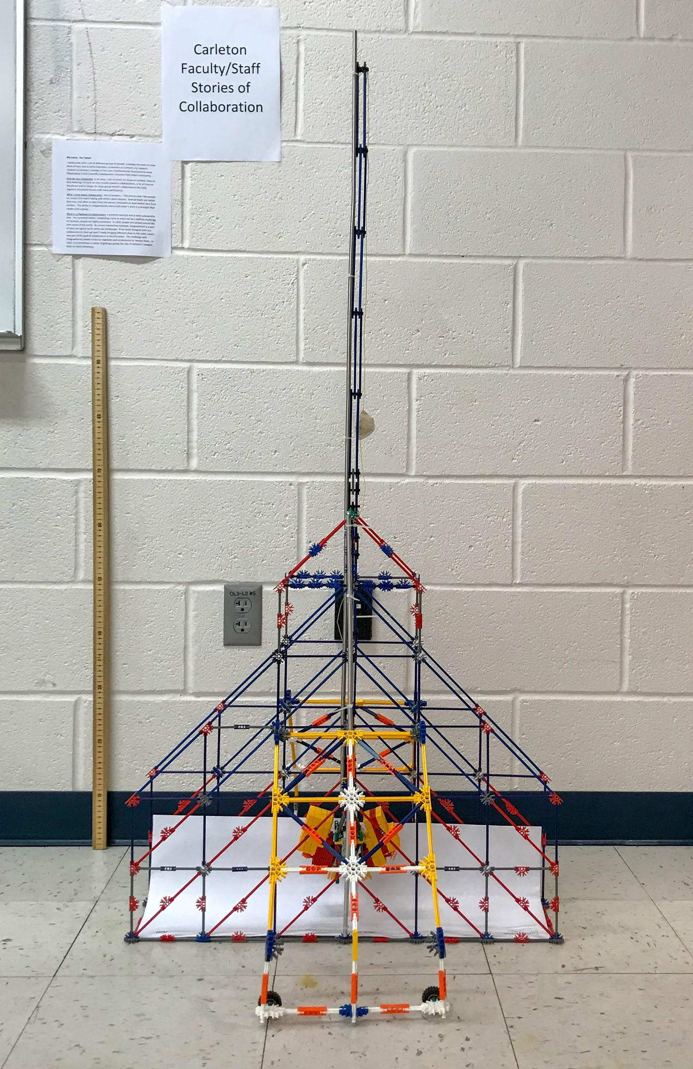
Meet our Trebuchet
Hinged counterweight
Sling
No Wheels

Slide 3
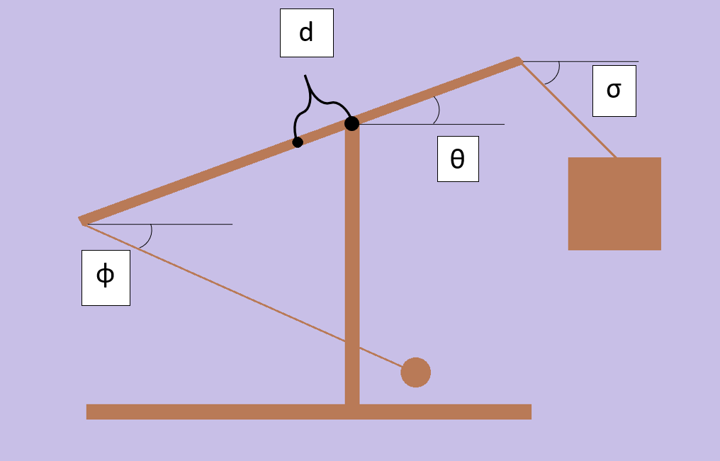
A Basic Schematic

Slide 4
Goals of our Project
Best range
Best destructive potential
Best match between our computational model and the real thing

Slide 5
How do we make the best trebuchet possible?
Optimize several parameters
Fulcrum position
Sling Length
Counterweight starting angle
Use of wheels

Slide 6
Computational Methods
Mathematica numerically solves for equations of motion
First part includes a Lagrange multiplier
Second part begins when Lagrange goes to 0
Solve equations of motion for when 𝜃[t] and 𝜙[t] are equal
Find range using x= v₀² sin(2𝜙)/g
Compare this range for different values of the parameter of interest
Fulcrum position
Sling length
Counterweight angle

Slide 7
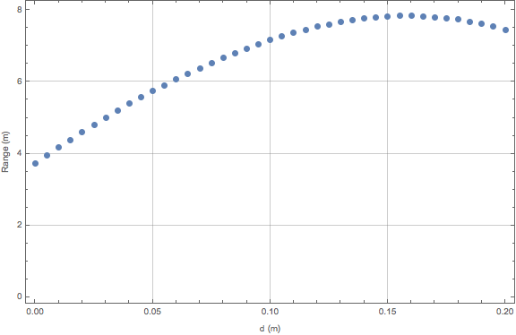
Fulcrum Position
Peak around d = +0.16 m
Relatively flat peak

Slide 8
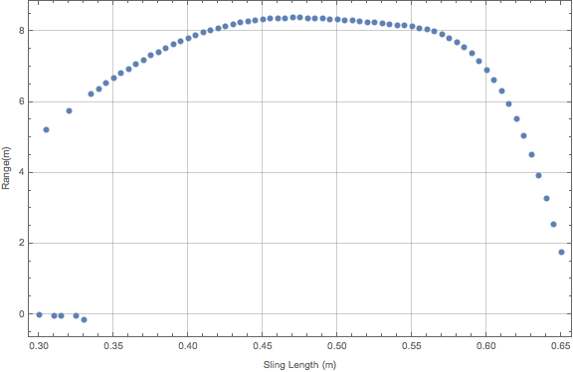
Sling Length
Optimal sling length:
~45 cm
~Flat section near the peak
~The length between the fulcrum and the end of the throwing arm
Notes:
Using our trebuchet simulation on mathematica we found that the optimal sling length is about 45 cm and corresponds to a range just over 8 meters. This optimum value can be seen here on the graph where the line goes slightly higher than the rest of the graph.
This peak is only slightly higher and is surrounded by a relatively flat section of the graph corresponding to sling lengths from 40 to 55 cm. This apparently flat line shows that even when the sling length varies a little bit the range of the projectile is largely unchanged. The sling simply needs to be within a reasonable distance from the optimal value. This is good when trying to optimize the sling on our actual trebuchet as we will not lose much of our range if our sling is not exactly 45 cm long.
This optimum range between 40 and 55 cm corresponds to the length of the throwing arm from the fulcrum to the end of the arm where the sling attaches. On our trebuchet this length on the throwing arm falls in the upper end of the range due to our position of the fulcrum but if the fulcrum were slightly closer to the center of mass of the beam it would easily be closer to the same as the optimal sling length

Slide 9
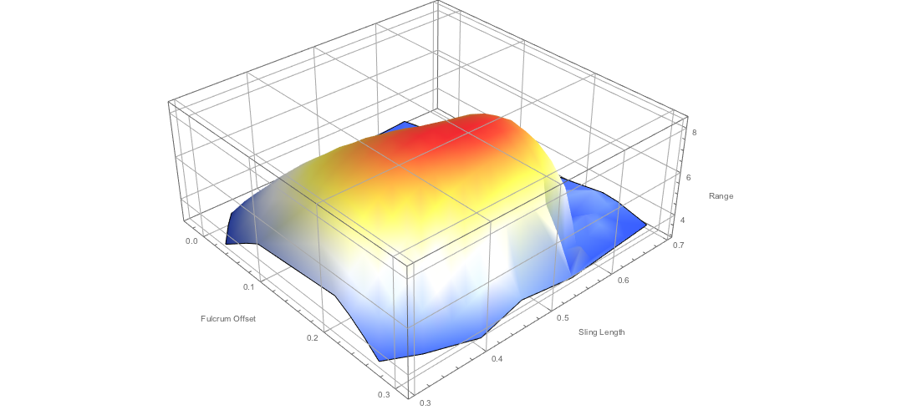
Optimizing Range as a function of fulcrum position and sling length
Fulcrum position and sling length correspond to each other
Double loop method
Fulcrum position between 15 and 20 cm and sling length between 40 and 55 cm
Wide peak
Notes:
In doing our research on fulcrum position and sling length it seemed like the optimums for these variables were largely related and possibly dependent on each other. We decided to look into optimizing the two of these variables together in order to get a optimum pair for the values.
To find the optimal values for these two variables at once we had mathematica run through our trebuchet simulation holding the fulcrum position constant and running through the values we were testing for the sling length before going back and incrementing our fulcrum position by a small step size and repeating this process. The simulation thus ran through all possible pairs of fulcrum position and sling length test values. This process gave us a list of fulcrum positions, sling lengths, and range values which we were able to plot in the 3D plot shown here.
As seen on this graph the highest peak was in a range of 40 to 55 cm for sling length and 15 to 20 cm for the distance from the center of mass to the fulcrum with the highest peak at about 50 cm for sling length and 17 cm for the distance between the center of mass of the beam and the fulcrum.
Because this is such a wide peak it does not make a huge difference when the sling length and fulcrum positions are slightly off of their calculated maximum values. Even with some deviations from the maximum value the range of the projectile was approximately the same as it was at the highest peak. This was very helpful in rebuilding our trebuchet as we could put our fulcrum in a position that was more convenient with the materials we were using and we did not have to get a longer piece of string to make our sling a little bit longer to reach the optimal value.

Slide 10
Are Wheels truly Better?
Our computer simulations showed that wheels are better.
Are wheels feasible?
Sling Velocity upon projectile release
Wheels | Immobile
14.91 (m/s) | 11.36 (m/s)

Slide 11
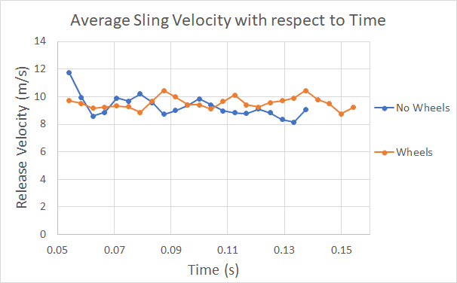
Confirming our results with experimental data
Collecting
Comparing
Results
Average Sling Velocity (m/s)
No Wheels | Wheels
9.28 | 9.54

Slide 12
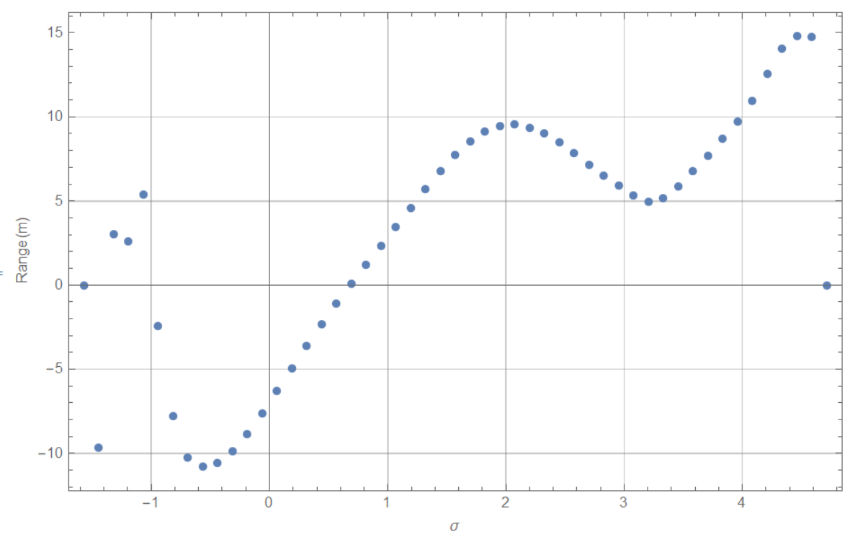
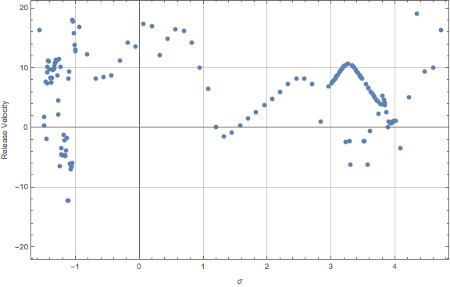
Optimal initial angle for a hanging counterweight

Slide 13
Results
Sling Length and Fulcrum Position:
A sling of 40 to 55 cm and a value for d between 15 to 20 cm
Wheels and starting counterweight angle require little adjustment for maximum efficiency.

Slide 14
Questions?

