Slide 1
Schmidt Decomposition in Quantum Information Theory
Using the Singular Value Decomposition to Initialize Quantum States
April Reisenfeld and Charlie Bushman

Slide 2
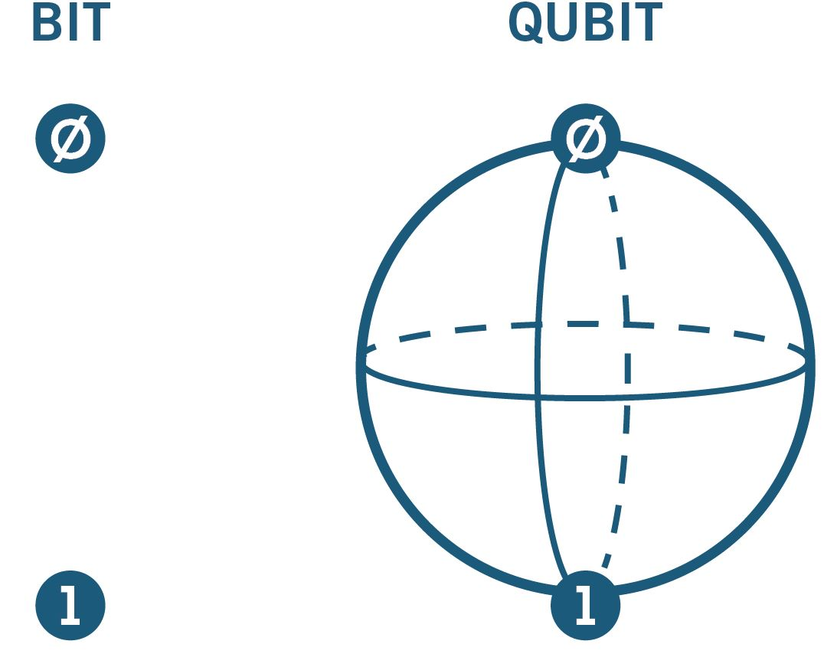
Overview
What is quantum information theory?
How is the Schmidt decomposition a reformulation of the singular value decomposition?
Why is it useful?

Slide 3
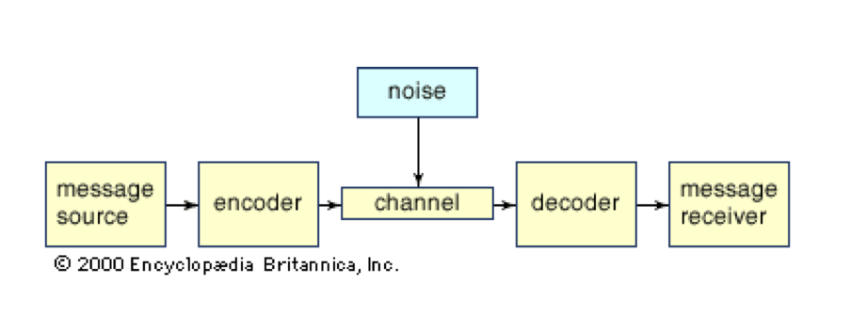
Information theory
Shannon’s communication model
Binary system of digits: “bits”
Information contained in two-state systems
Development of quantum information and computing
Notes:
Systematic way of describing and manipulating communication, broken down into encryption and transmission
Possible only by eliminating meaning from messages, turned into units of information that are characterized with binary digits (bits)
Any two-state systems can be represented with binary, can be used for information processing
Separate from semantics, can measure and analyze information in bit form
Classical computing uses bits, quantum computing uses quantum bits (qubits) that are created from quantum two-state systems subject to quantum mechanical principles

Slide 4

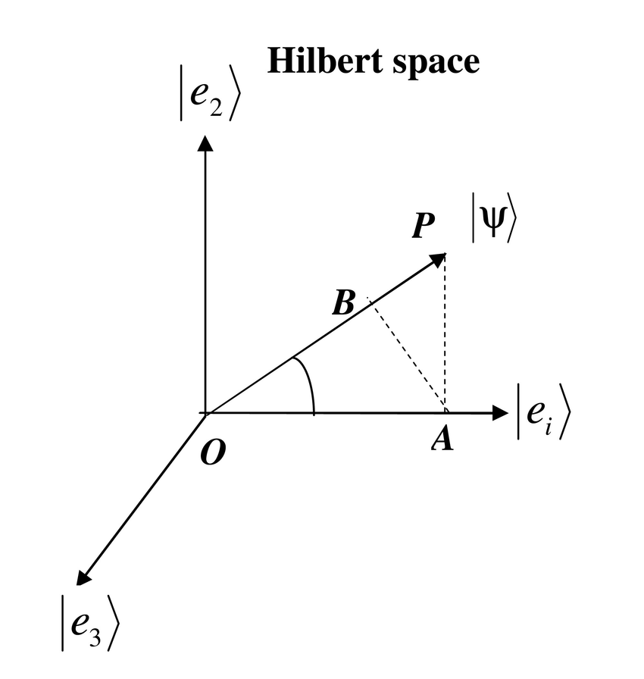


Quantum mechanical principles
Superposition
Probability amplitudes
Entanglement
Tensor products
Operators
Hermitian, unitary
Notes:
Quantum states exist in complex vector space known as Hilbert space
Due to linearity of vector spaces, can have states that are linear combinations of other states
Known as superposition
Normalizing coefficients represent “probability amplitudes” that determine the probability of a measurement realizing that particular state
System containing multiple quantum states (for example a two qubit system) exists in space given as the tensor product of the two vector spaces
If the tensor product of the two quantum states cannot be factored, then the state of one determines the state of the other
Called entanglement
Operators can act on quantum states to transform or measure them
Unitary operators rotate state vectors in Hilbert space, analogous to an information processing operation
Hermitian operators produce an observable quantity (specifically eigenvalues) that can be measured, analogous to information extraction

Slide 5


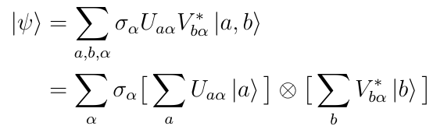
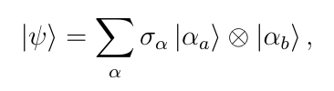
Schmidt decomposition
Bipartite state represented in composite basis
State represented in terms of SVD of coefficient matrix
Tensor product of two quantum vector spaces
Notes:
In quantum computing, want to be able to initialize a multi-qubit system to a desired state by performing the correct matrix operations on qubits in arbitrary states
Schmidt decomposition represents quantum state in terms of the singular value decomposition
Begin with bipartite state for the combined system of qubits a, b represented in terms of the composite basis, with coefficients for these basis vectors
Take the SVD of matrix containing coefficients
Obtain state vector in terms of singular values, and orthonormal bases alpha_a, alpha_b
Breaks down quantum state into unitary operations on qubits a, b -> used for many applications in quantum computing

Slide 6
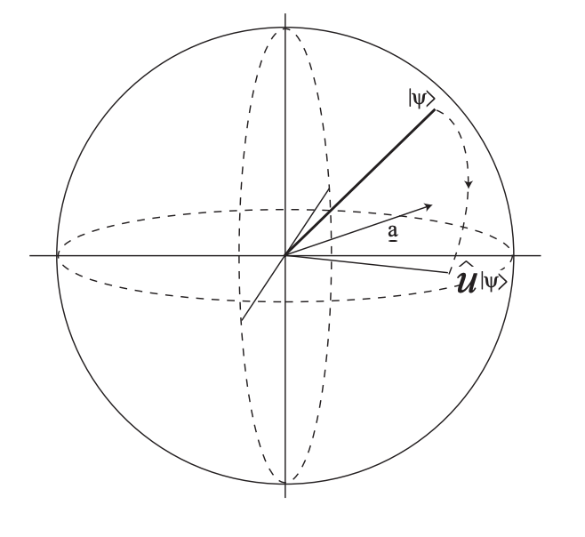
Applications to quantum information theory
Measure of entanglement
Schmidt rank
Von Neumann Entropy
Quantum state initialization
Gate-based quantum circuits
Notes:
https://www.quantumfoundations.org/reconstruction-of-quantum-mechanics.html

Slide 7
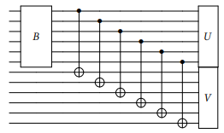


Qubit state initialization

Slide 8
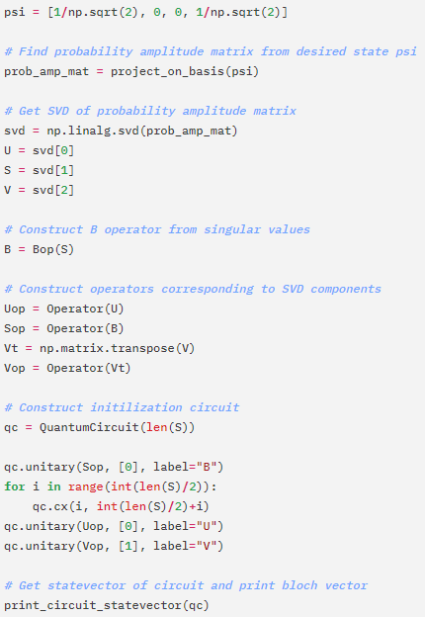
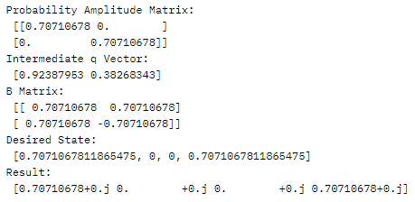

Two-qubit quantum circuit

Slide 9

Conclusion
Schmidt decomposition possible for multi-qubit systems
Precise initial quantum states required for effective computing
Straightforward method for initializing states using SVD

Slide 10
Bibliography
Information theory. (2020). In Encyclopædia Britannica. Retrieved from https://academic.eb.com/levels/collegiate/article/information-theory/106012
Martignon, L. (2001). Information Theory. In International encyclopedia of the social \& behavioral sciences / (pp. 7476–7480). Elsevier,. https://doi.org/10.1016/B0-08-043076-7/00608-2
Griffiths, R.B. (2014). Hilbert Space Quantum Mechanics. Carnegie Mellon University. http://quantum.phys.cmu.edu/QCQI/qitd114.pdf
Fisher, C. (n.d.). IBM | What is Quantum Computing? IBM Quantum. https://www.ibm.com/quantum-computing/learn/what-is-quantum-computing/
Barnett, S. (2009). Quantum Information (Oxford Master Series in Physics, 16) (Illustrated ed.). Oxford University Press.
Instituto de Física Universidade de São Paulo. (2020). Singular value and Schmidt decompisition [Slides]. IFUSP. http://www.fmt.if.usp.br/~gtlandi/04---reduced-dm-2.pdf
Abhijith J., et al. Quantum Algorithm Implementations for Beginners. Los Alamos National Laboratory. https://arxiv.org/pdf/1804.03719.pdf
Skript, Density Matrices, https://homepage.univie.ac.at/reinhold.bertlmann/pdfs/T2_Skript_Ch_9corr.pdf

