Slide 1












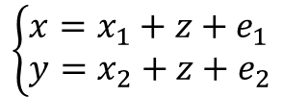
























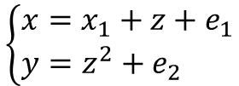
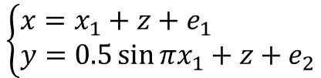
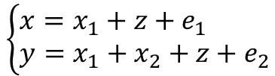




















M1
M2
M3
M4
$$\left\{\begin{aligned}&x=x_{1}+z+e_{1} \\ &y=x_{2}+z+e_{2}\end{aligned}\right.$$
$$\left\{\begin{aligned}&x=x_{1}+z+e_{1} \\ &y=z^{2}+e_{2}\end{aligned}\right.$$
$$\left\{\begin{aligned}&x=x_{1}+z+e_{1} \\ &y=0.5\sin{πx_{1}}+z+e_{2}\end{aligned}\right.$$
$$\left\{\begin{aligned}&x=x_{1}+z+e_{1} \\ &y=x_{1}+x_{2}+z+e_{2}\end{aligned}\right.$$
数学关系
$$x_{1}$$
$$z$$
$$x_{2}$$
$$x_{1}$$
$$z$$
$$x_{2}$$
$$x_{1}$$
$$z$$
$$x_{2}$$
$$x_{1}$$
$$z$$
$$x_{2}$$
$$x$$
$$y$$
$$x$$
$$y$$
$$x$$
$$y$$
$$x$$
$$y$$
因果关系
$$e_{1}$$
$$e_{2}$$
$$e_{1}$$
$$e_{2}$$
$$e_{1}$$
$$e_{2}$$
$$e_{1}$$
$$e_{2}$$
$$x_{1}$$
$$z$$
$$x_{2}$$
$$x_{1}$$
$$z$$
$$x_{2}$$
$$x_{1}$$
$$z$$
$$x_{2}$$
$$x_{1}$$
$$z$$
$$x_{2}$$
独立性判断
$$x$$
$$y$$
$$x$$
$$y$$
$$x$$
$$y$$
$$x$$
$$y$$
$$e_{1}$$
$$e_{2}$$
$$e_{1}$$
$$e_{2}$$
$$e_{1}$$
$$e_{2}$$
$$e_{1}$$
$$e_{2}$$
x和y关于z条件独立
x和y不关于z条件独立

