Slide 1












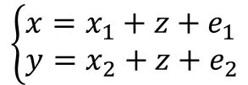
























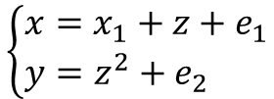
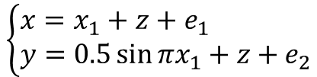
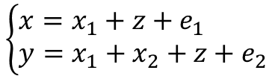




















M1
M2
M3
M4
数学关系
$$\left\{\begin{aligned}&x=x_{1}+z+e_{1} \\ &y=x_{2}+z+e_{2}\end{aligned}\right.$$
$$\left\{\begin{aligned}&x=x_{1}+z+e_{1} \\ &y=z^{2}+e_{2}\end{aligned}\right.$$
$$\left\{\begin{aligned}&x=x_{1}+z+e_{1} \\ &y=0.5\sin{πx_{1}}+z+e_{2}\end{aligned}\right.$$
$$\left\{\begin{aligned}&x=x_{1}+z+e_{1} \\ &y=x_{1}+x_{2}+z+e_{2}\end{aligned}\right.$$
$$x_{1}$$
$$z$$
$$x_{2}$$
$$x_{1}$$
$$z$$
$$x_{2}$$
$$x_{1}$$
$$z$$
$$x_{2}$$
$$x_{1}$$
$$z$$
$$x_{2}$$
$$x$$
$$y$$
$$x$$
$$y$$
$$x$$
$$y$$
$$x$$
$$y$$
因果关系
$$e_{1}$$
$$e_{2}$$
$$e_{1}$$
$$e_{2}$$
$$e_{1}$$
$$e_{2}$$
$$e_{1}$$
$$e_{2}$$
$$x_{1}$$
$$z$$
$$x_{2}$$
$$x_{1}$$
$$z$$
$$x_{2}$$
$$x_{1}$$
$$z$$
$$x_{2}$$
$$x_{1}$$
$$z$$
$$x_{2}$$
独立性判断
$$x$$
$$y$$
$$x$$
$$y$$
$$x$$
$$y$$
$$x$$
$$y$$
$$e_{1}$$
$$e_{2}$$
$$e_{1}$$
$$e_{2}$$
$$e_{1}$$
$$e_{2}$$
$$e_{1}$$
$$e_{2}$$
x和y关于z条件独立
x和y不关于z条件独立

Slide 2
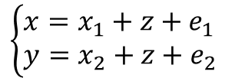
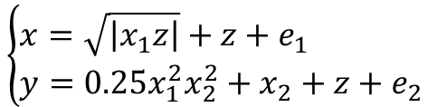
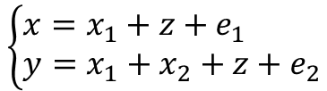
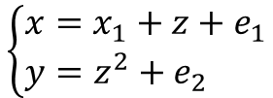
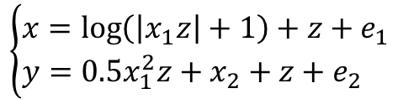
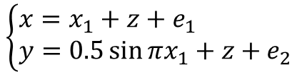
数学关系
贝叶斯网络
独立关系判断
$$x_{1}$$
$$z$$
$$x_{2}$$
$$x_{1}$$
$$z$$
$$x_{2}$$
M1
$$\left\{\begin{aligned}&x=x_{1}+z+e_{1} \\ &y=x_{2}+z+e_{2}\end{aligned}\right.$$
$$x$$
$$y$$
$$x$$
$$y$$
x和y关于z条件独立
$$e_{1}$$
$$e_{2}$$
$$e_{1}$$
$$e_{2}$$
$$x_{1}$$
$$z$$
$$x_{2}$$
$$x_{1}$$
$$z$$
$$x_{2}$$
M2
$$\left\{\begin{aligned}&x=x_{1}+z+e_{1} \\ &y=z^{2}+e_{2}\end{aligned}\right.$$
$$x$$
$$y$$
$$x$$
$$y$$
$$e_{1}$$
$$e_{2}$$
$$e_{1}$$
$$e_{2}$$
$$x_{1}$$
$$z$$
$$x_{2}$$
$$x_{1}$$
$$z$$
$$x_{2}$$
M3
$$\left\{\begin{aligned}&x=x_{1}+z+e_{1} \\ &y=0.5\sin{πx_{1}}+z+e_{2}\end{aligned}\right.$$
$$x$$
$$y$$
$$x$$
$$y$$
$$e_{1}$$
$$e_{2}$$
$$e_{1}$$
$$e_{2}$$
$$x_{1}$$
$$z$$
$$x_{2}$$
$$x_{1}$$
$$z$$
$$x_{2}$$
M4
$$\left\{\begin{aligned}&x=x_{1}+z+e_{1} \\ &y=x_{1}+x_{2}+z+e_{2}\end{aligned}\right.$$
$$x$$
$$y$$
$$x$$
$$y$$
x和y不关于z条件独立
$$e_{1}$$
$$e_{2}$$
$$e_{1}$$
$$e_{2}$$
$$x_{1}$$
$$z$$
$$x_{2}$$
$$x_{1}$$
$$z$$
$$x_{2}$$
M5
$$\left\{\begin{aligned}&x=\sqrt{\left|x_{1}z\right|}+z+e_{1} \\ &y=0.25x_{1}^{2}x_{2}^{2}+x_{2}+z+e_{2}\end{aligned}\right.$$
$$x$$
$$y$$
$$x$$
$$y$$
$$e_{1}$$
$$e_{2}$$
$$e_{1}$$
$$e_{2}$$
$$x_{1}$$
$$z$$
$$x_{2}$$
$$x_{1}$$
$$z$$
$$x_{2}$$
M6
$$\left\{\begin{aligned}&x=\log\left(\left|x_{1}z\right|+1\right)+z+e_{1} \\ &y=0.5x_{1}^{2}z+x_{2}+z+e_{2}\end{aligned}\right.$$
$$x$$
$$y$$
$$x$$
$$y$$
$$e_{1}$$
$$e_{2}$$
$$e_{1}$$
$$e_{2}$$

