Slide 1
Instance Router & Process Bandit
Created: 2022-01-08 13:00
Last Updated: 2022-01-08 20:00

Slide 2
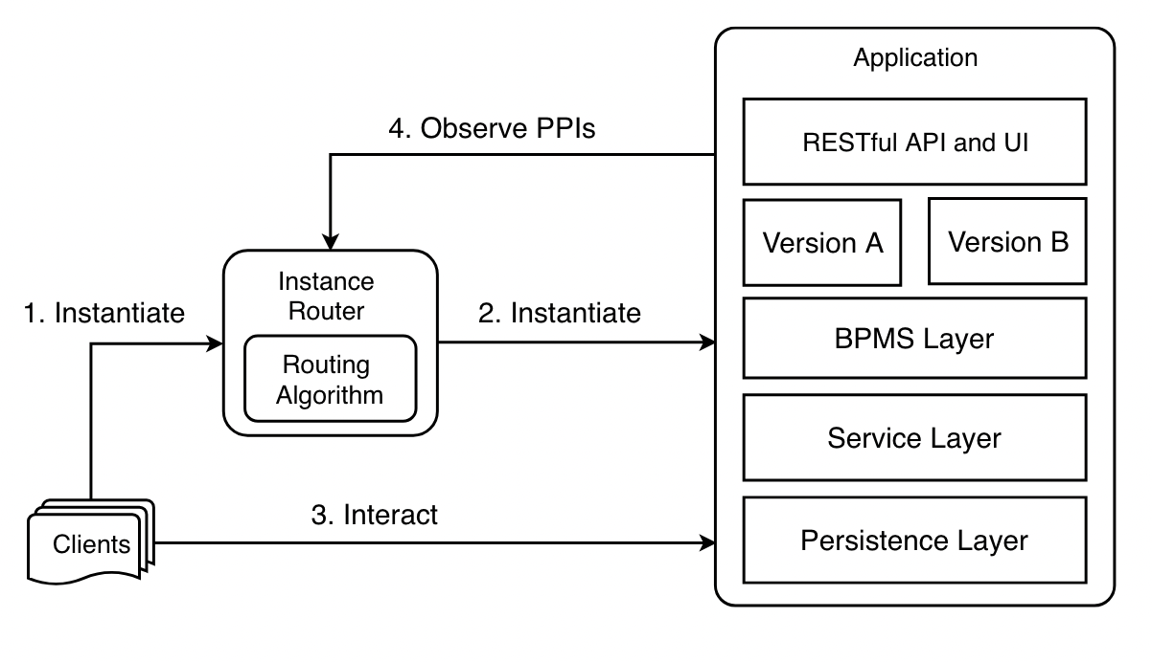
[1] p. 49

Slide 3

Flask
Inside of backend in our case
Frontend/
streamlit
Camunda
PostgresQL
[1] p. 49

Slide 4

[1] p. 49

Slide 5
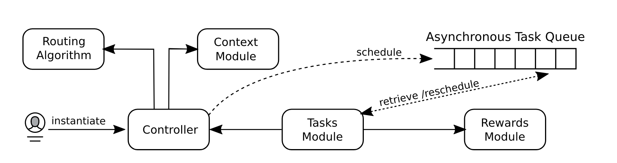
[1] p. 129

Slide 6

For guidance on how to structure source/backend/instance_router/private
[1] p. 129

Slide 7
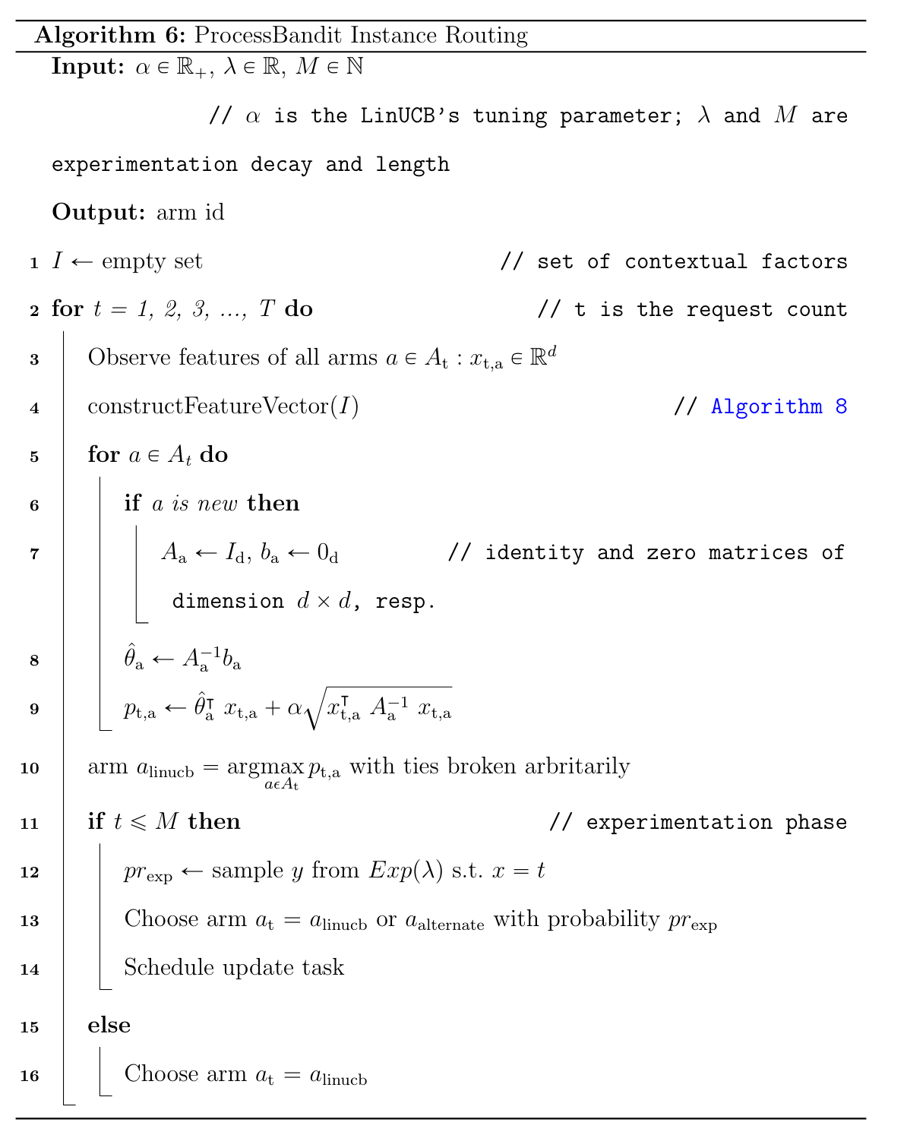
Use VW here (option)

Slide 8
Batch Policy
Learning Policy
{ "batchSize": 200, "executionStrategy": [ { "customerCategory": "public", "explorationProbabilityA": 1.3, "explorationProbabilityB": 0.7 }, { "customerCategory": "gov", "explorationProbabilityA": 0.7, "explorationProbabilityB": 0.3 } ] }
{ "experimentationLength": 200,
"experimentationDecay": 5, "executionStrategy": [ { "customerCategory": "public", "explorationProbabilityA": 1.3, "explorationProbabilityB": 0.7 }, { "customerCategory": "gov", "explorationProbabilityA": 0.7, "explorationProbabilityB": 0.3 } ] }
✅ Implemented

