Slide 1


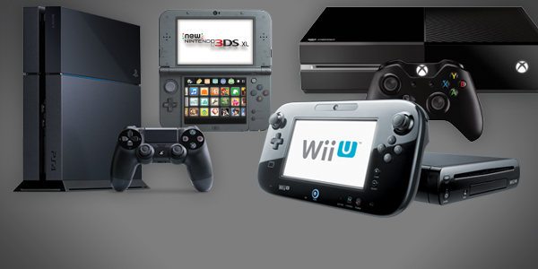
Video Game Franchise Sales based on release years, Consoles, and Genres
Members: Junior Peralta Djakaridia Diabagate

Slide 2
Relation of Sales Over the Years
The main topic of this project was to show the similarities and differences between video game sales and how they can be based on the consoles most of these games run on and how their genres influence their sales and finally how many copies of each game and console had been sold for the last decades.
In conclusion, the hypothesis is false. The franchises sold in the lowest selling systems only have large numbers because they release at the beginning of the 1980s and have continuously sold multiple sequels and different console versions of the games. All these franchises that vary in variety of genre and gaming console, these have their sales up to the numerous games per franchise, leading up to a larger total number sales regardless of the number of respective console sales.

